Slide 1
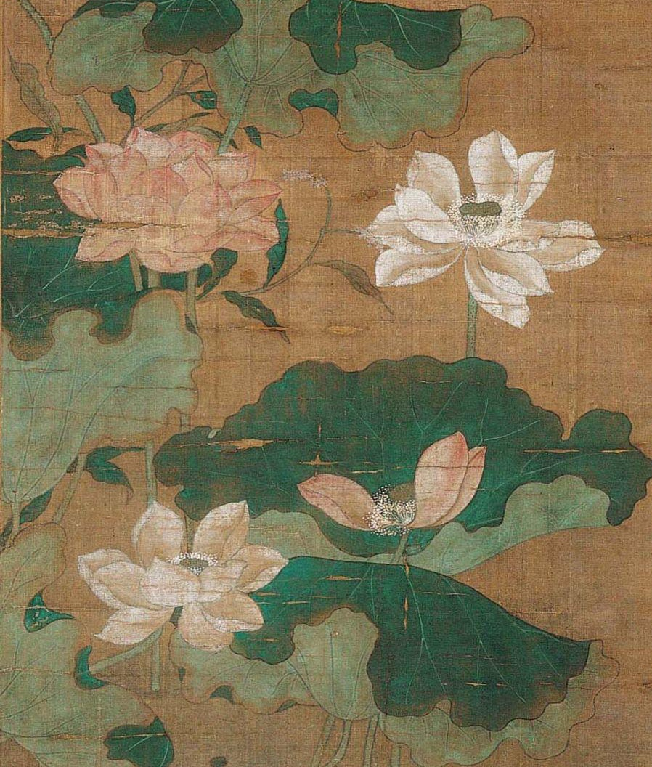
Elements of Art
The Elements of Art are the foundations of all artworks.
Line
Color
Shape
Form
Texture
Value
Space
Chinese, Pink and White Lotus (detail), 14th century, hanging scroll; mineral pigments on silk. Kimbell Art Museum
Notes:
https://kimbellart.org/collection/ap-198419

Slide 2
Line
A line connects two or more points and is used to define space, contours, and outlines.

Slide 3
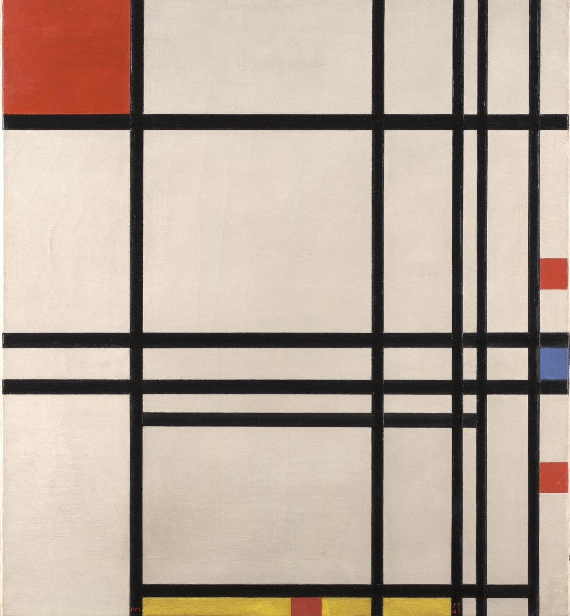
Line
Lines can be straight. They can be horizontal, vertical, or diagonal.
Piet Mondrian, Abstraction, 1939–42, oil on canvas. Kimbell Art Museum
Notes:
https://kimbellart.org/collection/ap-199405

Slide 4
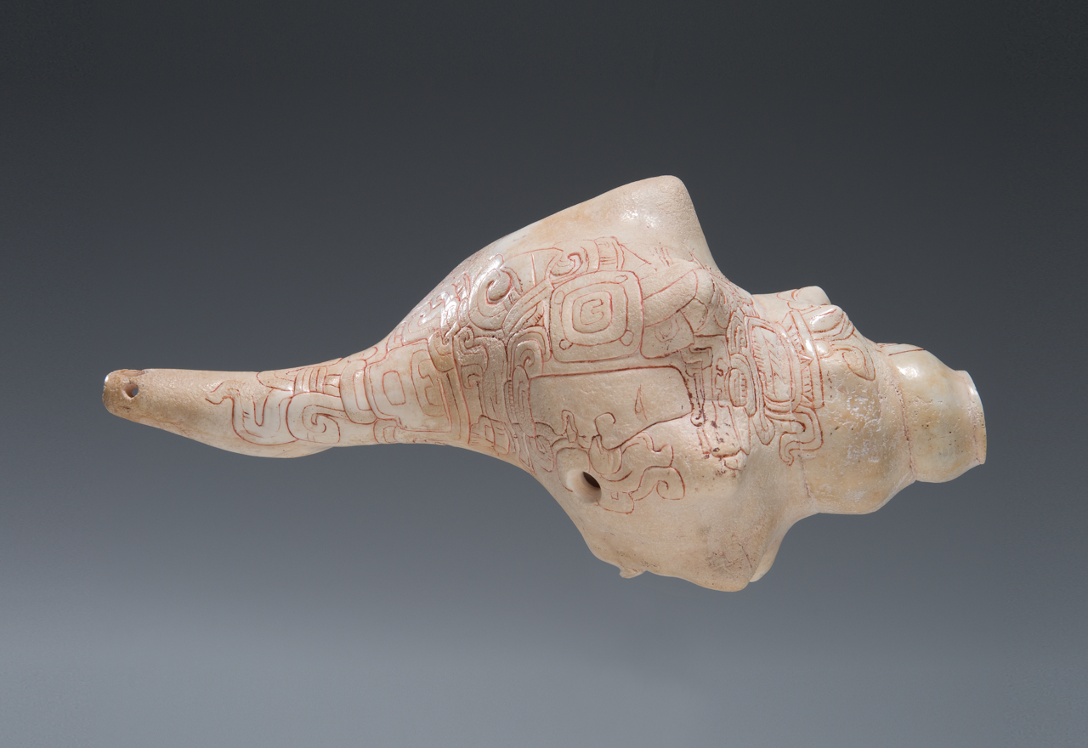
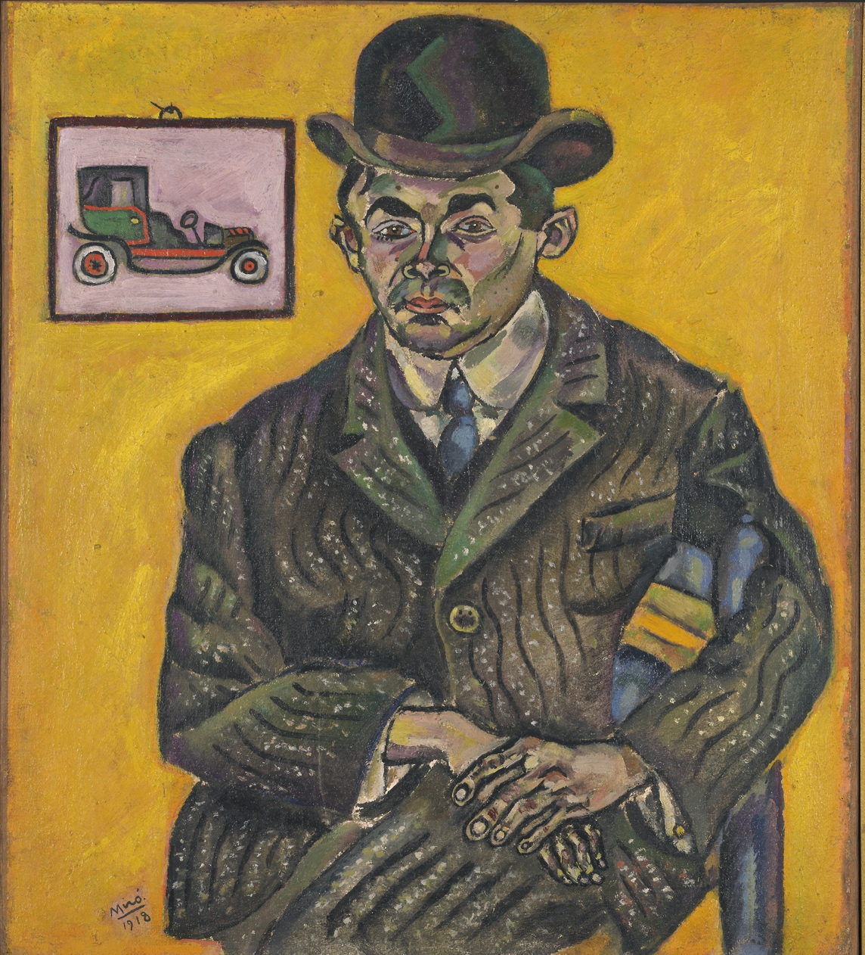
Line
They can be squiggly, curved, dotted, or dashed.
Maya, Conch Shell Trumpet, c. 250–400 AD, shell with traces of cinnabar. Kimbell Art Museum
Joan Miró, Portrait of Heriberto Casany, 1918, oil on canvas. Kimbell Art Museum
Notes:
https://kimbellart.org/collection/ap-198411
https://kimbellart.org/collection/ap-198409

Slide 5
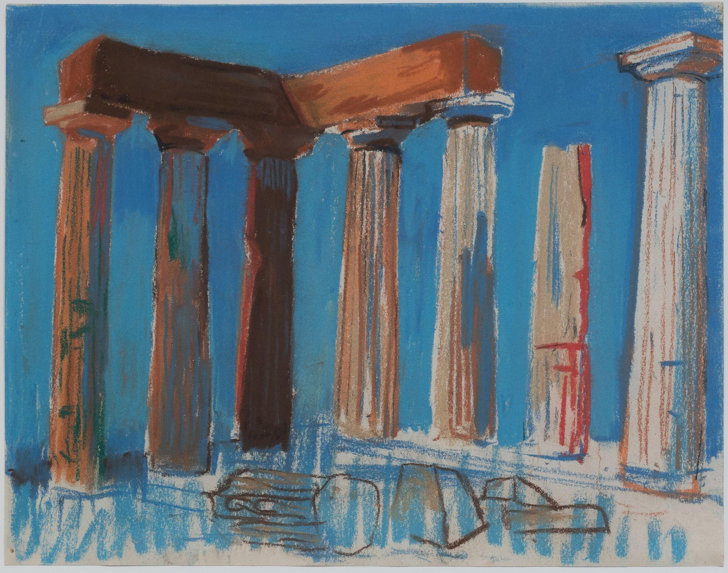
Line
They can be thick or thin.
Louis Kahn, Temple of Apollo, Corinth, at Midday, 1951, pastel. Kimbell Art Museum
Notes:
https://kimbellart.org/collection/ap-202102

Slide 6
Color
Color
Color comes from reflected light.
Color wheels show how colors are
related to one another.

Slide 7
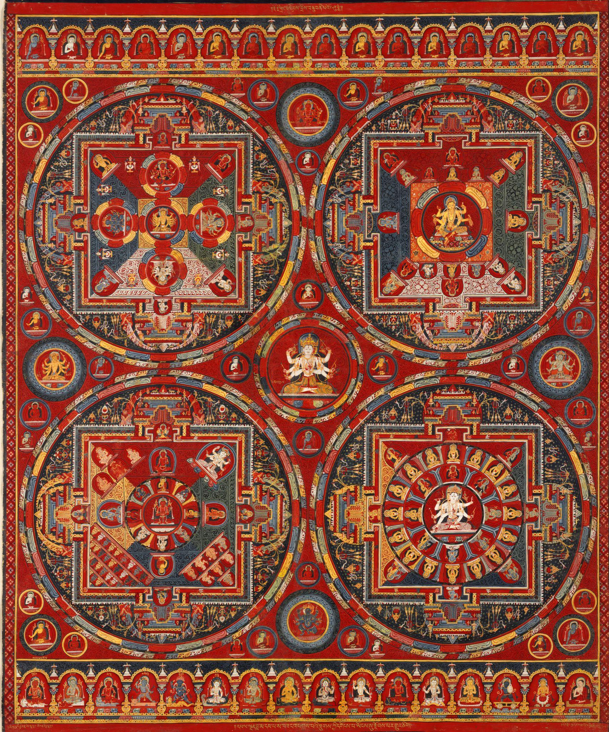
Color
Primary colors are red, yellow, and blue.
Tibetan, Four Mandalas of the Vajravali Series, c. 1429–56, thangka, gouache on cotton. Kimbell Art Museum
Notes:
https://kimbellart.org/collection/ap-200001

Slide 8
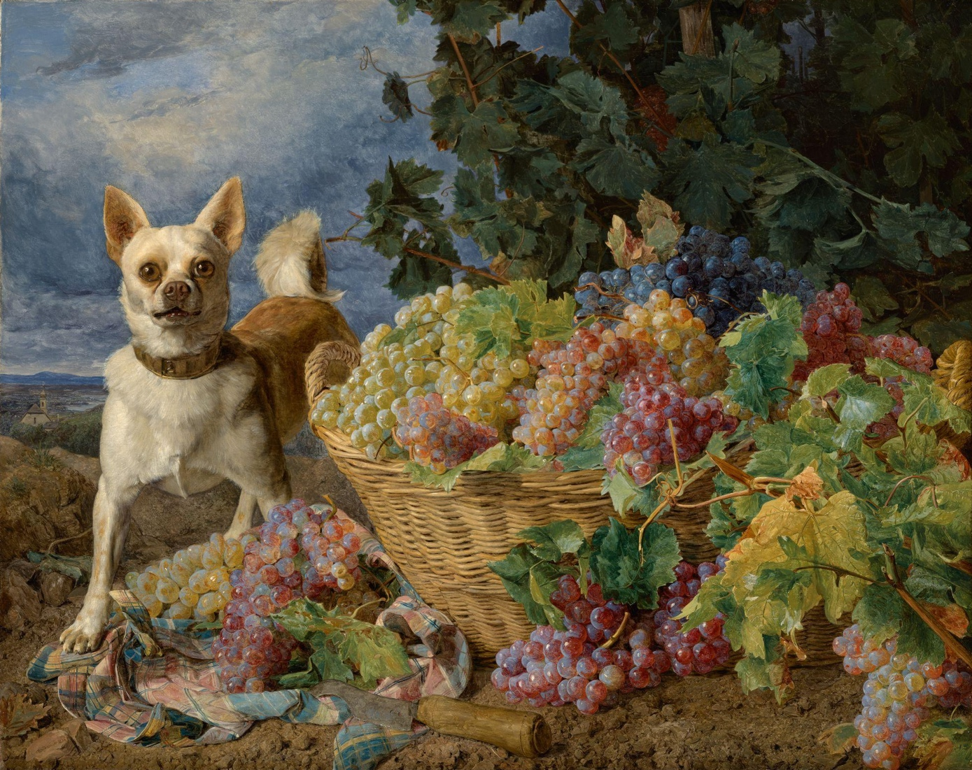
Color
Secondary colors are orange, green, and purple and are made from mixing primary colors together.
Ferdinand Georg Waldmüller, Dog Guarding a Basket of Grapes, 1836, oil on canvas. Kimbell Art Museum
Notes:
https://kimbellart.org/collection/ap-202201

Slide 9
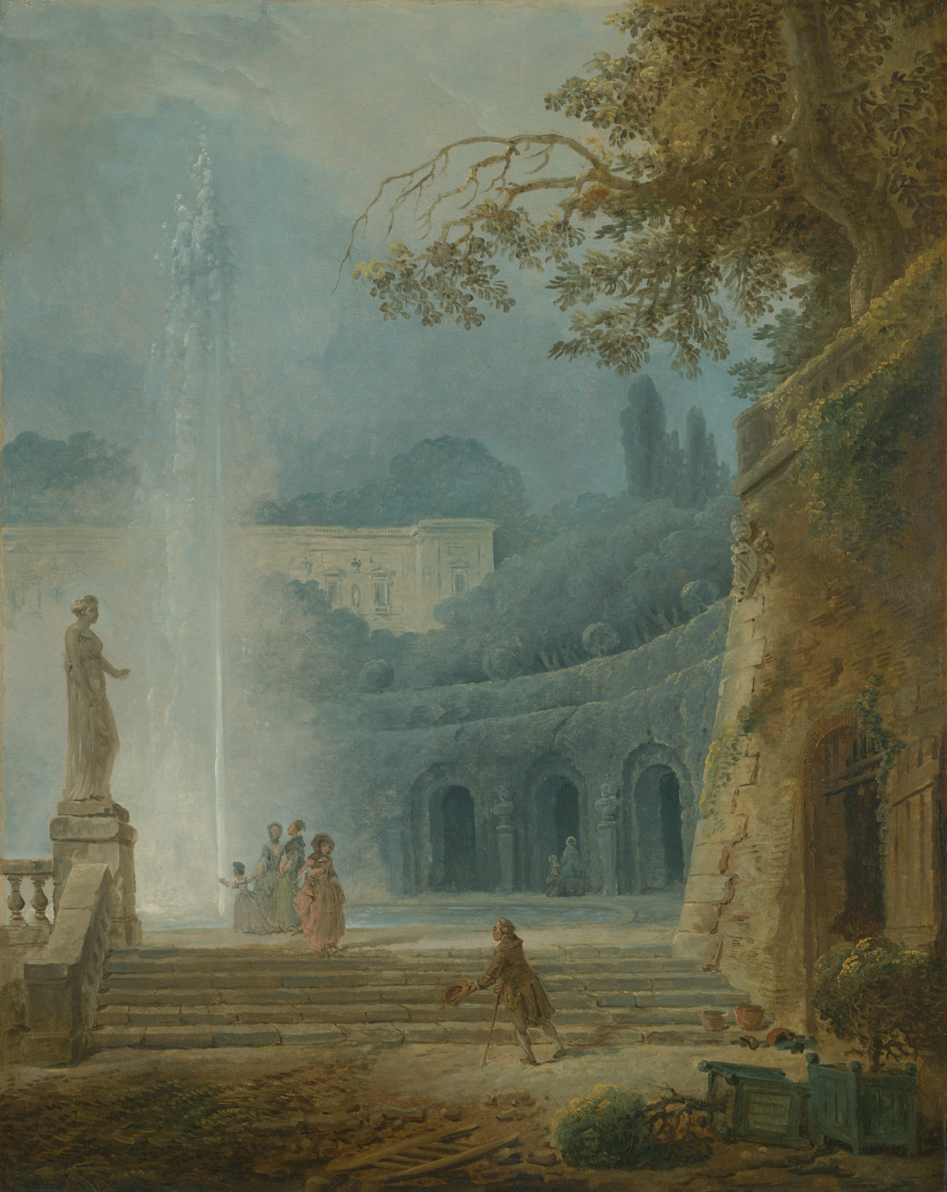
Color
Colors can be warm or cool.
The area farthest from the viewer, the background, shows cool tones.
The area closest to the viewer, the foreground, shows warm tones.
Hubert Robert, The Fountain, c. 1775–78, oil on canvas. Kimbell Art Museum
Notes:
https://kimbellart.org/collection/ap-197015

Slide 10
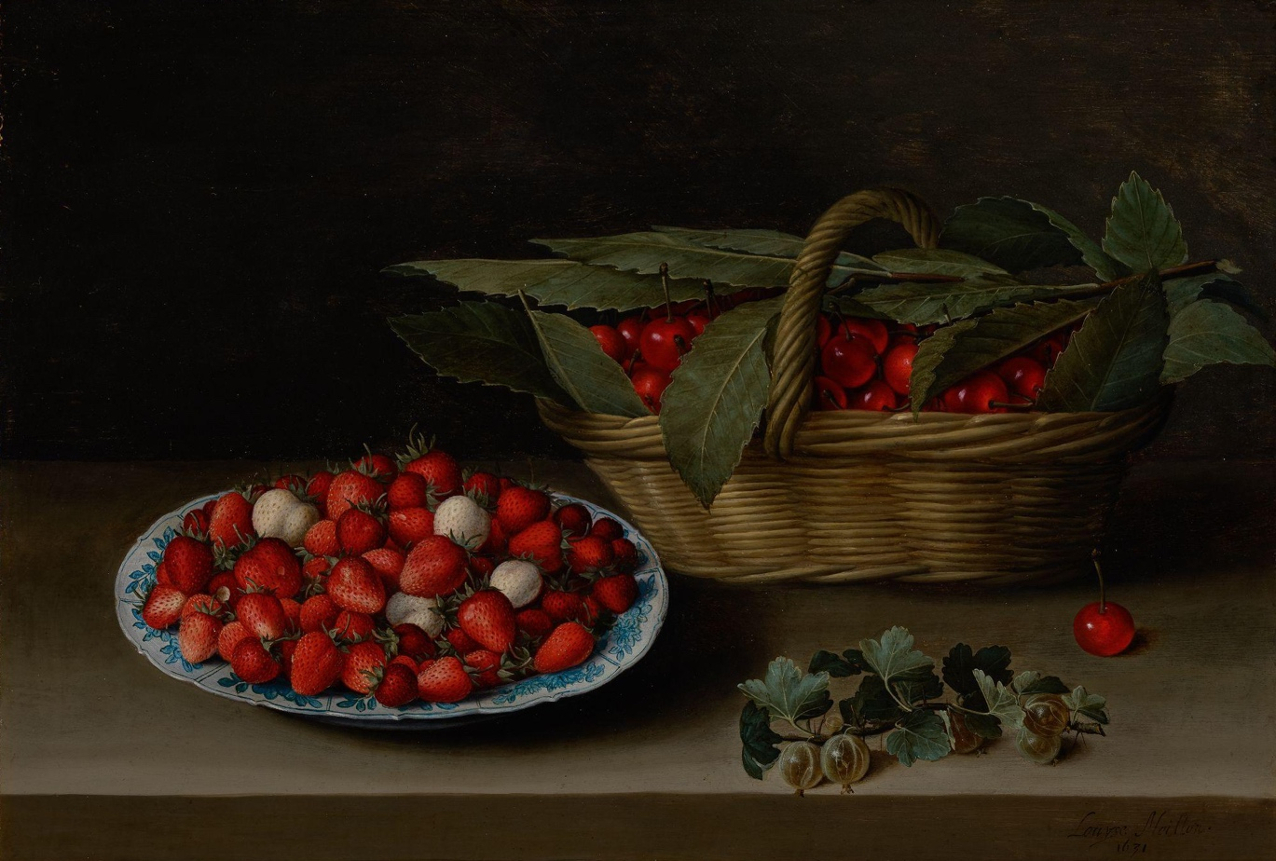
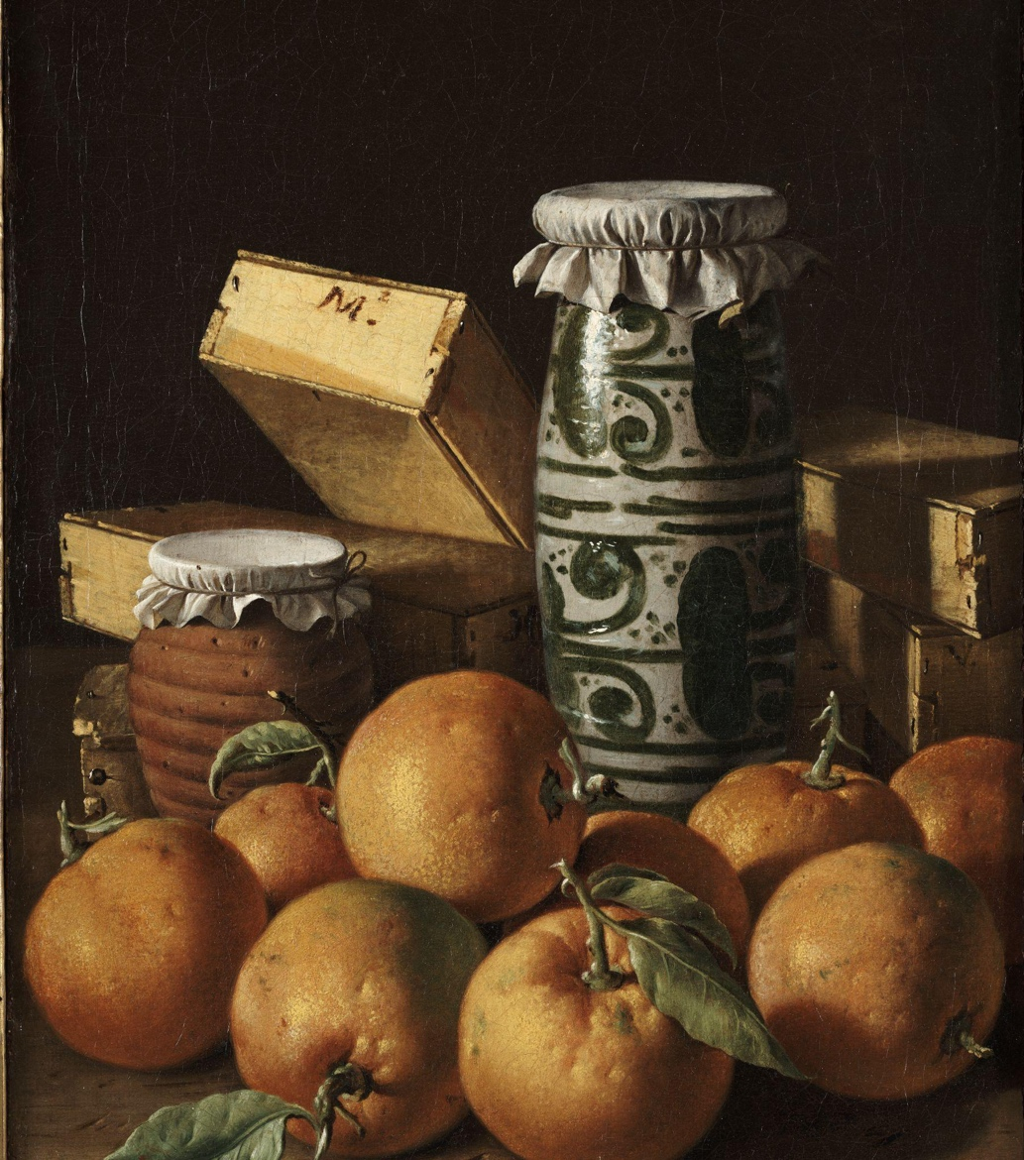
Color
The red of the berries and the green of the leaves are complementary colors.
The oranges and the blue details on the vase are complementary.
Left:
Luis Meléndez, Still Life with Oranges, Jars, and Boxes of Sweets, c. 1760–65, oil on canvas. Kimbell Art Museum
Right:
Louise Moillon, Still Life with a Bowl of Strawberries, Basket of Cherries, and Branch of Gooseberries, 1631, oil on canvas. Kimbell Art Museum
Notes:
https://kimbellart.org/collection/ap-198513
https://kimbellart.org/collection/ap-202204

Slide 11
Color
Colors opposite from each other on the color wheel are called complementary.

Slide 12
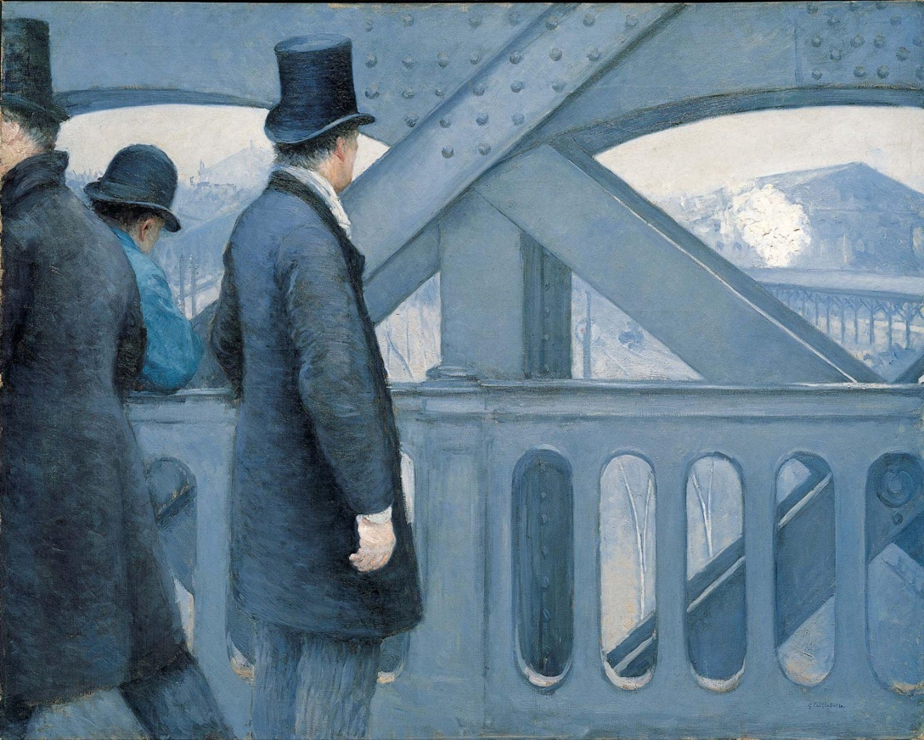
Shape
Shape
Shapes have two dimensions: height and width.
They can be either geometric or organic.
height
height
width
width
Gustave Caillebotte, On the Pont de l’Europe, 1876–77, oil on canvas. Kimbell Art Museum
Notes:
https://kimbellart.org/collection/ap-198201

Slide 13
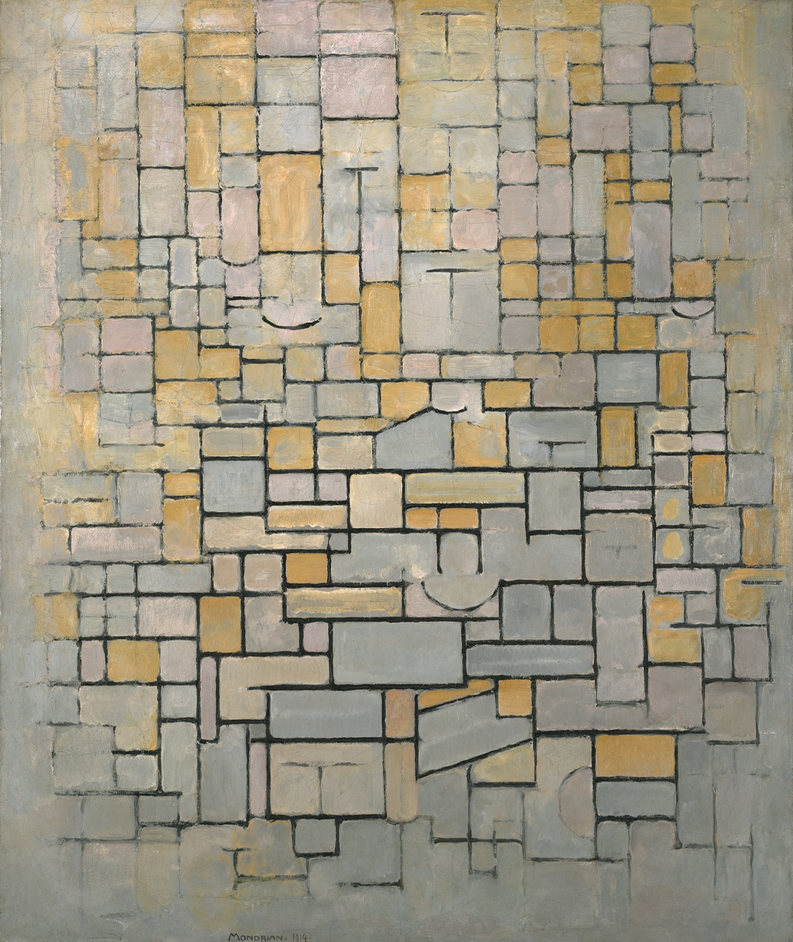
Shape
Geometric shapes typically have names:
Rectangle
Triangle
Square
Circle
Pentagon
Piet Mondrian, Composition, 1914, oil on canvas. Kimbell Art Museum
Notes:
https://kimbellart.org/collection/apg-198303

Slide 14

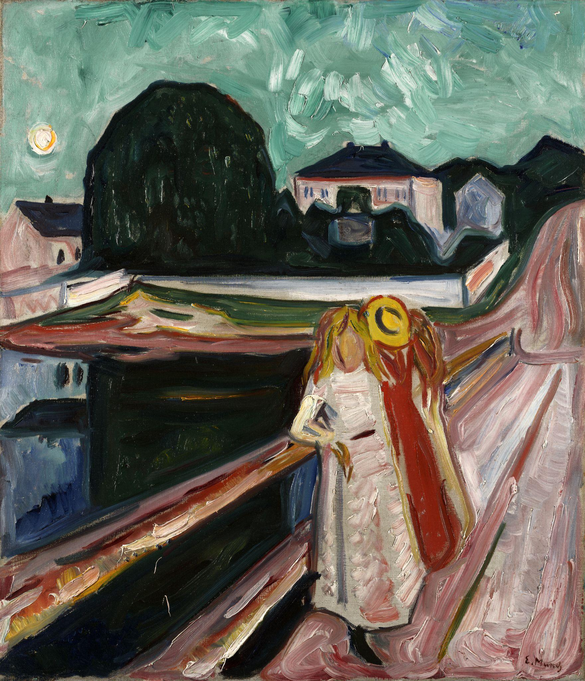



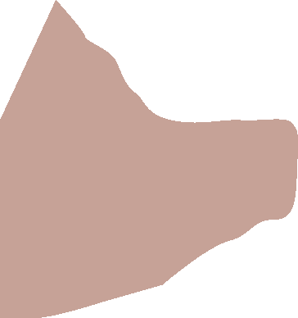
Shape
Organic shapes typically don’t have names and can be blob-like.
Edvard Munch, Girls on a Bridge, c. 1904, oil on canvas. Kimbell Art Museum
Notes:
https://kimbellart.org/collection/ap-196606

Slide 15
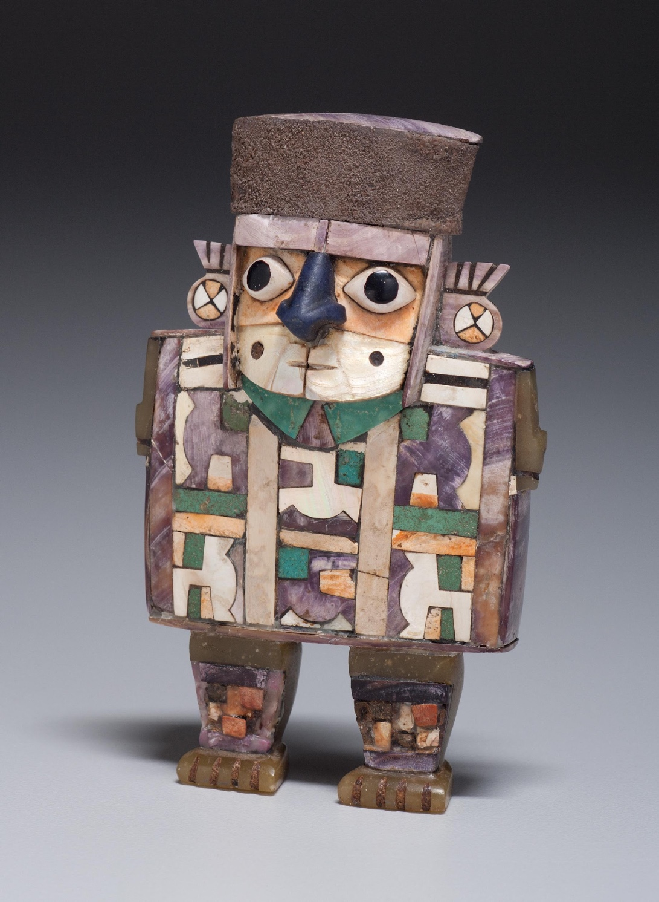
Shape
Often, artworks have both geometric and organic shapes.
In this sculpture, where do you see geometric shapes and where are there organic shapes?
Wari culture, Standing Dignitary, c. AD 600–1000, wood with shell-and-stone inlay and silver. Kimbell Art Museum
Notes:
https://kimbellart.org/collection/ap-200204

Slide 16
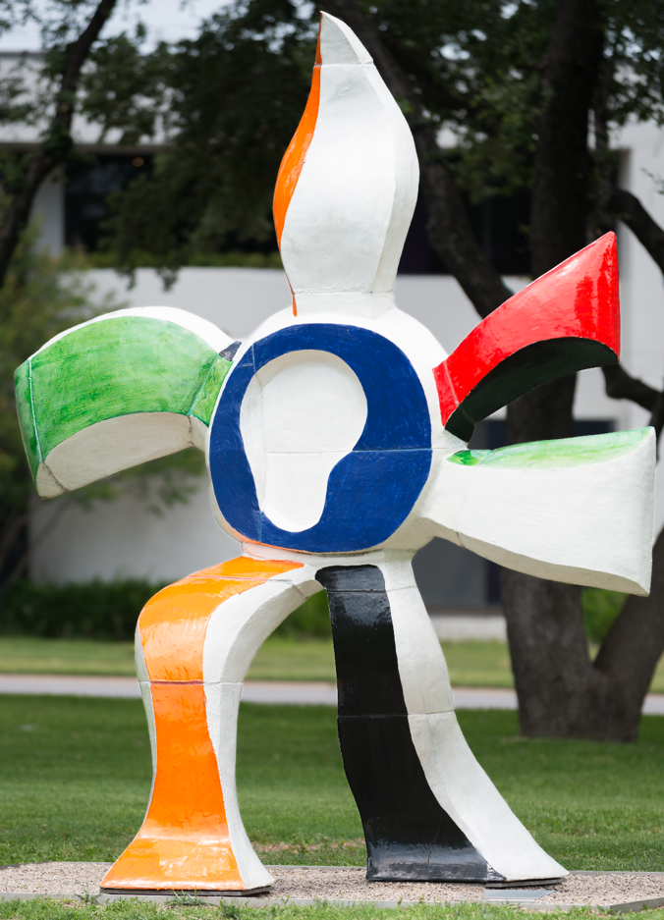
Form
Form
A form has three dimensions:
height, width, and depth.
height
height
depth
Fernand Léger, Walking Flower (La fleur qui marche), 1952, ceramic. Kimbell Art Museum
width
depth
width
Notes:
https://kimbellart.org/collection/ag-201102

Slide 17
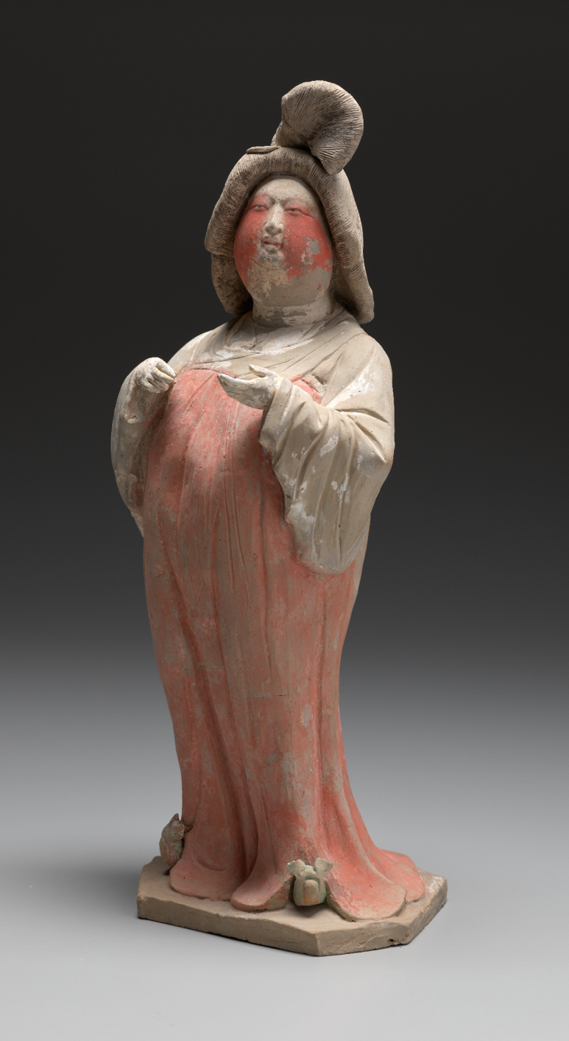
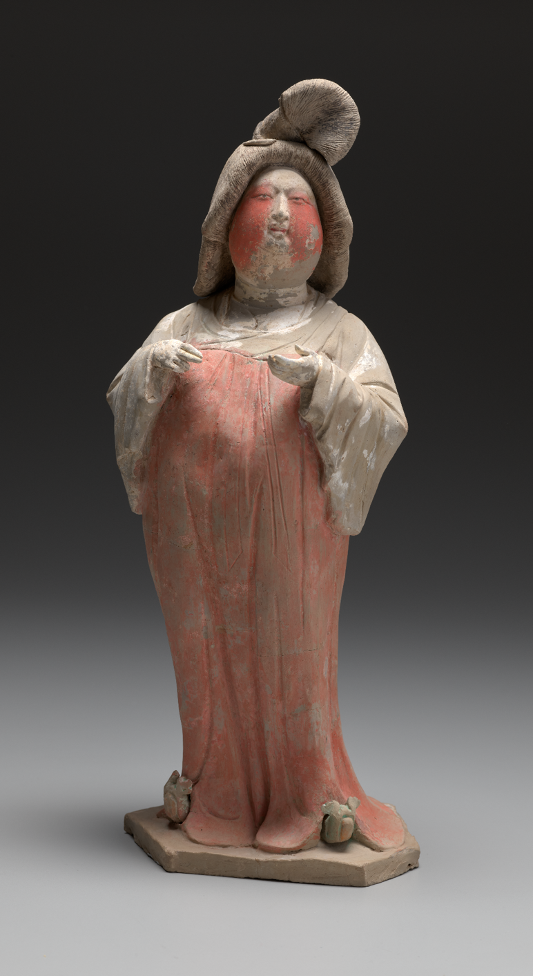
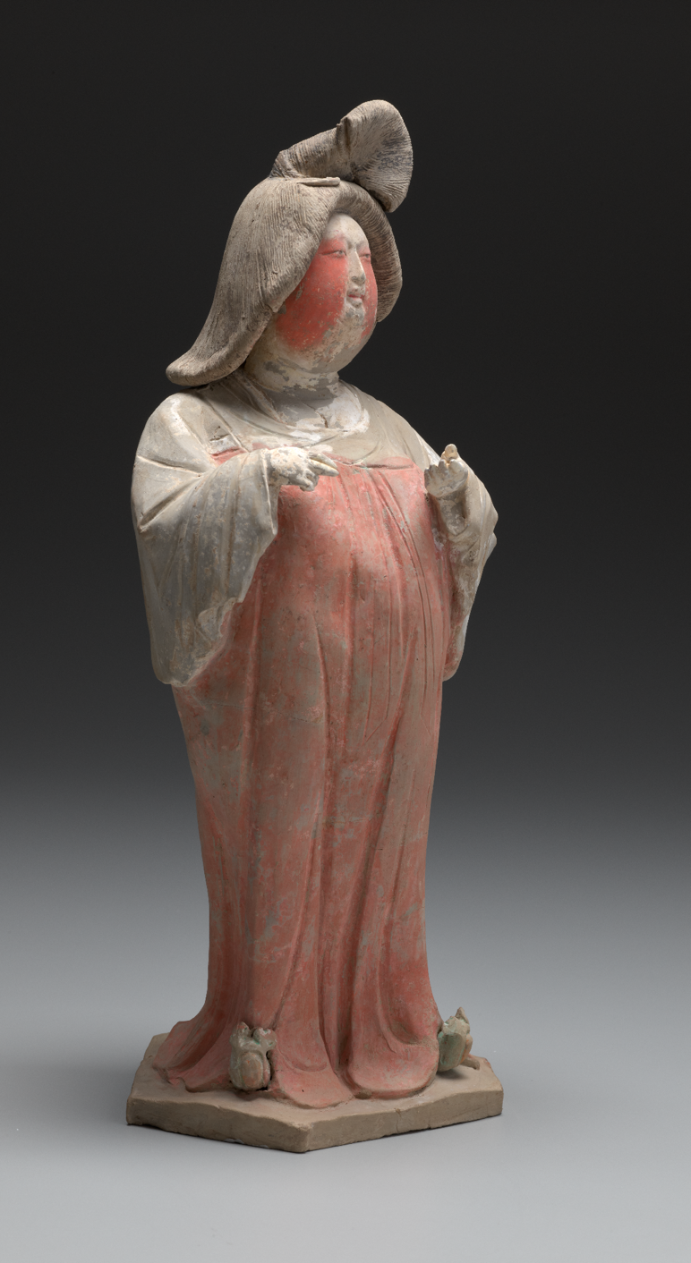
Form
Chinese, Court Lady, first half of the 8th century AD, gray earthenware with painted polychrome decoration.
Kimbell Art Museum
Notes:
https://kimbellart.org/collection/ap-200101

Slide 18
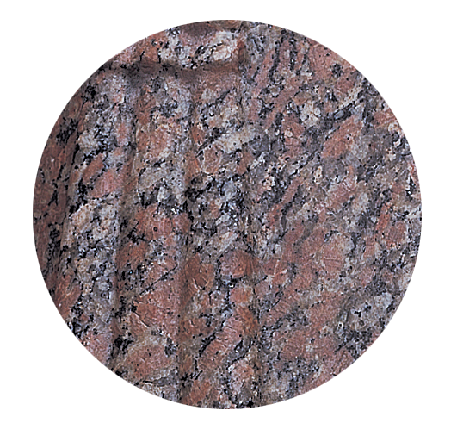
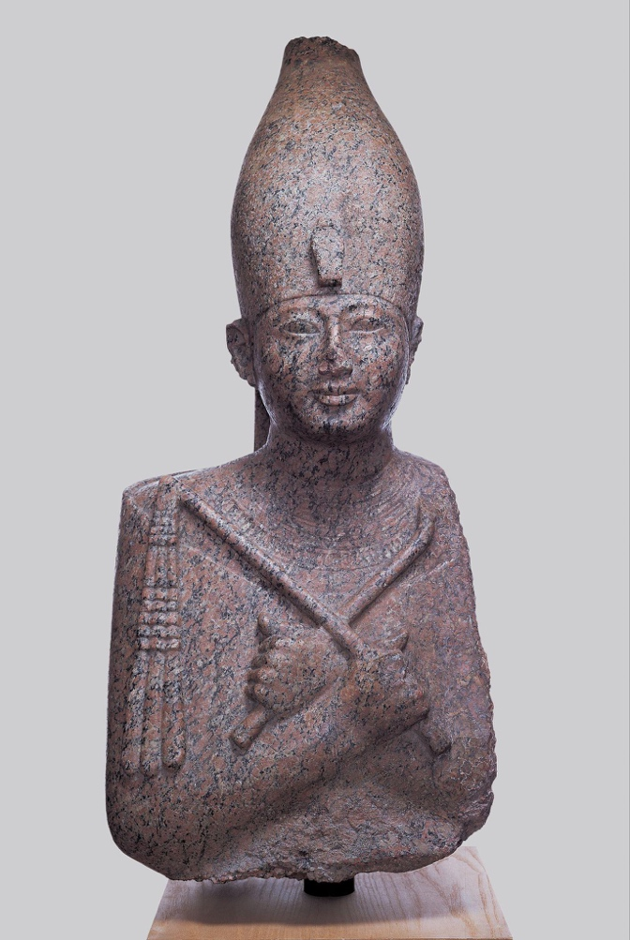
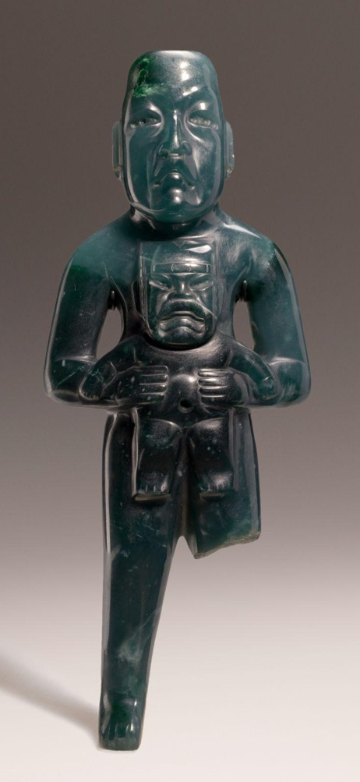
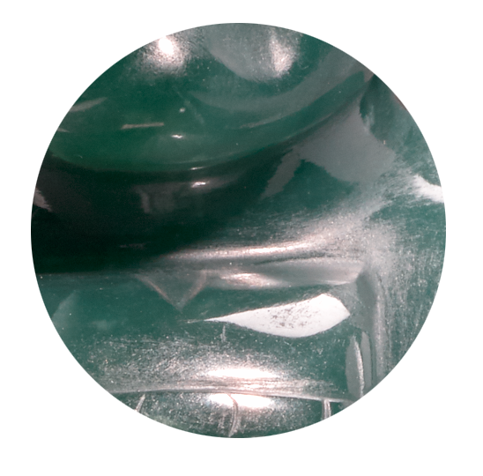
Texture
Texture
Texture describes how things feel (actual texture) or how they look like they might feel (implied texture).
Rough
Smooth
Egyptian, Portrait Statue of Pharaoh Amenhotep II, c. 1400 BC, recarved for Ramesses II (the Great), c. 1250 BC, rose granite. Kimbell Art Museum
Olmec, Standing Figure Holding a Were-Jaguar Baby, c. 900–300 BC, jade (jadeite). Kimbell Art Museum
Notes:
https://kimbellart.org/collection/ap-198204
https://kimbellart.org/collection/ap-202302

Slide 19
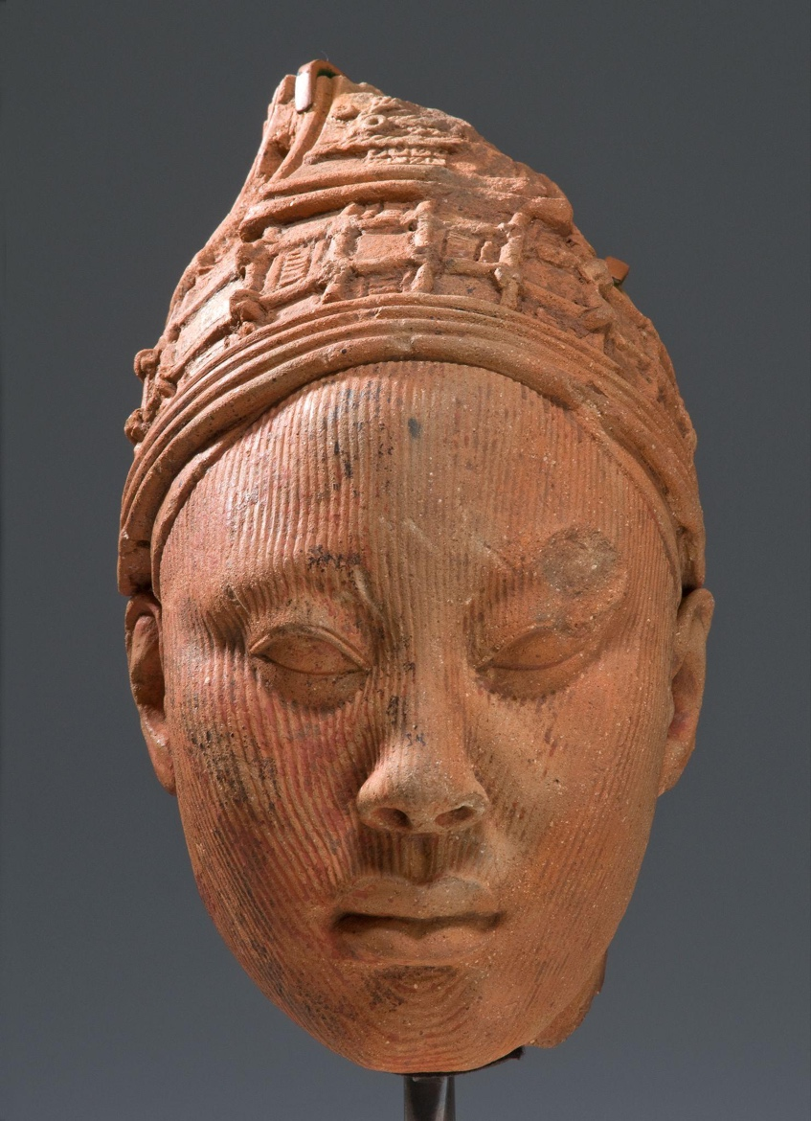
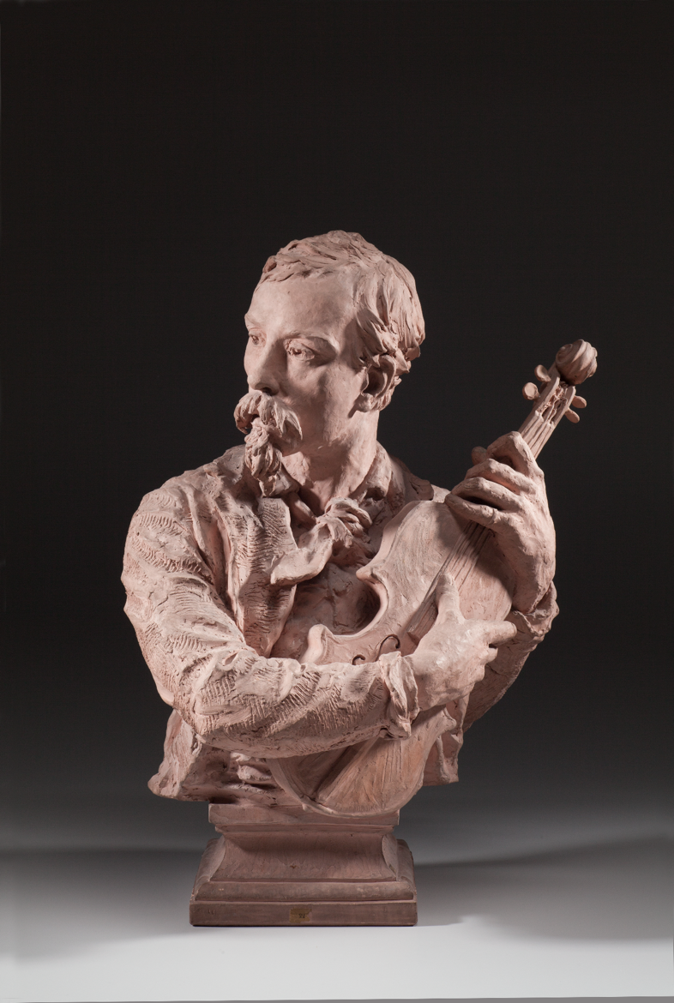
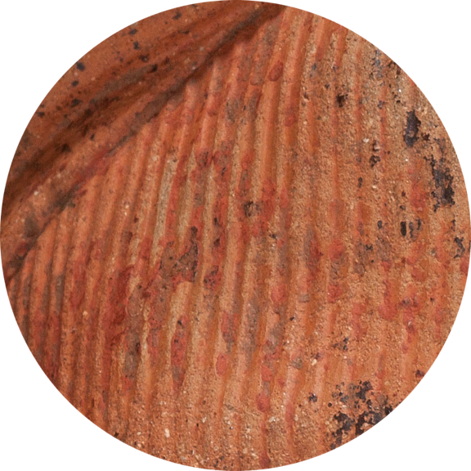
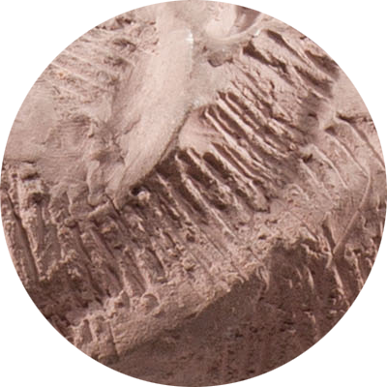
Texture
Actual Texture
Ife culture, Head, possibly a King,
12th–14th century, terracotta with residue of red pigment and traces
of mica. Kimbell Art Museum
Jean-Baptiste Carpeaux, Portrait of Charles Carpeaux, the Sculptor’s Brother, 1874, terracotta. Kimbell Art Museum
Notes:
https://kimbellart.org/collection/ap-199404
https://kimbellart.org/collection/ap-198421

Slide 20
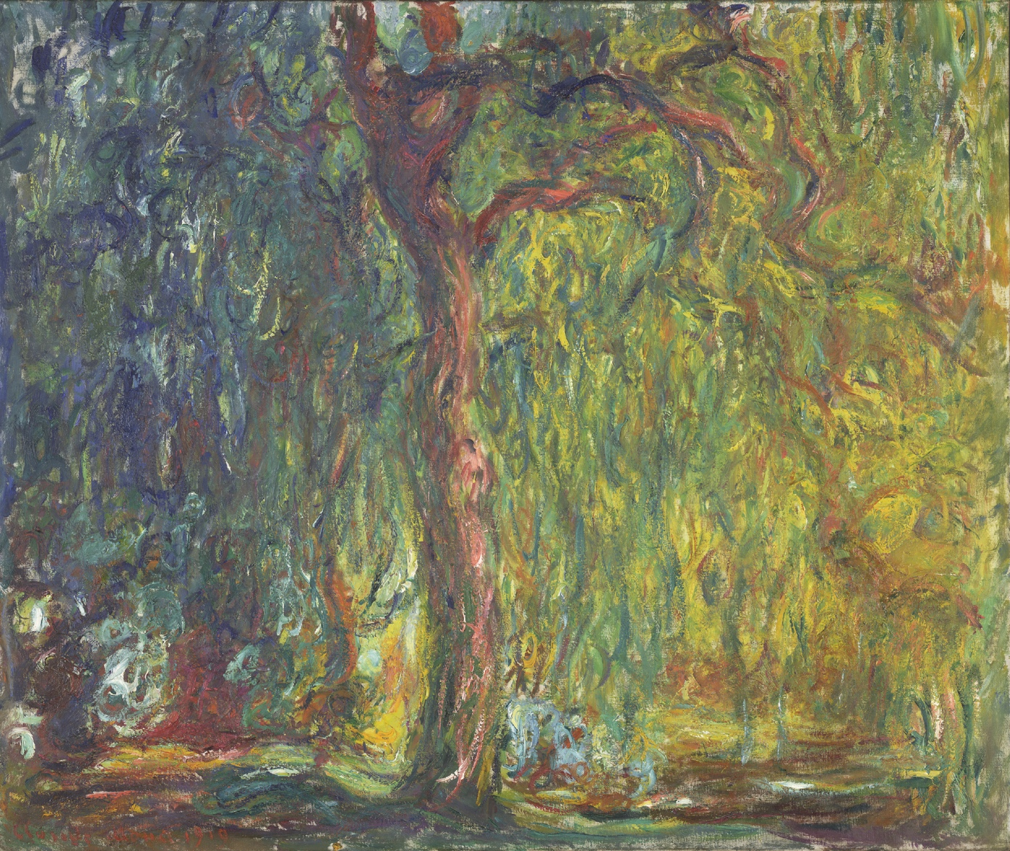
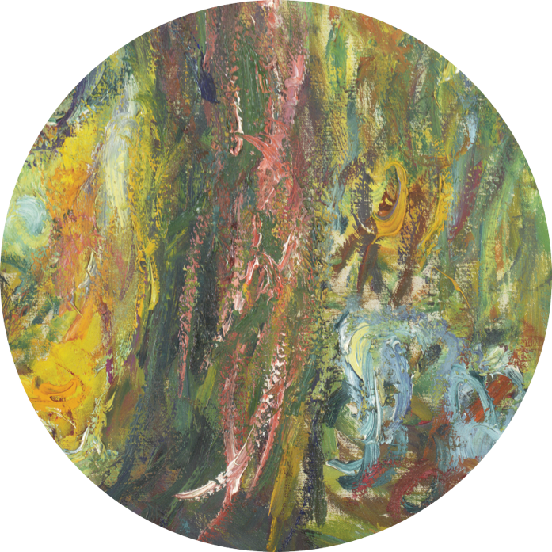
Texture
Actual Texture
Claude Monet, Weeping Willow, 1918–19, oil on canvas. Kimbell Art Museum
Notes:
https://kimbellart.org/collection/ap-199602

Slide 21
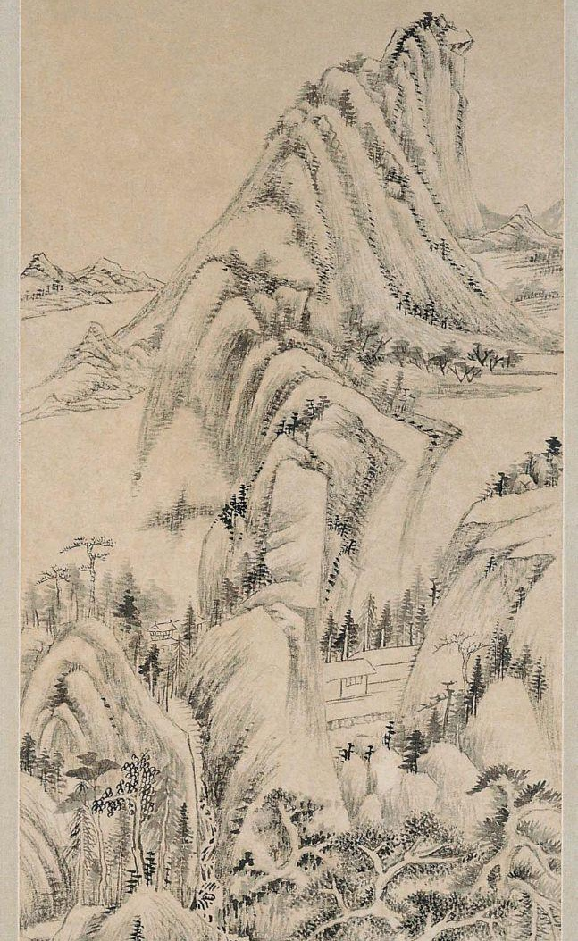
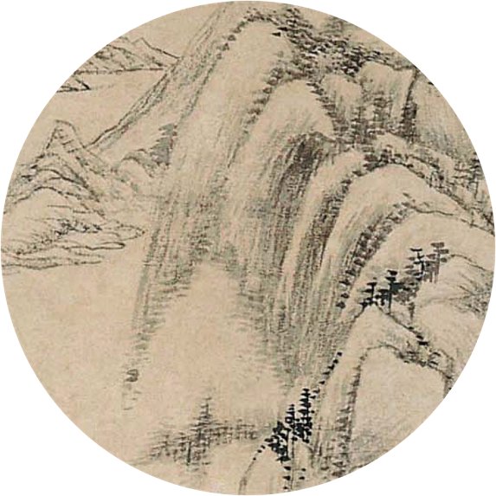
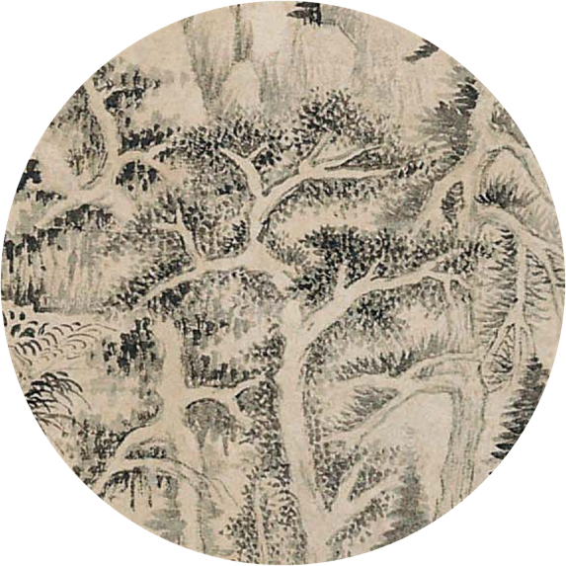
Texture
Implied Texture
Dong Qichang, Steep Mountains and Silent Waters, 1632, hanging scroll; ink on paper. Kimbell Art Museum
Notes:
https://kimbellart.org/collection/ap-198002

Slide 22
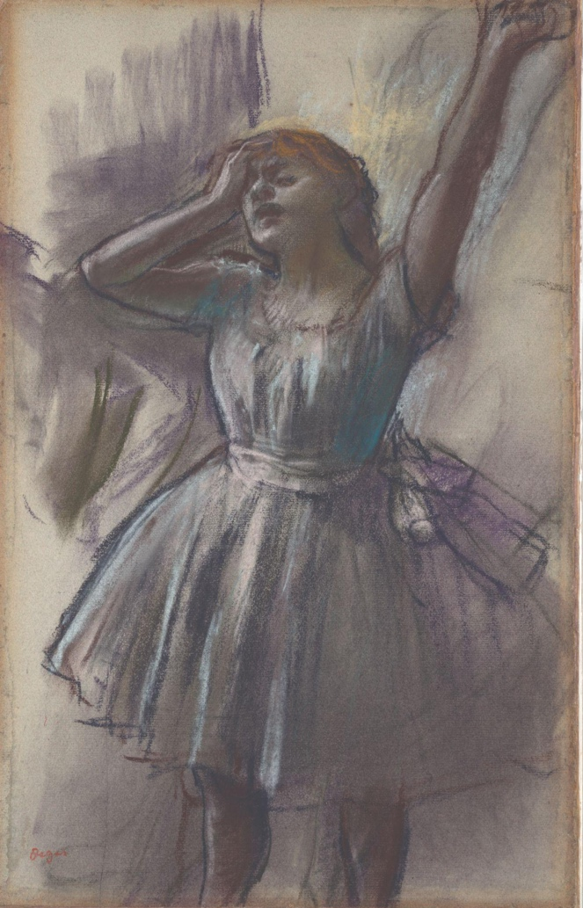
Value
Value
Value refers to the lightness or darkness of colors.
Examples of value scales
Edgar Degas, Dancer Stretching, c. 1882–85, pastel on pale blue gray paper. Kimbell Art Museum
Notes:
https://kimbellart.org/collection/ap-196804

Slide 23
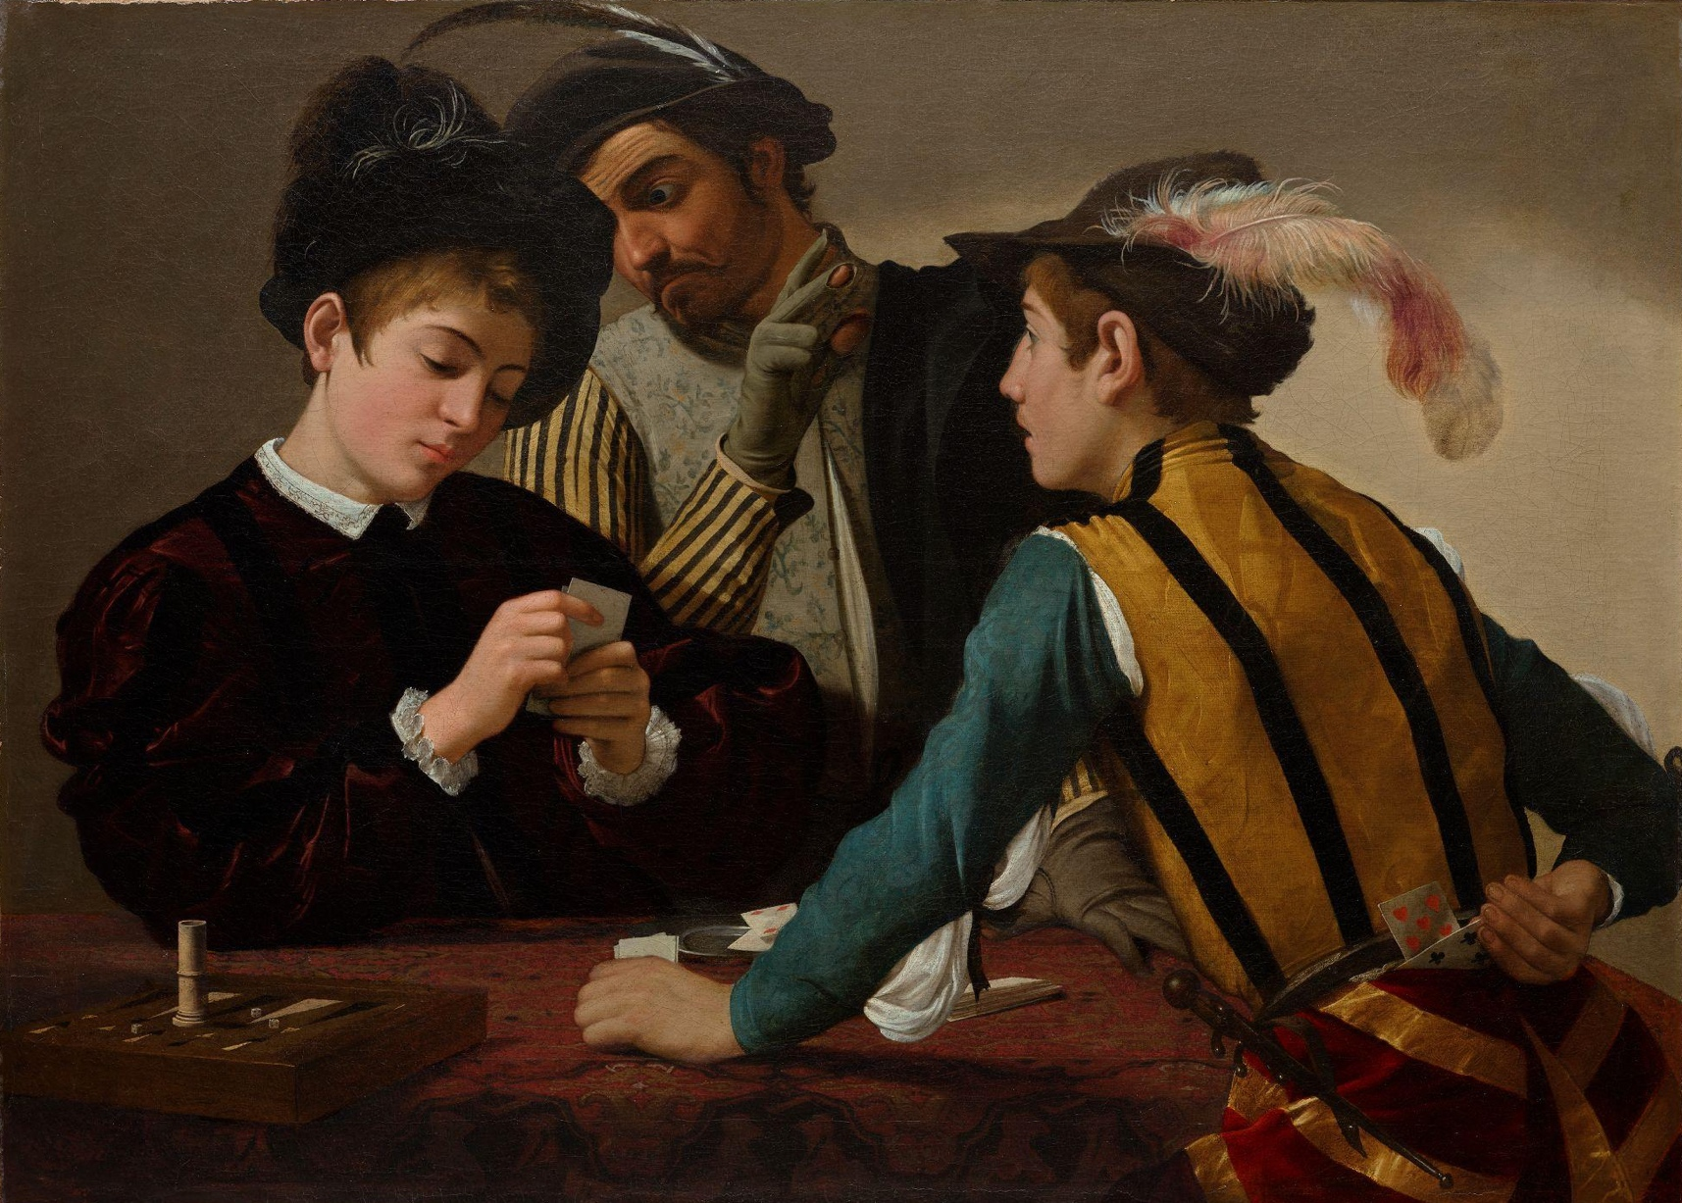
Value
Values are important to help visually group parts of a composition.
In The Cardsharps, Caravaggio created high contrast between the lights and the shadows to draw attention to the figures.
This use of high contrast between lights and darks is called chiaroscuro.
Caravaggio, The Cardsharps, c. 1596–97, oil on canvas. Kimbell Art Museum
Notes:
https://kimbellart.org/collection/ap-198706

Slide 24
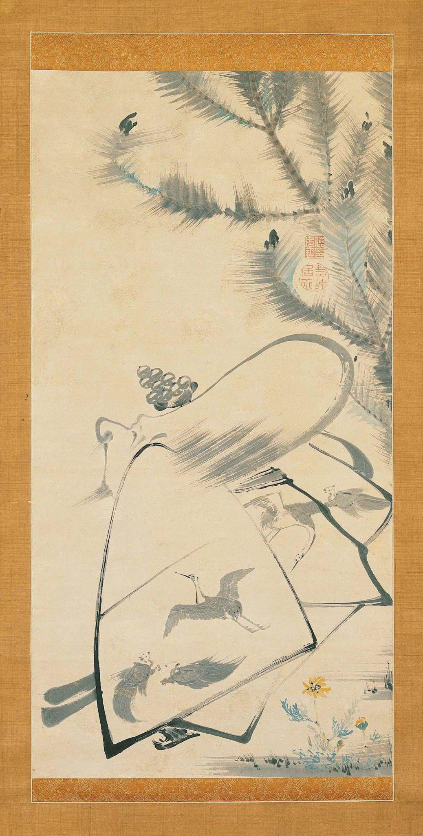
Value
An artwork can be either high key or low key.
High key = Overall light tones; typically less contrast
Ito Jakuchu, Fukurojin, the God of Longevity and Wisdom, c. 1790, hanging scroll; ink and light colors on paper. Kimbell Art Museum
Notes:
https://kimbellart.org/collection/apx-198602

Slide 25
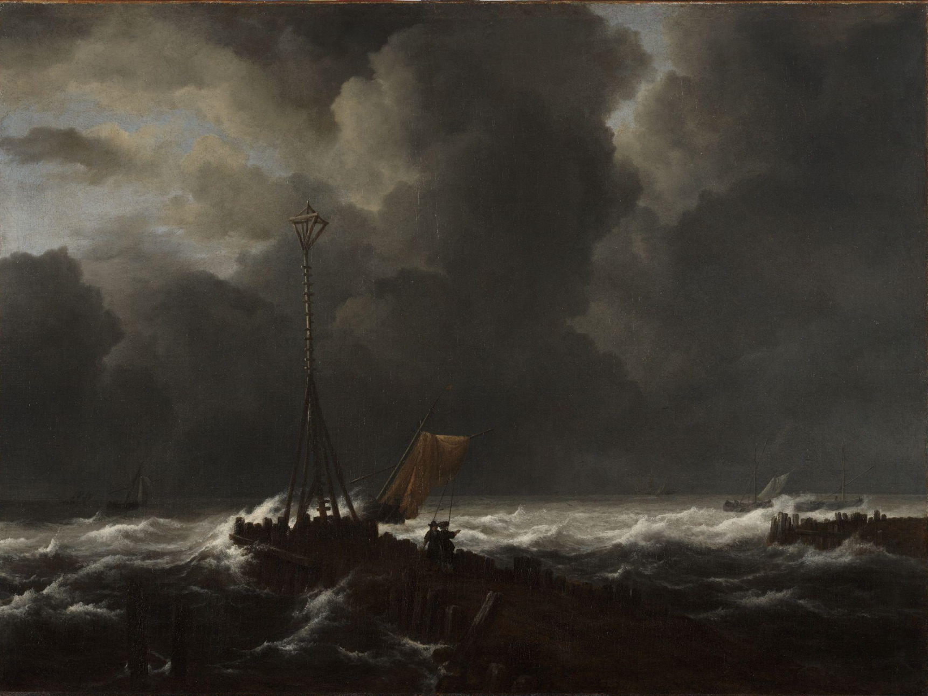
Value
An artwork can be either high key or low key.
Low key = Overall dark tones; typically more contrast
Jacob van Ruisdael, Rough Sea at a Jetty, 1650s, oil on canvas. Kimbell Art Museum
Notes:
https://kimbellart.org/collection/ap-198901

Slide 26
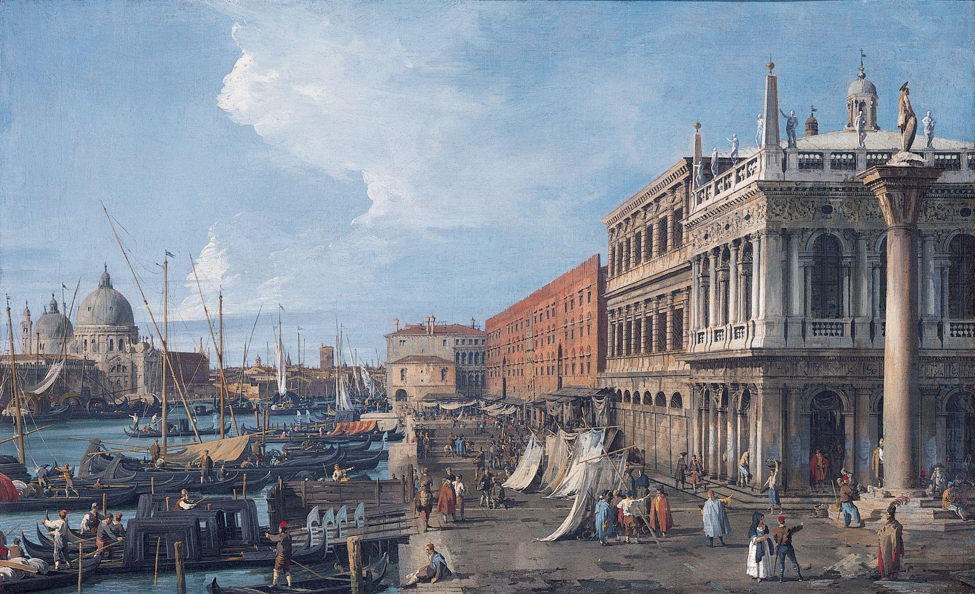
Space
Space
Space is the emptiness or area between, around, above, below, or within objects.
Canaletto, The Molo, Venice, c. 1735, oil on canvas. Kimbell Art Museum
Notes:
https://kimbellart.org/collection/ap-196922

Slide 27
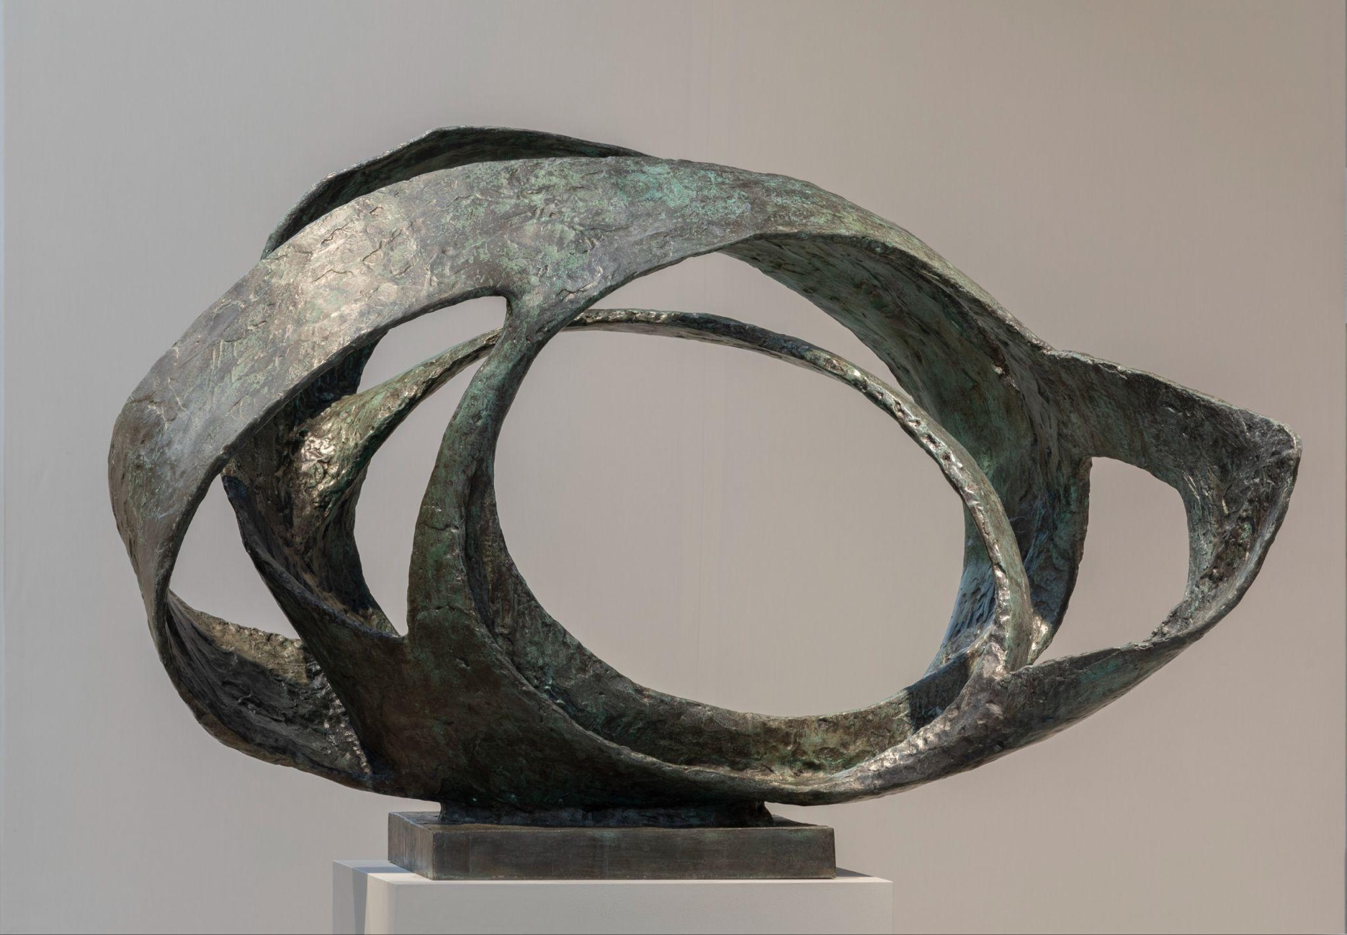
Space
Artworks contain both positive and negative space.
Positive space = the subject
Negative space = the empty areas around the subject
Barbara Hepworth, Oval Form (Trezion), 1961–63, bronze. Kimbell Art Museum
Notes:
https://kimbellart.org/collection/ag-201103

Slide 28
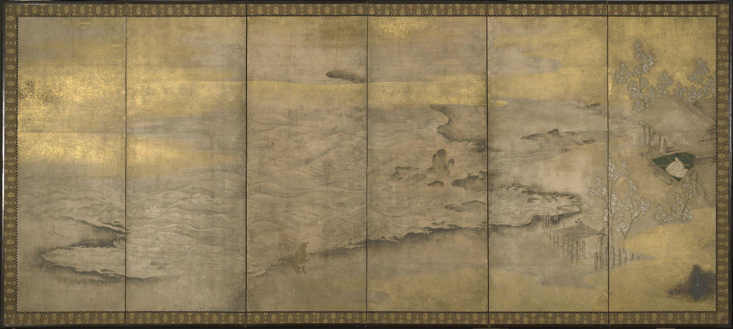
Space
Negative Space
Positive Space
Japanese, Genji in Exile at Suma, late 16th century, six-fold screen; ink, gold, silver, and pigments on paper. Kimbell Art Museum
Notes:
https://kimbellart.org/collection/ap-197111

Slide 29
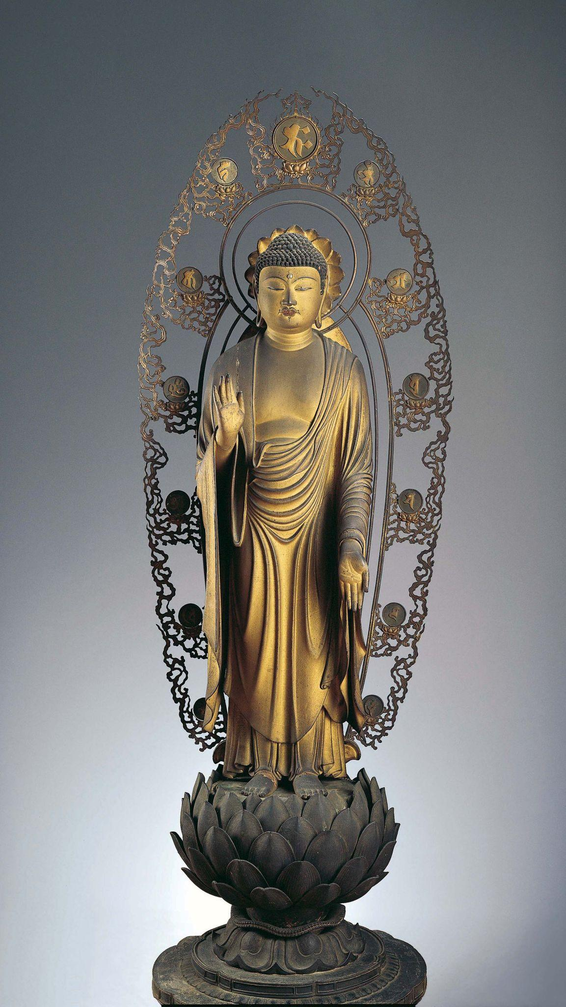
Space
Positive Space
Negative Space
Kaikei, Standing Shaka Buddha, c. 1210, gilt and lacquered wood. Kimbell Art Museum
Notes:
https://kimbellart.org/collection/ap-198401-abc

Slide 30
Art in order of appearance:
Chinese, Detail from Pink and White Lotus, 14th century, hanging scroll; mineral pigments on silk. Kimbell Art Museum, Fort Worth, AP 1984.19
Piet Mondrian, Abstraction, 1939–42, oil on canvas. Kimbell Art Museum, Fort Worth, AP 1994.05​
​
Maya, Conch Shell Trumpet, c. 250–400 AD, shell with traces of cinnabar. Kimbell Art Museum, Fort Worth, AP 1984.11.
​
Joan Miró, Portrait of Heriberto Casany, 1918, oil on canvas. Kimbell Art Museum, Fort Worth, AP 1984.09
​
Louis Kahn, Temple of Apollo, Corinth, at Midday, 1951, pastel. Kimbell Art Museum, Fort Worth, AP 2021.02​
Tibetan, Four Mandalas of the Vajravali Series, c. 1429–56, thangka, gouache on cotton.. Kimbell Art Museum, Fort Worth, AP 2000.01
Ferdinand Georg Waldmüller, Dog Guarding a Basket of Grapes, 1836, oil on canvas. Kimbell Art Museum, Fort Worth, AP 2022.01.
​Hubert Robert, The Fountain, c. 1775–78, oil on canvas. Kimbell Art Museum, Fort Worth, AP 1970.15
​
Luis Meléndez, Still Life with Oranges, Jars, and Boxes of Sweets, c. 1760–65, oil on canvas. Kimbell Art Museum, Fort Worth, AP 1985.13
​
Louise Moillon, Still Life with a Bowl of Strawberries, Basket of Cherries, and Branch of Gooseberries, 1631, oil on canvas. ​
Kimbell Art Museum, Fort Worth, AP 2022.04
​
Gustave Caillebotte, On the Pont de l’Europe, 1876–77, oil on canvas. Kimbell Art Museum, Fort Worth, AP 1982.01
​
Piet Mondrian, Composition, 1914, oil on canvas. Kimbell Art Museum, Fort Worth, AP 1983.03
© 2025 Kimbell Art Museum

Slide 31
Art in order of appearance:
​
Edvard Munch, Girls on a Bridge, c. 1904, oil on canvas. Kimbell Art Museum, Fort Worth, AP 1966.06
Wari culture, Standing Dignitary, c. AD 600–1000, wood with shell-and-stone inlay and silver. Kimbell Art Museum, Fort Worth, AP 2002.04
Fernand Léger, Walking Flower (La fleur qui marche), 1952, ceramic. Kimbell Art Museum, Fort Worth, AP 2011.02
Chinese, Court Lady, first half of the 8th century AD, gray earthenware with painted polychrome decoration. Kimbell Art Museum, Fort Worth, AP 2001.01
Egyptian, Portrait Statue of Pharaoh Amenhotep II, c. 1400 BC, recarved for Ramesses II (the Great), c. 1250 BC, rose granite.
Kimbell Art Museum, Fort Worth, AP 1982.04
​
Olmec, Standing Figure Holding a Were-Jaguar Baby, c. 900–300 BC, jade (jadeite). Kimbell Art Museum, Fort Worth AP 2023.02​
​
Ife culture, Head, possibly a King, 12th–14th century, terracotta with residue of red pigment and traces of mica. Kimbell Art Museum, Fort Worth AP 1994.04​
​
Jean-Baptiste Carpeaux, Portrait of Charles Carpeaux, the Sculptor’s Brother, 1874, terracotta. Kimbell Art Museum, Fort Worth AP 1984.21​
​
Claude Monet, Weeping Willow, 1918–19, oil on canvas. Kimbell Art Museum, Fort Worth AP 1996.02​
​
Dong Qichang, Steep Mountains and Silent Waters, 1632, hanging scroll; ink on paper. Kimbell Art Museum, Fort Worth AP 1980.02​
Edgar Degas, Dancer Stretching, c. 1882–85, pastel on pale blue gray paper. Kimbell Art Museum, Fort Worth AP 1968.04​
​
Caravaggio, The Cardsharps, c. 1596–97, oil on canvas. Kimbell Art Museum, Fort Worth AP 1987.06​
© 2025 Kimbell Art Museum

Slide 32
Art in order of appearance:
​
​
Ito Jakuchu, Fukurojin, the God of Longevity and Wisdom, c. 1790, hanging scroll; ink and light colors on paper. Kimbell Art Museum, Fort Worth AP 1986.02​
​
Jacob van Ruisdael, Rough Sea at a Jetty, 1650s, oil on canvas. Kimbell Art Museum, Fort Worth AP 1989.01​
Canaletto, The Molo, Venice, c. 1735, oil on canvas. Kimbell Art Museum, Fort Worth AP 1969.22
​
Barbara Hepworth, Oval Form (Trezion), 1961–63, bronze. Kimbell Art Museum, Fort Worth AP 2011.03​
Japanese, Genji in Exile at Suma, late 16th century, six-fold screen; ink, gold, silver, and pigments on paper. Kimbell Art Museum, Fort Worth AP 1971.11​
​
Kaikei, Standing Shaka Buddha, c. 1210, gilt and lacquered wood. Kimbell Art Museum, Fort Worth AP 1984.01 a,b,c​
© 2025 Kimbell Art Museum

