Slide 1
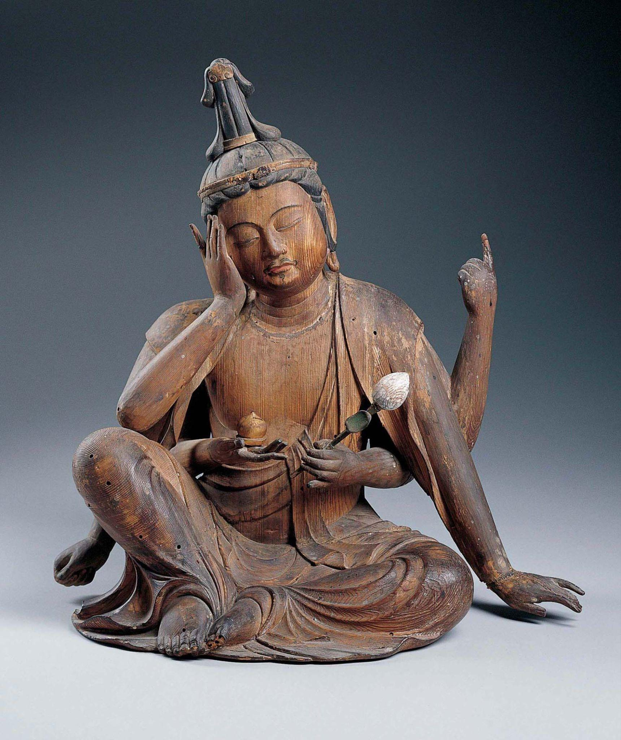
Principles of Design
The Principles of Design are the tools for how artworks are arranged.
Balance
Unity
Variety/Contrast
Emphasis
Movement/Rhythm
Pattern/Repetition
Proportion
Japanese, Seated Nyoirin Kannon, c. 1230–50, wood with traces of gilt and pigment. Kimbell Art Museum
Chinese, Detail from Pink and White Lotus, 14th century. Hanging scroll; mineral pigments on silk.
Notes:
https://kimbellart.org/collection/ap-198515

Slide 2
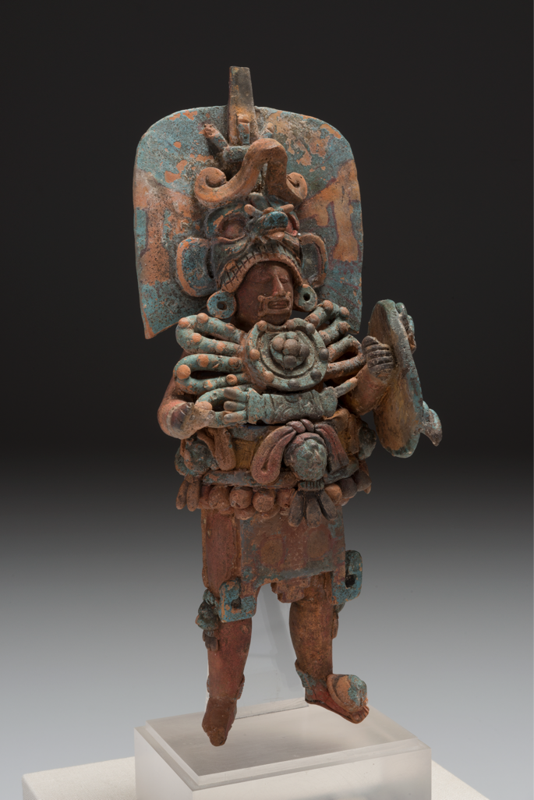
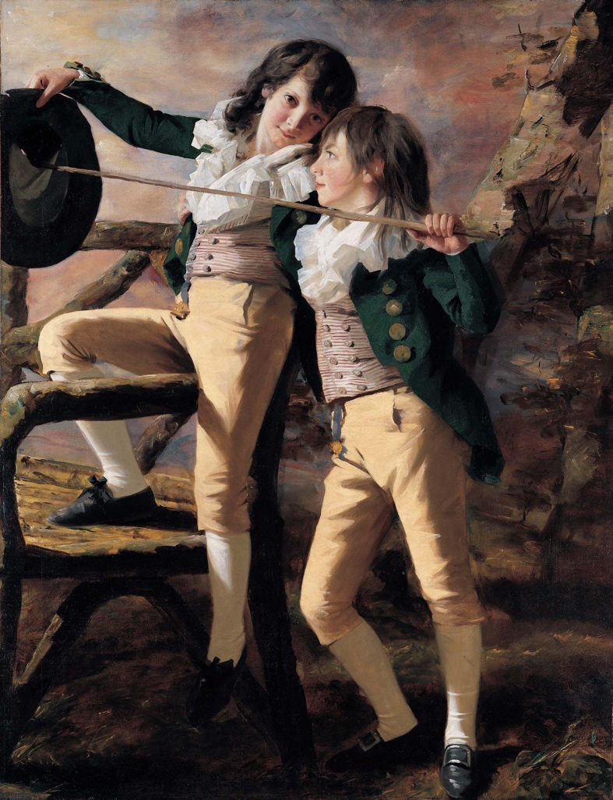
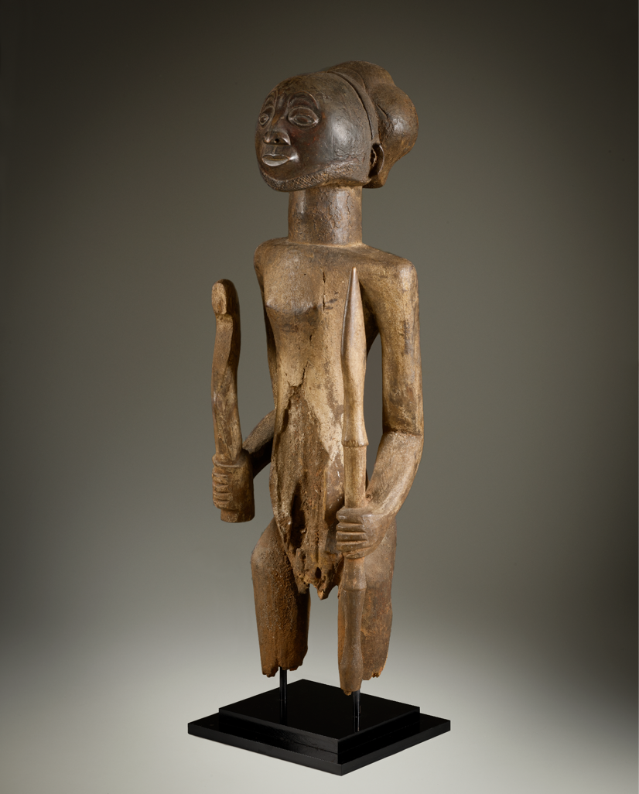
Unity
Balance
Balance refers to how artworks are weighted compositionally.
Left:
Maya, Standing Ruler, c. 600–800, ceramic with traces of paint.
Kimbell Art Museum
Middle:
Henry Raeburn, The Allen Brothers (Portrait of James and John Lee Allen), early 1790s, oil on canvas. Kimbell Art Museum
Right:
Hemba, Warrior Ancestor Figure, 19th century, wood.
Kimbell Art Museum
Notes:
https://kimbellart.org/collection/ap-198403
https://kimbellart.org/collection/ap-200205
https://kimbellart.org/collection/ap-197903

Slide 3
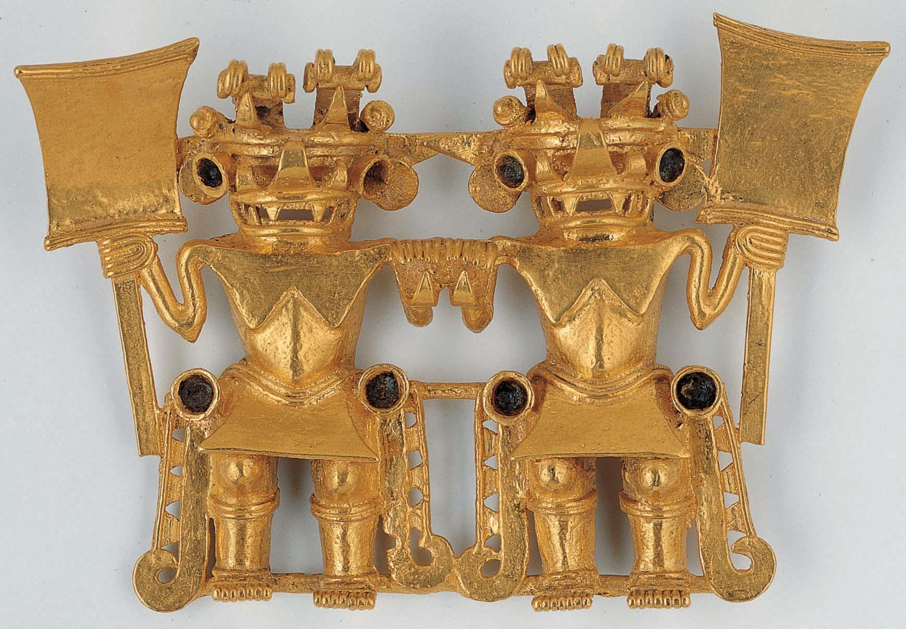
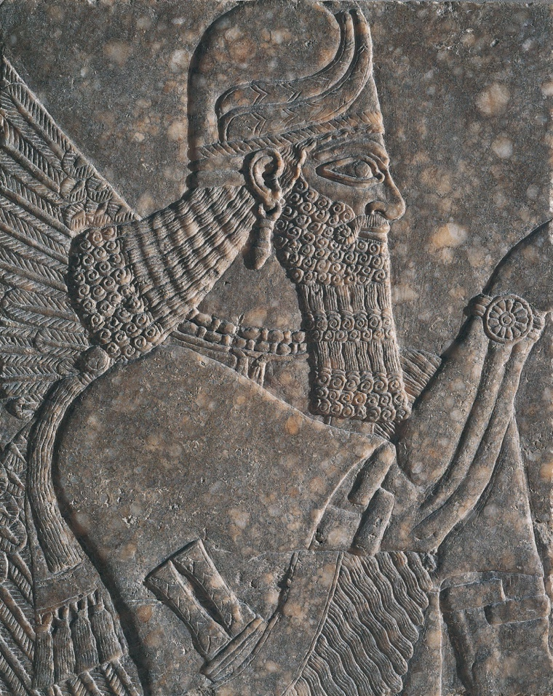
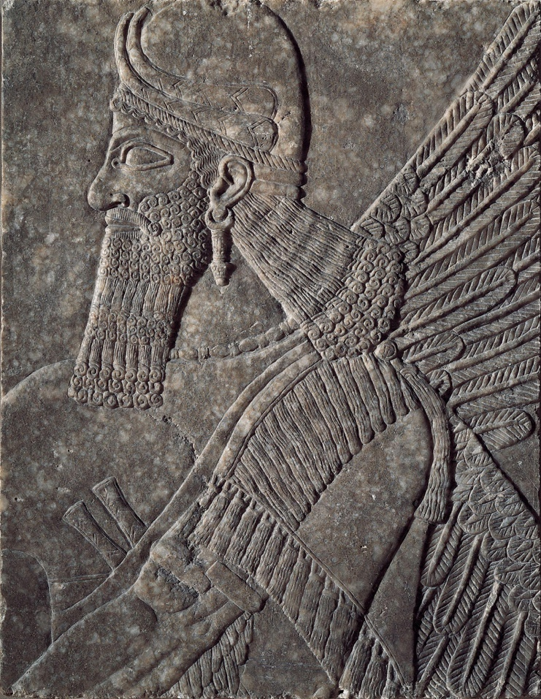
Balance
Balance can be symmetrical—meaning elements are similar or the same on each side of an artwork.
Conte Style, Pendant: Twin Warriors​​, c. 700–1200, gold. Kimbell Art Museum
Assyrian, Pair of Winged Deities, c. 874–860 BC, gypsum. Kimbell Art Museum
Notes:
https://kimbellart.org/collection/ap-197923
https://kimbellart.org/collection/ap-198104-ab

Slide 4
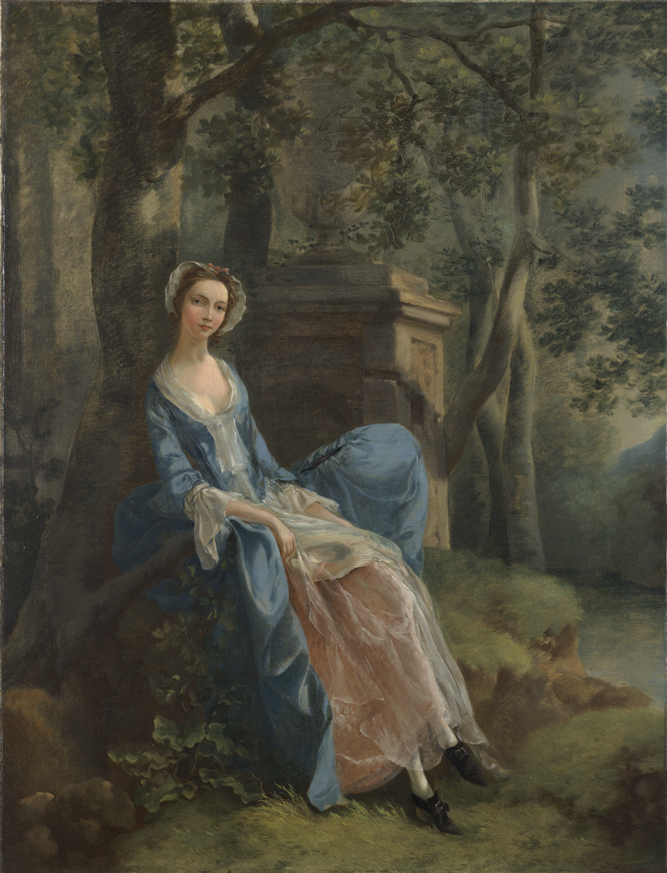
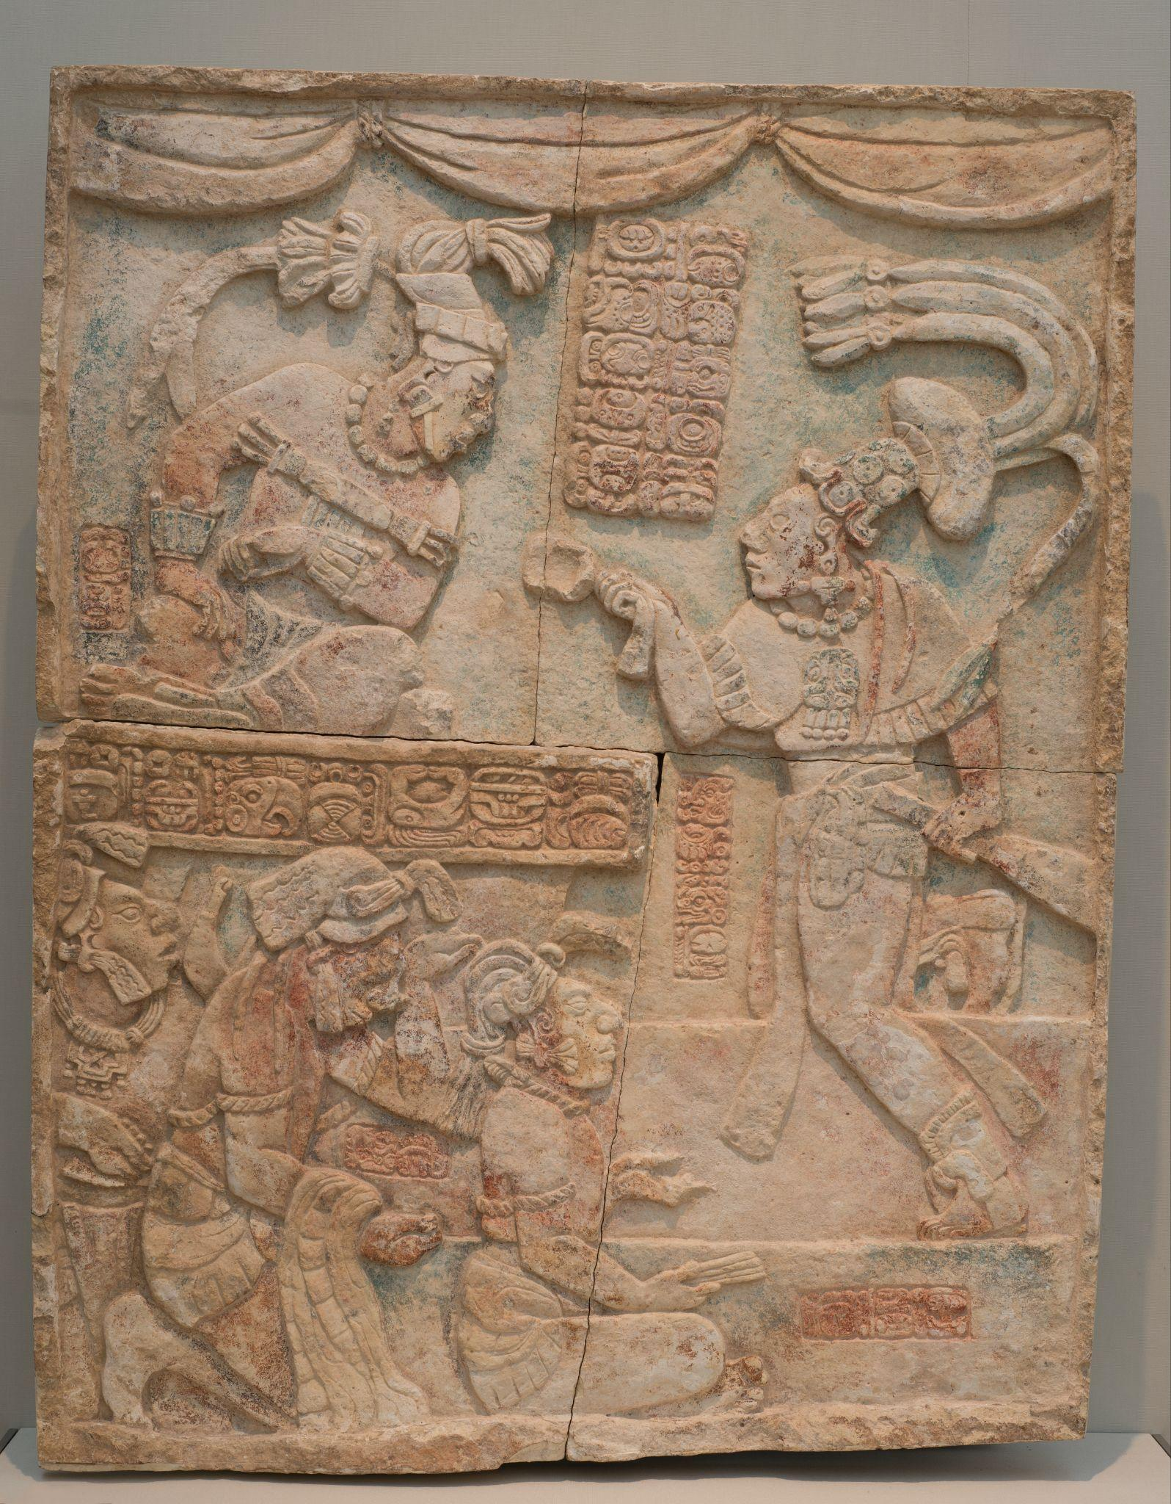
Balance
Balance can be asymmetrical—meaning there is a visual focus on one side.
​Thomas Gainsborough, Portrait of a Woman, Possibly of the Lloyd Family, c. 1750​, oil on canvas. Kimbell Art Museum
Maya, Presentation of Captives to a Maya Ruler​, c. AD 785, limestone with traces of paint. Kimbell Art Museum
Notes:
https://kimbellart.org/collection/acf-194604
https://kimbellart.org/collection/ap-197107

Slide 5
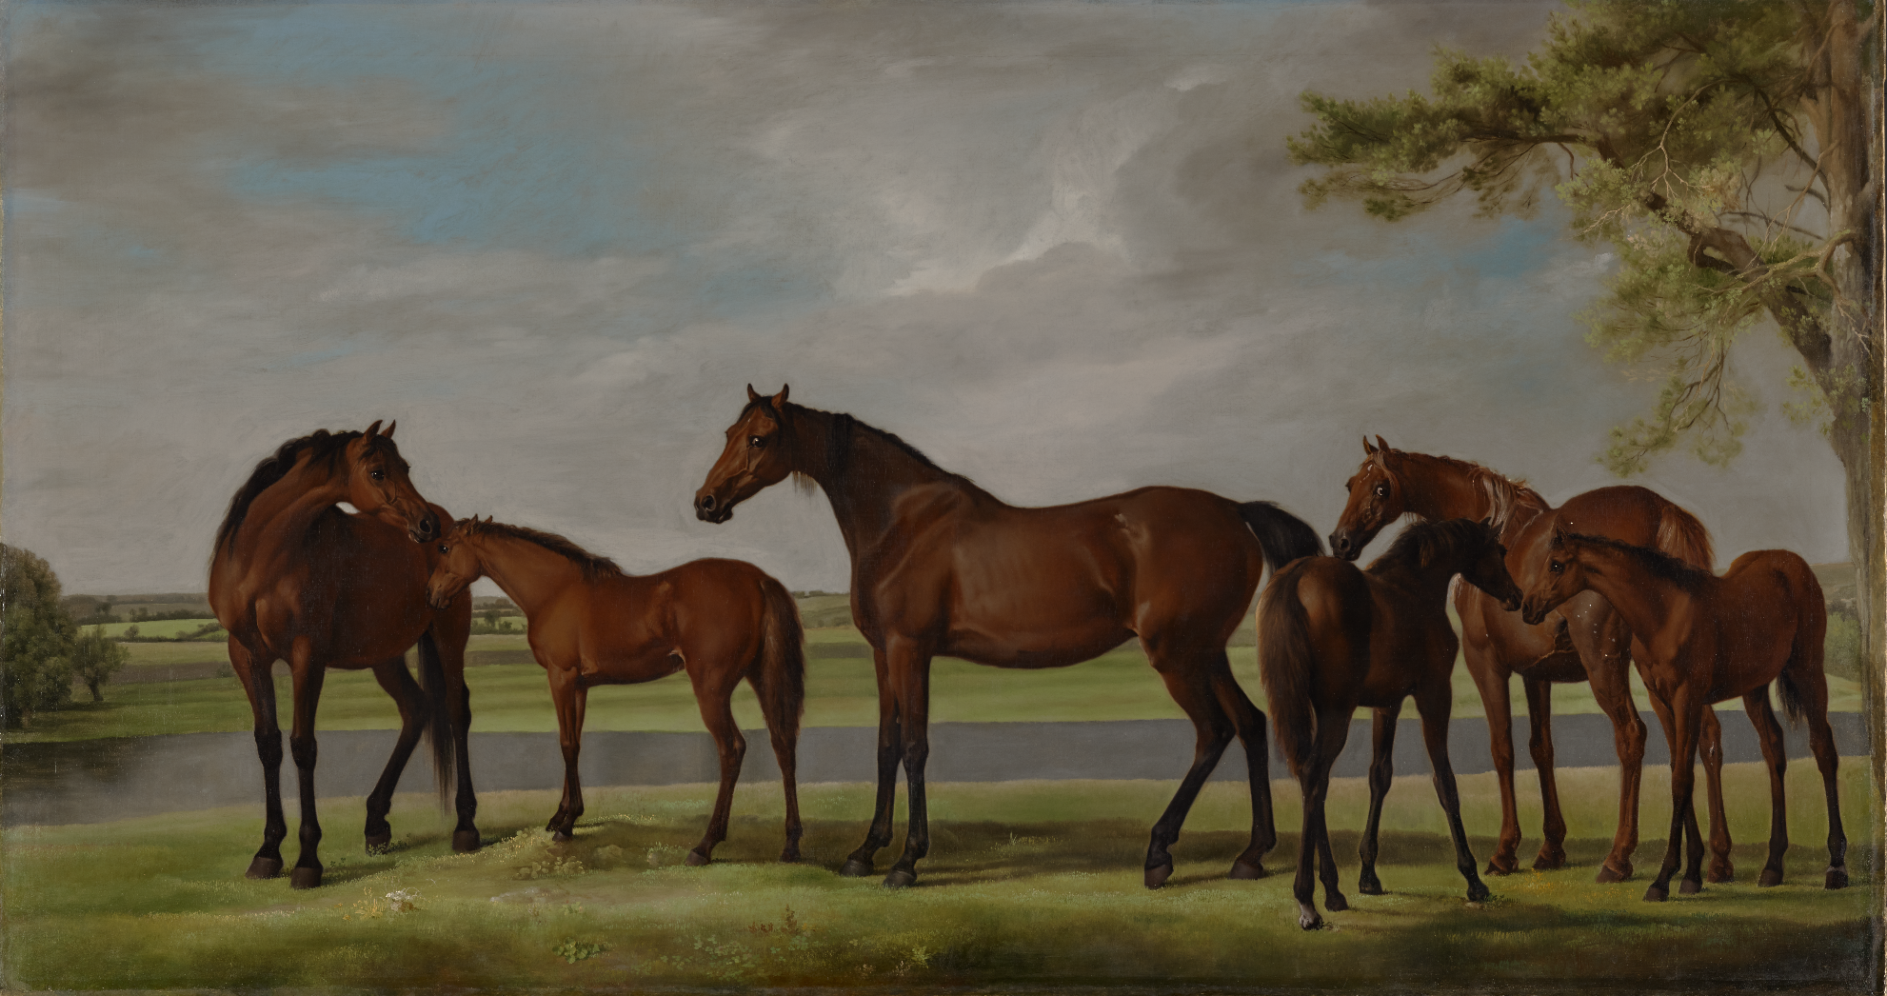
Unity
Unity
Unity is shown when one or more elements of art is repeated.
George Stubbs, Mares and Foals Belonging to the 2nd Viscount Bolingbroke​, c. 1761–62, oil on canvas. Kimbell Art Museum
Notes:
https://kimbellart.org/collection/ap-202401

Slide 6
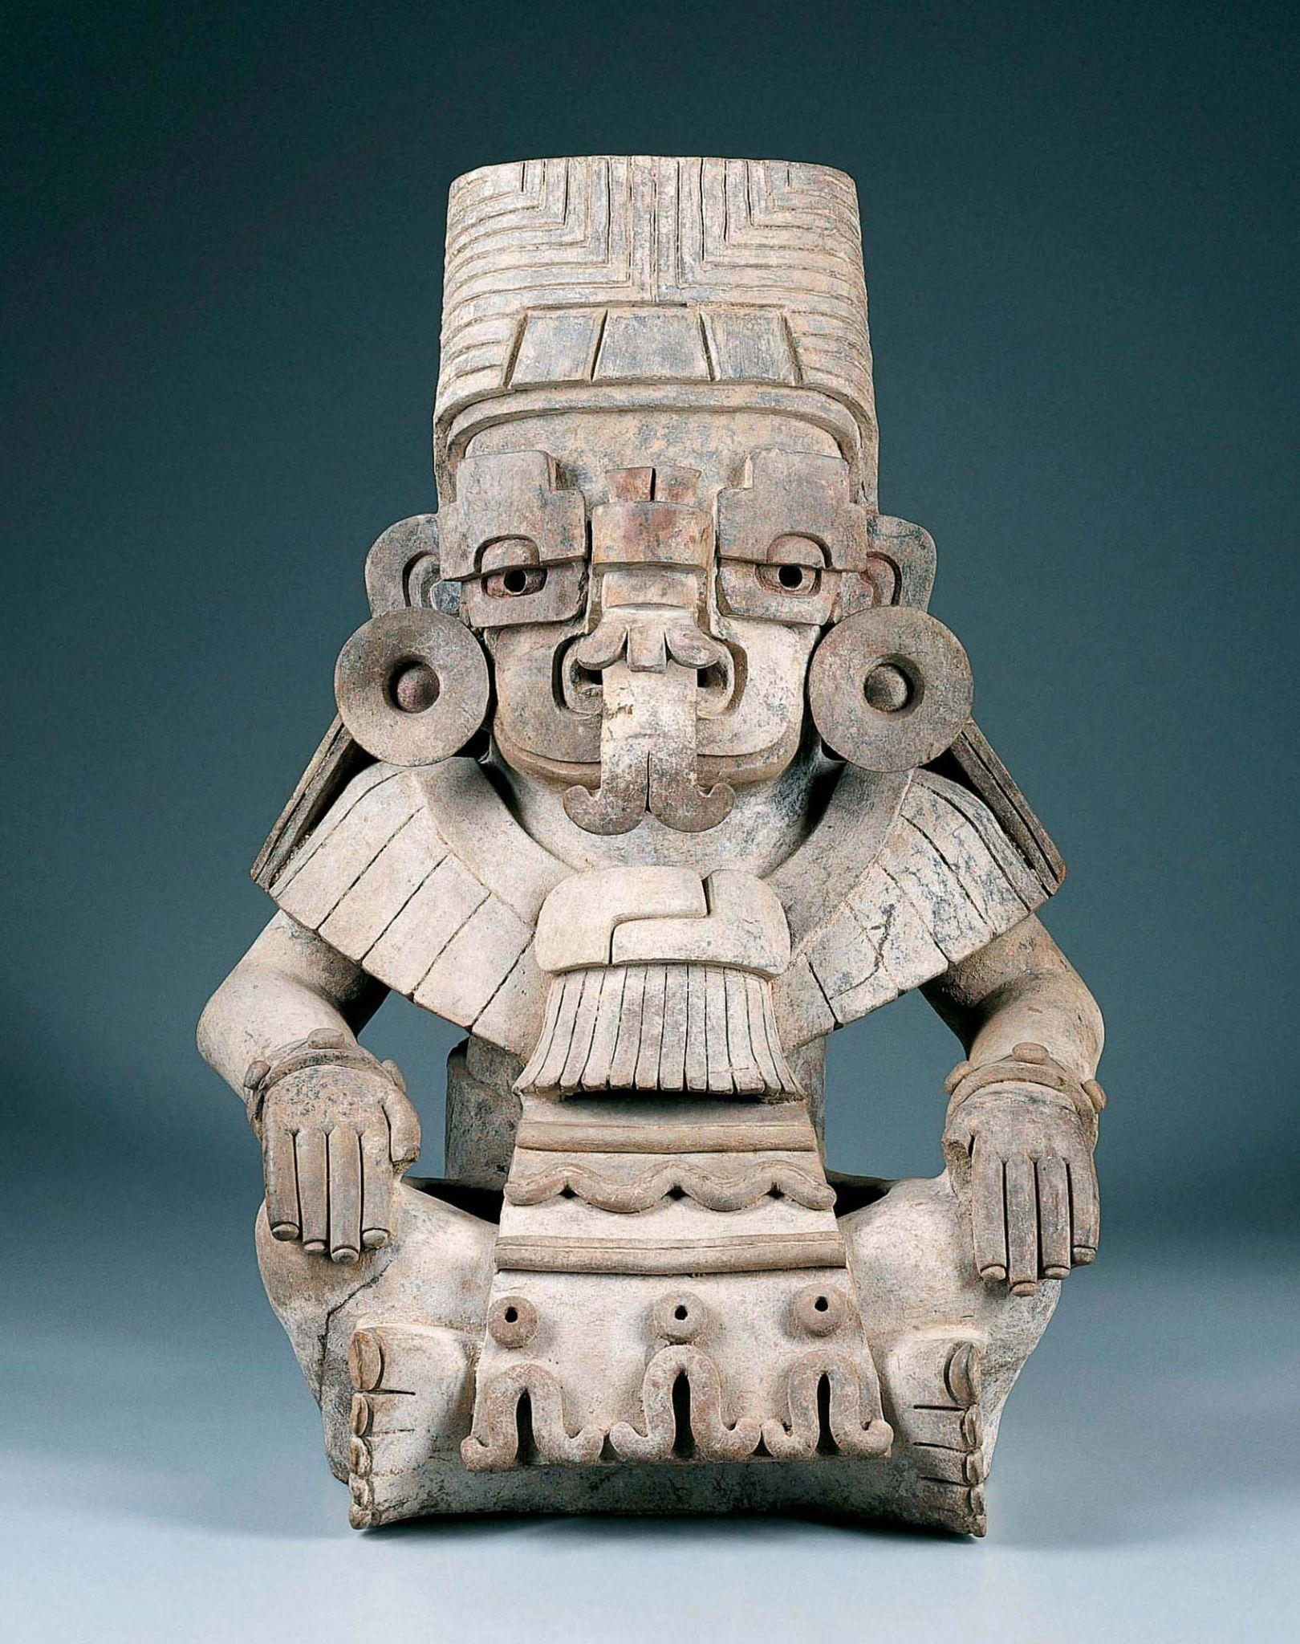
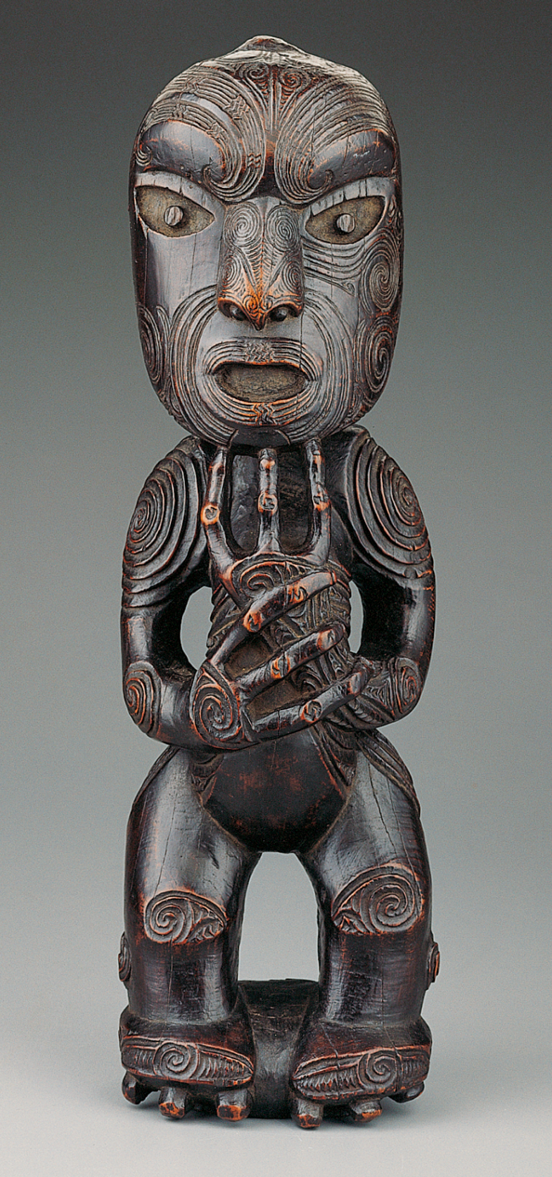
Unity
Artworks can have unity because they use similar lines or patterns throughout.
Zapotec culture, Urn in the Form of Cociyo, ​God of Lightning and Rain​, c. AD 400–500, ceramic.​ Kimbell Art Museum
Maori, Standing Ancestor Figure​, c. 1800–1840, wood. Kimbell Art Museum
Notes:
https://kimbellart.org/collection/ap-198509
https://kimbellart.org/collection/ap-198904

Slide 7
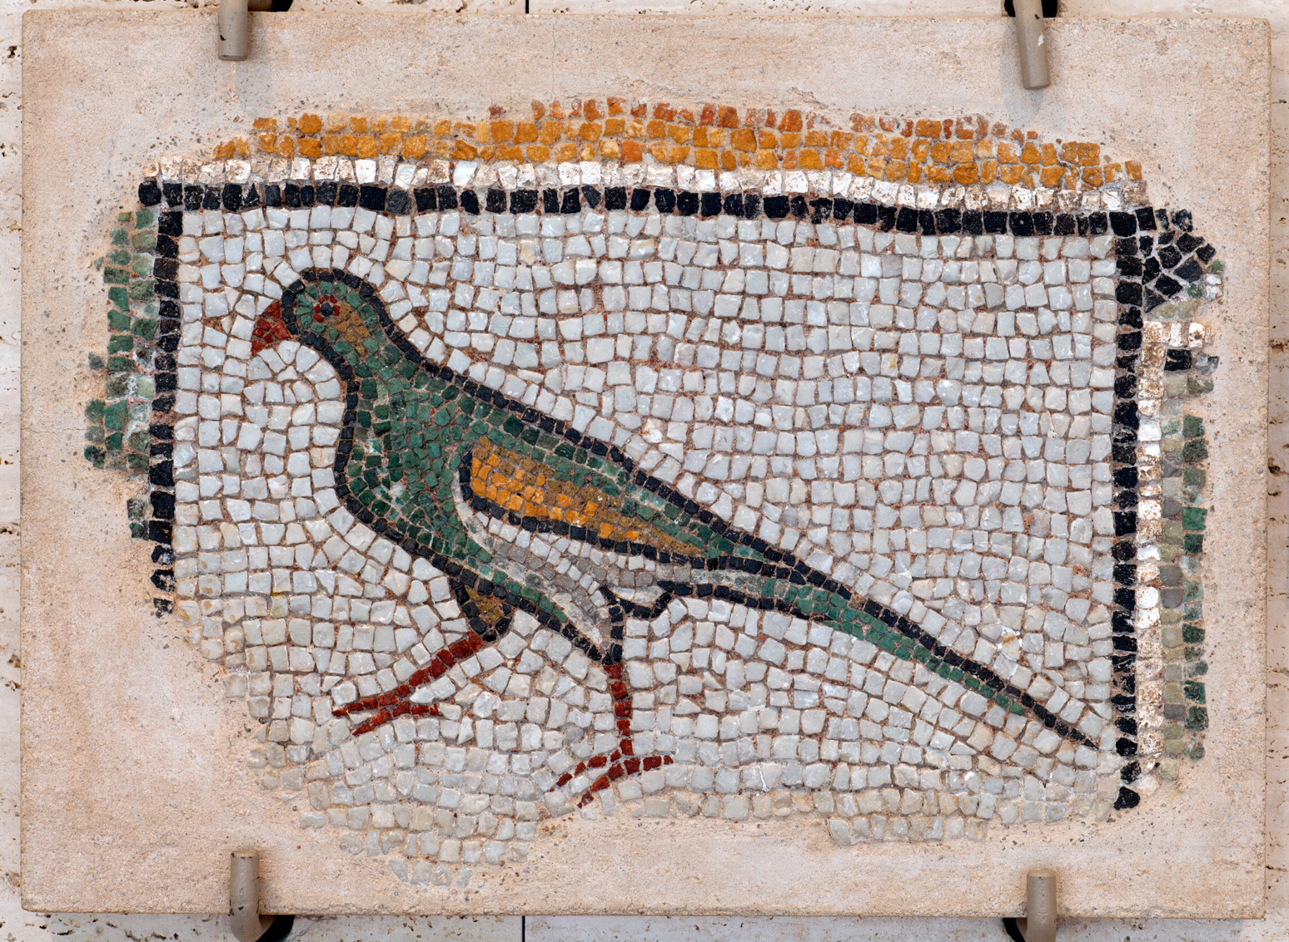
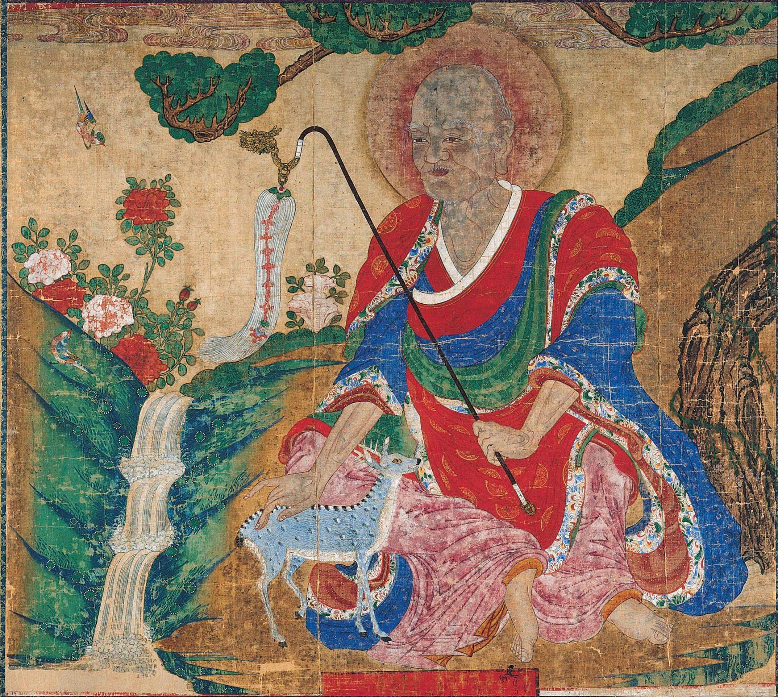
Unity
Unity can be created from application of the same colors throughout an artwork.
Roman, Parrot​, c. AD 400​, mosaic. Kimbell Art Museum
Korean, Arhat and Deer​, late 17th century, hanging scroll. Kimbell Art Museum
Notes:
https://kimbellart.org/collection/ap-197221
https://kimbellart.org/collection/ap-199506

Slide 8
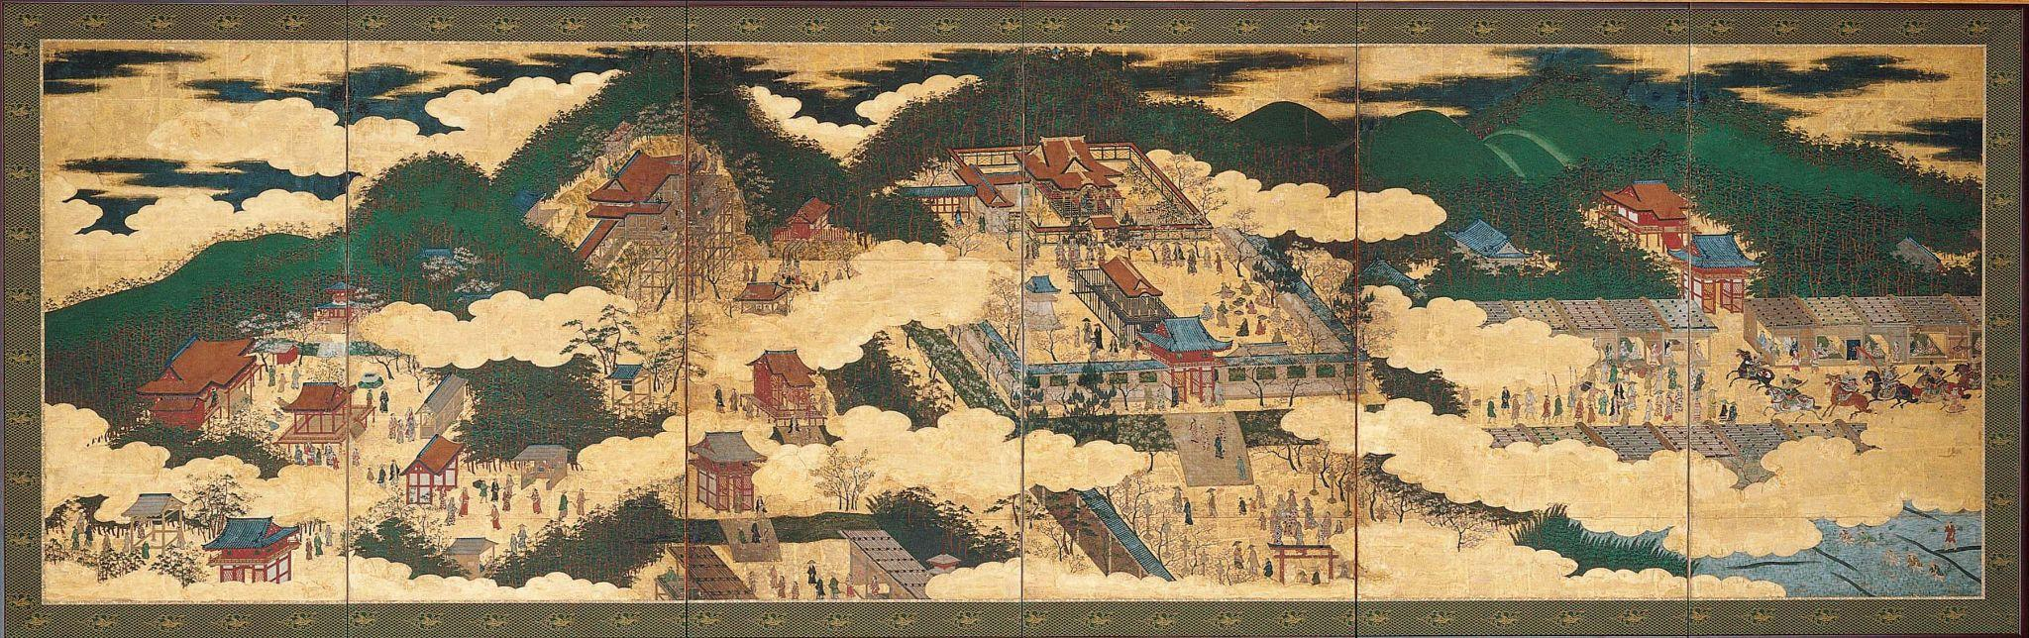
Unity
Artworks might show unity through their use of shape and space.
Japanese, Temples in Eastern Kyoto, c. 1600​, six-fold screen; mineral pigments on gold. Kimbell Art Museum
Notes:
https://kimbellart.org/collection/ap-198610

Slide 9
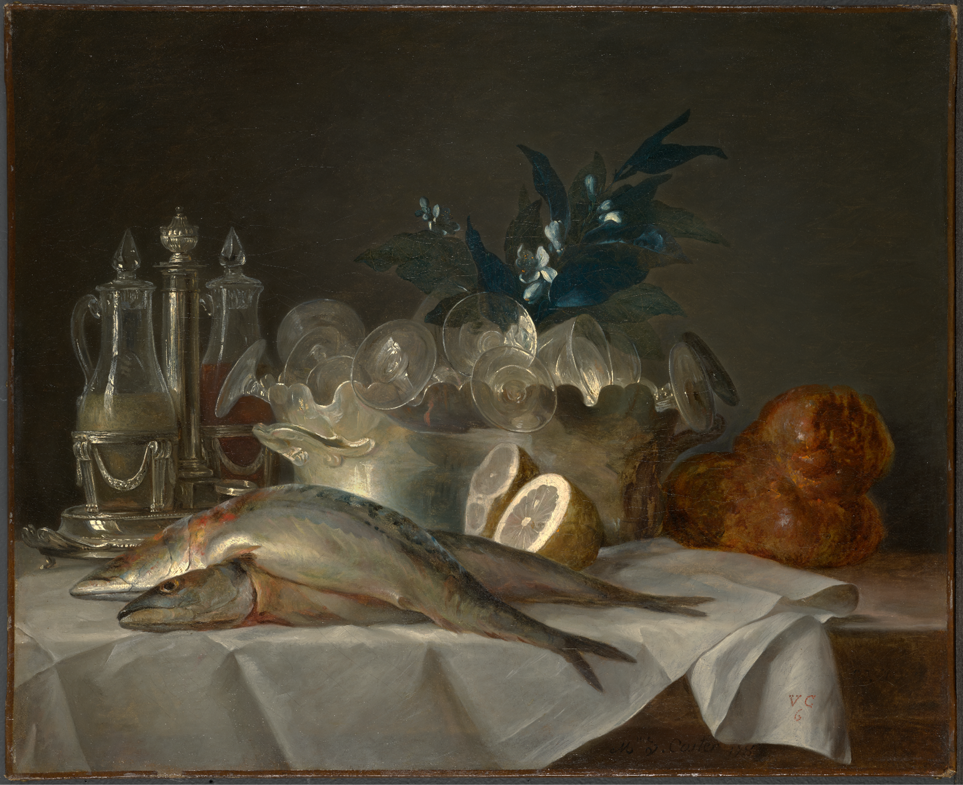
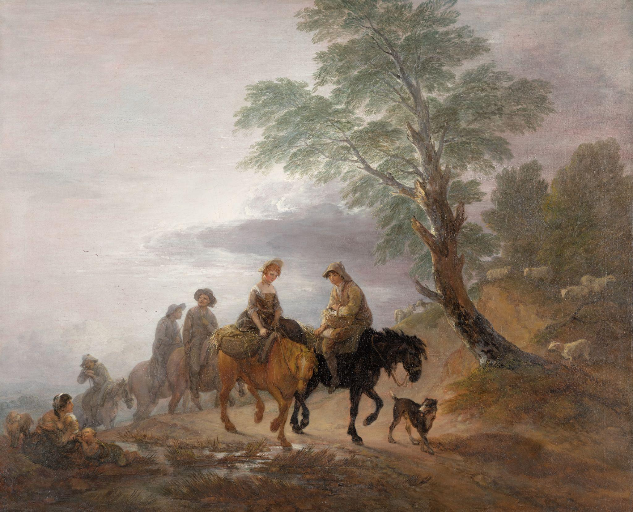
Unity
Unity can be depicted through texture and value.
Anne Vallayer-Coster, Still Life with Mackerel, 1787​, oil on canvas. Kimbell Art Museum
Thomas Gainsborough, Going to Market, Early Morning, c. 1773​, oil on canvas. Kimbell Art Museum
Notes:
https://kimbellart.org/collection/apg-201901
https://kimbellart.org/collection/ap-202301

Slide 10
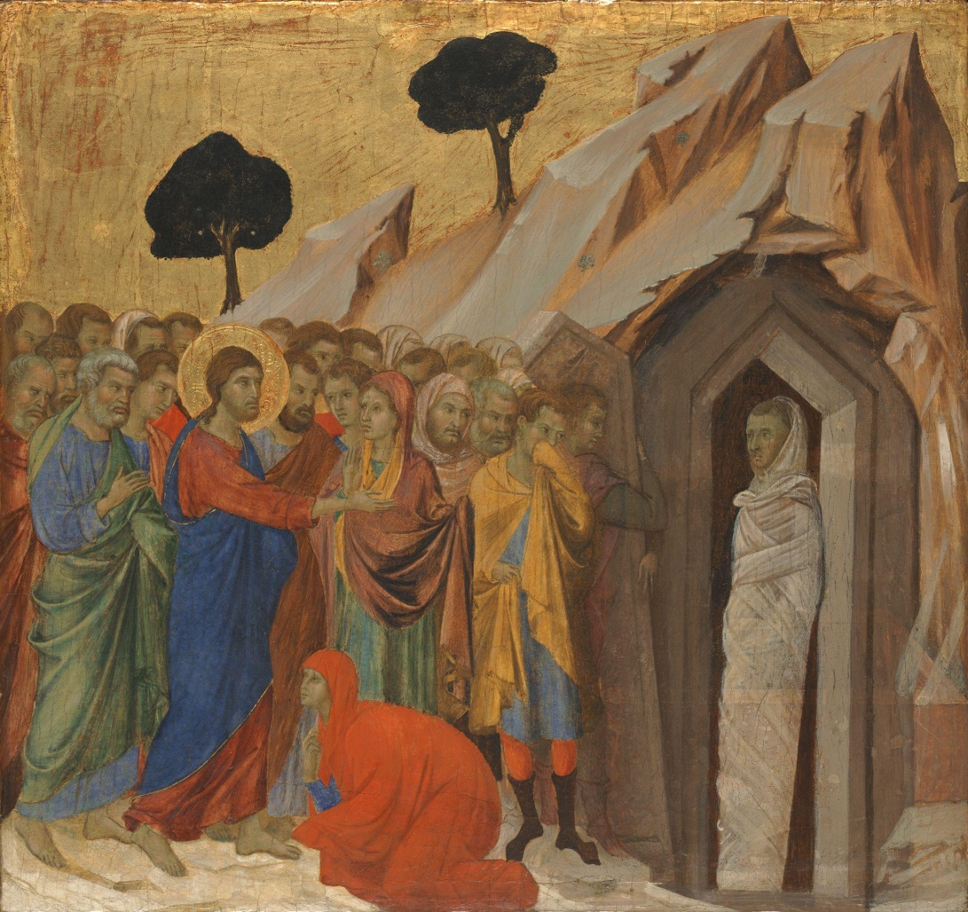
Unity
Variety/Contrast
Variety is shown when there are contrasting elements.
The figures on the left wear bright colors and are grouped together.
The figure on the right wears neutral colors and is isolated from the group.
Duccio di Buoninsegna, The Raising of Lazarus, 1310–11, tempera and gold on panel. Kimbell Art Museum
Notes:
https://kimbellart.org/collection/apx-197501

Slide 11
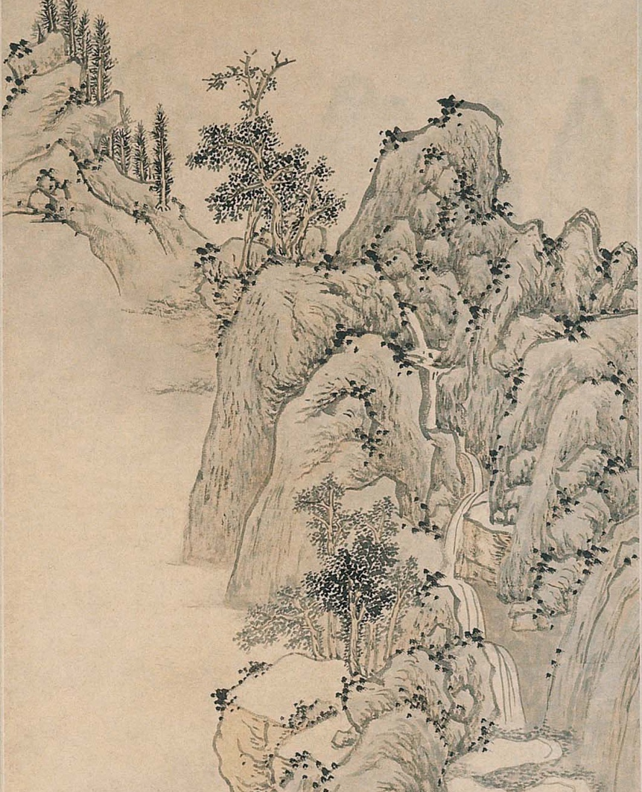
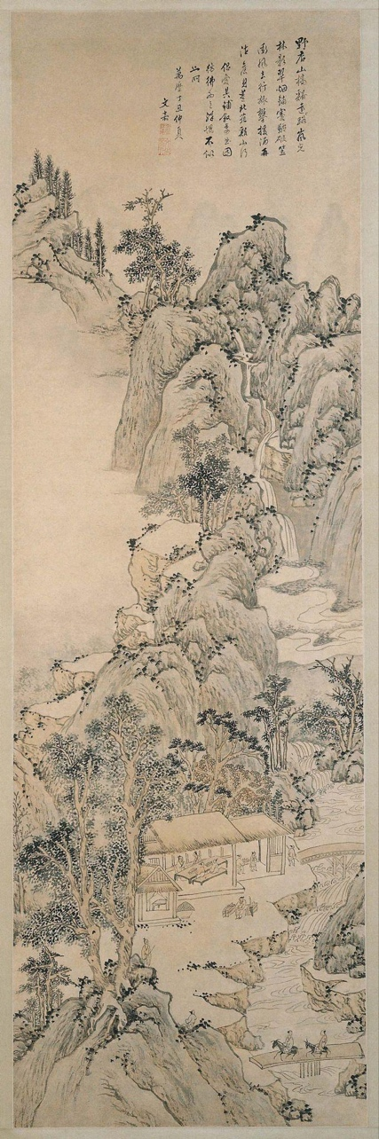
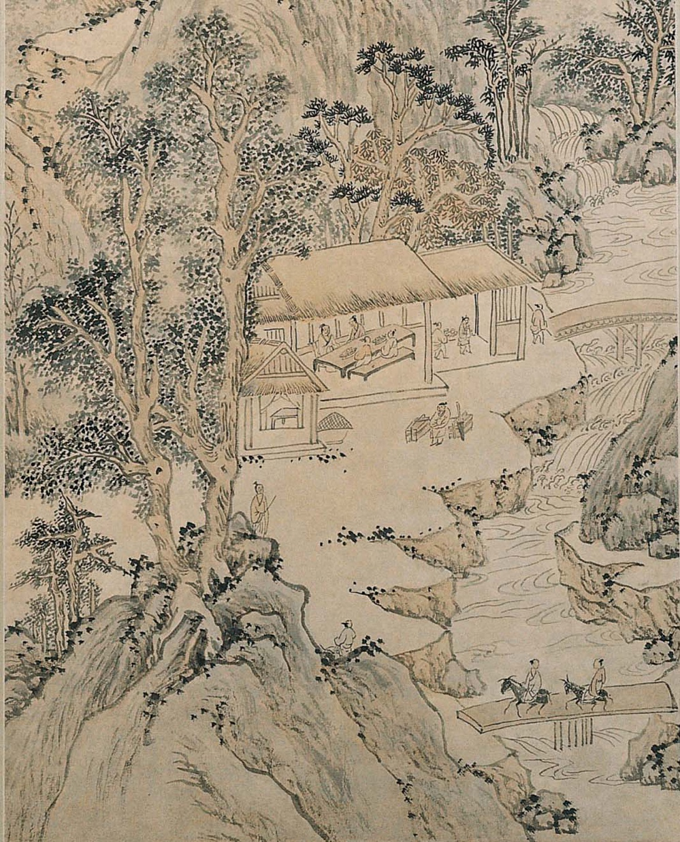
Variety/Contrast
Different types of lines can create variety within an artwork.
Wen Jia, Landscape in the Style of Dong Yuan, 1577, hanging scroll; ink and light colors on paper. Kimbell Art Museum
Notes:
https://kimbellart.org/collection/ap-198001

Slide 12
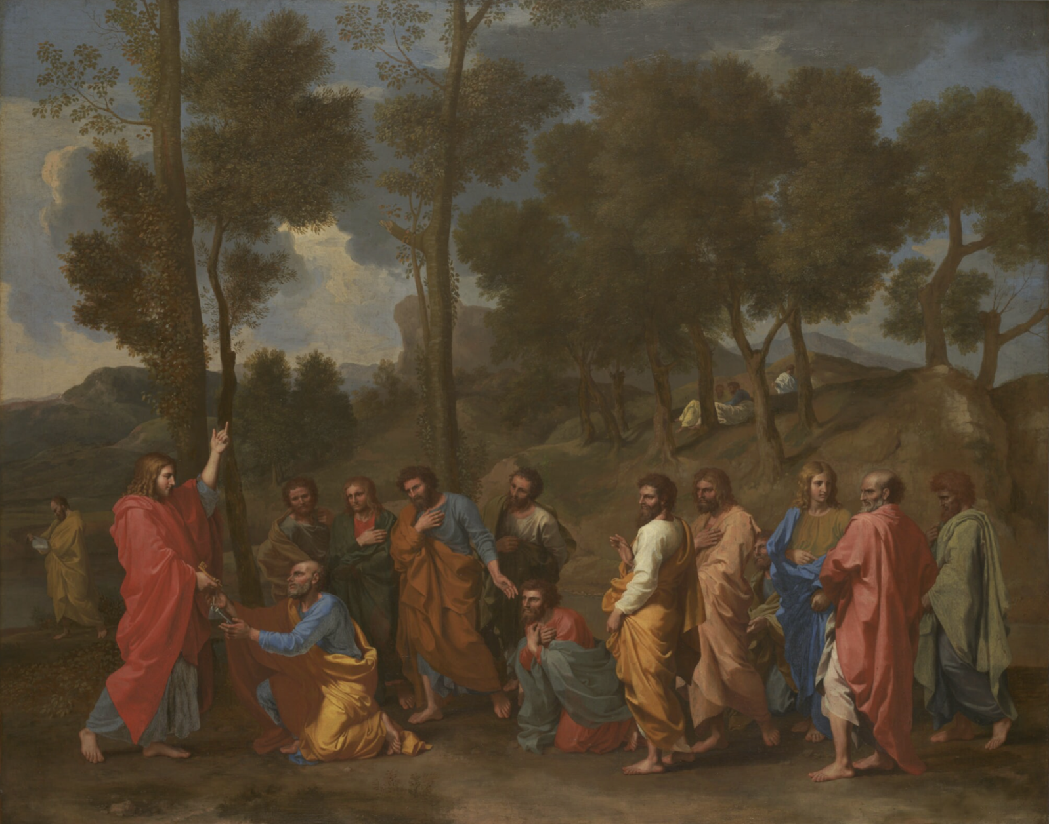
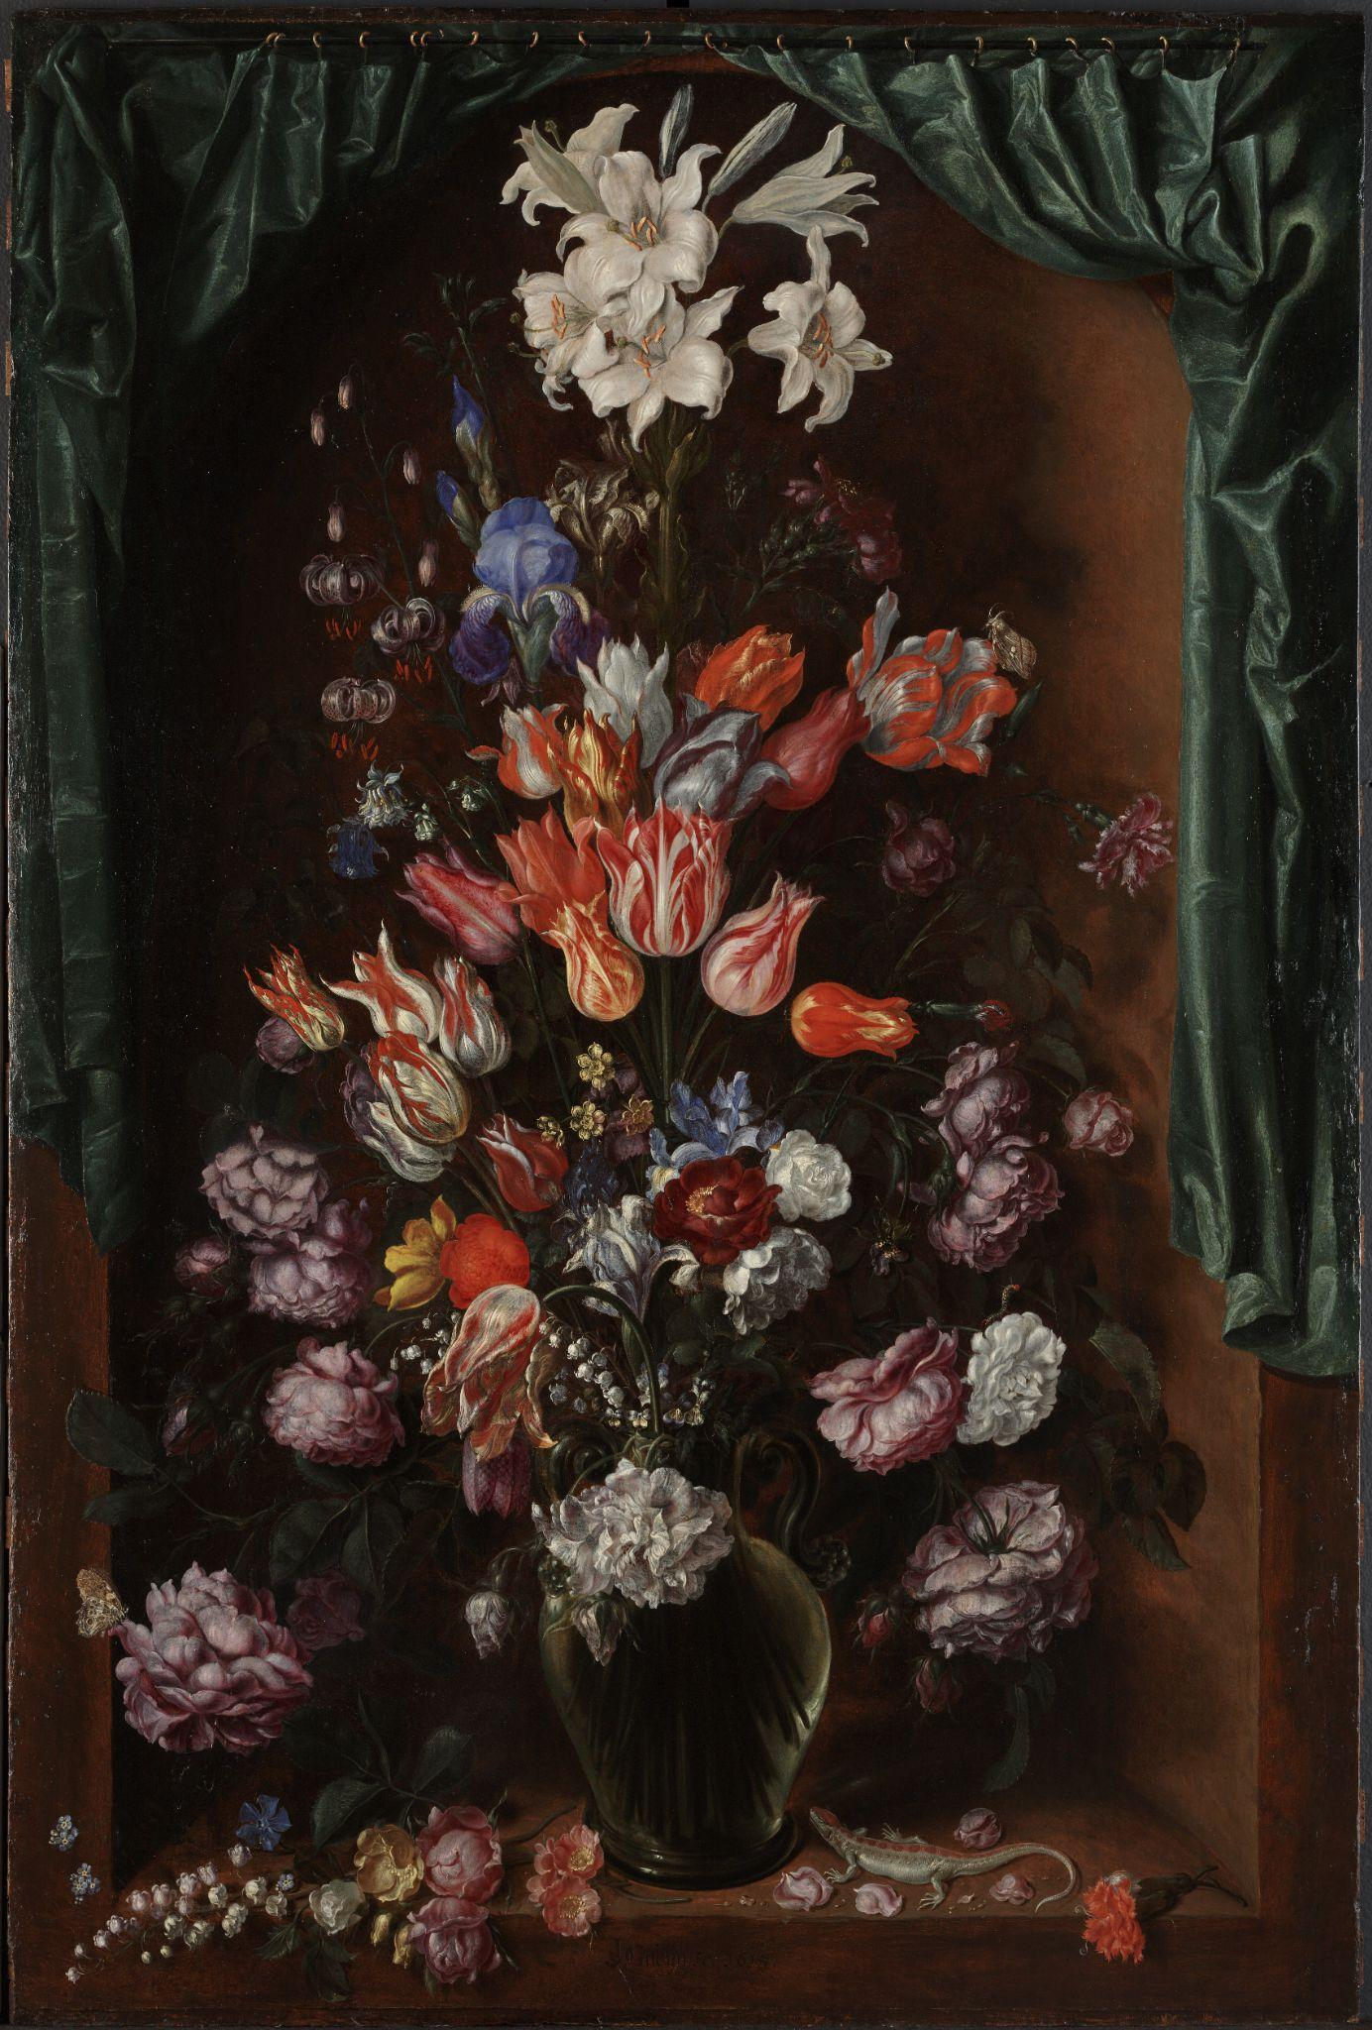
Variety/Contrast
Artworks can show variety by using differing colors for similar shapes.
Left:
Nicolas Poussin, The Sacrament of Ordination (Christ Presenting the Keys to Saint Peter)​, c. 1636–40​, oil on canvas. Kimbell Art Museum
Right:
Jacques de Gheyn II, Vase of Flowers with a Curtain​, c. 1615​, oil on canvas. Kimbell Art Museum
Notes:
https://kimbellart.org/collection/ap-201101
https://kimbellart.org/collection/ap-200801

Slide 13
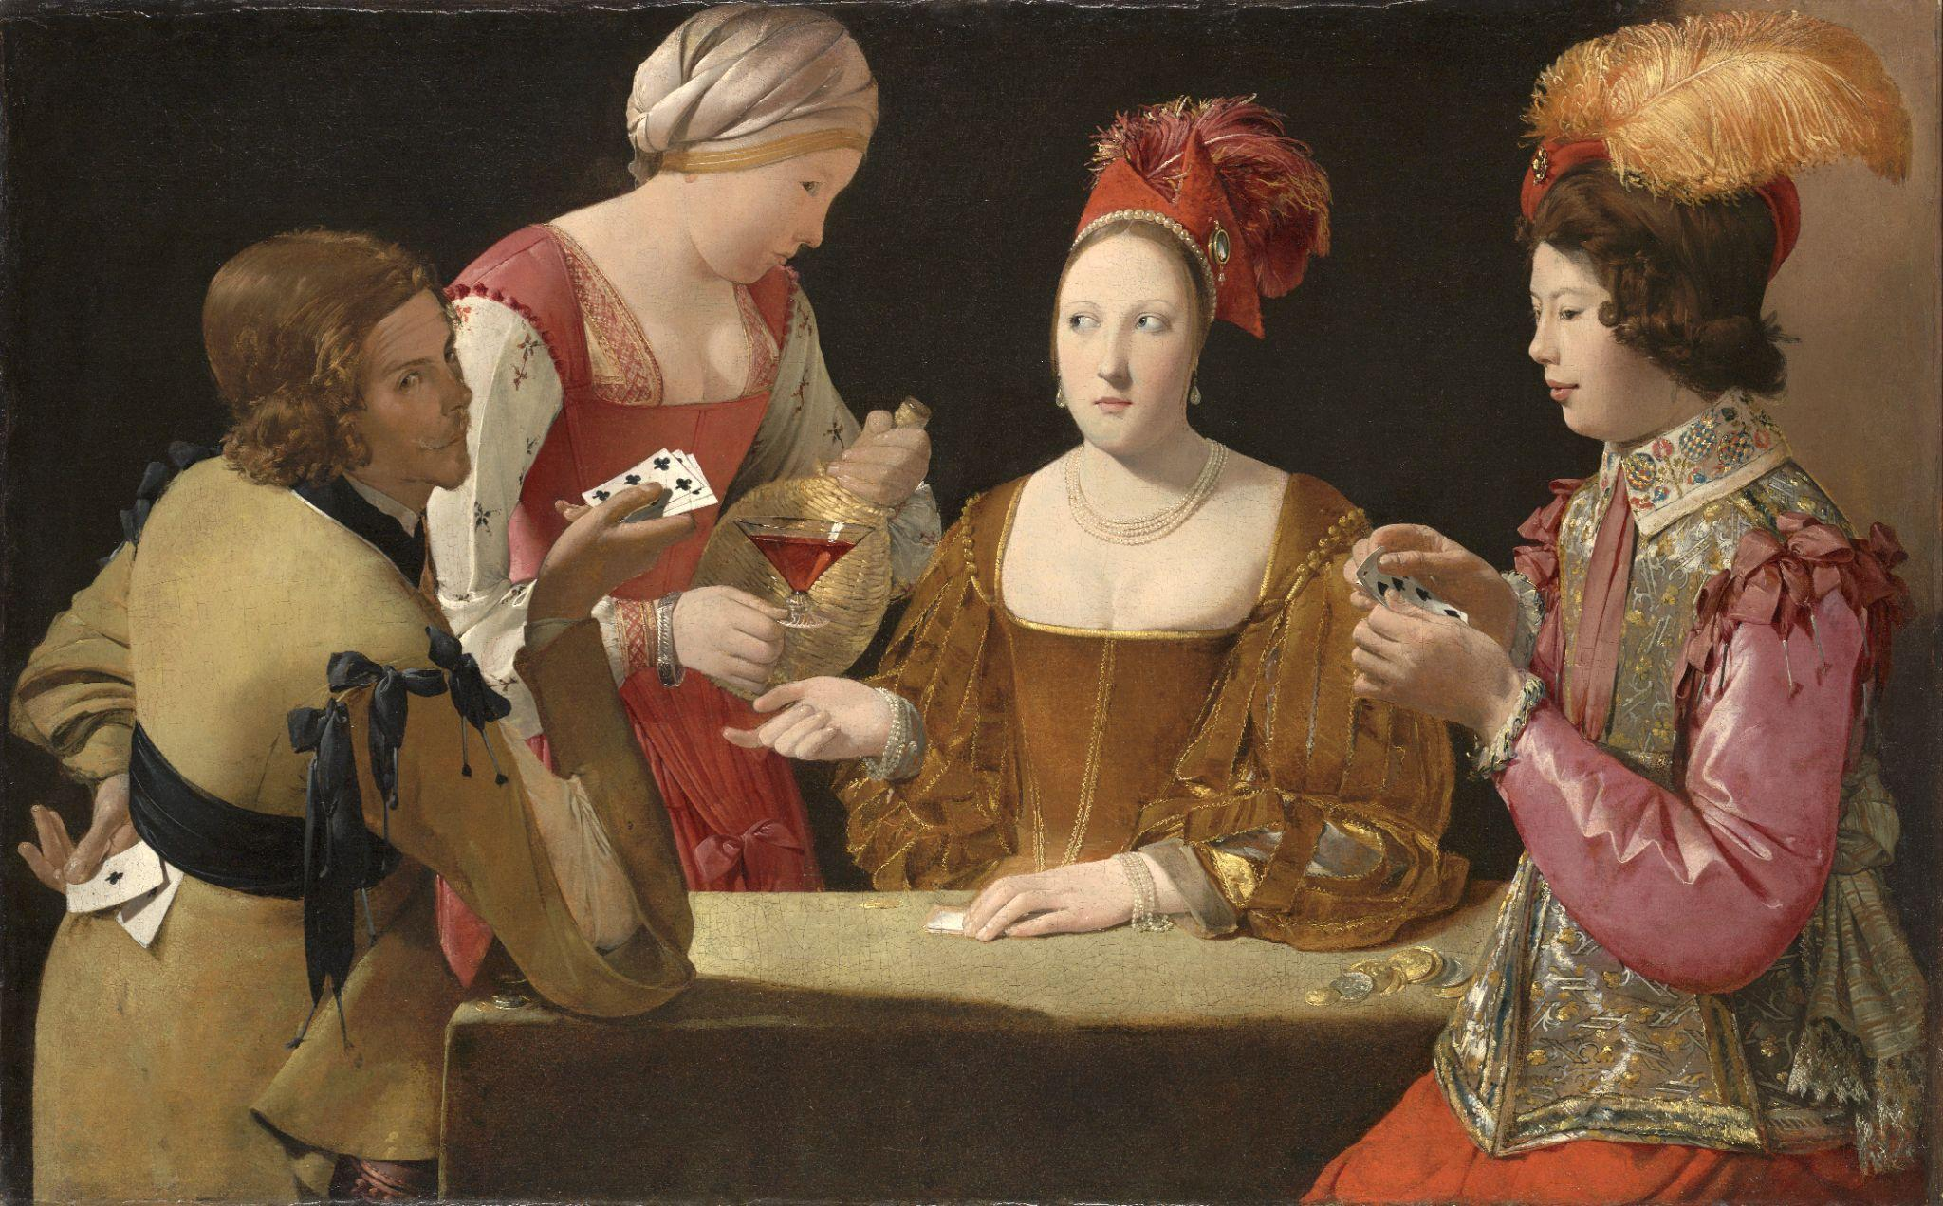
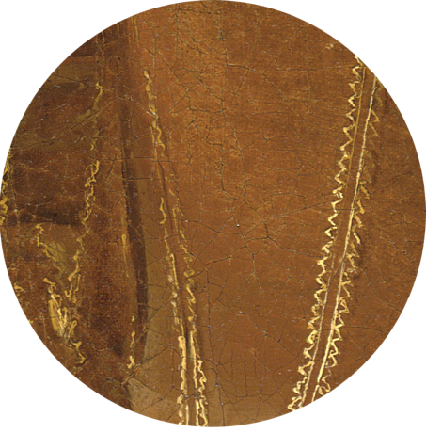
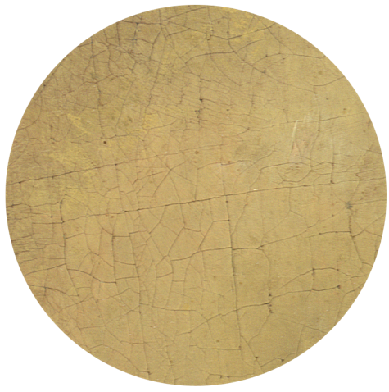
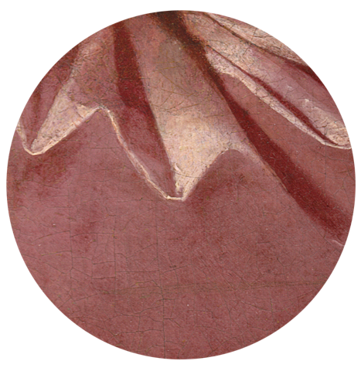
Variety/Contrast
Different textures within one artwork can create variety.
Georges de La Tour, The Cheat with the Ace of Clubs​, c. 1630–34​, oil on canvas. Kimbell Art Museum
Notes:
https://kimbellart.org/collection/ap-198106

Slide 14
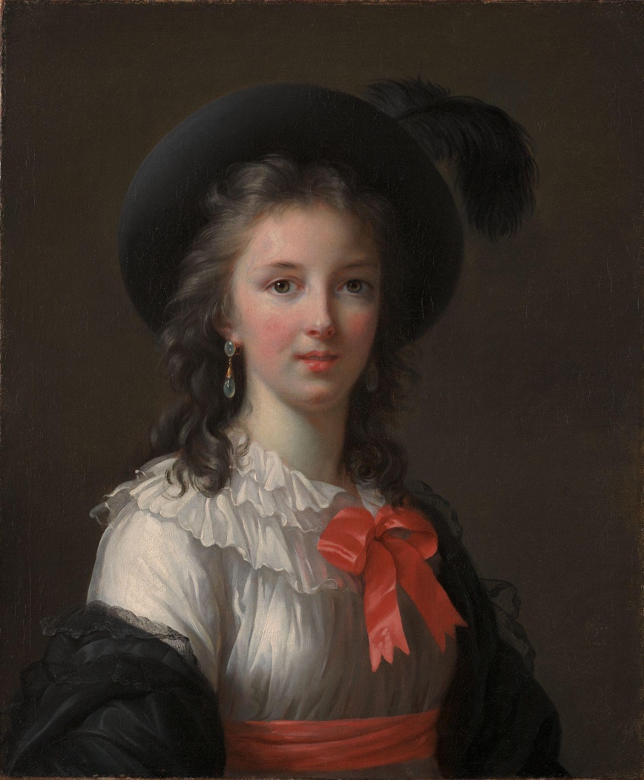
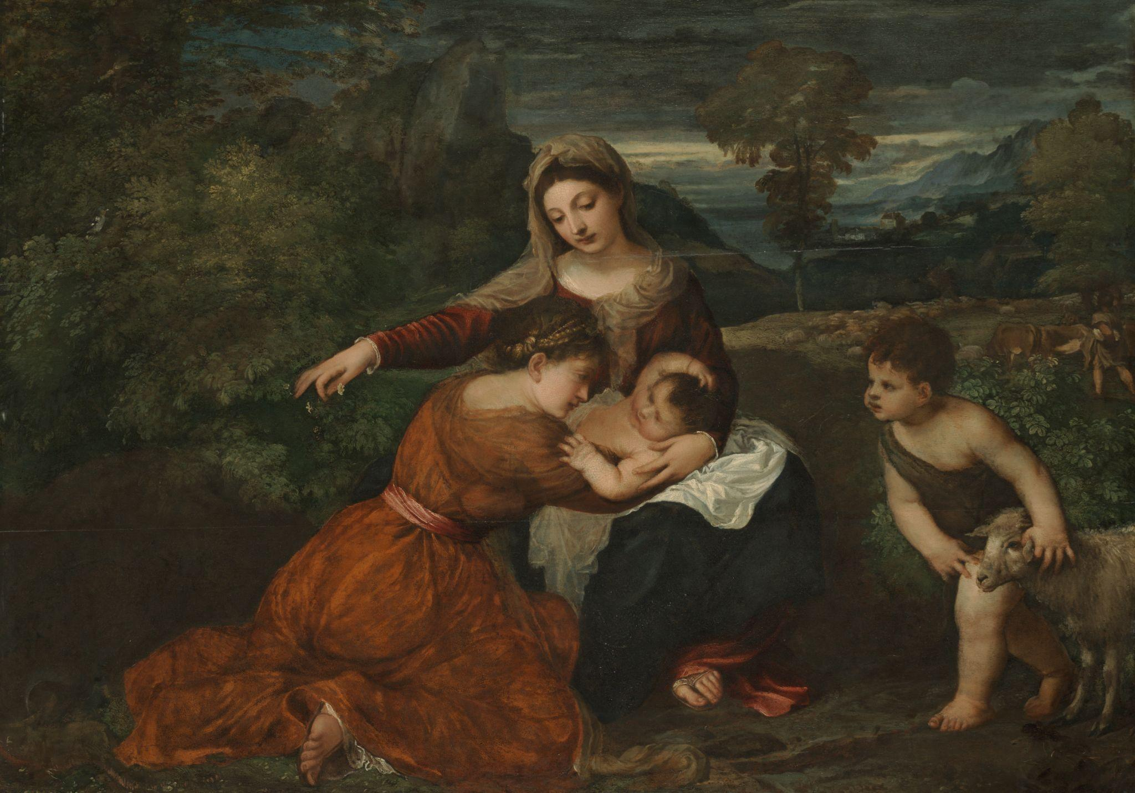
Unity
Emphasis
The area within an artwork that draws the viewer’s attention.
Left:
Elisabeth Louise Vigée Le Brun, Self-Portrait, c. 1781, oil on canvas. Kimbell Art Museum
Right:
Titian, The Madonna and Child with a Female Saint and the Infant Saint John the Baptist, 1530s, oil on panel. Kimbell Art Museum
Notes:
https://kimbellart.org/collection/ack-194902
https://kimbellart.org/collection/ap-198607

Slide 15
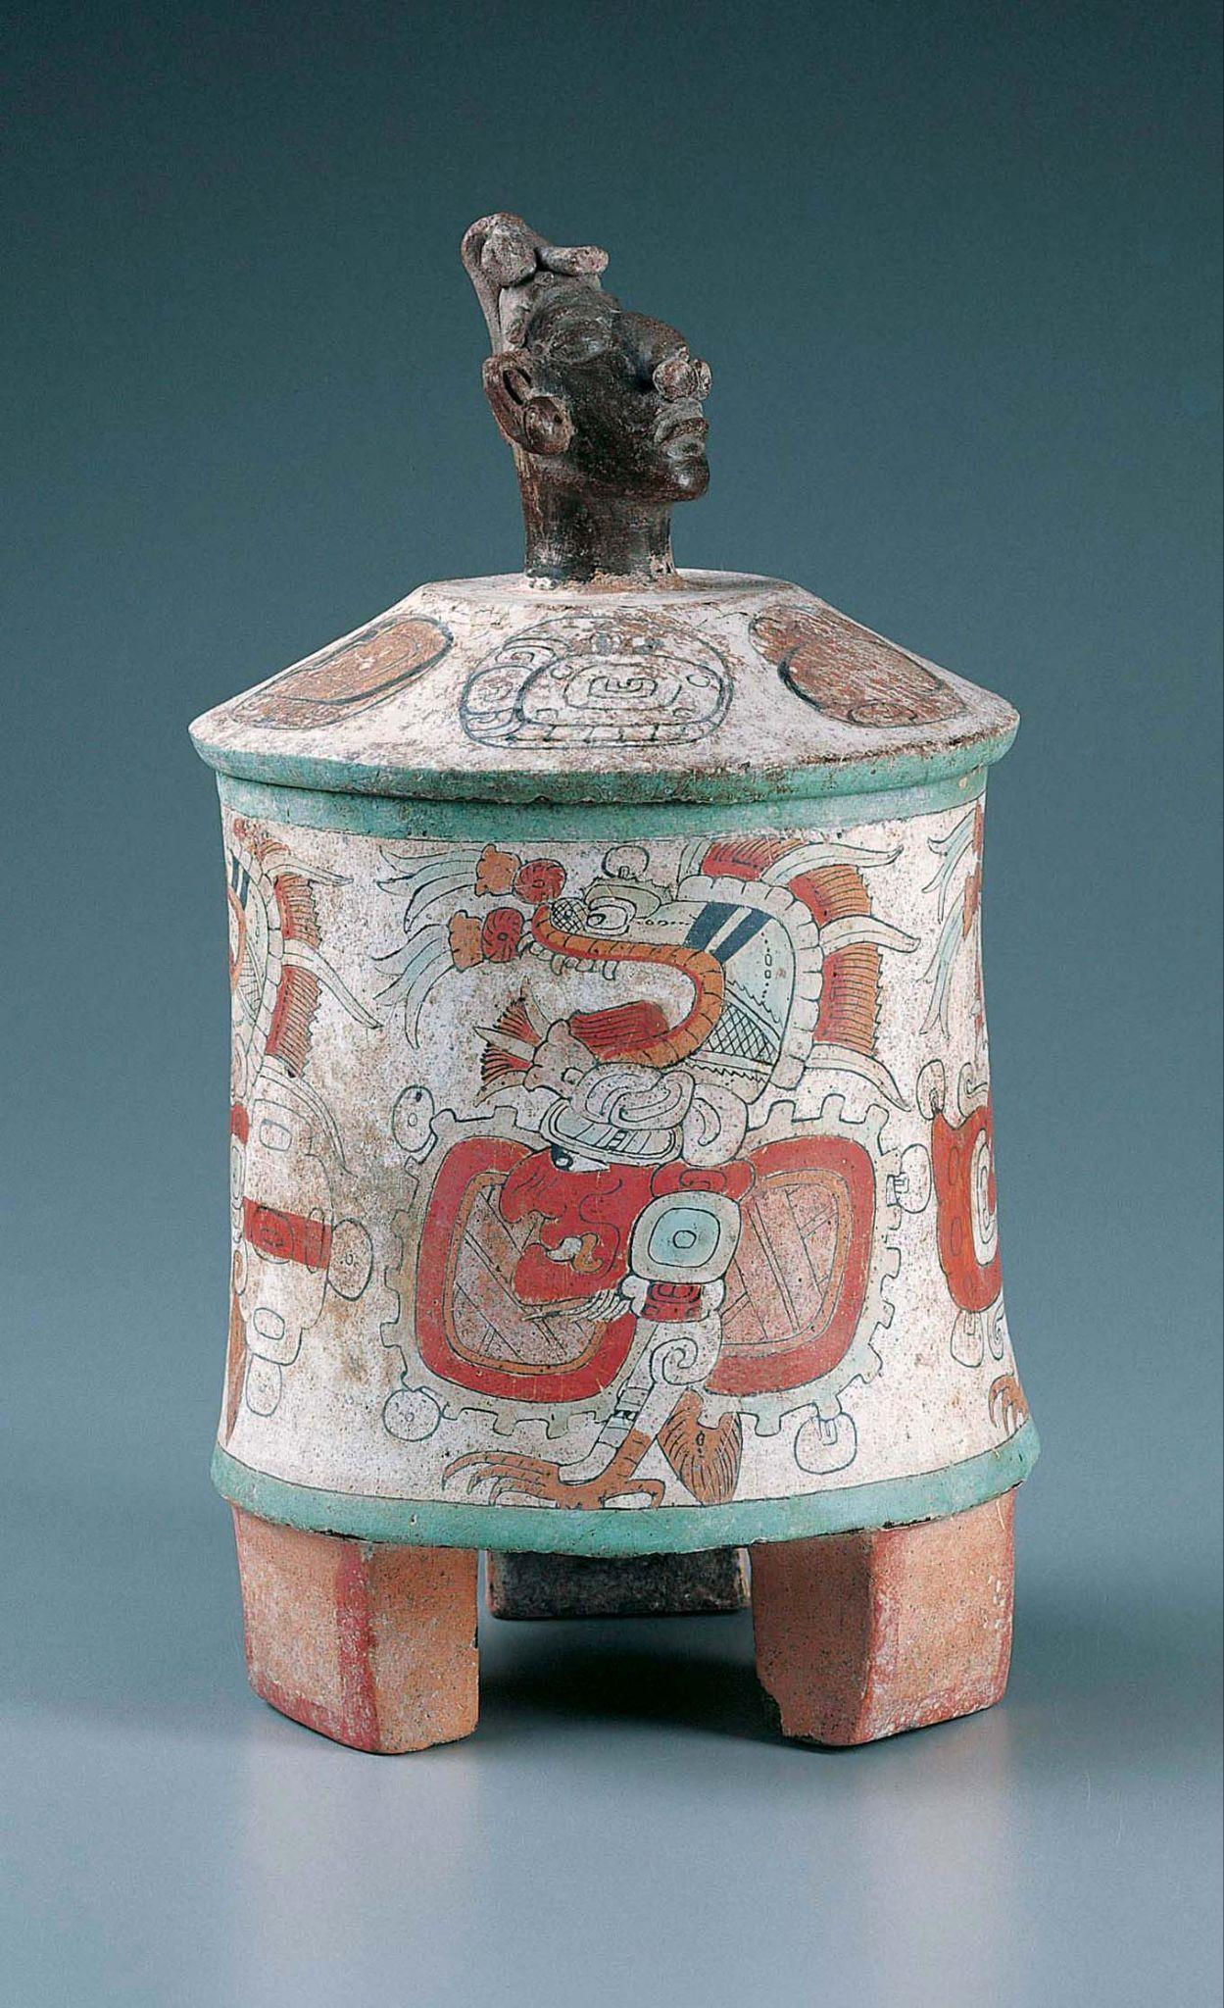
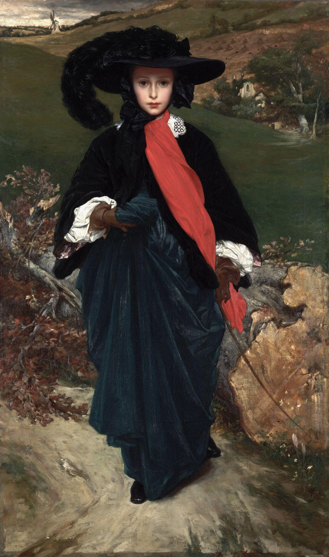
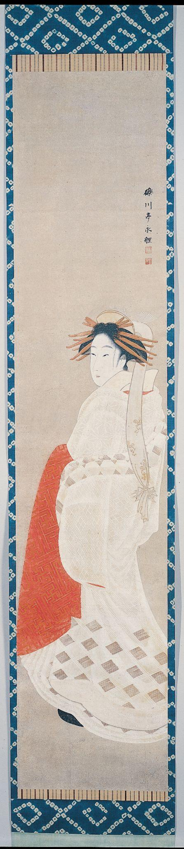
Emphasis
Color can catch the eye and draw emphasis.
Left:
Maya, Tripod Vessel with Lid, c. 400–500, ceramic with stucco and polychrome pigments. Kimbell Art Museum
Middle:
Frederic Leighton, Portrait of May Sartoris, c. 1860, oil on canvas. Kimbell Art Museum
Right:
Rekisentei Eiri, Beauty in a White Kimono, c. 1800, hanging scroll; ink and mineral pigments on paper. Kimbell Art Museum
Notes:
https://kimbellart.org/collection/ap-199701
https://kimbellart.org/collection/acf-196403
https://kimbellart.org/collection/ap-198110

Slide 16
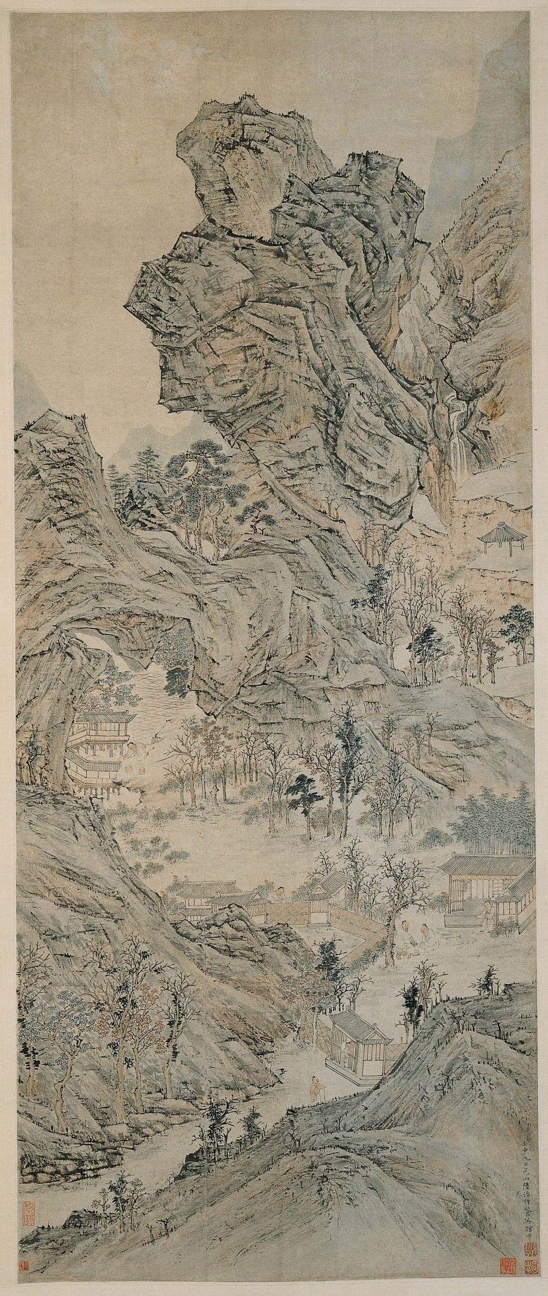
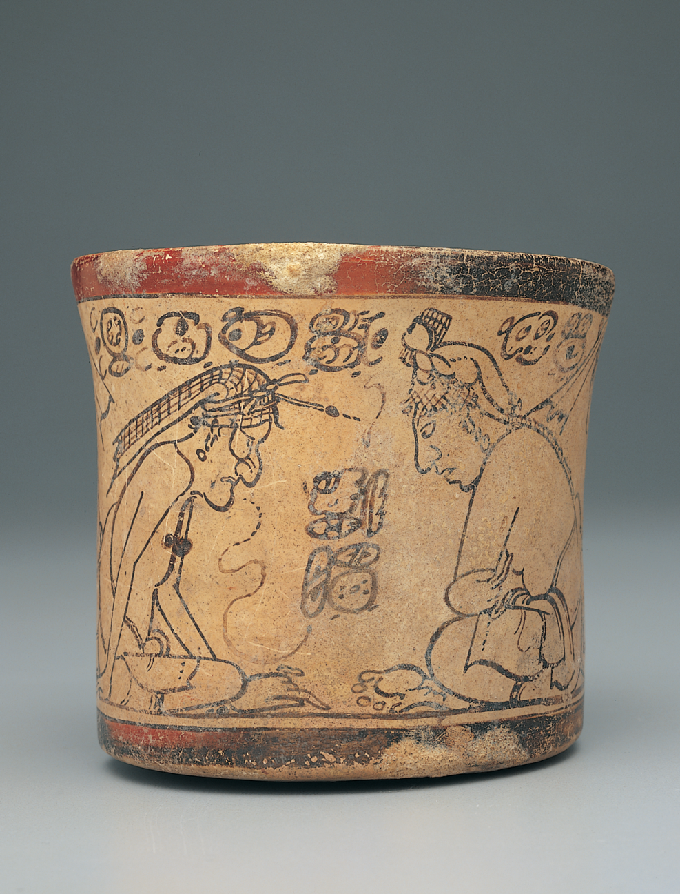
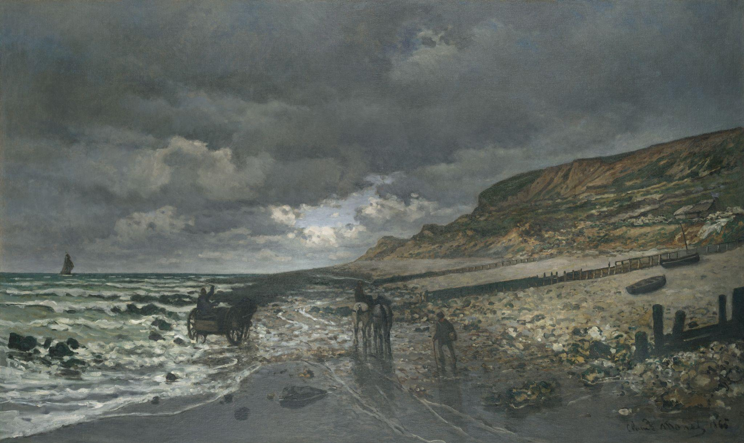
Emphasis
Lines can direct the viewer’s eye to an area of emphasis.
Far Left:
Lu Zhi, The Canying Hall, 1572, hanging scroll; ink and light colors on paper. Kimbell Art Museum
Left:
Maya, Codex-Style Vessel with Two Scenes of Itzam Instructing Young Pupils, c. 700–750, ceramic with monochrome decoration. Kimbell Art Museum
Above:
Claude Monet, La Pointe de la Hève at Low Tide, 1865, oil on canvas. Kimbell Art Museum
Notes:
https://kimbellart.org/collection/ap-198115
https://kimbellart.org/collection/ap-200404
https://kimbellart.org/collection/ap-196807

Slide 17
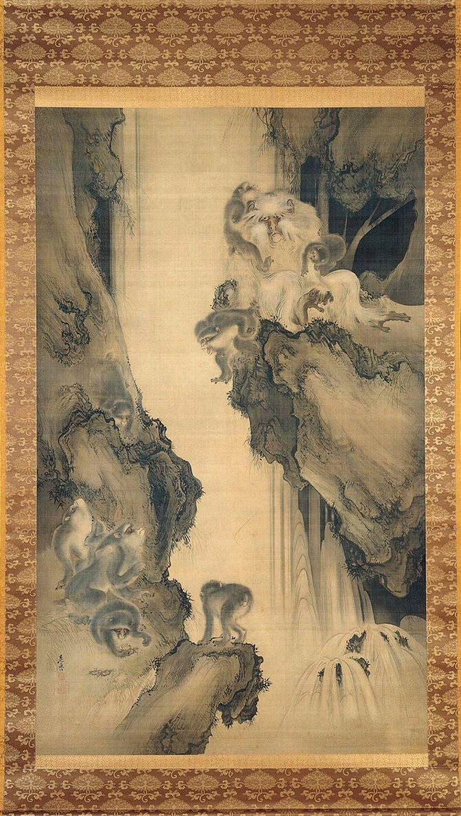
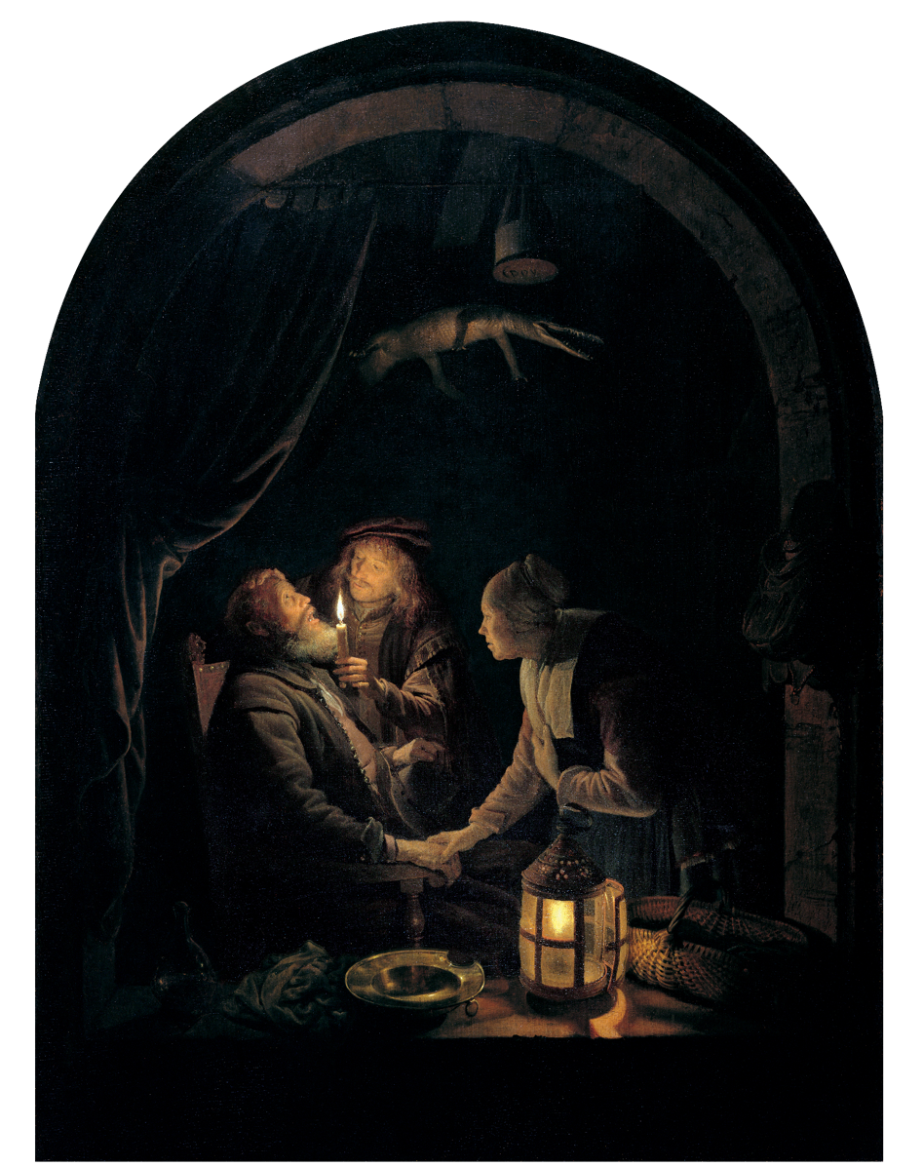
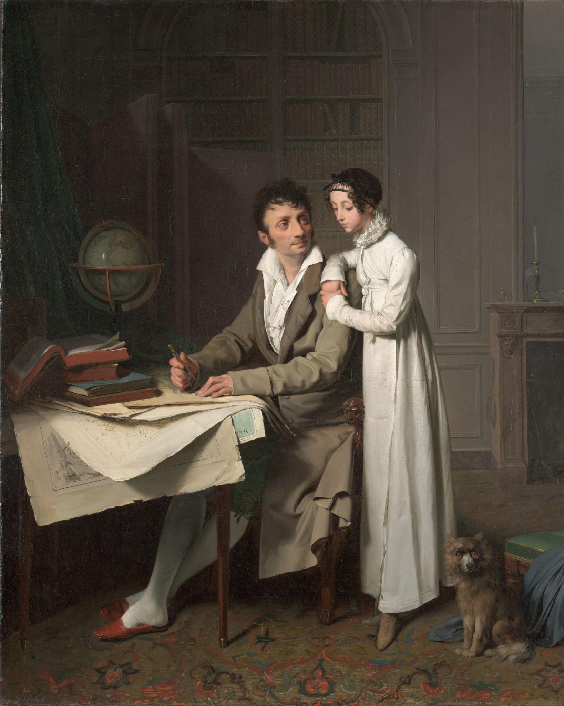
Emphasis
High contrasting value draws emphasis.
Shibata Zeshin, Waterfall and Monkeys, 1872, hanging scroll; ink and light colors on silk. Kimbell Art Museum
Gerrit Dou, Dentist by Candlelight, c. 1660–65, oil on oak panel. Kimbell Art Museum
Louis-Léopold Boilly, Portrait of Monsieur G. Giving His Daughter a Geography Lesson, 1812, oil on canvas. Kimbell Art Museum
Notes:
https://kimbellart.org/collection/ap-198412
https://kimbellart.org/collection/ap-200201
https://kimbellart.org/collection/ap-199001

Slide 18
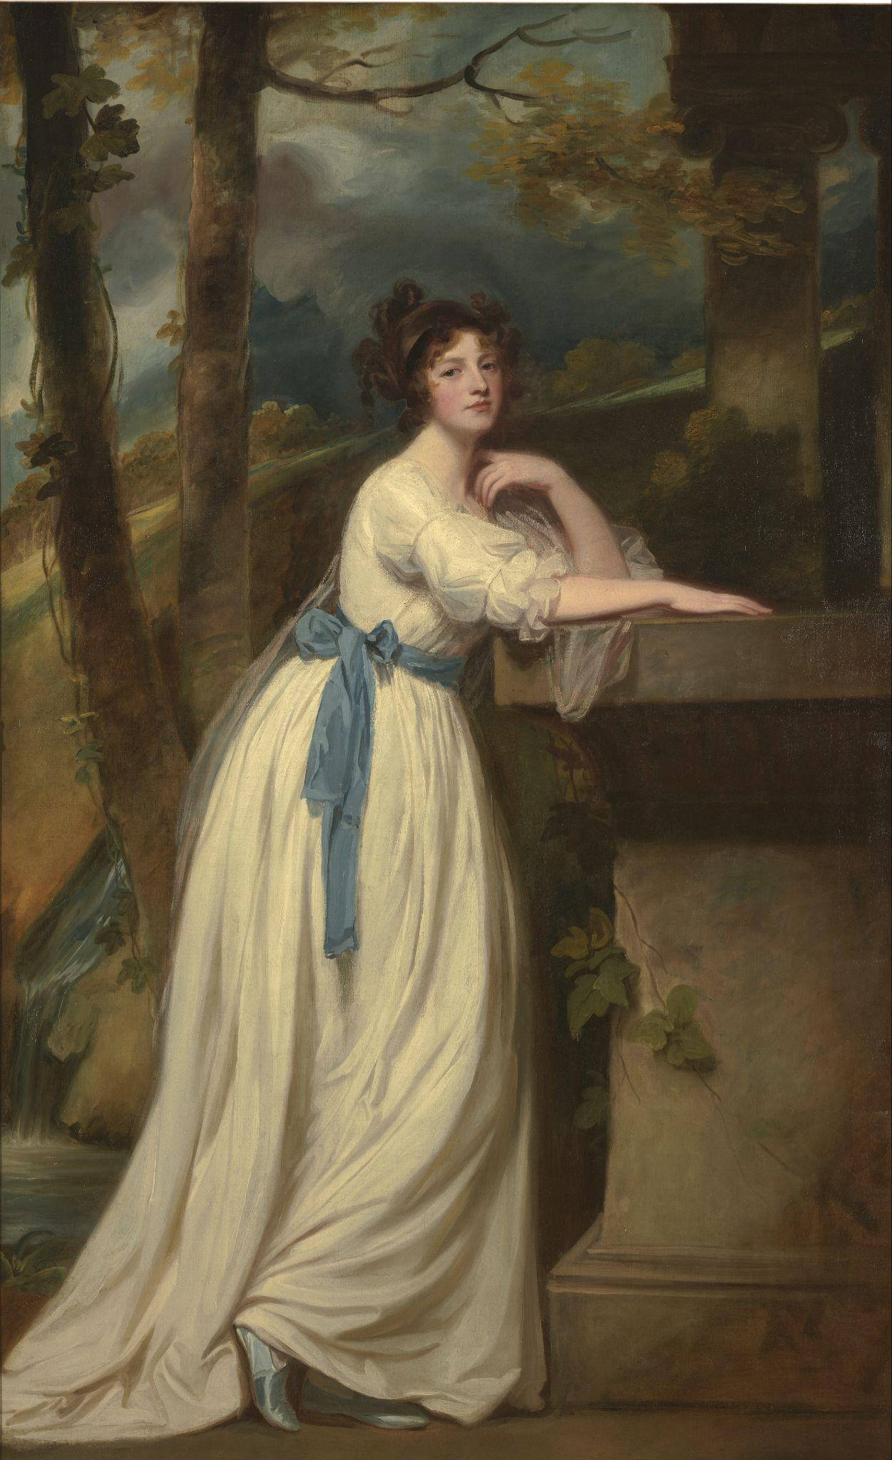
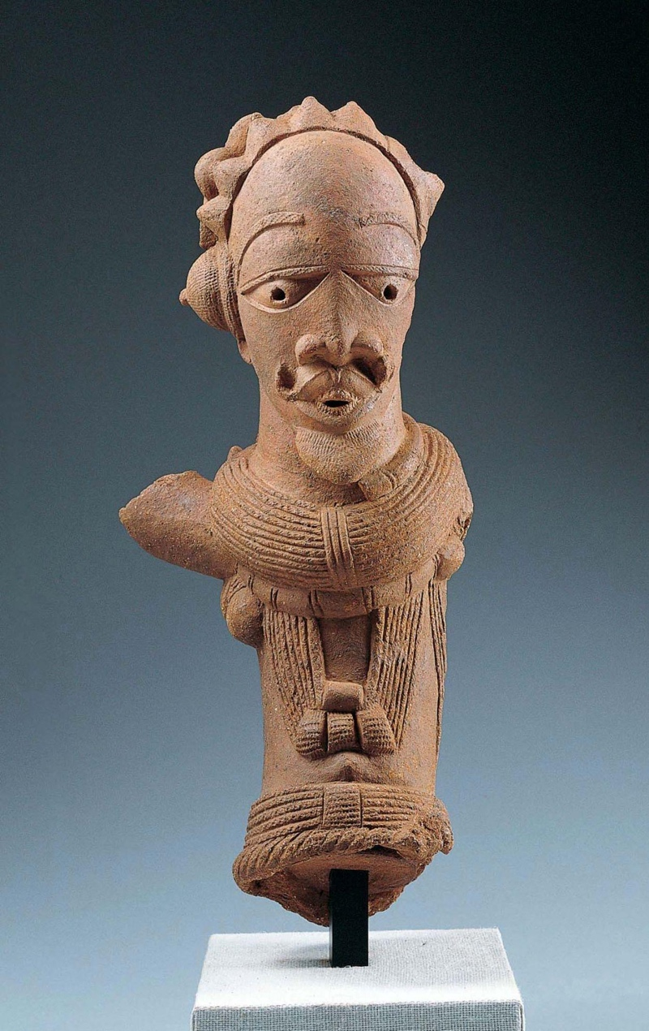
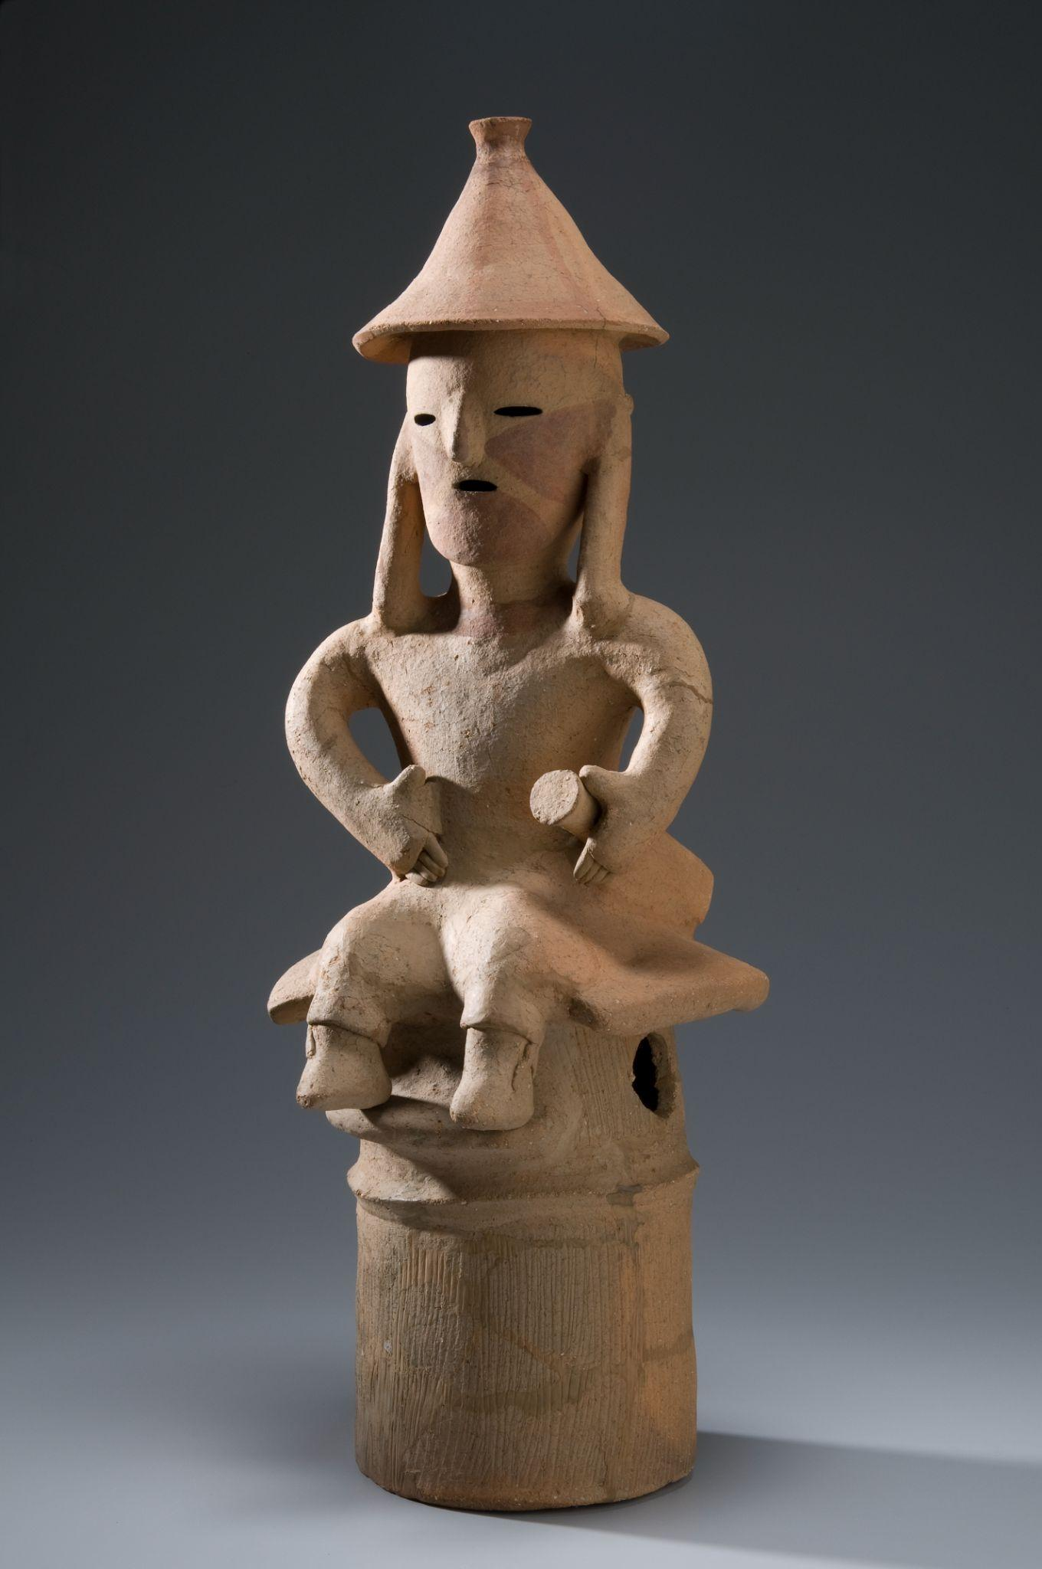
Emphasis
Proportion also creates emphasis. Larger shapes and forms catch the eye.
Left:
George Romney, Portrait
of Mrs. Andrew Reid​,
c. 1780–88, oil on canvas. Kimbell Art Museum
Middle:
Nok, Male Figure, c. 195 BC–AD 205, terracotta. Kimbell Art Museum
Right:
Japanese, Haniwa Seated Man, c. AD 500, low-fired clay with cinnabar pigment. Kimbell Art Museum
Notes:
https://kimbellart.org/collection/acf-195703
https://kimbellart.org/collection/ap-199603
https://kimbellart.org/collection/ap-197202

Slide 19
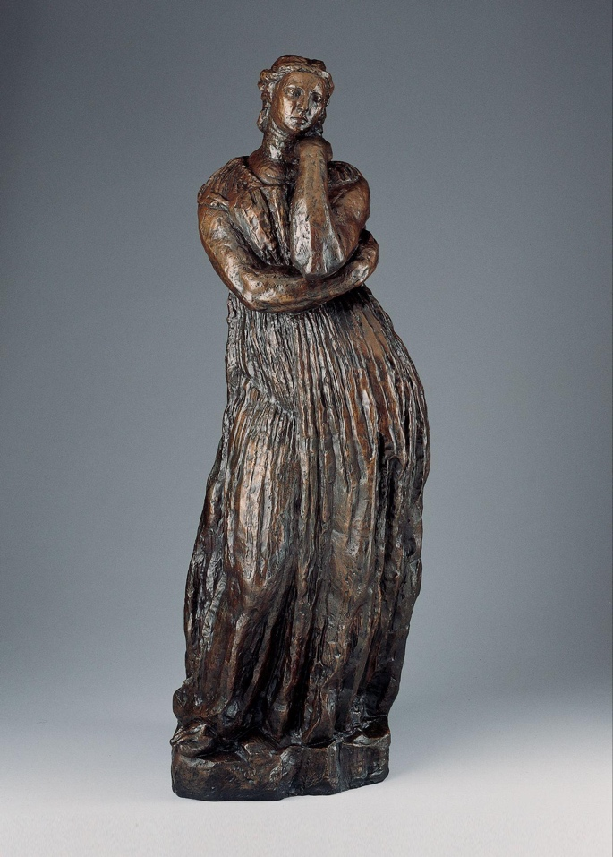
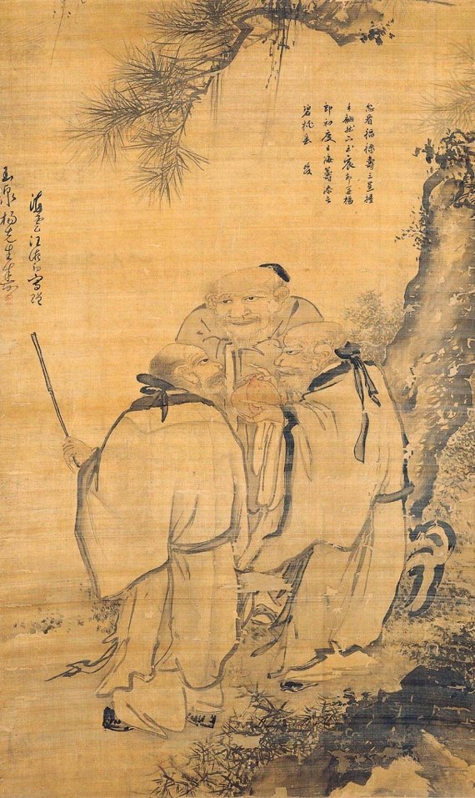
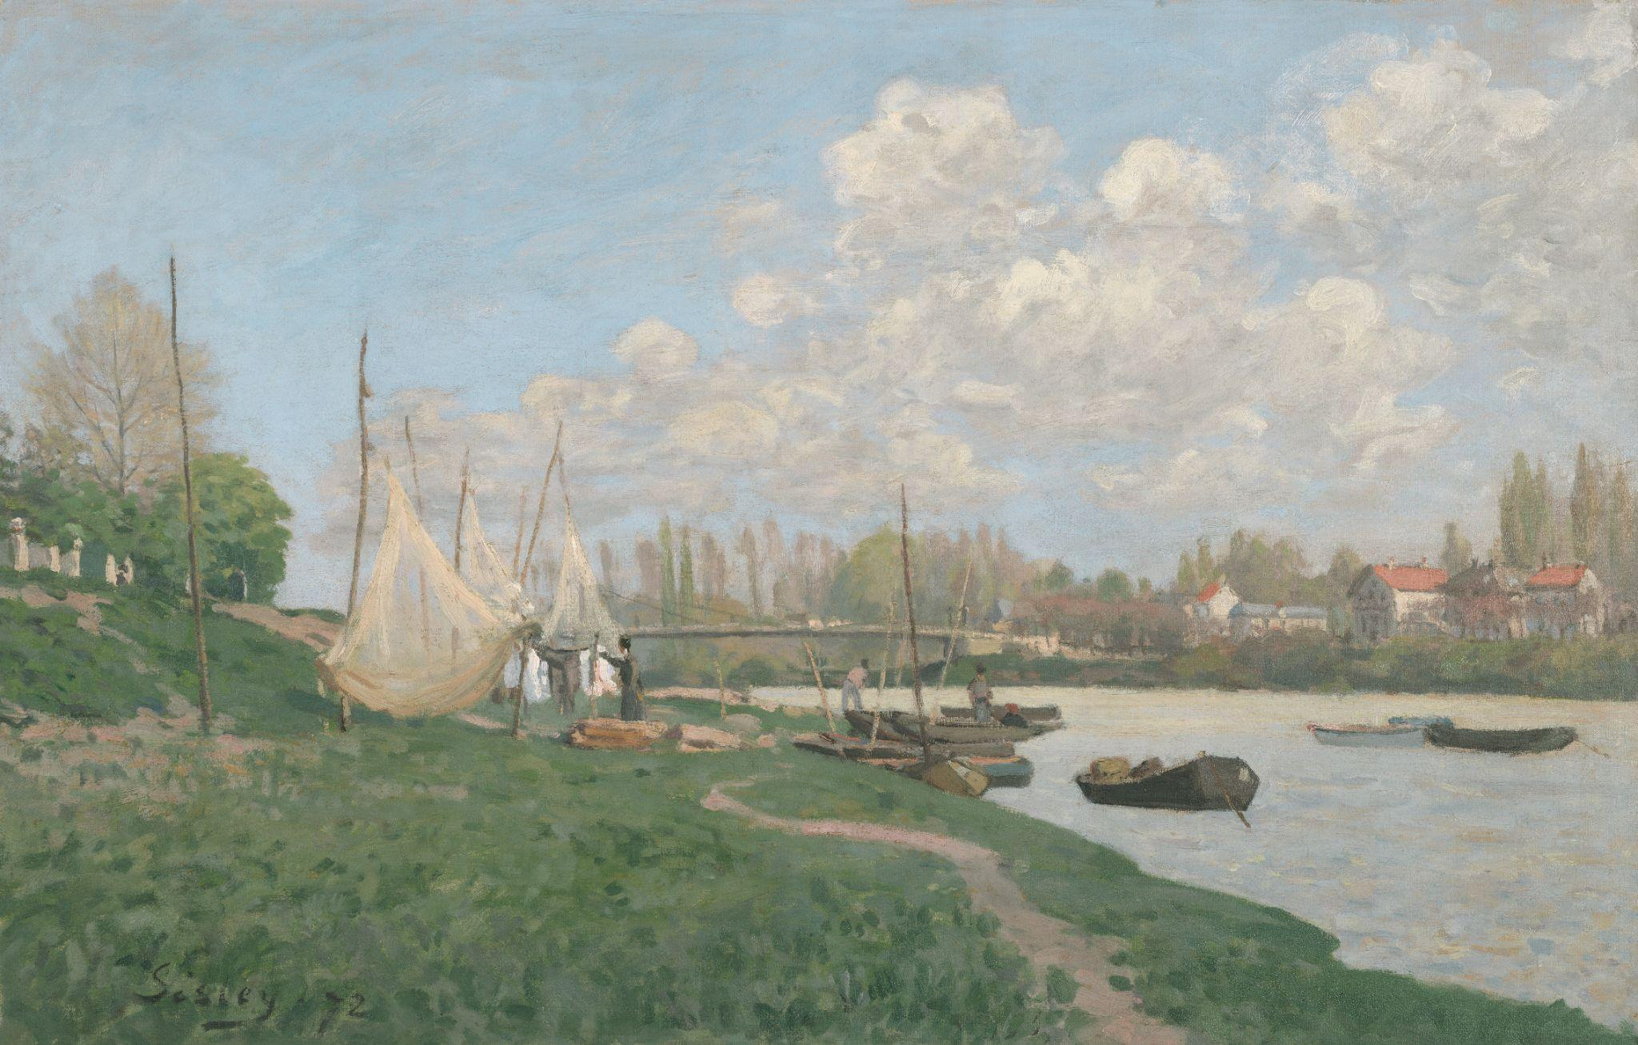
Unity
Movement/Rhythm
The path the viewer’s eye follows through an artwork.
Antoine Bourdelle, Penelope, 1909, cast bronze, dark green patina. Kimbell Art Museum
Wang Zhao, The Three Stars of Happiness, Wealth, and Longevity, c. 1500, hanging scroll; ink and light colors on silk. Kimbell Art Museum
Alfred Sisley, Drying Nets, 1872, oil on canvas. Kimbell Art Museum
Notes:
https://kimbellart.org/collection/ap-196903
https://kimbellart.org/collection/ap-198506
https://kimbellart.org/collection/apx-197701

Slide 20
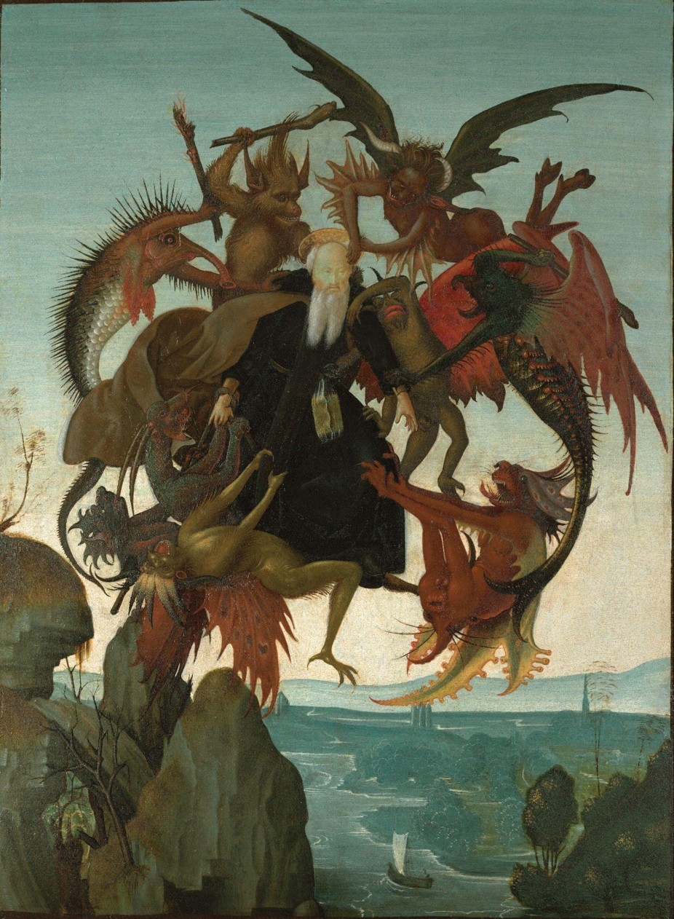
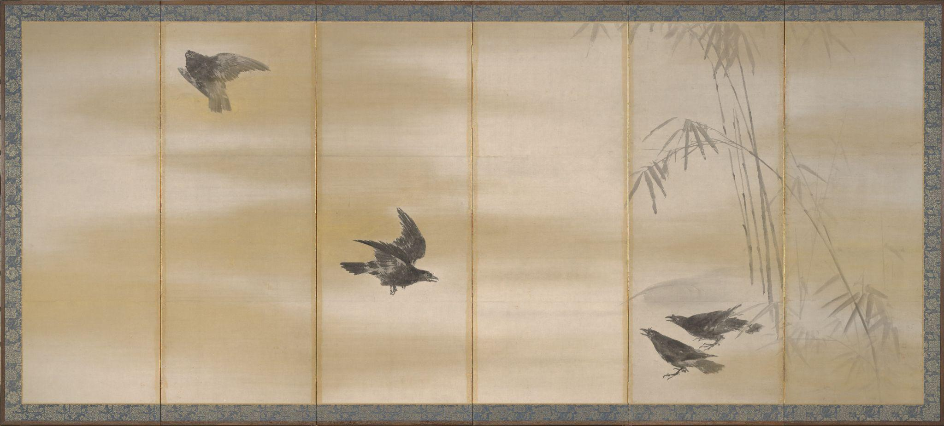
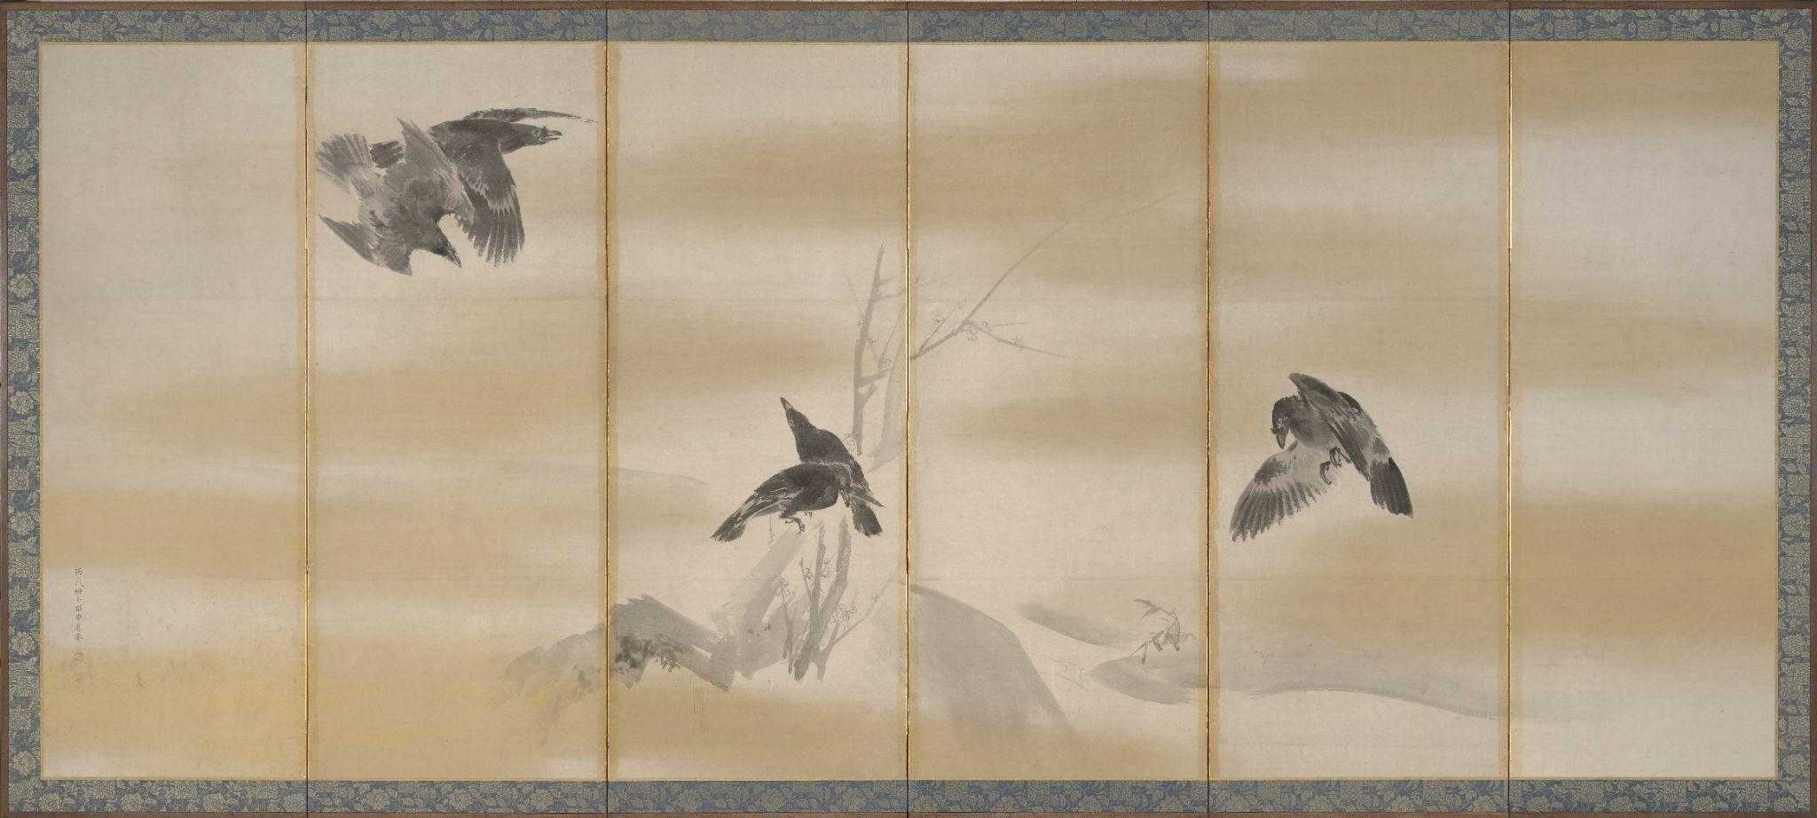
Movement/Rhythm
Movement can be created by showing a subject in motion.
Left:
Michelangelo Buonarroti, The Torment of Saint Anthony, 1487, tempera on panel. Kimbell Art Museum
Right:
Maruyama Okyo, Crows, 1766, pair of six-fold screens; ink and gold on paper. Kimbell Art Museum
Notes:
https://kimbellart.org/collection/ap-200901
https://kimbellart.org/collection/ap-196911-ab

Slide 21
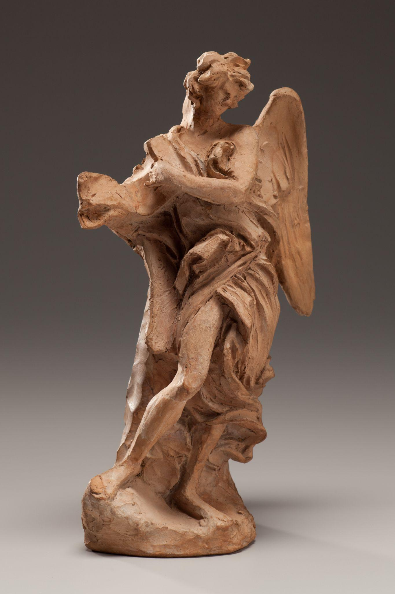
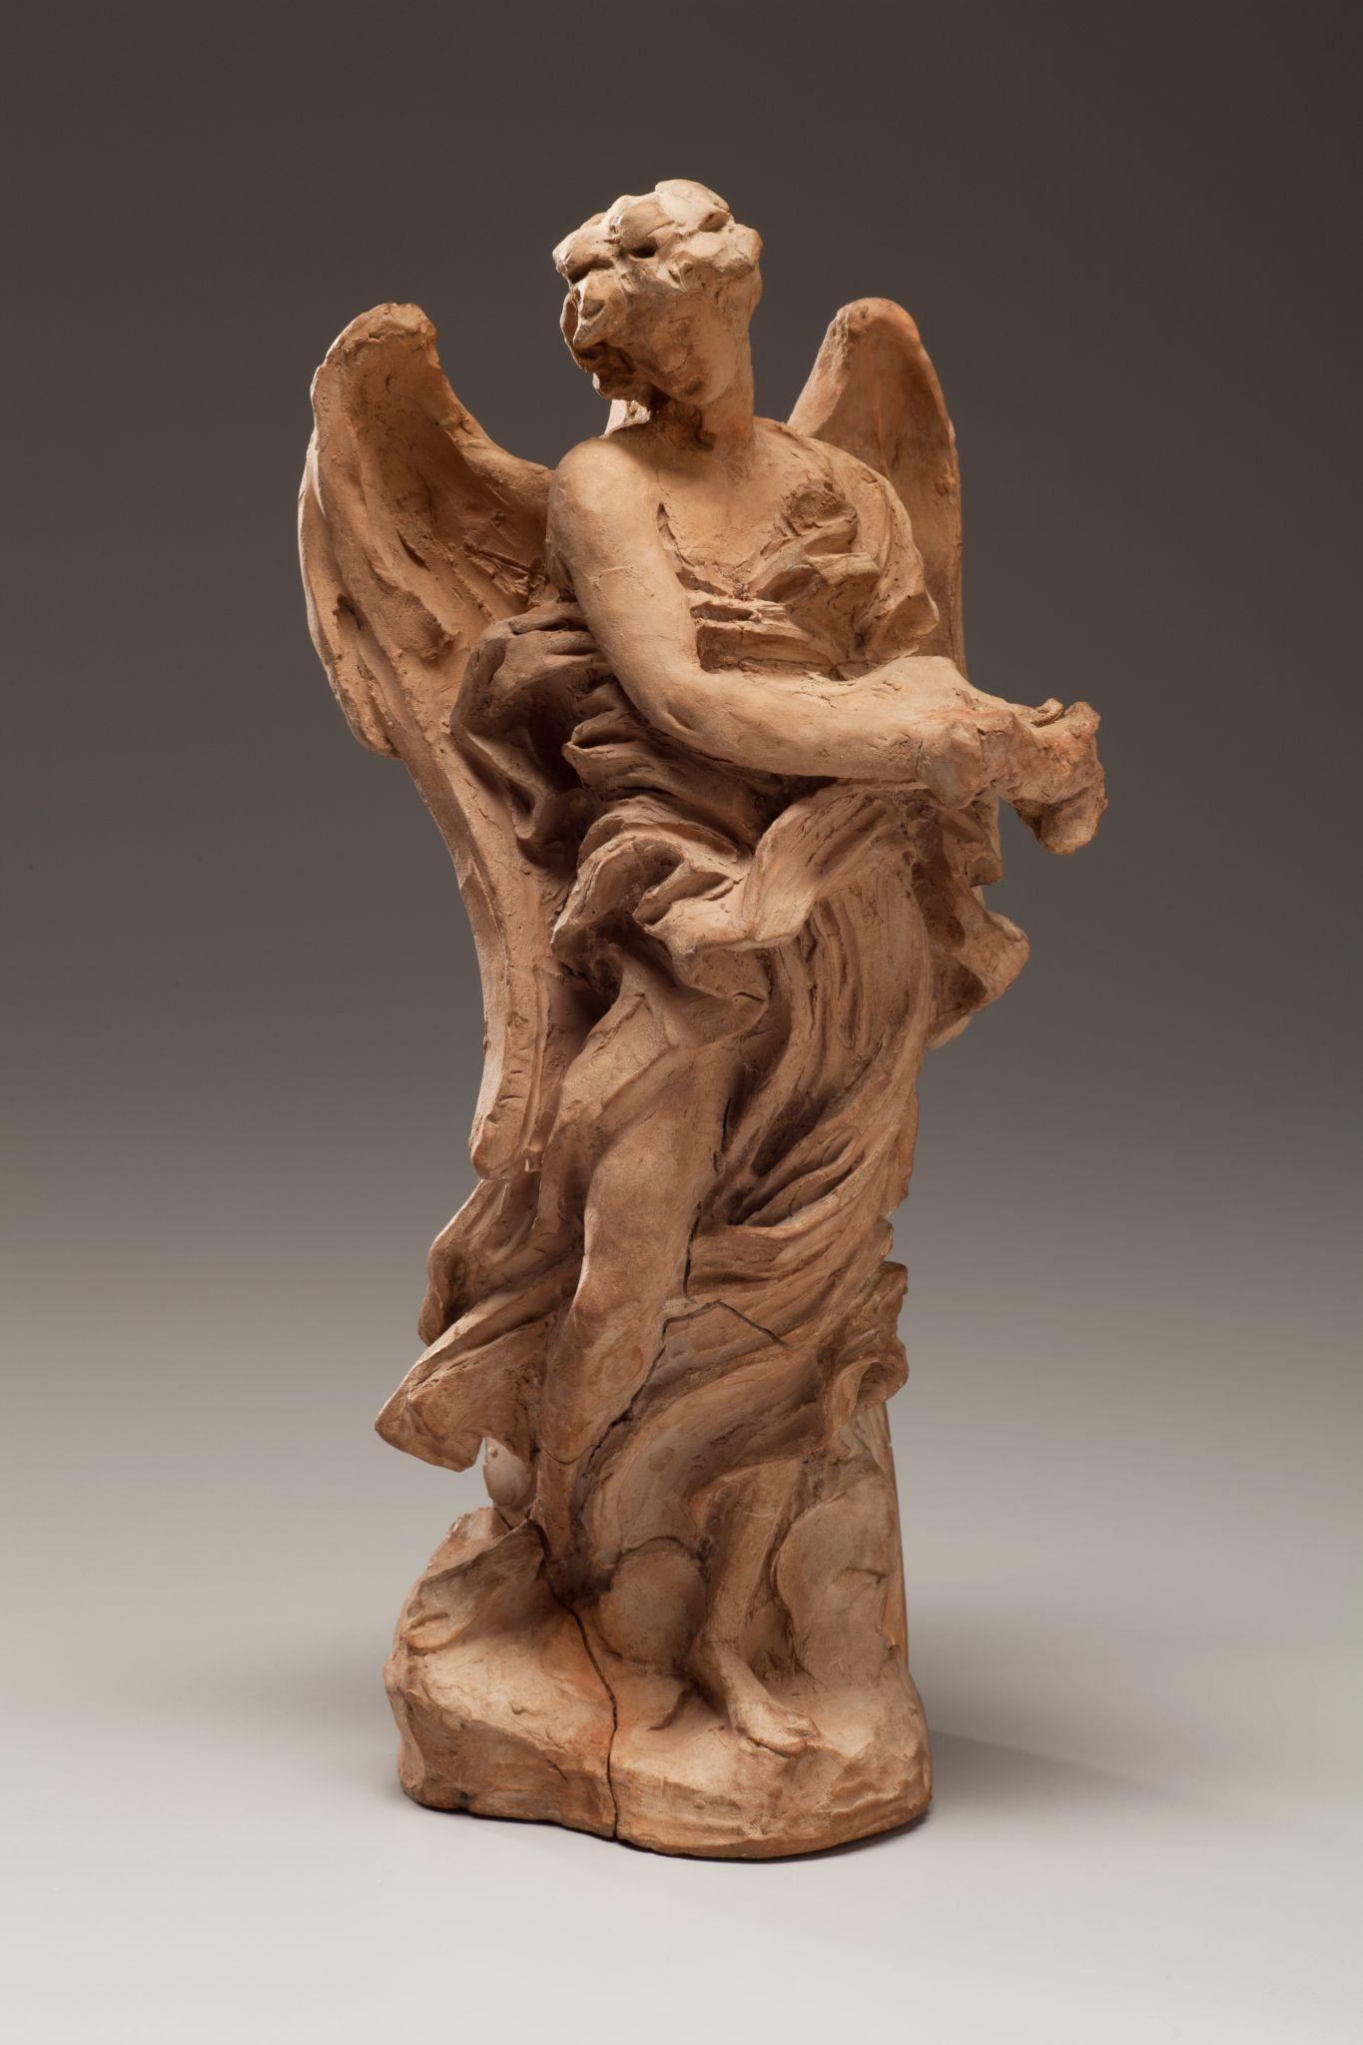
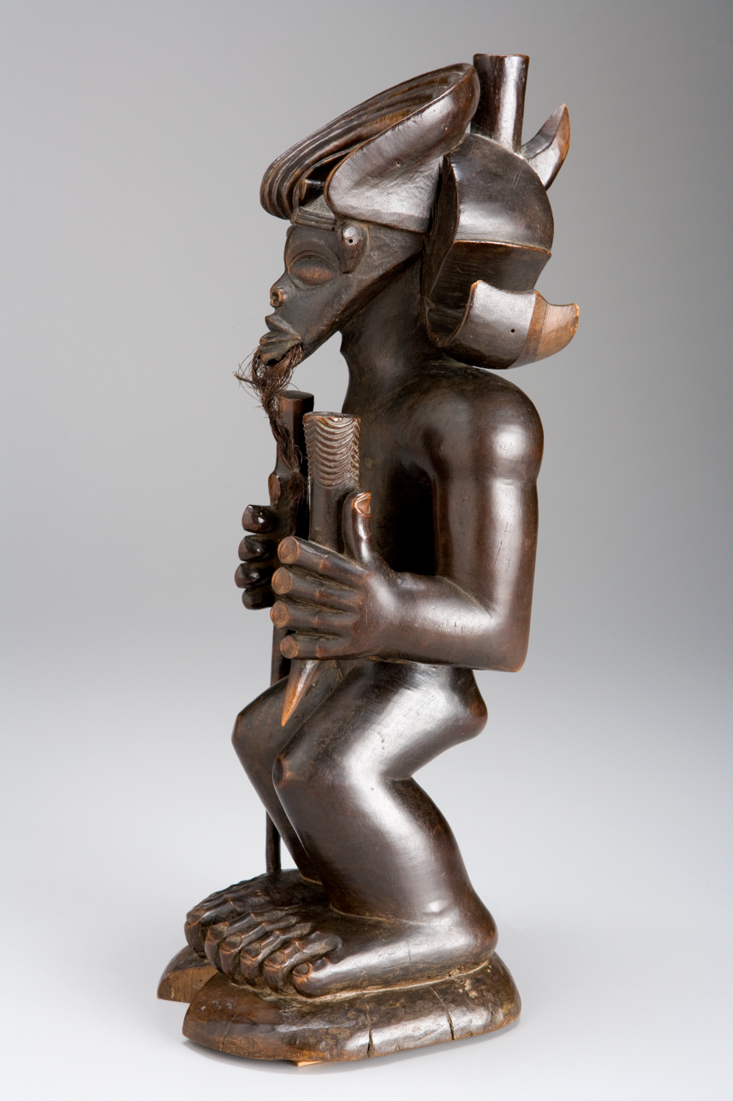
Movement/Rhythm
Movement can be implied through pose.
Left:
Gian Lorenzo Bernini, Angel with the Superscription and Angel with the Crown of Thorns, 1668, terracotta. Kimbell Art Museum
Right:
Chokwe​, Chibinda Ilunga​, mid-19th century, wood, hair, and hide​. Kimbell Art Museum
Notes:
https://kimbellart.org/collection/ap-198702-ab
https://kimbellart.org/collection/ap-197805

Slide 22


Movement/Rhythm
Lines can be used to move the eye around an artwork.
Paul Cézanne, Maison Maria with a View of Château Noir​, c. 1895, oil on canvas. Kimbell Art Museum
Fernand Léger, Composition, c. 1920, oil on canvas. Kimbell Art Museum
Notes:
https://kimbellart.org/collection/ap-198205
https://kimbellart.org/collection/ap-198511

Slide 23


Unity
Pattern/Repetition
Pattern is shown by repeating elements of art.
Left:
Egyptian, Kneeling Statue of Senenmut, Chief Steward of Queen Hatshepsut​​, c. 1473–1458 BC, gray green schist. Kimbell Art Museum
Right:
Isoda Koryusai, Courtesan Playing the Samisen​​, c. 1785, hanging scroll; ink and gold on silk. Kimbell Art Museum
Notes:
https://kimbellart.org/collection/ap-198502
https://kimbellart.org/collection/ap-198423

Slide 24


Pattern/Repetition
Patterns are often depicted by repeating lines.
Left:
Chinese, Dish with a Melon Design, early 15th century, blue-and-white ware, porcelain, cobalt oxide pigment. Kimbell Art Museum
Right:
Mixtec style, Rain God Vessel​, c. 1100–1400, polychromed ceramic. Kimbell Art Museum
Notes:
https://kimbellart.org/collection/ap-197003
https://kimbellart.org/collection/apx-197402

Slide 25


Pattern/Repetition
Patterns are often depicted by repeating lines.
Left:
Chinese, Standing Dog, c. 1st century AD, earthenware with lead-fluxed glaze. Kimbell Art Museum
Right:
Henri Matisse, L’Asie (Asia), 1946, oil on canvas. Kimbell Art Museum
Notes:
https://kimbellart.org/collection/ap-199501
https://kimbellart.org/collection/apg-199301

Slide 26


Pattern/Repetition
Patterns can also be formed from repeating shapes.
Left:
Jacques-Louis David, The Anger of Achilles​, 1819, oil on canvas. Kimbell Art Museum
Right:
Chinese, Jar in the Shape of a Stupa, late 6th or early 7th century AD, earthenware with traces of painted polychrome pigment. Kimbell Art Museum
Notes:
https://kimbellart.org/collection/ap-198007
https://kimbellart.org/collection/ap-199406-abc

Slide 27


Unity
Proportion
The relationship of one part to another within an artwork.
Indian, Four-Armed Ganesha, 5th–6th century AD, terracotta relief. Kimbell Art Museum
Ito Jakuchu, Two Gibbons Reaching for the Moon, c. 1770, hanging scroll; ink on paper. Kimbell Art Museum
Notes:
https://kimbellart.org/collection/ap-198111
https://kimbellart.org/collection/ap-200501

Slide 28


Proportion
One figure that is larger than the others will stand out.
In these examples, the largest figure signifies importance.
Left:
Egyptian, Group Statue of Ka-nefer and His Family​, c. 2450 BC, limestone with traces of original painted decoration. Kimbell Art Museum
Right:
Indian, Seated Buddha with Two Attendants, c. AD 131, red sandstone. Kimbell Art Museum
Notes:
https://kimbellart.org/collection/ap-200503
https://kimbellart.org/collection/ap-198606

Slide 29


Proportion
A body part on a figure that is large will draw the eye.
In Chinese culture, Fukurojin has a large forehead due to his superhuman intelligence and wisdom.
For the Maya peoples, large eyes indicates a supernatural being.
Left:
Ito Jakuchu, Fukurojin, the God of Longevity and Wisdom, c. 1790, hanging scroll; ink and light colors on paper. Kimbell Art Museum
Right:
Maya, Censer Stand with the Head of a Supernatural Being with a Kan Cross, c. AD 690–720, ceramic with traces of pigments. Kimbell Art Museum
Notes:
https://kimbellart.org/collection/apx-198602
https://kimbellart.org/collection/ap-201302

Slide 30




Proportion
A space that is large will emphasize its significance.
Yosa Buson, Landscape with a Solitary Traveler, c. 1780, hanging scroll; ink and light colors on silk. Kimbell Art Museum
Pieter Jansz. Saenredam, Interior of the Buurkerk, Utrecht, 1645. Oil on panel. Kimbell Art Museum
Notes:
https://kimbellart.org/collection/ap-198118
https://kimbellart.org/collection/ap-198609

Slide 31
Art in order of appearance:
Japanese, Seated Nyoirin Kannon, c. 1230–50, wood with traces of gilt and pigment. Kimbell Art Museum, Fort Worth, AP 1985.15
Maya, Standing Ruler, c. 600–800, ceramic with traces of paint. Kimbell Art Museum, Fort Worth, AP 1984.03
Henry Raeburn, The Allen Brothers (Portrait of James and John Lee Allen), early 1790s, oil on canvas. Kimbell Art Museum, Fort Worth, AP 2002.05
Hemba, Warrior Ancestor Figure, 19th century, wood. Kimbell Art Museum, Fort Worth, AP 1979.03
Conte Style, Pendant: Twin Warriors​​, c. 700–1200, gold. Kimbell Art Museum, Fort Worth, AP 1979.23
Assyrian, Pair of Winged Deities, c. 874–860 BC, gypsum. Kimbell Art Museum, Fort Worth, AP 1981.04 a,b.
​Thomas Gainsborough, Portrait of a Woman, Possibly of the Lloyd Family, c. 1750​, oil on canvas. Kimbell Art Museum, Fort Worth, ACF 1946.04
Maya, Presentation of Captives to a Maya Ruler​, c. AD 785, limestone with traces of paint. Kimbell Art Museum, Fort Worth, AP 1971.07
George Stubbs, Mares and Foals Belonging to the 2nd Viscount Bolingbroke​, c. 1761–62, oil on canvas. Kimbell Art Museum, Fort Worth, AP 2024.01
Zapotec culture, Urn in the Form of Cociyo, ​God of Lightning and Rain​, c. AD 400–500, ceramic. Kimbell Art Museum, Fort Worth, AP 1985.09
Maori, Standing Ancestor Figure​, c. 1800–1840, wood. Kimbell Art Museum, Fort Worth, AP 1984.04
Roman, Parrot​, c. AD 400​, mosaic. Kimbell Art Museum, Fort Worth, AP 1972.21
​​
© 2025 Kimbell Art Museum

Slide 32
Art in order of appearance:
Korean, Arhat and Deer​, late 17th century, hanging scroll. Kimbell Art Museum, Fort Worth, AP 1995.06
Japanese, Temples in Eastern Kyoto, c. 1600​, six-fold screen; mineral pigments on gold. Kimbell Art Museum, Fort Worth, AP 1986.10
Anne Vallayer-Coster, Still Life with Mackerel, 1787​, oil on canvas. Kimbell Art Museum, Fort Worth, APg 2019.01
Thomas Gainsborough, Going to Market, Early Morning, c. 1773​, oil on canvas. Kimbell Art Museum, Fort Worth, AP 2023.01
Duccio di Buoninsegna, The Raising of Lazarus, 1310–11, tempera and gold on panel. Kimbell Art Museum, Fort Worth, APx 1975.01
Wen Jia, Landscape in the Style of Dong Yuan, 1577, hanging scroll; ink and light colors on paper. Kimbell Art Museum, Fort Worth, AP 1980.01
Nicolas Poussin, The Sacrament of Ordination (Christ Presenting the Keys to Saint Peter)​, c. 1636–40​, oil on canvas. Kimbell Art Museum, Fort Worth, AP 2011.01
Jacques de Gheyn II, Vase of Flowers with a Curtain​, c. 1615​, oil on canvas. Kimbell Art Museum, Fort Worth, AP 2008.01
Georges de La Tour, The Cheat with the Ace of Clubs​, c. 1630–34​, oil on canvas. Kimbell Art Museum, Fort Worth, AP 1981.06​
Elisabeth Louise Vigée Le Brun, Self-Portrait, c. 1781, oil on canvas. Kimbell Art Museum, Fort Worth, ACK 1949.02
Titian, The Madonna and Child with a Female Saint and the Infant Saint John the Baptist, 1530s, oil on panel. Kimbell Art Museum, Fort Worth, AP 1986.07
Maya, Tripod Vessel with Lid, c. AD 400–500, ceramic with stucco and polychrome pigments. Kimbell Art Museum, Fort Worth, AP 1997.01
​​
© 2025 Kimbell Art Museum

Slide 33
Art in order of appearance:
Frederic Leighton, Portrait of May Sartoris, c. 1860, oil on canvas. Kimbell Art Museum, Fort Worth, ACF 1964.03
Rekisentei Eiri, Beauty in a White Kimono, c. 1800, hanging scroll; ink and mineral pigments on paper. Kimbell Art Museum, Fort Worth, AP 1981.10
Lu Zhi, The Canying Hall, 1572, hanging scroll; ink and light colors on paper. Kimbell Art Museum, Fort Worth, AP 1981.15
Maya, Codex-Style Vessel with Two Scenes of Itzam Instructing Young Pupils, c. AD 700–750, ceramic with monochrome decoration. Kimbell Art Museum, Fort Worth, AP 2004.04
Claude Monet, La Pointe de la Hève at Low Tide, 1865, oil on canvas. Kimbell Art Museum, Fort Worth, AP 1986.07
Shibata Zeshin, Waterfall and Monkeys, 1872, hanging scroll; ink and light colors on silk. Kimbell Art Museum, Fort Worth, AP 1984.12
Gerrit Dou, Dentist by Candlelight, c. 1660–65, oil on oak panel. Kimbell Art Museum, Fort Worth, AP 2002.01
Louis-Léopold Boilly, Portrait of Monsieur G. Giving His Daughter a Geography Lesson, 1812, oil on canvas. Kimbell Art Museum, Fort Worth, AP 1990.01
George Romney, Portrait of Mrs. Andrew Reid​, c. 1780–88, oil on canvas. Kimbell Art Museum, Fort Worth, ACF 1957.03
Nok, Male Figure, c. 195 BC–AD 205, terracotta. Kimbell Art Museum, Fort Worth, AP 1996.03
Japanese, Haniwa Seated Man, c. AD 500, low-fired clay with cinnabar pigment. Kimbell Art Museum, Fort Worth, AP 1972.02​
Antoine Bourdelle, Penelope, 1909, cast bronze, dark green patina. Kimbell Art Museum, Fort Worth, AP 1969.03
​​
© 2025 Kimbell Art Museum

Slide 34
Art in order of appearance:
Wang Zhao, The Three Stars of Happiness, Wealth, and Longevity, c. 1500, hanging scroll; ink and light colors on silk. Kimbell Art Museum, Fort Worth, AP 1985.06
Alfred Sisley, Drying Nets, 1872, oil on canvas. Kimbell Art Museum, Fort Worth, APx 1977.01
Michelangelo Buonarroti, The Torment of Saint Anthony, 1487, tempera on panel. Kimbell Art Museum, Fort Worth, AP 2009.01
Maruyama Okyo, Crows, 1766, pair of six-fold screens; ink and gold on paper. Kimbell Art Museum, Fort Worth, AP 1969.11 a,b
Gian Lorenzo Bernini, Angel with the Superscription and Angel with the Crown of Thorns, 1668, terracotta. Kimbell Art Museum, Fort Worth, AP 1987.02 a,b
Chokwe​, Chibinda Ilunga​, mid-19th century, wood, hair, and hide​. Kimbell Art Museum, Fort Worth, AP 1978.05
Paul Cézanne, Maison Maria with a View of Château Noir​, c. 1895, oil on canvas. Kimbell Art Museum, Fort Worth, AP 1982.05
Fernand Léger, Composition, c. 1920, oil on canvas. Kimbell Art Museum, Fort Worth, AP 1985.11
Egyptian, Kneeling Statue of Senenmut, Chief Steward of Queen Hatshepsut​​, c. 1473–1458 BC, gray green schist. Kimbell Art Museum, Fort Worth, AP 1985.02
Isoda Koryusai, Courtesan Playing the Samisen​​, c. 1785, hanging scroll; ink and gold on silk. Kimbell Art Museum, Fort Worth, AP 1984.23
Chinese, Dish with a Melon Design, early 15th century, blue-and-white ware, porcelain, cobalt oxide pigment. Kimbell Art Museum, Fort Worth, AP 1970.03
Mixtec style, Rain God Vessel​, c. 1100–1400, polychromed ceramic. Kimbell Art Museum, Fort Worth, APx 1974.02
​​
© 2025 Kimbell Art Museum

Slide 35
Art in order of appearance:
Chinese, Standing Dog, c. 1st century AD, earthenware with lead-fluxed glaze. Kimbell Art Museum, Fort Worth, AP 1995.01​
Henri Matisse, L’Asie (Asia), 1946, oil on canvas. Kimbell Art Museum, Fort Worth, APg 1993.01​
Jacques-Louis David, The Anger of Achilles​, 1819, oil on canvas. Kimbell Art Museum, Fort Worth, AP 1980.07
Chinese, Jar in the Shape of a Stupa, late 6th or early 7th century AD, earthenware with traces of painted polychrome pigment. Kimbell Art Museum, Fort Worth, AP 1994.06 a,b,c
Indian, Four-Armed Ganesha, 5th–6th century AD, terracotta relief. Kimbell Art Museum, Fort Worth, AP 1981.11
Ito Jakuchu, Two Gibbons Reaching for the Moon, c. 1770, hanging scroll; ink on paper. Kimbell Art Museum, Fort Worth, AP 2005.01
Egyptian, Group Statue of Ka-nefer and His Family​, c. 2450 BC, ​limestone with traces of original painted decoration. Kimbell Art Museum, Fort Worth, AP 2005.03
Indian, Seated Buddha with Two Attendants, c. AD 131, red sandstone. Kimbell Art Museum, Fort Worth, AP 1986.06
Ito Jakuchu, Fukurojin, the God of Longevity and Wisdom, c. 1790, hanging scroll; ink and light colors on paper. Kimbell Art Museum, Fort Worth, APx 1986.02​
Maya, Censer Stand with the Head of a Supernatural Being with a Kan Cross, c. AD 690–720, ceramic with traces of pigments. Kimbell Art Museum, Fort Worth, AP 2013.02
Yosa Buson, Landscape with a Solitary Traveler, c. 1780, hanging scroll; ink and light colors on silk. Kimbell Art Museum, Fort Worth, AP 1981.18
Pieter Jansz. Saenredam, Interior of the Buurkerk, Utrecht, 1645, oil on panel. Kimbell Art Museum, Fort Worth, AP 1986.09
​​
© 2025 Kimbell Art Museum

