Slide 1
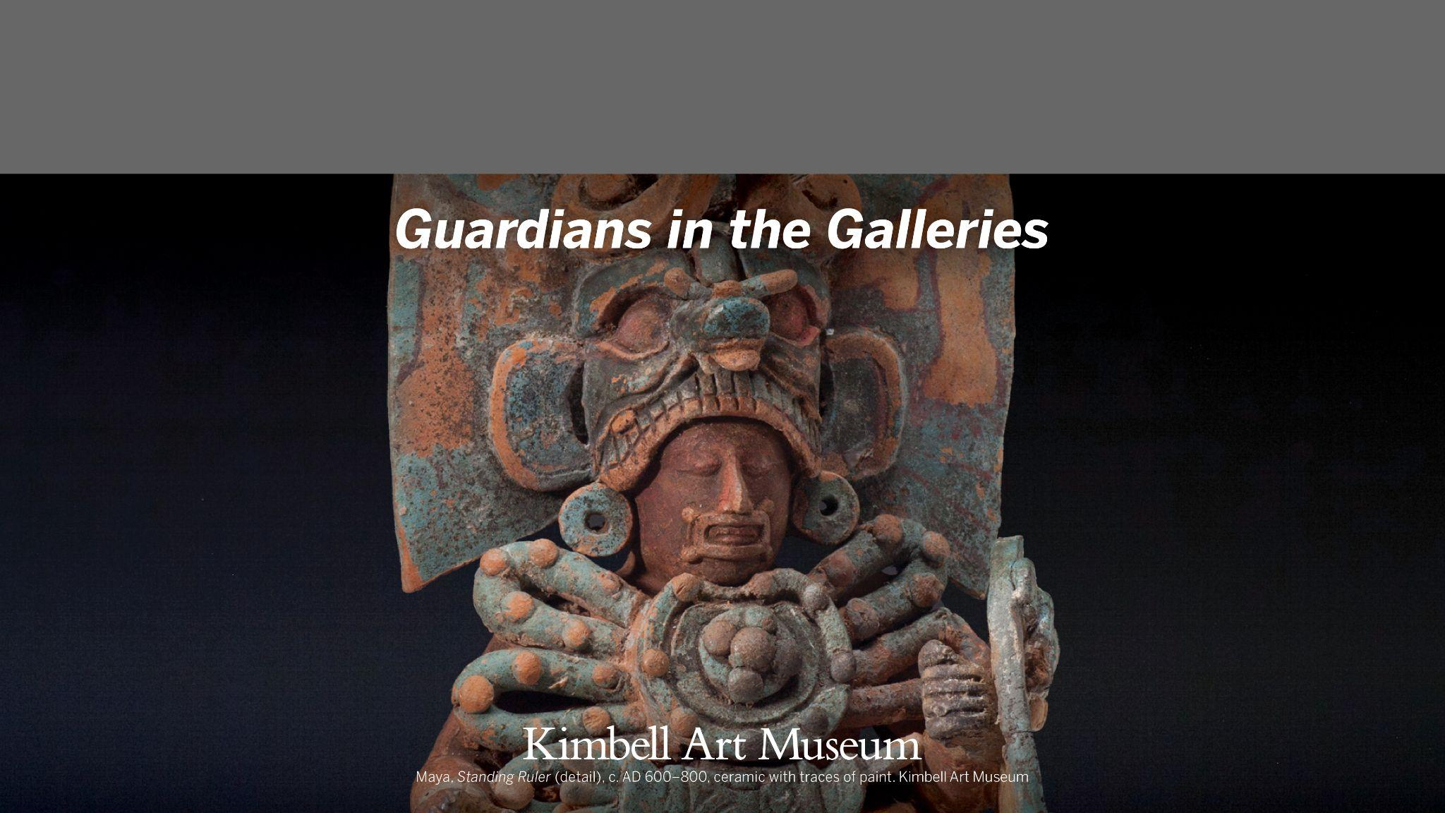
Kimbell Educator Packet

Slide 2
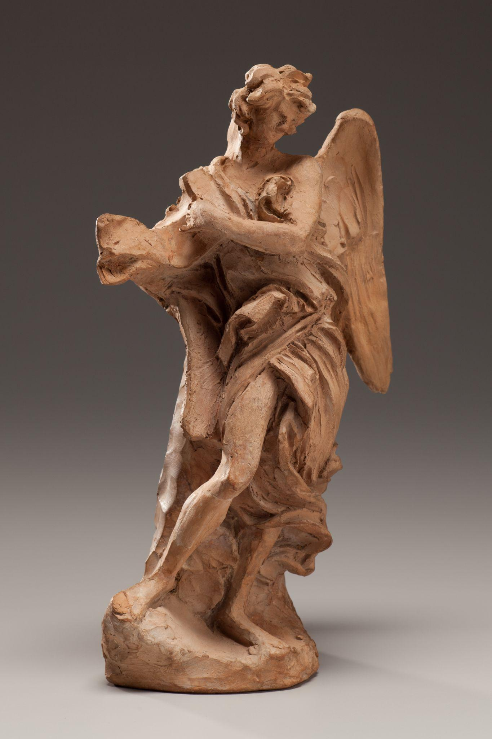
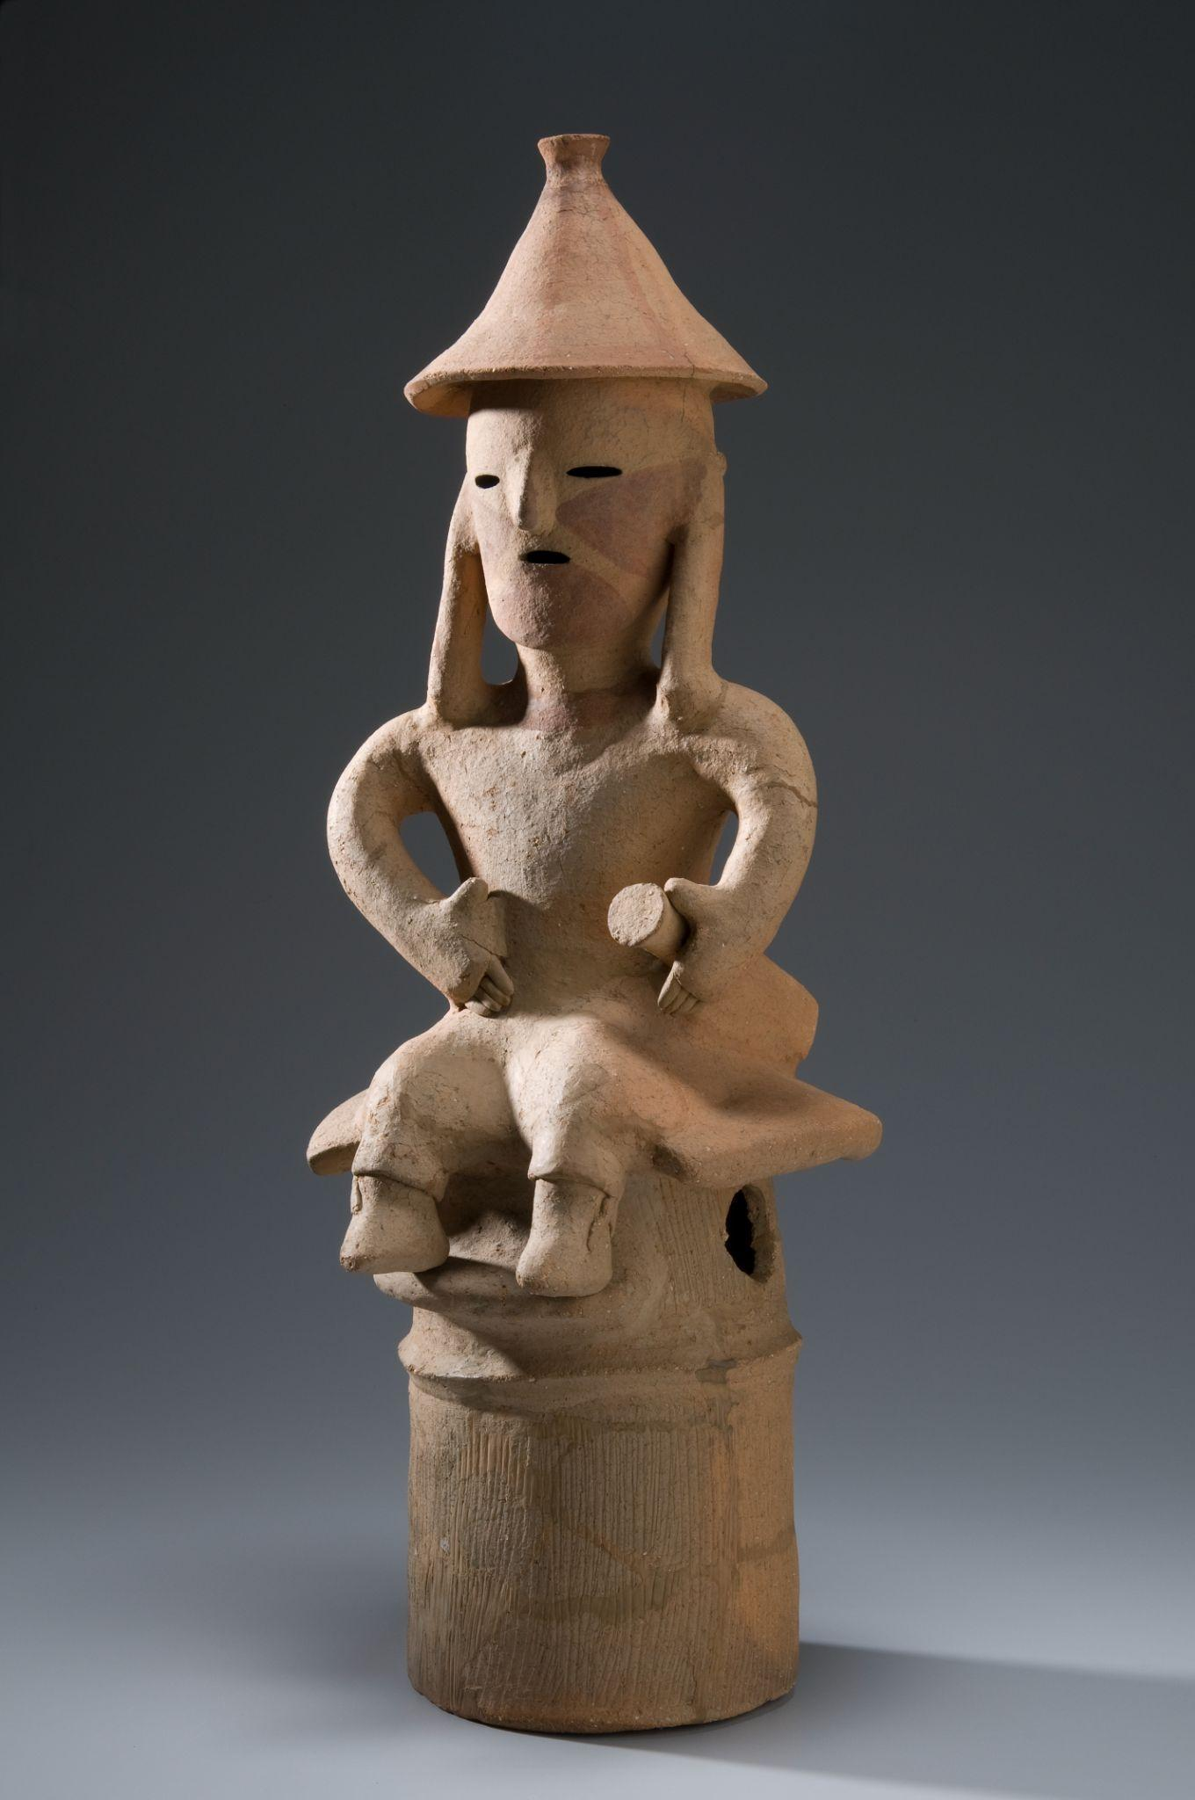
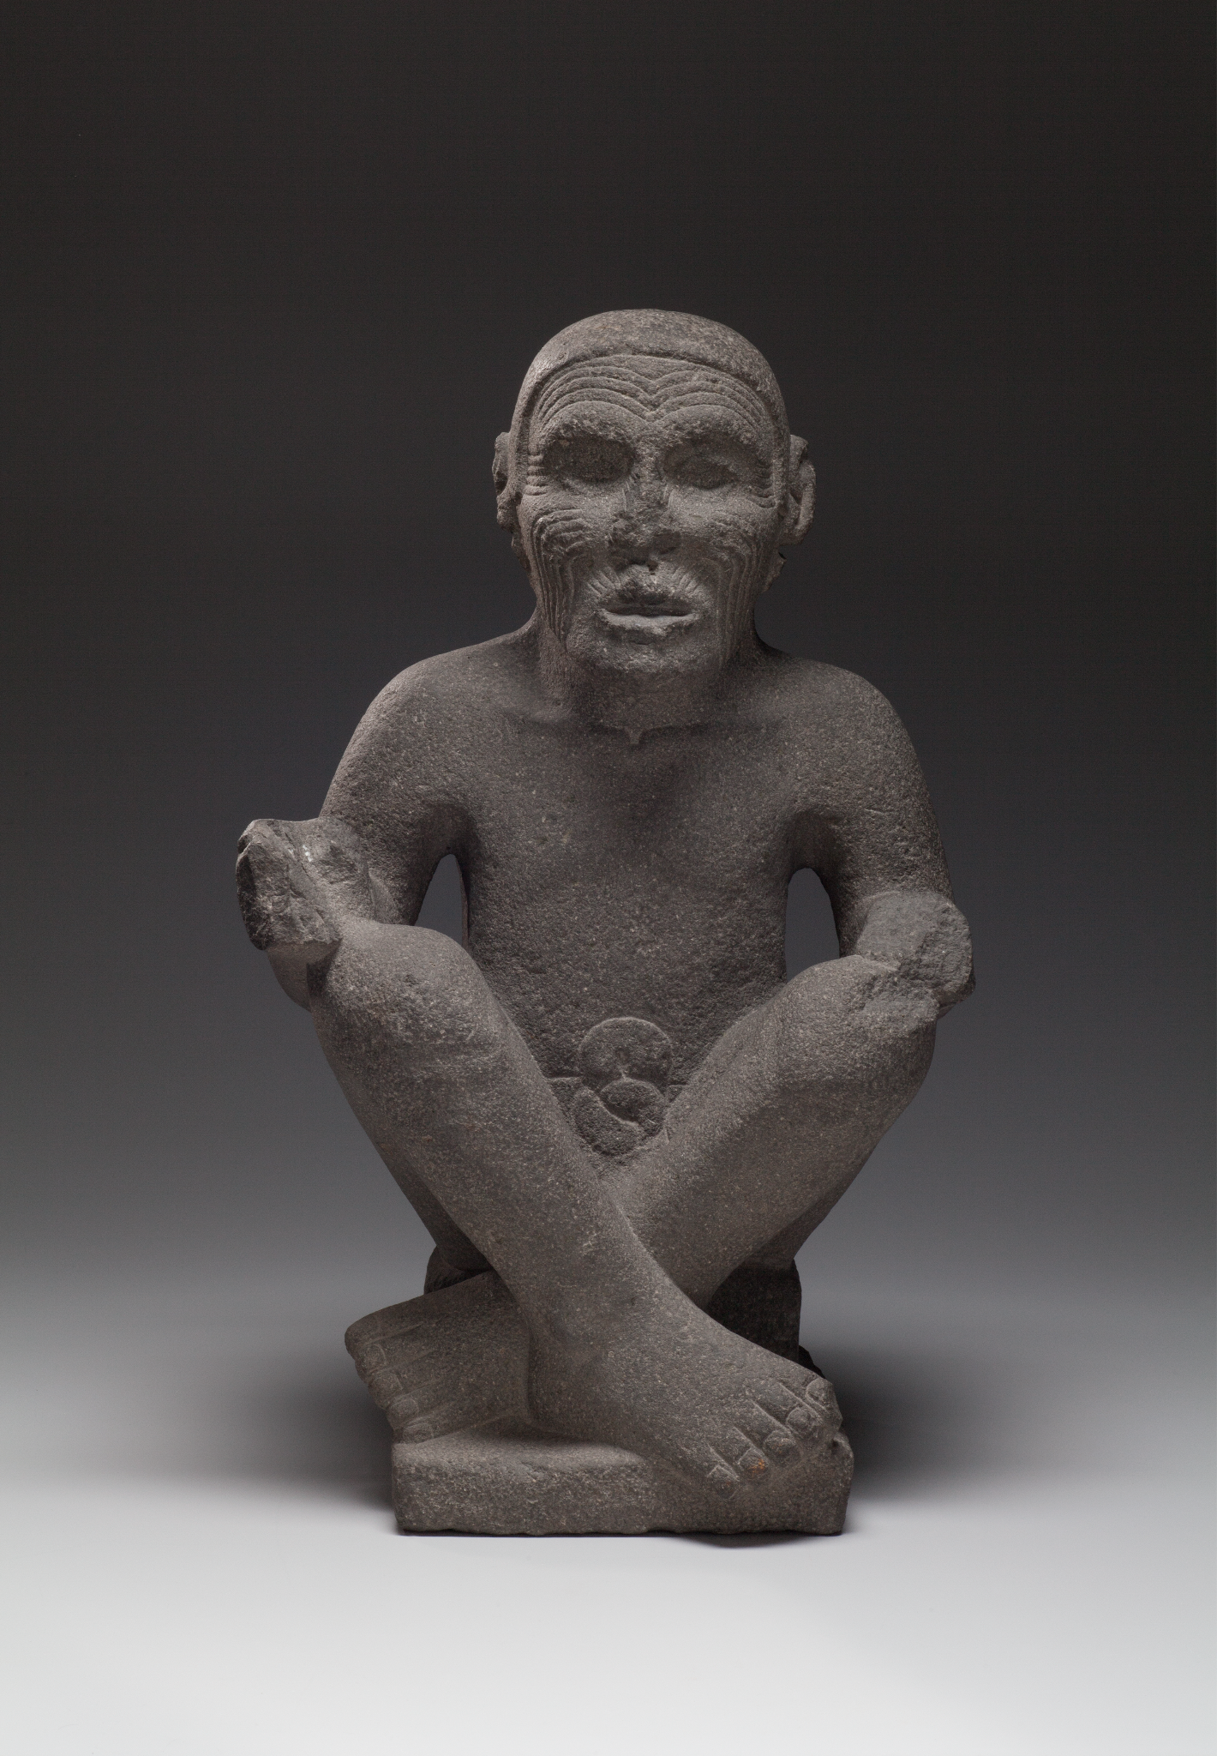
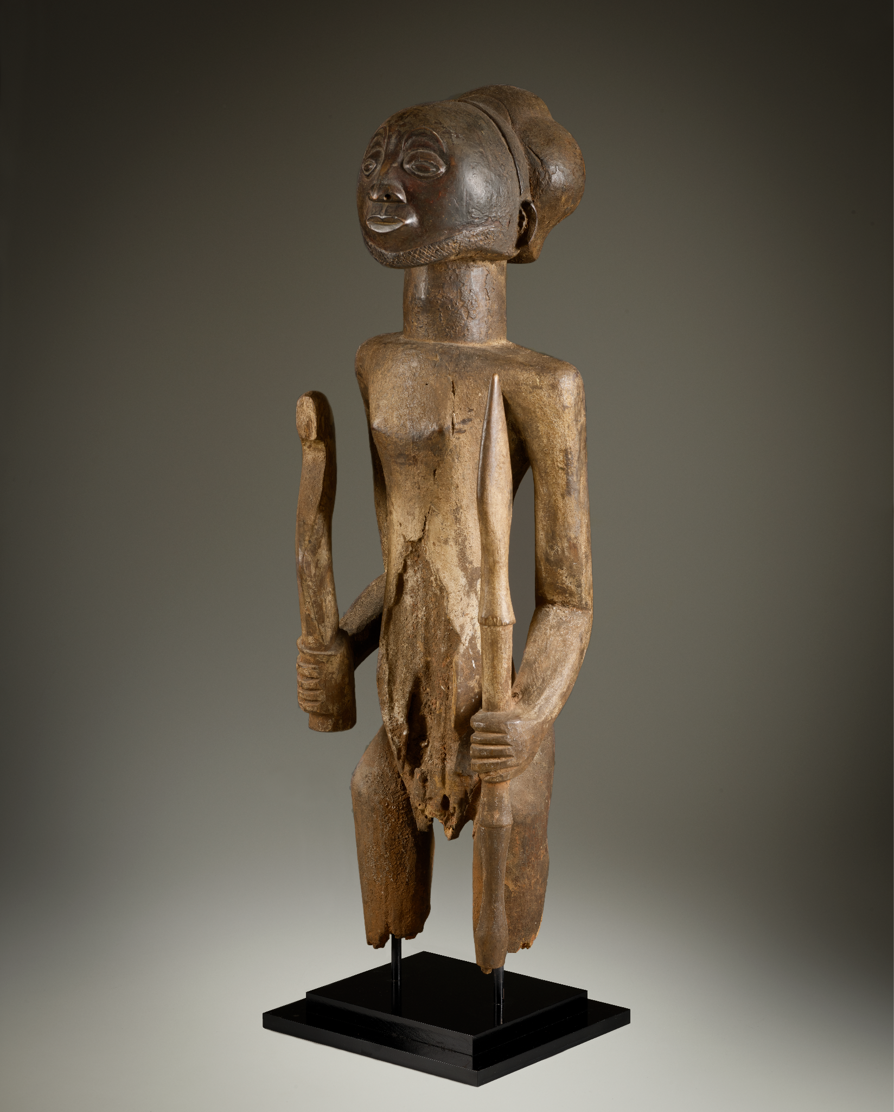
Guardians in
the Galleries
Guardian figures have been created by artists across cultures and throughout history.
Explore artworks that function as:
Afterlife Guardians
Ancestor Guardians
Gods, Guardians, and Guides
Gian Lorenzo Bernini, Angel with the Superscription and Angel with the Crown of Thorns, 1668, terracotta. Kimbell Art Museum; Japanese, Haniwa Seated Man, c. AD 500, low-fired clay with cinnabar pigment. Kimbell Art Museum; Aztec, Seated Man, Possibly Huehueteotl, c. 1500, basalt. Kimbell Art Museum; Hemba, Warrior Ancestor Figure, 19th century, wood. Kimbell Art Museum

Slide 3
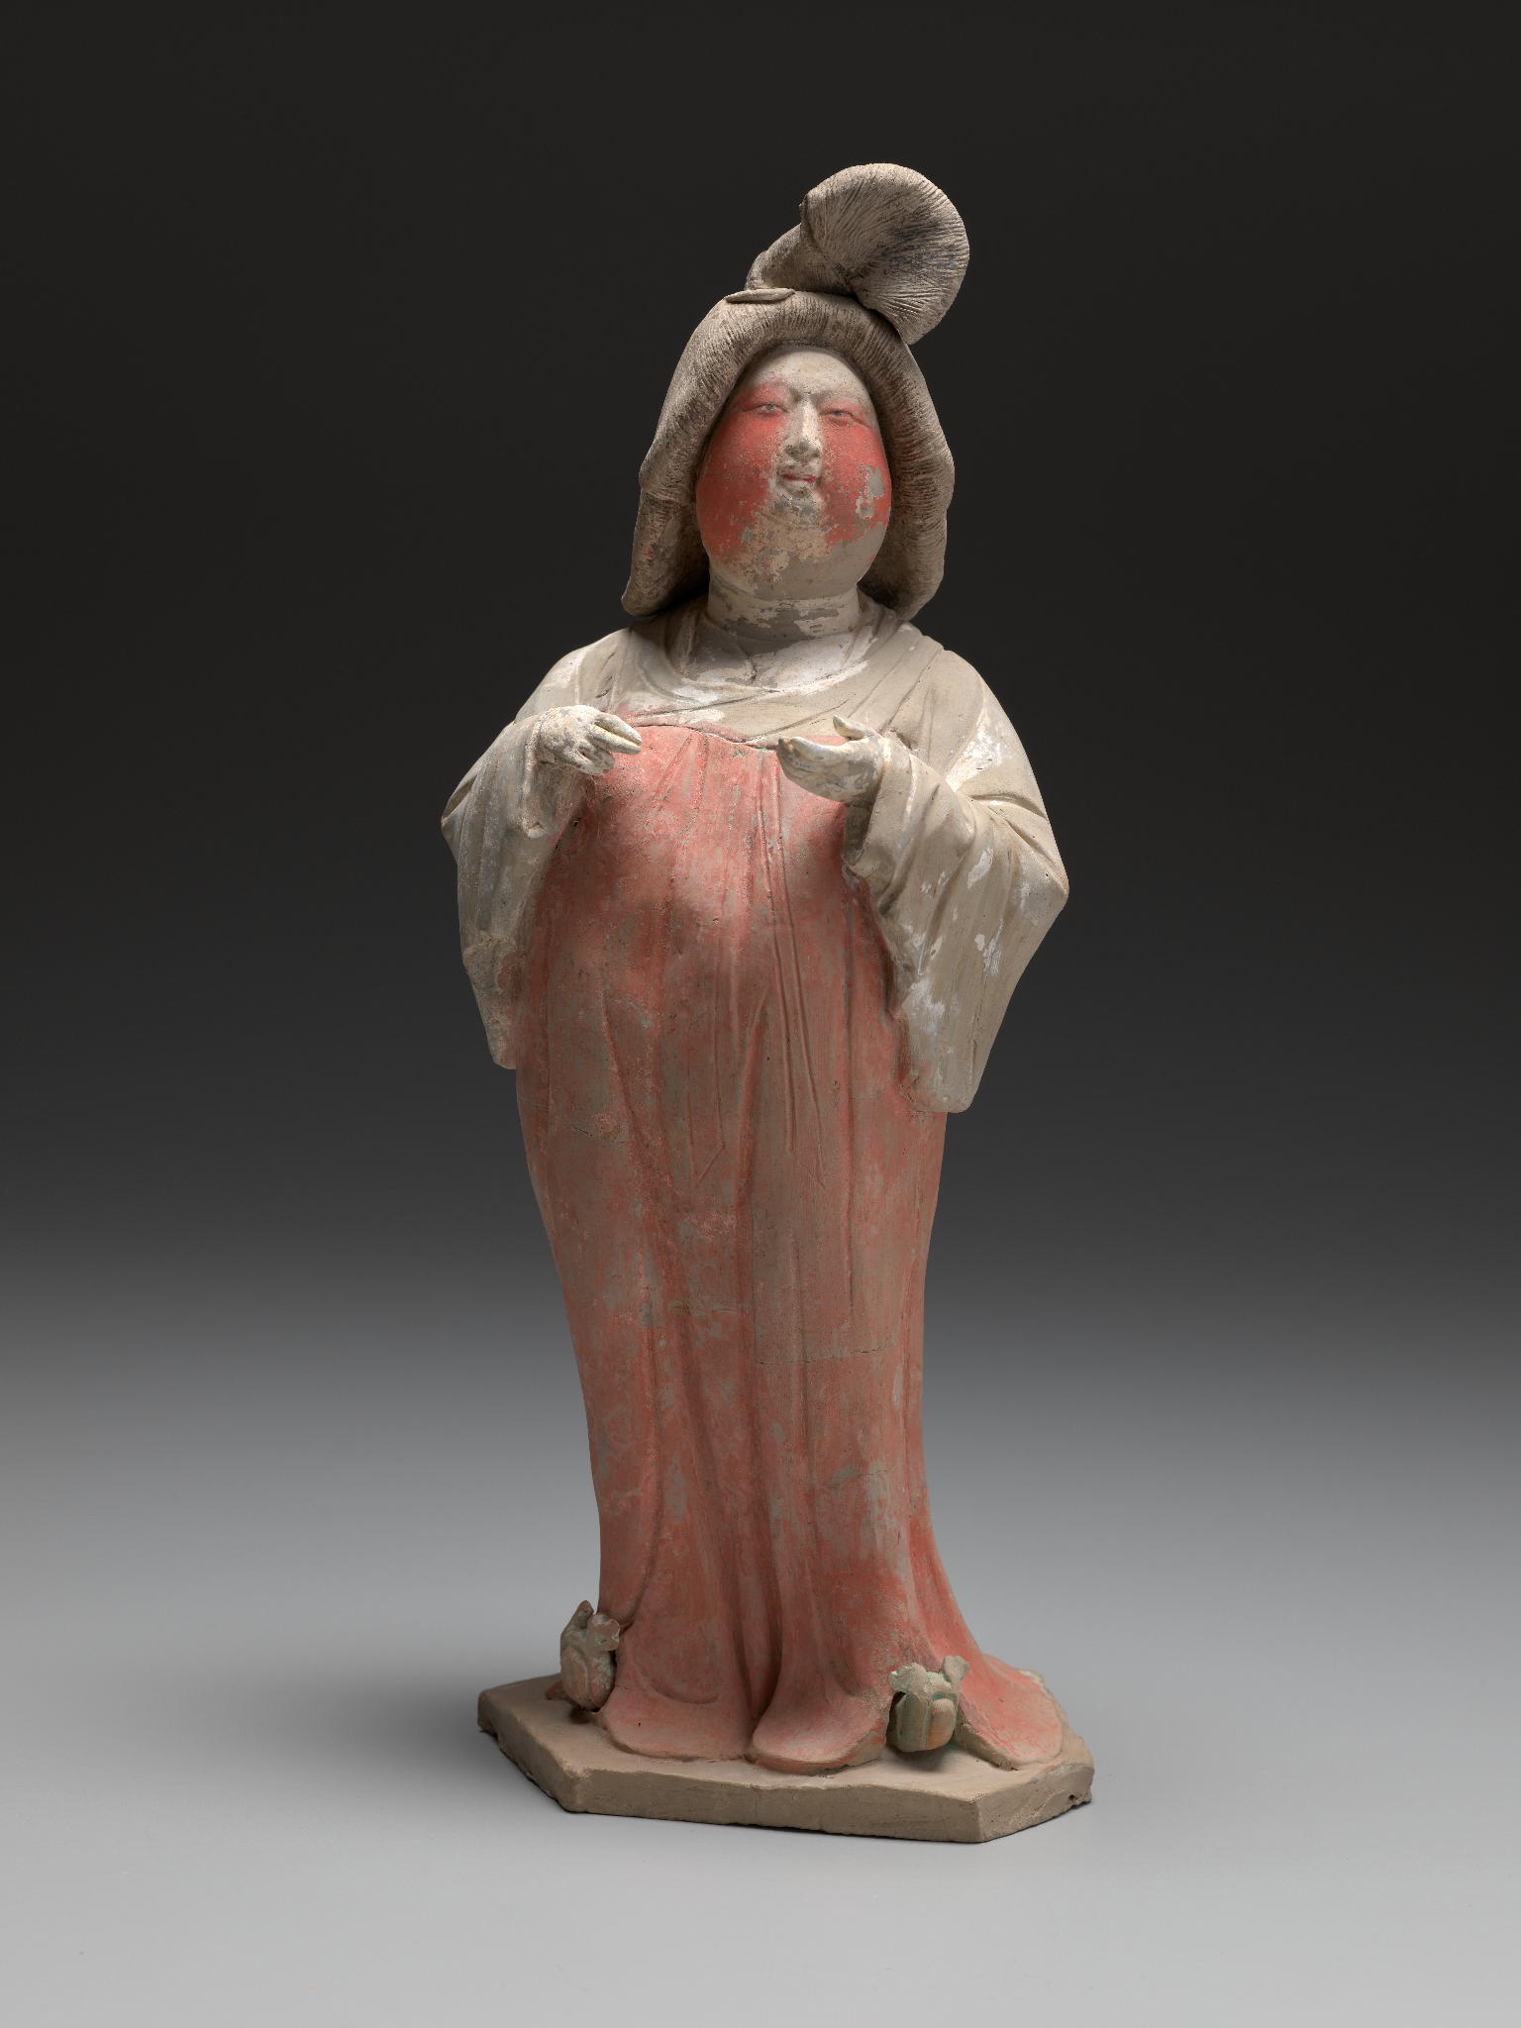
Afterlife Guardians
What role can guardian figures play in the afterlife?
What considerations might an artist make when creating the design of afterlife guardians?
Chinese, Tang dynasty (AD 618–907), Court Lady, first half of the 8th century AD, gray earthenware with painted polychrome decoration. Kimbell Art Museum

Slide 4
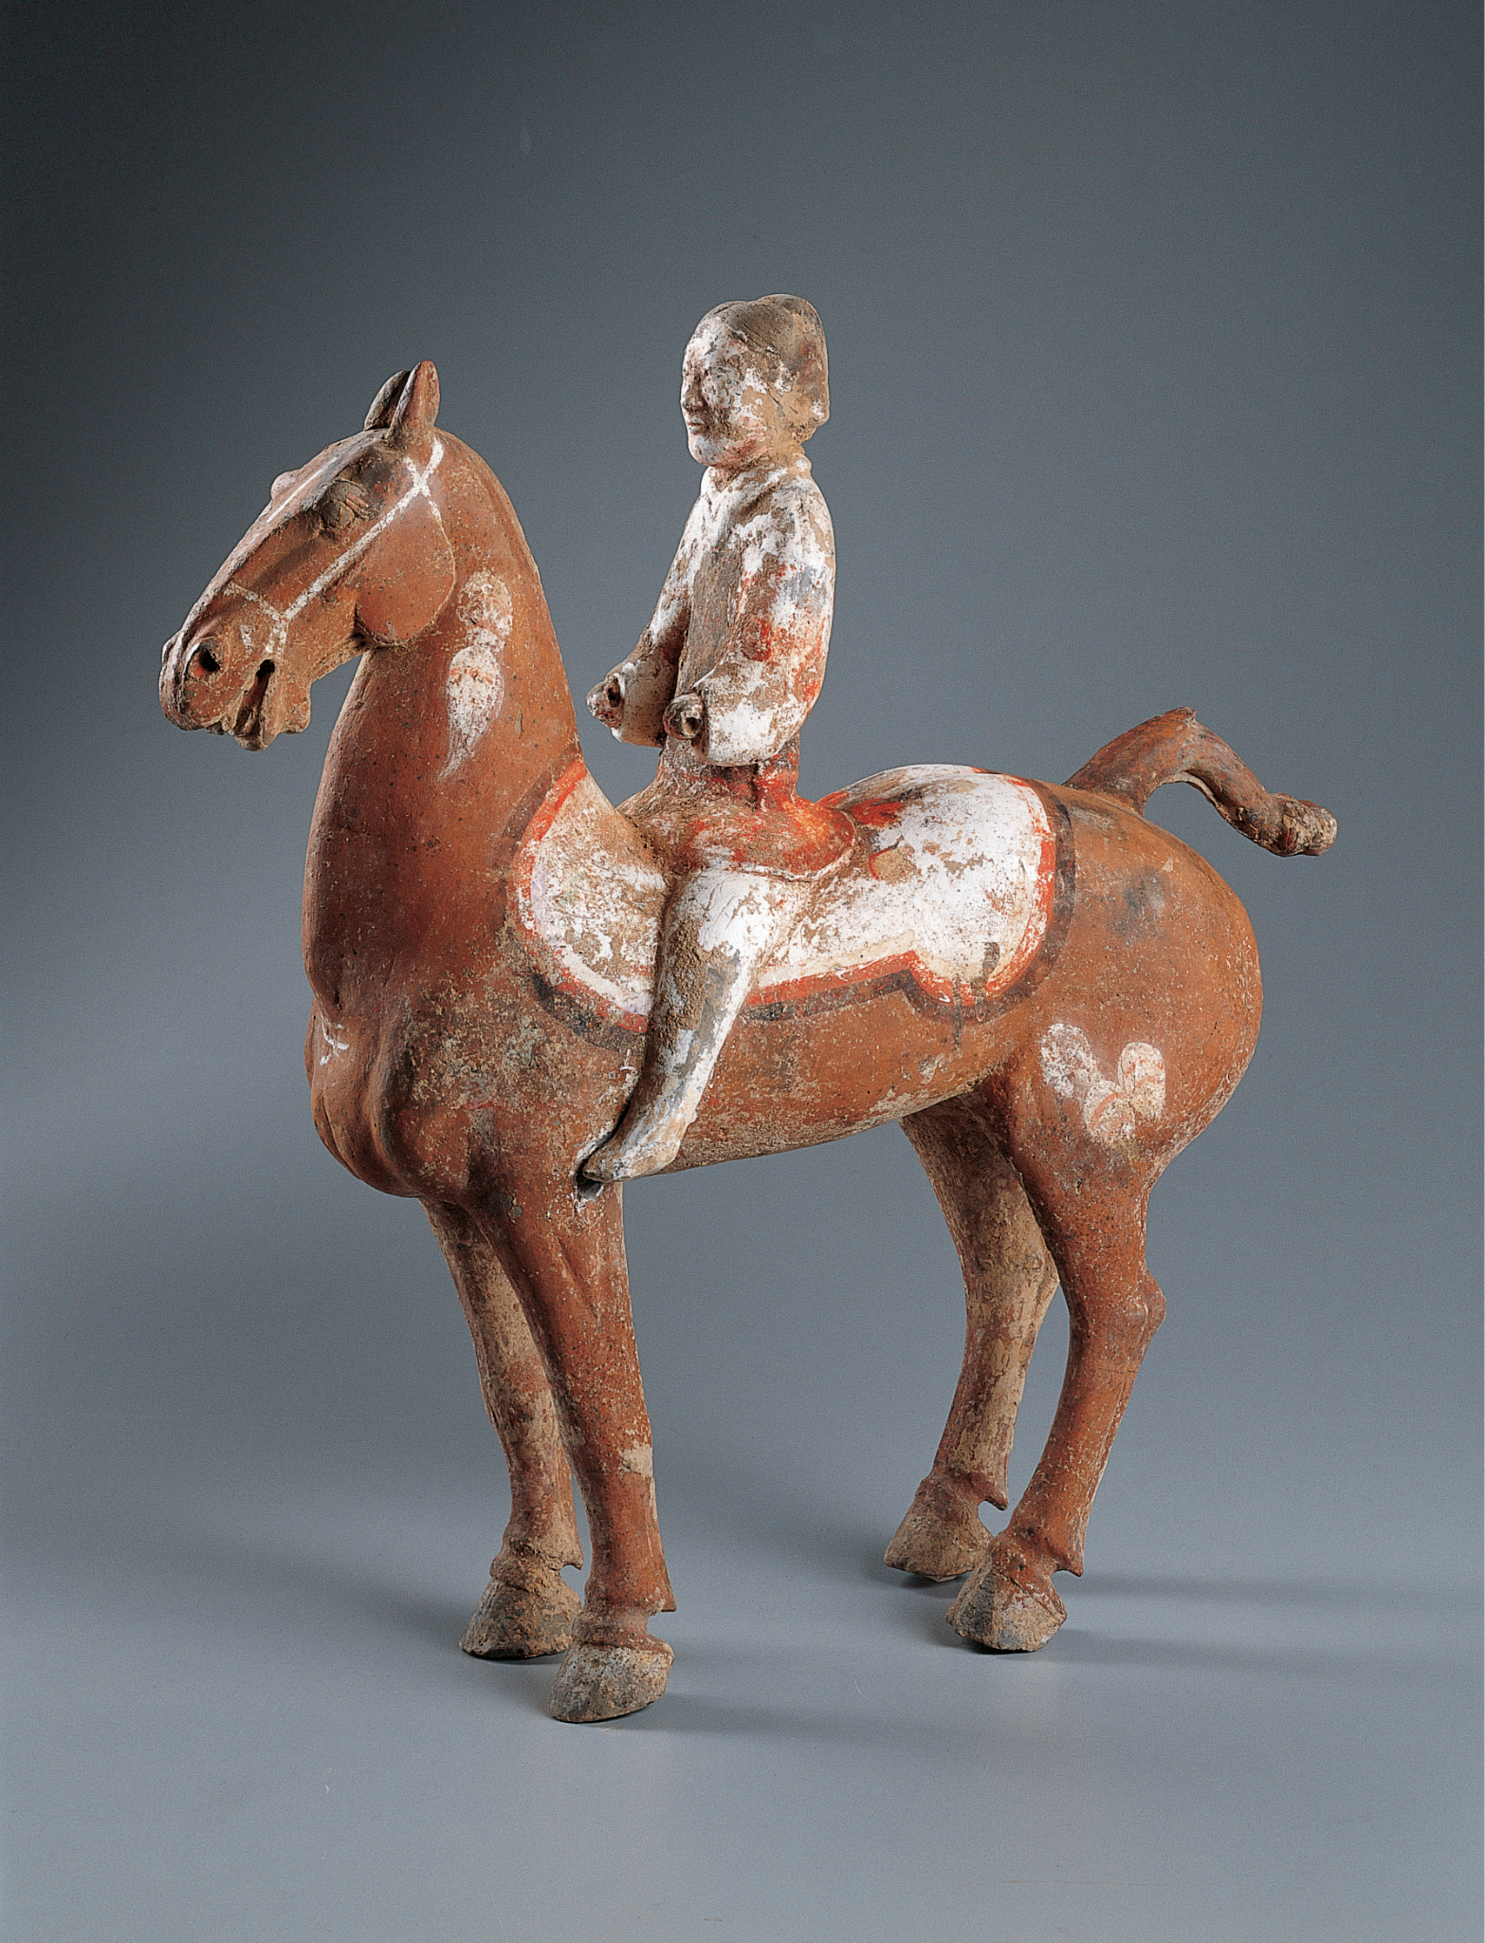
Chinese, Horse and Rider, 2nd–1st century BC, earthenware with painted polychrome decoration. Kimbell Art Museum
Notes:
https://kimbellart.org/collection/ap-199407
Tombs of the Han dynasty (206 BC–AD 220) were typically furnished with model figures and other objects believed to be necessary for a safe journey to the afterlife. Records indicate that when important military officials died, the imperial Han court would give them elaborate funerals, including a full military cortege. This figure of a horse and rider was likely part of a model funerary retinue comprised of soldiers and cavalrymen that would have been placed in such a tomb. It is closely related stylistically to a group of military figures excavated in a Western Han tomb in Yangjiawan village, Shaanxi province.
To meet increased demand for burial goods during the Han dynasty, these figures were produced in great numbers. Despite their standardized types and simple sculptural techniques, however, the Kimbell group displays great vitality of form and considerable descriptive and expressive power.
As with much Western Han sculpture, the artist has here focused attention on the figures’ heads. That of the horse is boldly sculpted and precisely rendered, suggesting the physical attributes of the Samanthian breed from Xinjiang province in Central Asia, prized by the Chinese for its superior strength and speed. The rider’s face is characteristic of the period, with simple, naturally modeled features. In both figures, the strong contours help to define a sense of volume, enhanced by the addition of colorful pigments, which delineate the rider’s costume and the horse’s saddle and harness. Despite their relatively modest size, the pair possess a monumental quality normally associated with more massive Han stone sculptures.

Slide 5
Describe the horse. What do you notice about its expression and body language? What details are painted on it?
What stands out to you about the rider? How might they be feeling in this moment? How would you describe their pose? What are they wearing?
What colors and shapes do you notice?
Chinese, Horse and Rider, 2nd–1st century BC, earthenware with painted polychrome decoration. Kimbell Art Museum
Notes:
https://kimbellart.org/collection/ap-199407
Tombs of the Han dynasty (206 BC–AD 220) were typically furnished with model figures and other objects believed to be necessary for a safe journey to the afterlife. Records indicate that when important military officials died, the imperial Han court would give them elaborate funerals, including a full military cortege. This figure of a horse and rider was likely part of a model funerary retinue comprised of soldiers and cavalrymen that would have been placed in such a tomb. It is closely related stylistically to a group of military figures excavated in a Western Han tomb in Yangjiawan village, Shaanxi province.
To meet increased demand for burial goods during the Han dynasty, these figures were produced in great numbers. Despite their standardized types and simple sculptural techniques, however, the Kimbell group displays great vitality of form and considerable descriptive and expressive power.
As with much Western Han sculpture, the artist has here focused attention on the figures’ heads. That of the horse is boldly sculpted and precisely rendered, suggesting the physical attributes of the Samanthian breed from Xinjiang province in Central Asia, prized by the Chinese for its superior strength and speed. The rider’s face is characteristic of the period, with simple, naturally modeled features. In both figures, the strong contours help to define a sense of volume, enhanced by the addition of colorful pigments, which delineate the rider’s costume and the horse’s saddle and harness. Despite their relatively modest size, the pair possess a monumental quality normally associated with more massive Han stone sculptures.

Slide 6
Where do you think this sculpture might have been placed? Who may have owned it?
Research other tomb figures from the Han dynasty. How do they compare to Horse and Rider?
Chinese, Horse and Rider, 2nd–1st century BC, earthenware with painted polychrome decoration. Kimbell Art Museum
Notes:
https://kimbellart.org/collection/ap-199407
Tombs of the Han dynasty (206 BC–AD 220) were typically furnished with model figures and other objects believed to be necessary for a safe journey to the afterlife. Records indicate that when important military officials died, the imperial Han court would give them elaborate funerals, including a full military cortege. This figure of a horse and rider was likely part of a model funerary retinue comprised of soldiers and cavalrymen that would have been placed in such a tomb. It is closely related stylistically to a group of military figures excavated in a Western Han tomb in Yangjiawan village, Shaanxi province.
To meet increased demand for burial goods during the Han dynasty, these figures were produced in great numbers. Despite their standardized types and simple sculptural techniques, however, the Kimbell group displays great vitality of form and considerable descriptive and expressive power.
As with much Western Han sculpture, the artist has here focused attention on the figures’ heads. That of the horse is boldly sculpted and precisely rendered, suggesting the physical attributes of the Samanthian breed from Xinjiang province in Central Asia, prized by the Chinese for its superior strength and speed. The rider’s face is characteristic of the period, with simple, naturally modeled features. In both figures, the strong contours help to define a sense of volume, enhanced by the addition of colorful pigments, which delineate the rider’s costume and the horse’s saddle and harness. Despite their relatively modest size, the pair possess a monumental quality normally associated with more massive Han stone sculptures.

Slide 7
Japanese, Haniwa Seated Man, c. AD 500, low-fired clay with cinnabar pigment. Kimbell Art Museum
Notes:
https://kimbellart.org/collection/ap-197202
The Kofun (“Old Tomb/Mound”) period (c. 3rd century–538 AD) is characterized by the burial mounds built for the clan leaders of an emerging upper class, who would form the basis of imperial rule. The practice of building burial mounds and interring valuables with the dead was adopted in Japan from the Asian continent. During this period, great numbers of monumental burial mounds symbolized the increasingly unified power of the governing class.
Haniwa, which means “circle (or tube) of clay,” is the term given to large numbers of hollow clay cylinders that were placed in and around the bases of the Kofun-period burial mounds. Their function is unknown, but it is thought that they were used to protect the sides of the mound from erosion or perhaps formed a symbolic barrier around the precincts of the dead, protecting the site from evil spirits. The majority of haniwa are unadorned, but a number of them are decorated with sculpted human figures, animals, or domestic and ceremonial objects, rendered with the typical simplification and abstraction that characterizes the Kimbell figure. Seated on a platform, he has short legs and rounded, tubelike arms that are held in front in a somewhat formal pose. There is no suggestion of clothing, but the masklike face is marked by triangles on the cheeks and chin, painted in red cinnabar. Although the status and function of the person represented are not known, his distinctive conical cap and the sword at his side suggest a low-ranking soldier.

Slide 8
What is your first impression of this haniwa figure? Describe his facial expression and pose.
What clues suggest that this soldier is on duty? What might have been his job?
From what material is this figure made? What shapes do you recognize? Does it look delicate or sturdy?
Japanese, Haniwa Seated Man, c. AD 500, low-fired clay with cinnabar pigment. Kimbell Art Museum
Notes:
https://kimbellart.org/collection/ap-197202
The Kofun (“Old Tomb/Mound”) period (c. 3rd century–538 AD) is characterized by the burial mounds built for the clan leaders of an emerging upper class, who would form the basis of imperial rule. The practice of building burial mounds and interring valuables with the dead was adopted in Japan from the Asian continent. During this period, great numbers of monumental burial mounds symbolized the increasingly unified power of the governing class.
Haniwa, which means “circle (or tube) of clay,” is the term given to large numbers of hollow clay cylinders that were placed in and around the bases of the Kofun-period burial mounds. Their function is unknown, but it is thought that they were used to protect the sides of the mound from erosion or perhaps formed a symbolic barrier around the precincts of the dead, protecting the site from evil spirits. The majority of haniwa are unadorned, but a number of them are decorated with sculpted human figures, animals, or domestic and ceremonial objects, rendered with the typical simplification and abstraction that characterizes the Kimbell figure. Seated on a platform, he has short legs and rounded, tubelike arms that are held in front in a somewhat formal pose. There is no suggestion of clothing, but the masklike face is marked by triangles on the cheeks and chin, painted in red cinnabar. Although the status and function of the person represented are not known, his distinctive conical cap and the sword at his side suggest a low-ranking soldier.

Slide 9
Where do you see hints of color? How does color create emphasis in this sculpture?
Imagine what the burial mounds would have looked like with lots of haniwa figures.
Japanese, Haniwa Seated Man, c. AD 500, low-fired clay with cinnabar pigment. Kimbell Art Museum
Notes:
https://kimbellart.org/collection/ap-197202
The Kofun (“Old Tomb/Mound”) period (c. 3rd century–538 AD) is characterized by the burial mounds built for the clan leaders of an emerging upper class, who would form the basis of imperial rule. The practice of building burial mounds and interring valuables with the dead was adopted in Japan from the Asian continent. During this period, great numbers of monumental burial mounds symbolized the increasingly unified power of the governing class.
Haniwa, which means “circle (or tube) of clay,” is the term given to large numbers of hollow clay cylinders that were placed in and around the bases of the Kofun-period burial mounds. Their function is unknown, but it is thought that they were used to protect the sides of the mound from erosion or perhaps formed a symbolic barrier around the precincts of the dead, protecting the site from evil spirits. The majority of haniwa are unadorned, but a number of them are decorated with sculpted human figures, animals, or domestic and ceremonial objects, rendered with the typical simplification and abstraction that characterizes the Kimbell figure. Seated on a platform, he has short legs and rounded, tubelike arms that are held in front in a somewhat formal pose. There is no suggestion of clothing, but the masklike face is marked by triangles on the cheeks and chin, painted in red cinnabar. Although the status and function of the person represented are not known, his distinctive conical cap and the sword at his side suggest a low-ranking soldier.

Slide 10
Chinese, Court Lady, first half of the 8th century AD, gray earthenware with painted polychrome decoration. Kimbell Art Museum
Notes:
https://kimbellart.org/collection/ap-200101
The Tang dynasty (AD 618–907) practice of sumptuous burials has left a rich legacy of Tang funerary sculpture. One of the most engaging and distinctive groups of such figures comprises representations of court ladies. This animated and charming example stands in a gracefully swayed pose, her petite hands held in a conversational gesture in front of her swelling form. She wears a long scarf draped over her shoulder and a white, long-sleeved jacket tucked into a full-length red robe, which is belted above her bosom and falls in looping folds to her feet, leaving her upturned, ruyi-shaped, triple-cloud shoes visible. Her hairstyle, known as a gaoji (upswept topknot), is stiffly lacquered and folded, with a clump of hair bound into a fan shape in the front, all held in place by two crescent-shaped combs. Her plump, heavily made-up cheeks are offset by exquisitely delicate eyes, nose, and slightly parted lips, reflecting the contemporary ideal of voluptuous beauty.
The Tang sculptors’ careful attention to details of fashion and physiognomy allows us to trace in their works the changing fashions of ladies at court. In the early eighth century, a new aesthetic favored a fuller and more rotund physique and loose, billowing robes. This new trend was probably set by Yang Guifei, the imperial consort of the emperor Xuanzong (reigned AD 712–56). Dressed in elegant clothes, with their hair arranged in elaborate coiffures and their faces beautified with cosmetics, these figures of aristocratic Tang women possess a singular grace and charm.

Slide 11
What is she wearing? How is her hair styled? What little details did the artist want us to notice in particular?
Imitate her hand gestures. What are you usually doing when gesturing like that? What do you think she would say to you?
Why do you think someone would put her in their tomb? What might she do for them in the afterlife? What would you want to take with you on a long journey? Or who?
Chinese, Court Lady, first half of the 8th century AD, gray earthenware with painted polychrome decoration. Kimbell Art Museum
Notes:
https://kimbellart.org/collection/ap-200101
The Tang dynasty (AD 618–907) practice of sumptuous burials has left a rich legacy of Tang funerary sculpture. One of the most engaging and distinctive groups of such figures comprises representations of court ladies. This animated and charming example stands in a gracefully swayed pose, her petite hands held in a conversational gesture in front of her swelling form. She wears a long scarf draped over her shoulder and a white, long-sleeved jacket tucked into a full-length red robe, which is belted above her bosom and falls in looping folds to her feet, leaving her upturned, ruyi-shaped, triple-cloud shoes visible. Her hairstyle, known as a gaoji (upswept topknot), is stiffly lacquered and folded, with a clump of hair bound into a fan shape in the front, all held in place by two crescent-shaped combs. Her plump, heavily made-up cheeks are offset by exquisitely delicate eyes, nose, and slightly parted lips, reflecting the contemporary ideal of voluptuous beauty.
The Tang sculptors’ careful attention to details of fashion and physiognomy allows us to trace in their works the changing fashions of ladies at court. In the early eighth century, a new aesthetic favored a fuller and more rotund physique and loose, billowing robes. This new trend was probably set by Yang Guifei, the imperial consort of the emperor Xuanzong (reigned AD 712–56). Dressed in elegant clothes, with their hair arranged in elaborate coiffures and their faces beautified with cosmetics, these figures of aristocratic Tang women possess a singular grace and charm.

Slide 12
What is this sculpture made of? What sort of tools did the artist use to create the details you see?
Conduct an imaginary interview with the Court Lady. What questions would you ask? What answers would she give?
Chinese, Court Lady, first half of the 8th century AD, gray earthenware with painted polychrome decoration. Kimbell Art Museum
Notes:
https://kimbellart.org/collection/ap-200101
The Tang dynasty (AD 618–907) practice of sumptuous burials has left a rich legacy of Tang funerary sculpture. One of the most engaging and distinctive groups of such figures comprises representations of court ladies. This animated and charming example stands in a gracefully swayed pose, her petite hands held in a conversational gesture in front of her swelling form. She wears a long scarf draped over her shoulder and a white, long-sleeved jacket tucked into a full-length red robe, which is belted above her bosom and falls in looping folds to her feet, leaving her upturned, ruyi-shaped, triple-cloud shoes visible. Her hairstyle, known as a gaoji (upswept topknot), is stiffly lacquered and folded, with a clump of hair bound into a fan shape in the front, all held in place by two crescent-shaped combs. Her plump, heavily made-up cheeks are offset by exquisitely delicate eyes, nose, and slightly parted lips, reflecting the contemporary ideal of voluptuous beauty.
The Tang sculptors’ careful attention to details of fashion and physiognomy allows us to trace in their works the changing fashions of ladies at court. In the early eighth century, a new aesthetic favored a fuller and more rotund physique and loose, billowing robes. This new trend was probably set by Yang Guifei, the imperial consort of the emperor Xuanzong (reigned AD 712–56). Dressed in elegant clothes, with their hair arranged in elaborate coiffures and their faces beautified with cosmetics, these figures of aristocratic Tang women possess a singular grace and charm.

Slide 13
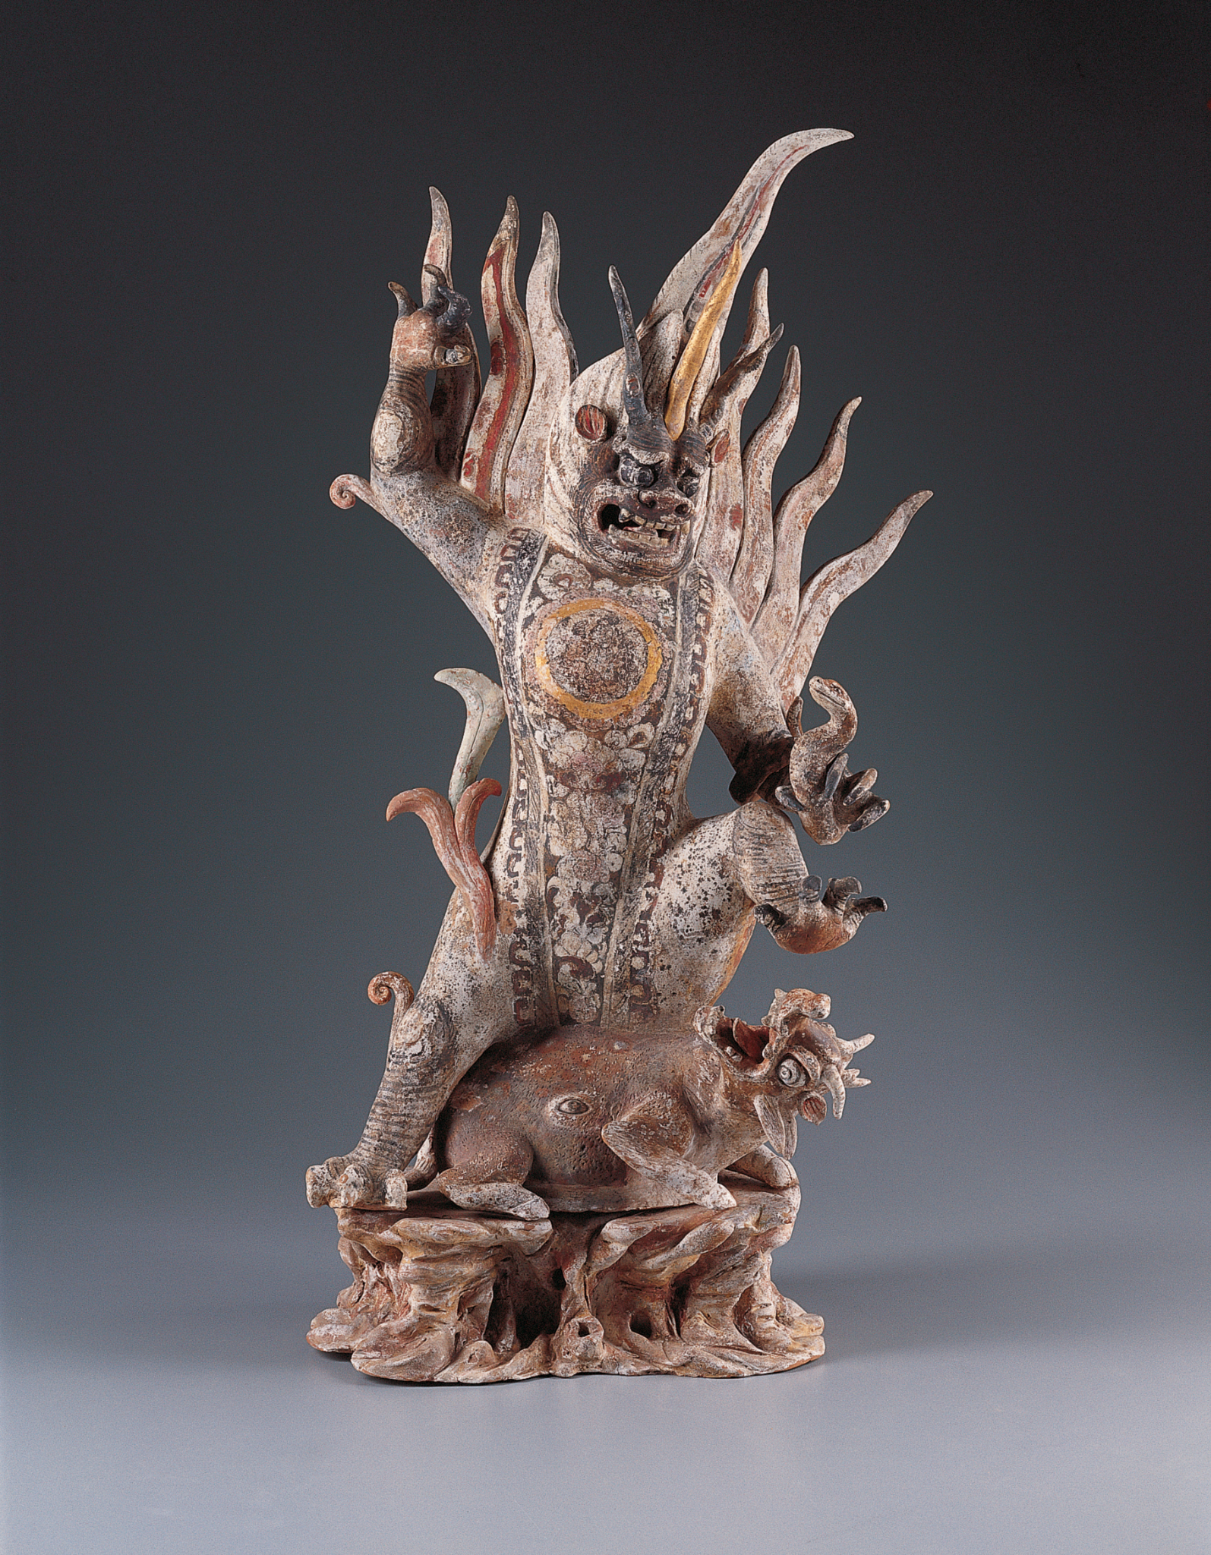
Chinese, Earth Spirit, first half of the 8th century AD, gray earthenware with painted polychrome decoration. Kimbell Art Museum
Notes:
https://kimbellart.org/collection/ap-200102
The inclusion of fantastic animal guardians as part of the retinue of Chinese tomb figures began in the Northern Wei dynasty (AD 386–534) and continued into the Tang dynasty (AD 618–907). Also called earth spirits, or zhenmushou (grave-quelling beasts), these guardians took the form of fantastic hybrid creatures composed of various animal and, in some cases, human elements. They were placed in tombs in pairs to ward off any malevolent beings.
Brilliantly painted in pink, red, orange, and black and highlighted with gilding, the Kimbell’s fierce figure stands in a rampant posture of conquest as it subdues a snarling beast upon a rockwork base, its left arm entwined with a serpent. The spirit’s triple horns, bulging eyes, bare-teethed grimace, and sharp claws add to its ferocious appearance. Undulating flames emerge from its head, shoulders, and right leg. A gilded tondo, finely painted with a group of figures (possibly musicians, who may also be foreigners) and set against a luxuriant floral panel, embellishes the figure’s chest.
The composite elements of the Earth Spirit, such as the large horns, claws, fangs, and tiger stripes, presumably conferred upon it the fearsome qualities of these animals. The guardian is quelling evil in the form of the horned, hoofed beast that he tramples underfoot. The eye on the side of the beast’s belly may represent the “third eye,” an indication of the influence of Esoteric Buddhism prevalent during the early Tang period.

Slide 14
What is your first response to this sculpture? Choose three words to describe it.
What actions do you see happening? Notice how your eye travels around the figures. How do their gestures and expressions help you figure out what’s going on?
Count the number of animal-like features you see in this sculpture. What animals do they remind you of? How do they contribute to the sculpture’s overall feeling?
Chinese, Earth Spirit, first half of the 8th century AD, gray earthenware with painted polychrome decoration. Kimbell Art Museum
Notes:
https://kimbellart.org/collection/ap-200102
The inclusion of fantastic animal guardians as part of the retinue of Chinese tomb figures began in the Northern Wei dynasty (AD 386–534) and continued into the Tang dynasty (AD 618–907). Also called earth spirits, or zhenmushou (grave-quelling beasts), these guardians took the form of fantastic hybrid creatures composed of various animal and, in some cases, human elements. They were placed in tombs in pairs to ward off any malevolent beings.
Brilliantly painted in pink, red, orange, and black and highlighted with gilding, the Kimbell’s fierce figure stands in a rampant posture of conquest as it subdues a snarling beast upon a rockwork base, its left arm entwined with a serpent. The spirit’s triple horns, bulging eyes, bare-teethed grimace, and sharp claws add to its ferocious appearance. Undulating flames emerge from its head, shoulders, and right leg. A gilded tondo, finely painted with a group of figures (possibly musicians, who may also be foreigners) and set against a luxuriant floral panel, embellishes the figure’s chest.
The composite elements of the Earth Spirit, such as the large horns, claws, fangs, and tiger stripes, presumably conferred upon it the fearsome qualities of these animals. The guardian is quelling evil in the form of the horned, hoofed beast that he tramples underfoot. The eye on the side of the beast’s belly may represent the “third eye,” an indication of the influence of Esoteric Buddhism prevalent during the early Tang period.

Slide 15
If you designed your own guardian against evil forces, what would it look like? Would it take on animal or mythological features? What other attributes might it have?
Sketch your own personal Earth Spirit. As a challenge, try to follow the color scheme of the Kimbell’s sculpture.
Chinese, Earth Spirit, first half of the 8th century AD, gray earthenware with painted polychrome decoration. Kimbell Art Museum
Notes:
https://kimbellart.org/collection/ap-200102
The inclusion of fantastic animal guardians as part of the retinue of Chinese tomb figures began in the Northern Wei dynasty (AD 386–534) and continued into the Tang dynasty (AD 618–907). Also called earth spirits, or zhenmushou (grave-quelling beasts), these guardians took the form of fantastic hybrid creatures composed of various animal and, in some cases, human elements. They were placed in tombs in pairs to ward off any malevolent beings.
Brilliantly painted in pink, red, orange, and black and highlighted with gilding, the Kimbell’s fierce figure stands in a rampant posture of conquest as it subdues a snarling beast upon a rockwork base, its left arm entwined with a serpent. The spirit’s triple horns, bulging eyes, bare-teethed grimace, and sharp claws add to its ferocious appearance. Undulating flames emerge from its head, shoulders, and right leg. A gilded tondo, finely painted with a group of figures (possibly musicians, who may also be foreigners) and set against a luxuriant floral panel, embellishes the figure’s chest.
The composite elements of the Earth Spirit, such as the large horns, claws, fangs, and tiger stripes, presumably conferred upon it the fearsome qualities of these animals. The guardian is quelling evil in the form of the horned, hoofed beast that he tramples underfoot. The eye on the side of the beast’s belly may represent the “third eye,” an indication of the influence of Esoteric Buddhism prevalent during the early Tang period.

Slide 16
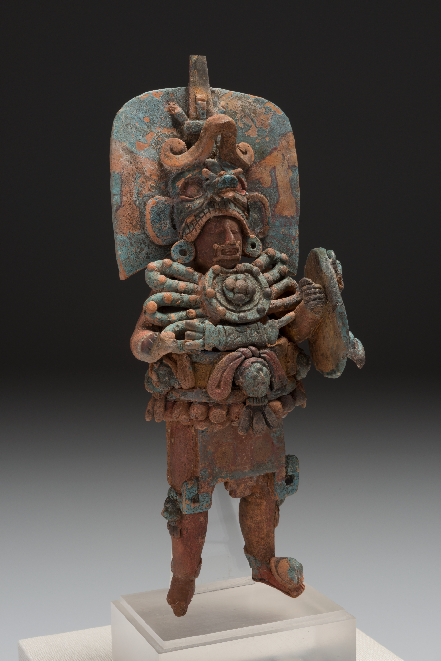
Ancestor Guardians
How can ancestors function as guardian figures?
Maya culture, Standing Ruler, AD 600–800, ceramic with traces of paint.
Kimbell Art Museum
Notes:
https://kimbellart.org/collection/ap-198403
Among the greatest achievements of Maya art are their small-scale ceramic sculptures. Despite their diminutive scale, these are among the most fully realized of Maya sculptures in the round. Most known examples come from the cemetery island of Jaina, off the coast of Campeche, but high-quality figurines have also been recovered from Palenque, in Mexico, and Río Azul, in Guatemala. In their extreme sensitivity and realism, these exquisitely detailed figurines represent the apogee of Maya ceramic sculpture. Their role in Maya belief and ritual is not clear, but their common appearance in Maya burials suggests a ritual function of some importance.
The Kimbell’s Standing Ruler represents a Maya lord costumed to impersonate a dynastic ancestor. The rectangular device over the mouth along with the shield in one hand and the now-missing spear in the other closely resemble the accoutrements of the nine ancestral figures in the sarcophagus chamber of Palenque’s Temple of the Inscriptions. The ruler’s wide belt once supported a rack of feathers across his back, and his knee-length apron is marked with a symbol of the World Tree, the central axis of the Maya world. Elements of the complex costume below the headdress recur in other portrayals of Maya rulers; these seem to define and reiterate his rank and position in the cosmos. As a complete three-dimensional representation of a figure type more familiar in low-relief stelae, this figurine is extremely rare. It may have been made to commemorate a rite performed by the king.

Slide 17
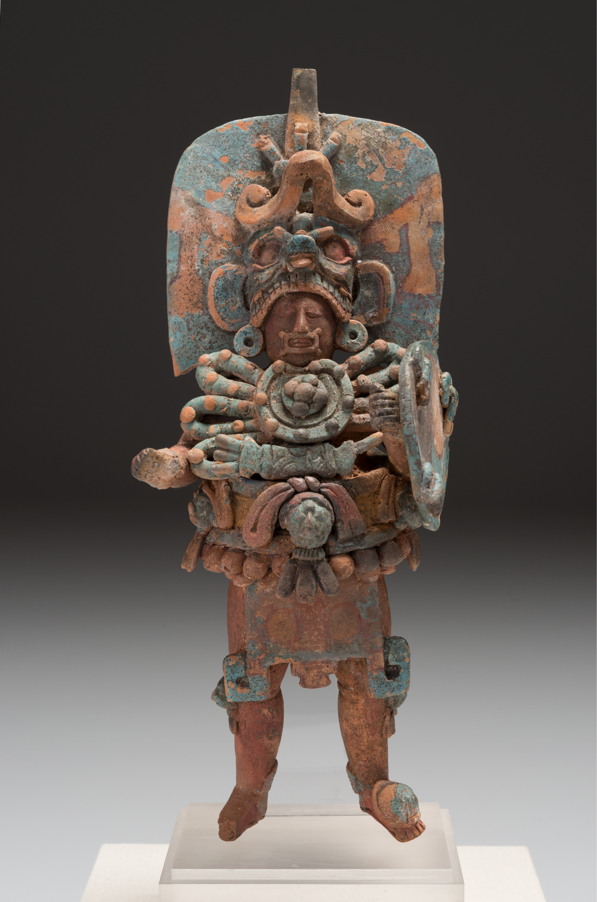
Maya culture, Standing Ruler, AD 600–800, ceramic with traces of paint. Kimbell Art Museum
Notes:
https://kimbellart.org/collection/ap-198403
Among the greatest achievements of Maya art are their small-scale ceramic sculptures. Despite their diminutive scale, these are among the most fully realized of Maya sculptures in the round. Most known examples come from the cemetery island of Jaina, off the coast of Campeche, but high-quality figurines have also been recovered from Palenque, in Mexico, and Río Azul, in Guatemala. In their extreme sensitivity and realism, these exquisitely detailed figurines represent the apogee of Maya ceramic sculpture. Their role in Maya belief and ritual is not clear, but their common appearance in Maya burials suggests a ritual function of some importance.
The Kimbell’s Standing Ruler represents a Maya lord costumed to impersonate a dynastic ancestor. The rectangular device over the mouth along with the shield in one hand and the now-missing spear in the other closely resemble the accoutrements of the nine ancestral figures in the sarcophagus chamber of Palenque’s Temple of the Inscriptions. The ruler’s wide belt once supported a rack of feathers across his back, and his knee-length apron is marked with a symbol of the World Tree, the central axis of the Maya world. Elements of the complex costume below the headdress recur in other portrayals of Maya rulers; these seem to define and reiterate his rank and position in the cosmos. As a complete three-dimensional representation of a figure type more familiar in low-relief stelae, this figurine is extremely rare. It may have been made to commemorate a rite performed by the king.

Slide 18
How do we know that this is an important figure? What stands out to you about the ruler’s clothing and accessories?
What ideas do you associate with jaguars? How do you think the ruler would feel when wearing this powerful headdress?
What colors, textures, and small details do you notice on this sculpture? Where do you see areas that are missing pieces?
Maya culture, Standing Ruler, AD 600–800, ceramic with traces of paint. Kimbell Art Museum
Notes:
https://kimbellart.org/collection/ap-198403
Among the greatest achievements of Maya art are their small-scale ceramic sculptures. Despite their diminutive scale, these are among the most fully realized of Maya sculptures in the round. Most known examples come from the cemetery island of Jaina, off the coast of Campeche, but high-quality figurines have also been recovered from Palenque, in Mexico, and Río Azul, in Guatemala. In their extreme sensitivity and realism, these exquisitely detailed figurines represent the apogee of Maya ceramic sculpture. Their role in Maya belief and ritual is not clear, but their common appearance in Maya burials suggests a ritual function of some importance.
The Kimbell’s Standing Ruler represents a Maya lord costumed to impersonate a dynastic ancestor. The rectangular device over the mouth along with the shield in one hand and the now-missing spear in the other closely resemble the accoutrements of the nine ancestral figures in the sarcophagus chamber of Palenque’s Temple of the Inscriptions. The ruler’s wide belt once supported a rack of feathers across his back, and his knee-length apron is marked with a symbol of the World Tree, the central axis of the Maya world. Elements of the complex costume below the headdress recur in other portrayals of Maya rulers; these seem to define and reiterate his rank and position in the cosmos. As a complete three-dimensional representation of a figure type more familiar in low-relief stelae, this figurine is extremely rare. It may have been made to commemorate a rite performed by the king.

Slide 19
Why might a ruler want to impersonate an ancestor?
In what ways is a ruler responsible for protecting their people? What are some of your responsibilities? How do you take care of your tasks?
Caption what the ruler might say to his people. What would he want to share?
Maya culture, Standing Ruler, AD 600–800, ceramic with traces of paint. Kimbell Art Museum
Notes:
https://kimbellart.org/collection/ap-198403
Among the greatest achievements of Maya art are their small-scale ceramic sculptures. Despite their diminutive scale, these are among the most fully realized of Maya sculptures in the round. Most known examples come from the cemetery island of Jaina, off the coast of Campeche, but high-quality figurines have also been recovered from Palenque, in Mexico, and Río Azul, in Guatemala. In their extreme sensitivity and realism, these exquisitely detailed figurines represent the apogee of Maya ceramic sculpture. Their role in Maya belief and ritual is not clear, but their common appearance in Maya burials suggests a ritual function of some importance.
The Kimbell’s Standing Ruler represents a Maya lord costumed to impersonate a dynastic ancestor. The rectangular device over the mouth along with the shield in one hand and the now-missing spear in the other closely resemble the accoutrements of the nine ancestral figures in the sarcophagus chamber of Palenque’s Temple of the Inscriptions. The ruler’s wide belt once supported a rack of feathers across his back, and his knee-length apron is marked with a symbol of the World Tree, the central axis of the Maya world. Elements of the complex costume below the headdress recur in other portrayals of Maya rulers; these seem to define and reiterate his rank and position in the cosmos. As a complete three-dimensional representation of a figure type more familiar in low-relief stelae, this figurine is extremely rare. It may have been made to commemorate a rite performed by the king.

Slide 20
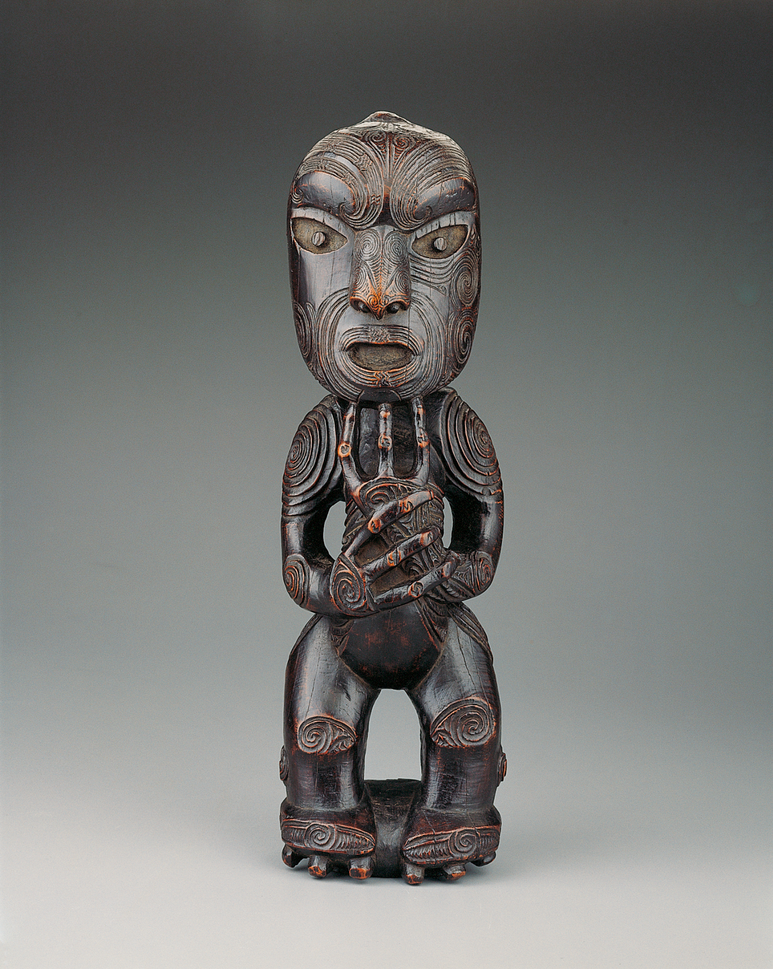
Maori, Standing Ancestor Figure, c. 1800–1840, wood. Kimbell Art Museum
Notes:
https://kimbellart.org/collection/ap-198904
The Maori tribes of New Zealand excelled in decorating their timber buildings with elaborate relief carvings and sculptures. This powerfully conceived, freestanding figure functioned either as a tekoteko—a carved figure placed on the gable peak of an assembly house, food storehouse, or chief’s dwelling—or as a poutokomanawa, the center post that holds up the ridgepole of a large house such as that of a chieftain. Symbolically, the ridgepole is the backbone of the ancestor who is represented by the house. The figure represents either a god or a recently deceased male ancestor who, in Maori culture, looks after the welfare of his descendants.
The form of the figure—the large head, narrow torso, bent knees, and knobby three-fingered hands—is a familiar type in Maori sculptures of gods and ancestors. As is common with these statues, the face is carved with an intricate curvilinear pattern reproducing the tattoos (moko) that decorate the faces of Maori chieftains. The carvings on the arms are specific patterns that are either unique to a particular family (whanau) or have an individual significance for that sculpture. Spirals mark the joints of the figure at the shoulders, elbows, wrists, knees, and hips; the rough edges indicate that these were cut with stone tools, before the introduction of steel knives in the early nineteenth century. The style of carving is characteristic of works made by the Rongowhakaata tribe in the area around Gisborne, on the east coast of the north island of New Zealand.

Slide 21
What is your first impression of this sculpture? How would you describe its proportions and pose? What expression does the figure have?
Describe the carved linework. Notice where thin lines are used instead of thick. Where did the artist use patterns to create emphasis?
Maori, Standing Ancestor Figure, c. 1800–1840, wood. Kimbell Art Museum
Notes:
https://kimbellart.org/collection/ap-198904
The Maori tribes of New Zealand excelled in decorating their timber buildings with elaborate relief carvings and sculptures. This powerfully conceived, freestanding figure functioned either as a tekoteko—a carved figure placed on the gable peak of an assembly house, food storehouse, or chief’s dwelling—or as a poutokomanawa, the center post that holds up the ridgepole of a large house such as that of a chieftain. Symbolically, the ridgepole is the backbone of the ancestor who is represented by the house. The figure represents either a god or a recently deceased male ancestor who, in Maori culture, looks after the welfare of his descendants.
The form of the figure—the large head, narrow torso, bent knees, and knobby three-fingered hands—is a familiar type in Maori sculptures of gods and ancestors. As is common with these statues, the face is carved with an intricate curvilinear pattern reproducing the tattoos (moko) that decorate the faces of Maori chieftains. The carvings on the arms are specific patterns that are either unique to a particular family (whanau) or have an individual significance for that sculpture. Spirals mark the joints of the figure at the shoulders, elbows, wrists, knees, and hips; the rough edges indicate that these were cut with stone tools, before the introduction of steel knives in the early nineteenth century. The style of carving is characteristic of works made by the Rongowhakaata tribe in the area around Gisborne, on the east coast of the north island of New Zealand.

Slide 22
Where might this sculpture have been placed so that the god or ancestor it represents could look after the welfare of its descendants?
What do you do to feel connected to your ancestors? What would you hope to leave for your descendants? Share with a partner.
Maori, Standing Ancestor Figure, c. 1800–1840, wood. Kimbell Art Museum
Notes:
https://kimbellart.org/collection/ap-198904
The Maori tribes of New Zealand excelled in decorating their timber buildings with elaborate relief carvings and sculptures. This powerfully conceived, freestanding figure functioned either as a tekoteko—a carved figure placed on the gable peak of an assembly house, food storehouse, or chief’s dwelling—or as a poutokomanawa, the center post that holds up the ridgepole of a large house such as that of a chieftain. Symbolically, the ridgepole is the backbone of the ancestor who is represented by the house. The figure represents either a god or a recently deceased male ancestor who, in Maori culture, looks after the welfare of his descendants.
The form of the figure—the large head, narrow torso, bent knees, and knobby three-fingered hands—is a familiar type in Maori sculptures of gods and ancestors. As is common with these statues, the face is carved with an intricate curvilinear pattern reproducing the tattoos (moko) that decorate the faces of Maori chieftains. The carvings on the arms are specific patterns that are either unique to a particular family (whanau) or have an individual significance for that sculpture. Spirals mark the joints of the figure at the shoulders, elbows, wrists, knees, and hips; the rough edges indicate that these were cut with stone tools, before the introduction of steel knives in the early nineteenth century. The style of carving is characteristic of works made by the Rongowhakaata tribe in the area around Gisborne, on the east coast of the north island of New Zealand.

Slide 23
Hemba, Warrior Ancestor Figure, 19th century, wood. Kimbell Art Museum
Notes:
https://kimbellart.org/collection/ap-197903
This dignified figure of a Hemba warrior, with his upright posture and lofty, outward gaze, would have served as the focus for ancestor veneration among one of the Hemba peoples of the central and eastern Congo. Each clan possessed an ancestral effigy that was revered as the image of a founder, both actual and ideal, and signified the legitimacy of clan leaders’ rule. As a receptacle for the ancestor’s spirit, the figure is both conceptually and stylistically universalized; it is not concerned with the specific or momentary. It embodies inner moral values as well as outer signs of power, serving as a forceful example to the ancestor’s living descendants. Such figures were preserved in funerary houses or chiefs’ houses and expressed the continuing relationship between the living and the dead.
The Kimbell ancestor figure holds a large parade knife and a lance, which, as extensions of his arms, symbolize courage and masculine physical prowess. These emblems of power, along with the carefully trimmed beard and the characteristic, cruciform headdress, probably allude to the office of war chief. Retaining overall the columnar stability of the living tree from which he carved the work, the sculptor has structured the image from bold spherical and cylindrical forms enlivened by the interplay of forceful diagonals and stabilizing horizontals. The focus of energy remains the noble head, the dwelling place of spirit and wisdom.

Slide 24
What is your first impression of this warrior ancestor? How would you describe his stance?
What do you notice in his hands? What details can you find in his hairstyle? How do these details inform your understanding of this figure?
Hemba, Warrior Ancestor Figure, 19th century, wood. Kimbell Art Museum
Notes:
https://kimbellart.org/collection/ap-197903
This dignified figure of a Hemba warrior, with his upright posture and lofty, outward gaze, would have served as the focus for ancestor veneration among one of the Hemba peoples of the central and eastern Congo. Each clan possessed an ancestral effigy that was revered as the image of a founder, both actual and ideal, and signified the legitimacy of clan leaders’ rule. As a receptacle for the ancestor’s spirit, the figure is both conceptually and stylistically universalized; it is not concerned with the specific or momentary. It embodies inner moral values as well as outer signs of power, serving as a forceful example to the ancestor’s living descendants. Such figures were preserved in funerary houses or chiefs’ houses and expressed the continuing relationship between the living and the dead.
The Kimbell ancestor figure holds a large parade knife and a lance, which, as extensions of his arms, symbolize courage and masculine physical prowess. These emblems of power, along with the carefully trimmed beard and the characteristic, cruciform headdress, probably allude to the office of war chief. Retaining overall the columnar stability of the living tree from which he carved the work, the sculptor has structured the image from bold spherical and cylindrical forms enlivened by the interplay of forceful diagonals and stabilizing horizontals. The focus of energy remains the noble head, the dwelling place of spirit and wisdom.

Slide 25
What material is this? Describe its color and texture. Does it look durable? How might your perception of this sculpture change had it been created in another material?
How do you pay respect to your family or ancestors?
Pose like this warrior ancestor. How does this posture make you feel?
Hemba, Warrior Ancestor Figure, 19th century, wood. Kimbell Art Museum
Notes:
https://kimbellart.org/collection/ap-197903
This dignified figure of a Hemba warrior, with his upright posture and lofty, outward gaze, would have served as the focus for ancestor veneration among one of the Hemba peoples of the central and eastern Congo. Each clan possessed an ancestral effigy that was revered as the image of a founder, both actual and ideal, and signified the legitimacy of clan leaders’ rule. As a receptacle for the ancestor’s spirit, the figure is both conceptually and stylistically universalized; it is not concerned with the specific or momentary. It embodies inner moral values as well as outer signs of power, serving as a forceful example to the ancestor’s living descendants. Such figures were preserved in funerary houses or chiefs’ houses and expressed the continuing relationship between the living and the dead.
The Kimbell ancestor figure holds a large parade knife and a lance, which, as extensions of his arms, symbolize courage and masculine physical prowess. These emblems of power, along with the carefully trimmed beard and the characteristic, cruciform headdress, probably allude to the office of war chief. Retaining overall the columnar stability of the living tree from which he carved the work, the sculptor has structured the image from bold spherical and cylindrical forms enlivened by the interplay of forceful diagonals and stabilizing horizontals. The focus of energy remains the noble head, the dwelling place of spirit and wisdom.
wisdom.

Slide 26
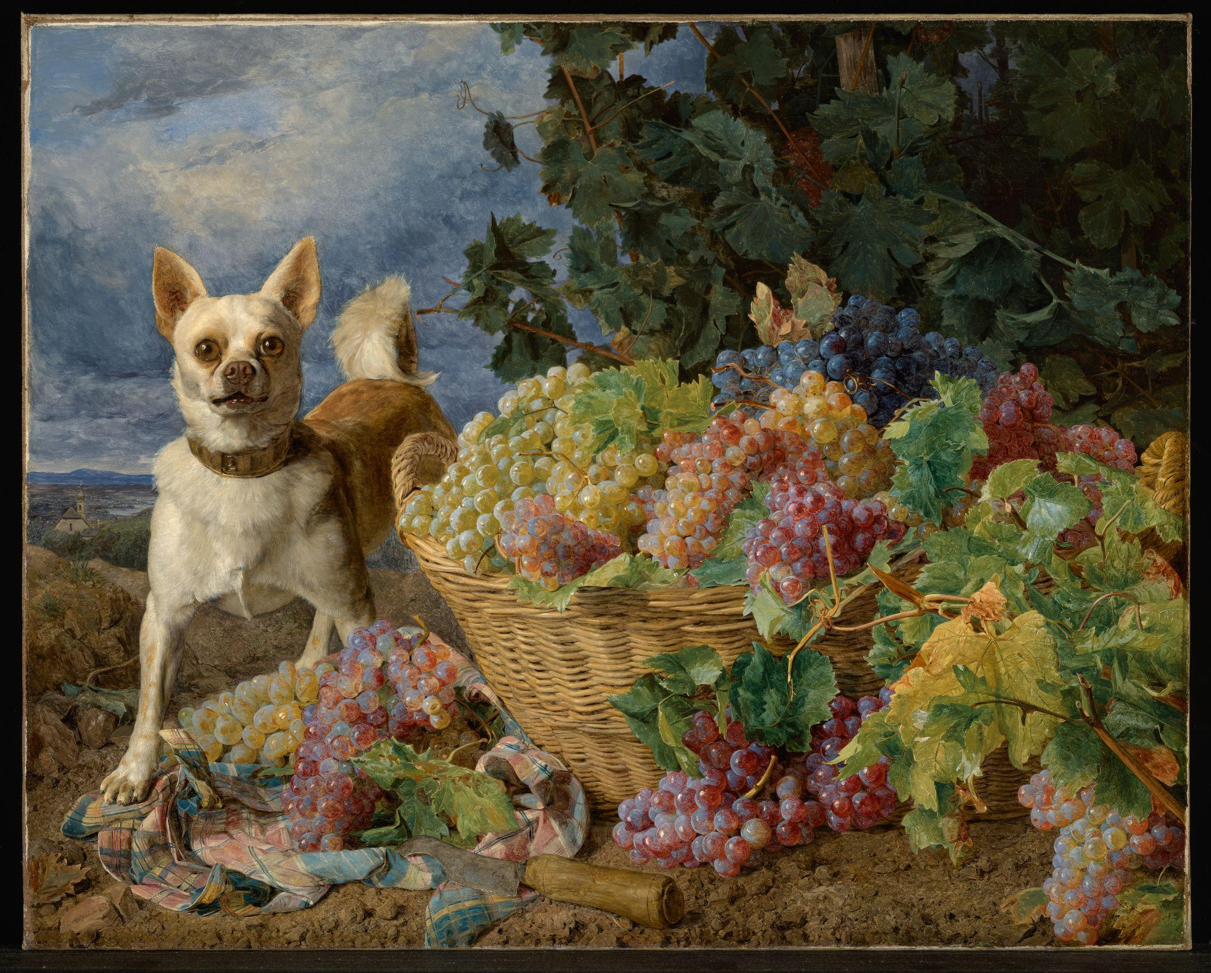
Gods, Guardians,
and Guides
What role might a god, guardian, or guide play in a person’s life?
In what ways might a guardian figure protect or guide?
Ferdinand Georg Waldmüller, Dog Guarding a Basket of Grapes, 1836, oil on canvas. Kimbell Art Museum

Slide 27
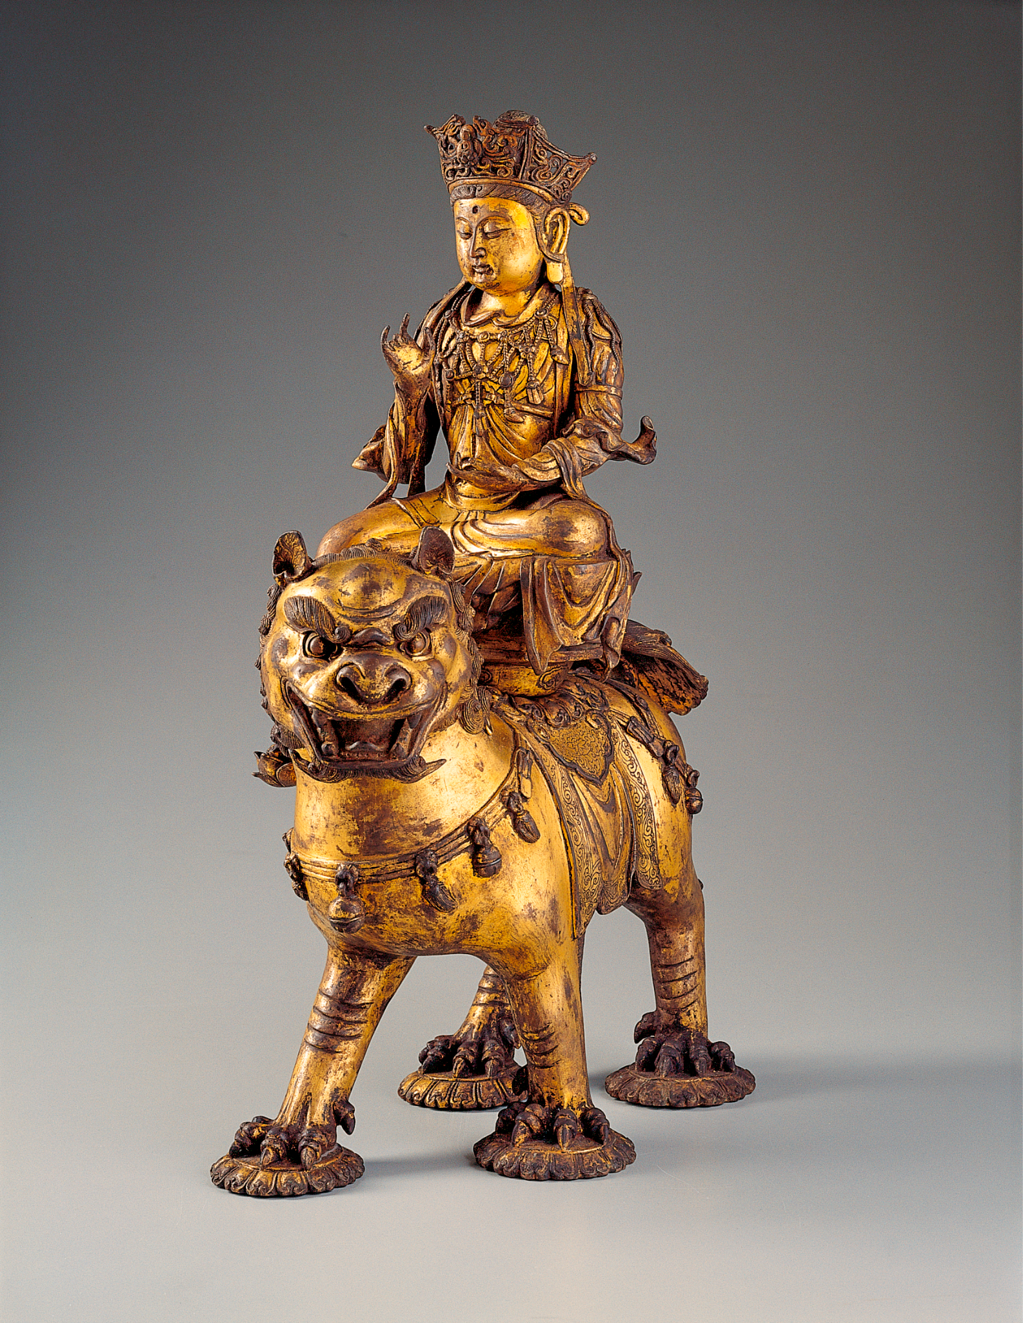
Chinese, Manjushri on a Lion, c. 1150–1279, gilt bronze. Kimbell Art Museum
Notes:
https://kimbellart.org/collection/ap-198705-ab
Of the many deities that played a role in Chinese Buddhism, Manjushri (in Chinese, Wenshu), the bodhisattva of wisdom, is among the most appealing. One of the three most important bodhisattvas in East Asia, Manjushri is said to have originated in China from the mountains associated with Mount Wutai, a famous Buddhist monastic center. He was worshiped in China as the embodiment of knowledge and the guardian of sacred doctrines. Usually presented as a youthful, bejeweled prince, he is often shown seated on the back of a lion, carrying a book of truth and a sword that cuts through the darkness of ignorance. Depictions of Manjushri on a lion were popular from the Tang dynasty (AD 618–907) onward. In this form, he was most frequently paired with the bodhisattva Samantabhadhra, these two figures flanking the historical Buddha Shakyamuni in a triad.
Among the Buddhist sculptures of China, bronze images occupy a very prominent place. Some of the finest religious works, especially during the Song dynasty (960–1279), were executed in this medium. Although paintings of Manjushri dating from the thirteenth to the fifteenth century are still extant, sculptures—particularly gilt-bronzes of this size—are extremely rare. This beautifully proportioned and superbly detailed example is a very rare complete image of the divinity. Its precise dating remains problematic due to the paucity of related material.

Slide 28
How can we tell this figure is important? What do you notice about Manjushri and the lion’s clothing and accessories? What details stand out to you?
Describe the poses and facial expressions of Manjushri and the lion. What words would you use to characterize the mood of each?
Chinese, Manjushri on a Lion, c. 1150–1279, gilt bronze. Kimbell Art Museum
Notes:
https://kimbellart.org/collection/ap-198705-ab
Of the many deities that played a role in Chinese Buddhism, Manjushri (in Chinese, Wenshu), the bodhisattva of wisdom, is among the most appealing. One of the three most important bodhisattvas in East Asia, Manjushri is said to have originated in China from the mountains associated with Mount Wutai, a famous Buddhist monastic center. He was worshiped in China as the embodiment of knowledge and the guardian of sacred doctrines. Usually presented as a youthful, bejeweled prince, he is often shown seated on the back of a lion, carrying a book of truth and a sword that cuts through the darkness of ignorance. Depictions of Manjushri on a lion were popular from the Tang dynasty (AD 618–907) onward. In this form, he was most frequently paired with the bodhisattva Samantabhadhra, these two figures flanking the historical Buddha Shakyamuni in a triad.
Among the Buddhist sculptures of China, bronze images occupy a very prominent place. Some of the finest religious works, especially during the Song dynasty (960–1279), were executed in this medium. Although paintings of Manjushri dating from the thirteenth to the fifteenth century are still extant, sculptures—particularly gilt-bronzes of this size—are extremely rare. This beautifully proportioned and superbly detailed example is a very rare complete image of the divinity. Its precise dating remains problematic due to the paucity of related material.

Slide 29
Do they seem still or active? Where do you see movement? What ideas do you associate with lions?
What clues help us to identify Manjushri, the bodhisattva of wisdom? Why would it be important to have a guardian of sacred doctrines?
Research other bodhisattvas. How do they compare to Manjushri?
Chinese, Manjushri on a Lion, c. 1150–1279, gilt bronze. Kimbell Art Museum
Notes:
https://kimbellart.org/collection/ap-198705-ab
Of the many deities that played a role in Chinese Buddhism, Manjushri (in Chinese, Wenshu), the bodhisattva of wisdom, is among the most appealing. One of the three most important bodhisattvas in East Asia, Manjushri is said to have originated in China from the mountains associated with Mount Wutai, a famous Buddhist monastic center. He was worshiped in China as the embodiment of knowledge and the guardian of sacred doctrines. Usually presented as a youthful, bejeweled prince, he is often shown seated on the back of a lion, carrying a book of truth and a sword that cuts through the darkness of ignorance. Depictions of Manjushri on a lion were popular from the Tang dynasty (AD 618–907) onward. In this form, he was most frequently paired with the bodhisattva Samantabhadhra, these two figures flanking the historical Buddha Shakyamuni in a triad.
Among the Buddhist sculptures of China, bronze images occupy a very prominent place. Some of the finest religious works, especially during the Song dynasty (960–1279), were executed in this medium. Although paintings of Manjushri dating from the thirteenth to the fifteenth century are still extant, sculptures—particularly gilt-bronzes of this size—are extremely rare. This beautifully proportioned and superbly detailed example is a very rare complete image of the divinity. Its precise dating remains problematic due to the paucity of related material.

Slide 30
Aztec, Seated Man, Possibly Huehueteotl, c. 1500, basalt. Kimbell Art Museum
Notes:
https://kimbellart.org/collection/ap-196919
Around 1337, the Aztecs settled on an island in the middle of Lake Texcoco, at the site of present-day Mexico City. They named their new capital Tenochtitlan after their chief, Tenoch. Aztec society was militaristic and regimented, and their art and culture show a pervasive interest in ritual and the symbolism of death. Guided by a sense of divine destiny and a complex religion that included the practice of blood-sacrifice to ensure the daily reappearance of the sun and the survival of their people, the Aztec established themselves as masters over much of Mesoamerica north of the Maya area until the conquest by the Spanish in 1521.
The Aztec pantheon included a vast number of gods who encapsulated almost every function of time and life. Many of these deities were borrowed from other cultures and given a distinctively Aztec cast that reflected their political and social structures. The Kimbell’s Seated Man was probably a local cult image and may have served as a guardian figure for the stairway of an Aztec temple platform. On ceremonial occasions, he may have held a banner staff in his right hand and perhaps wore a special costume. His sturdy body and coarse features indicate that he is an old macehualli, or man of the people. The bold facial scarification and more subtle, abstract patterns on the kneecaps, shoulder blades, and vertebrae suggest that he also represents the “Old God,” Huehueteotl, the Aztec patron of fire and lord of the center of the Universe.

Slide 31
Describe this figure. What details do you notice? How would you characterize his expression and pose? What age might he be?
Why might the Aztecs have placed this figure on a stairway to a temple?
What material was used for this object? How would your perception of the piece change if the sculptural material was different (marble, wood, clay, etc.)?
Aztec, Seated Man, Possibly Huehueteotl, c. 1500, basalt. Kimbell Art Museum
Notes:
https://kimbellart.org/collection/ap-196919
Around 1337, the Aztecs settled on an island in the middle of Lake Texcoco, at the site of present-day Mexico City. They named their new capital Tenochtitlan after their chief, Tenoch. Aztec society was militaristic and regimented, and their art and culture show a pervasive interest in ritual and the symbolism of death. Guided by a sense of divine destiny and a complex religion that included the practice of blood-sacrifice to ensure the daily reappearance of the sun and the survival of their people, the Aztec established themselves as masters over much of Mesoamerica north of the Maya area until the conquest by the Spanish in 1521.
The Aztec pantheon included a vast number of gods who encapsulated almost every function of time and life. Many of these deities were borrowed from other cultures and given a distinctively Aztec cast that reflected their political and social structures. The Kimbell’s Seated Man was probably a local cult image and may have served as a guardian figure for the stairway of an Aztec temple platform. On ceremonial occasions, he may have held a banner staff in his right hand and perhaps wore a special costume. His sturdy body and coarse features indicate that he is an old macehualli, or man of the people. The bold facial scarification and more subtle, abstract patterns on the kneecaps, shoulder blades, and vertebrae suggest that he also represents the “Old God,” Huehueteotl, the Aztec patron of fire and lord of the center of the Universe.

Slide 32
Where does it look like the sculpture has suffered damage? What might the piece have looked like whole? What do you think the figure originally held?
Research the capital of the Aztec Empire to learn about how they chose its location.
Aztec, Seated Man, Possibly Huehueteotl, c. 1500, basalt. Kimbell Art Museum
Notes:
https://kimbellart.org/collection/ap-196919
Around 1337, the Aztecs settled on an island in the middle of Lake Texcoco, at the site of present-day Mexico City. They named their new capital Tenochtitlan after their chief, Tenoch. Aztec society was militaristic and regimented, and their art and culture show a pervasive interest in ritual and the symbolism of death. Guided by a sense of divine destiny and a complex religion that included the practice of blood-sacrifice to ensure the daily reappearance of the sun and the survival of their people, the Aztec established themselves as masters over much of Mesoamerica north of the Maya area until the conquest by the Spanish in 1521.
The Aztec pantheon included a vast number of gods who encapsulated almost every function of time and life. Many of these deities were borrowed from other cultures and given a distinctively Aztec cast that reflected their political and social structures. The Kimbell’s Seated Man was probably a local cult image and may have served as a guardian figure for the stairway of an Aztec temple platform. On ceremonial occasions, he may have held a banner staff in his right hand and perhaps wore a special costume. His sturdy body and coarse features indicate that he is an old macehualli, or man of the people. The bold facial scarification and more subtle, abstract patterns on the kneecaps, shoulder blades, and vertebrae suggest that he also represents the “Old God,” Huehueteotl, the Aztec patron of fire and lord of the center of the Universe.

Slide 33
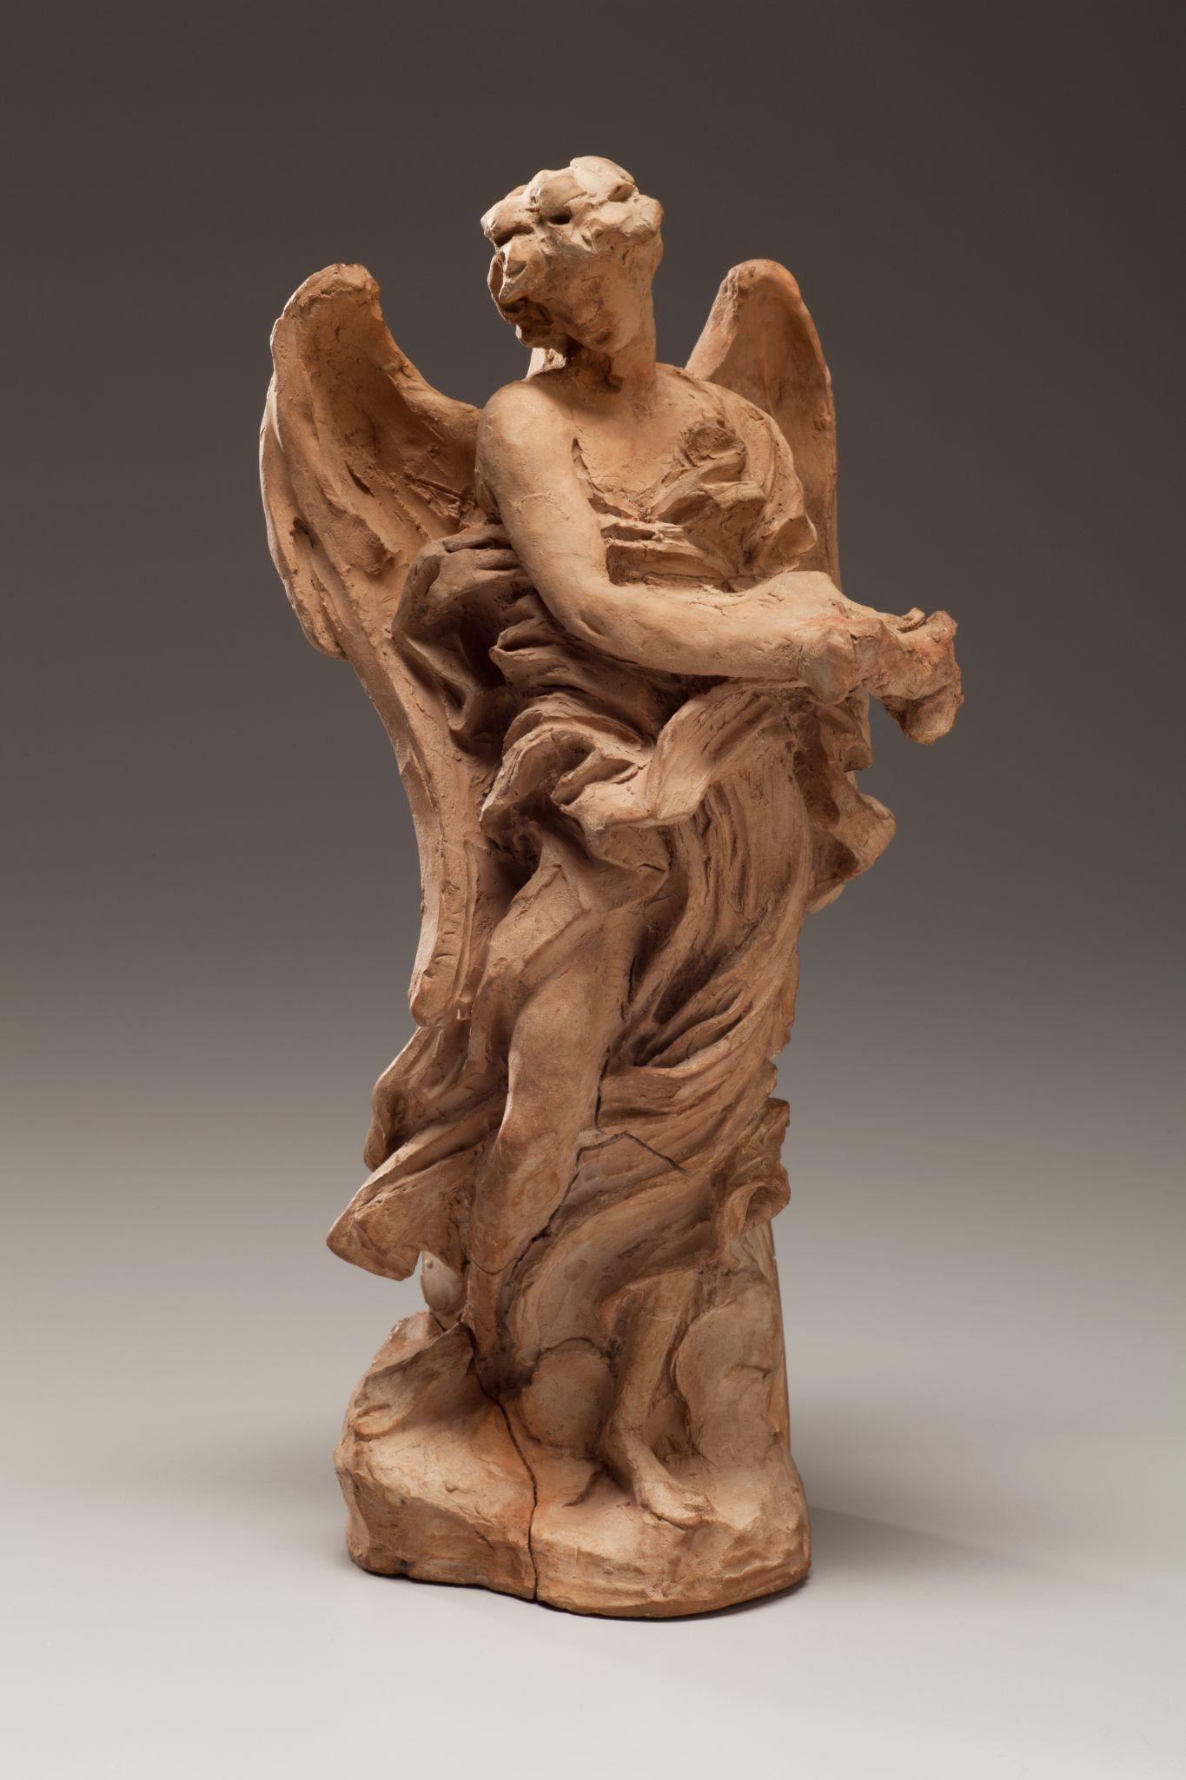
Gian Lorenzo Bernini, Angel with the Superscription and Angel with the Crown of Thorns, 1668, terracotta. Kimbell Art Museum
Notes:
https://kimbellart.org/collection/ap-198702-ab
More than any other artist, it was Gian Lorenzo Bernini, the leading sculptor of Baroque Italy, who reshaped the ancient city of Rome in a series of brilliant architectural and sculptural projects that affirmed its identity as the seat of the Roman Catholic Church. In 1667, Pope Clement IX appointed Bernini to supervise the renovation of the Ponte Sant’Angelo, the ancient bridge linking the city of Rome to the Vatican. Bernini designed ten angels, each carrying an instrument of Christ’s Passion, to alight on the bridge’s balustrades and guide the pilgrim’s approach, physically and spiritually, toward Saint Peter’s Basilica. Eight of the over-life-size angels were assigned to other sculptors, while the master himself made two: Angel with the Superscription and Angel with the Crown of Thorns. The pope deemed that the angels carved by Bernini with his own hand were too beautiful to be exposed to the elements, and copies were created for the bridge, which was completed in 1672. The original pair of angels remained in Bernini’s studio and was eventually bequeathed to Sant’Andrea delle Fratte, in Rome.
The lively terracotta angels in the Kimbell collection, conceived as a complementary pair, are among the surviving bozzetti (sketches) that trace Bernini’s successive ideas for the compositions. Leaving the imprint of his fingertips and toolmarks in the clay, Bernini modeled the figures in a rough, highly expressive manner, pinching and smoothing the forms into place. He arranged the components—long legs, arched wings, and swirling drapery—into a dynamic series of curves and counter-curves about the central axis so that each angel could be viewed from several directions.

Slide 34
What ideas do you associate with angels? Why might the pope have commissioned them? How might a pilgrim have felt walking across the Ponte Sant’Angelo while being guided by angels?
How do your eyes move around these sculptures? What design choices did Bernini make to create movement? Where do you notice changes in texture?
Gian Lorenzo Bernini, Angel with the Superscription and Angel with the Crown of Thorns, 1668, terracotta. Kimbell Art Museum
Notes:
https://kimbellart.org/collection/ap-198702-ab
More than any other artist, it was Gian Lorenzo Bernini, the leading sculptor of Baroque Italy, who reshaped the ancient city of Rome in a series of brilliant architectural and sculptural projects that affirmed its identity as the seat of the Roman Catholic Church. In 1667, Pope Clement IX appointed Bernini to supervise the renovation of the Ponte Sant’Angelo, the ancient bridge linking the city of Rome to the Vatican. Bernini designed ten angels, each carrying an instrument of Christ’s Passion, to alight on the bridge’s balustrades and guide the pilgrim’s approach, physically and spiritually, toward Saint Peter’s Basilica. Eight of the over-life-size angels were assigned to other sculptors, while the master himself made two: Angel with the Superscription and Angel with the Crown of Thorns. The pope deemed that the angels carved by Bernini with his own hand were too beautiful to be exposed to the elements, and copies were created for the bridge, which was completed in 1672. The original pair of angels remained in Bernini’s studio and was eventually bequeathed to Sant’Andrea delle Fratte, in Rome.
The lively terracotta angels in the Kimbell collection, conceived as a complementary pair, are among the surviving bozzetti (sketches) that trace Bernini’s successive ideas for the compositions. Leaving the imprint of his fingertips and toolmarks in the clay, Bernini modeled the figures in a rough, highly expressive manner, pinching and smoothing the forms into place. He arranged the components—long legs, arched wings, and swirling drapery—into a dynamic series of curves and counter-curves about the central axis so that each angel could be viewed from several directions.

Slide 35
Describe the angels’ postures. Where are they looking? What could be the significance of these poses? What little details can you find?
How do you think these terracotta “sketches” compare with the final carved marble sculptures?
Imagine walking across the Ponte Sant’Angelo. What music or sounds would you pair with the pilgrimage?
Gian Lorenzo Bernini, Angel with the Superscription and Angel with the Crown of Thorns, 1668, terracotta. Kimbell Art Museum
Notes:
https://kimbellart.org/collection/ap-198702-ab
More than any other artist, it was Gian Lorenzo Bernini, the leading sculptor of Baroque Italy, who reshaped the ancient city of Rome in a series of brilliant architectural and sculptural projects that affirmed its identity as the seat of the Roman Catholic Church. In 1667, Pope Clement IX appointed Bernini to supervise the renovation of the Ponte Sant’Angelo, the ancient bridge linking the city of Rome to the Vatican. Bernini designed ten angels, each carrying an instrument of Christ’s Passion, to alight on the bridge’s balustrades and guide the pilgrim’s approach, physically and spiritually, toward Saint Peter’s Basilica. Eight of the over-life-size angels were assigned to other sculptors, while the master himself made two: Angel with the Superscription and Angel with the Crown of Thorns. The pope deemed that the angels carved by Bernini with his own hand were too beautiful to be exposed to the elements, and copies were created for the bridge, which was completed in 1672. The original pair of angels remained in Bernini’s studio and was eventually bequeathed to Sant’Andrea delle Fratte, in Rome.
The lively terracotta angels in the Kimbell collection, conceived as a complementary pair, are among the surviving bozzetti (sketches) that trace Bernini’s successive ideas for the compositions. Leaving the imprint of his fingertips and toolmarks in the clay, Bernini modeled the figures in a rough, highly expressive manner, pinching and smoothing the forms into place. He arranged the components—long legs, arched wings, and swirling drapery—into a dynamic series of curves and counter-curves about the central axis so that each angel could be viewed from several directions.

Slide 36
Ferdinand Georg Waldmüller, Dog Guarding a Basket of Grapes, 1836, oil on canvas. Kimbell Art Museum
Notes:
https://kimbellart.org/collection/ap-202201
This true-to-life depiction of a sumptuous still life set in a vineyard in the hills overlooking Vienna showcases the outstanding pictorial imagination of Ferdinand Georg Waldmüller. The captivating composition, vibrant lighting, vivid color, and precision of detail bear out his status as the leading Viennese painter of his time. The virtuoso, lifelike execution of the dog’s protective watch over the basket of grapes reads as a manifesto championing the artist’s conviction that direct observation and truthful depiction of nature is the foundation of art.
Dog Guarding a Basket of Grapes merges still life with a remarkable animal portrait and striking landscape. In a vineyard, a large wicker fruit basket overflows with freshly cut clusters of grapes. An alert dog to the left, wearing a wide brass collar, commandeers the picture. Its features—pointed ears, bulging amber eyes, and curled tail—suggest it is a locally bred miniature guard dog or pinscher, of the type common on farms at the time. Facing the viewer, it places a paw on a plaid cloth upon which rest more bunches of grapes and a harvesting knife. The dusky, clouded background offsets the violet, blue, and honey hues of the varicolored grapes. Throughout, Waldmüller demonstrates his uncanny ability to describe the differing textures and surfaces of materials, from fabric to fur, metal to wicker, fruit to foliage. The landscape unfolding at left offers a splendid view from the foreground terrain, down the hills to the belltower of the parish church of Heiligenstadt and on to the Danube River and slate blue mountains in the far distance. The reverential rendering of the beauty and bounty of the Viennese countryside is brought down to earth by the dog’s comic role as sentinel for the vineyard.

Slide 37
What do you see happening in this painting? Who is the main character? How would you describe them?
Which colors and textures stand out to you?
From whom might the dog be guarding the grapes? What might have happened just before this scene, and what could happen next?
Ferdinand Georg Waldmüller, Dog Guarding a Basket of Grapes, 1836, oil on canvas. Kimbell Art Museum
Notes:
https://kimbellart.org/collection/ap-202201
This true-to-life depiction of a sumptuous still life set in a vineyard in the hills overlooking Vienna showcases the outstanding pictorial imagination of Ferdinand Georg Waldmüller. The captivating composition, vibrant lighting, vivid color, and precision of detail bear out his status as the leading Viennese painter of his time. The virtuoso, lifelike execution of the dog’s protective watch over the basket of grapes reads as a manifesto championing the artist’s conviction that direct observation and truthful depiction of nature is the foundation of art.
Dog Guarding a Basket of Grapes merges still life with a remarkable animal portrait and striking landscape. In a vineyard, a large wicker fruit basket overflows with freshly cut clusters of grapes. An alert dog to the left, wearing a wide brass collar, commandeers the picture. Its features—pointed ears, bulging amber eyes, and curled tail—suggest it is a locally bred miniature guard dog or pinscher, of the type common on farms at the time. Facing the viewer, it places a paw on a plaid cloth upon which rest more bunches of grapes and a harvesting knife. The dusky, clouded background offsets the violet, blue, and honey hues of the varicolored grapes. Throughout, Waldmüller demonstrates his uncanny ability to describe the differing textures and surfaces of materials, from fabric to fur, metal to wicker, fruit to foliage. The landscape unfolding at left offers a splendid view from the foreground terrain, down the hills to the belltower of the parish church of Heiligenstadt and on to the Danube River and slate blue mountains in the far distance. The reverential rendering of the beauty and bounty of the Viennese countryside is brought down to earth by the dog’s comic role as sentinel for the vineyard.

Slide 38
What other details can be found in the foreground and distant background?
Draw a scene with an animal you cherish. Who or what would your furry friend protect?
Ferdinand Georg Waldmüller, Dog Guarding a Basket of Grapes, 1836, oil on canvas. Kimbell Art Museum
Notes:
https://kimbellart.org/collection/ap-202201
This true-to-life depiction of a sumptuous still life set in a vineyard in the hills overlooking Vienna showcases the outstanding pictorial imagination of Ferdinand Georg Waldmüller. The captivating composition, vibrant lighting, vivid color, and precision of detail bear out his status as the leading Viennese painter of his time. The virtuoso, lifelike execution of the dog’s protective watch over the basket of grapes reads as a manifesto championing the artist’s conviction that direct observation and truthful depiction of nature is the foundation of art.
Dog Guarding a Basket of Grapes merges still life with a remarkable animal portrait and striking landscape. In a vineyard, a large wicker fruit basket overflows with freshly cut clusters of grapes. An alert dog to the left, wearing a wide brass collar, commandeers the picture. Its features—pointed ears, bulging amber eyes, and curled tail—suggest it is a locally bred miniature guard dog or pinscher, of the type common on farms at the time. Facing the viewer, it places a paw on a plaid cloth upon which rest more bunches of grapes and a harvesting knife. The dusky, clouded background offsets the violet, blue, and honey hues of the varicolored grapes. Throughout, Waldmüller demonstrates his uncanny ability to describe the differing textures and surfaces of materials, from fabric to fur, metal to wicker, fruit to foliage. The landscape unfolding at left offers a splendid view from the foreground terrain, down the hills to the belltower of the parish church of Heiligenstadt and on to the Danube River and slate blue mountains in the far distance. The reverential rendering of the beauty and bounty of the Viennese countryside is brought down to earth by the dog’s comic role as sentinel for the vineyard.

Slide 39
Art in order of appearance:
Maya culture, Guatemala, Standing Ruler, c. AD 600–800, ceramic with traces of paint. Kimbell Art Museum, Fort Worth, AP 1984.03
Gian Lorenzo Bernini, Angel with the Superscription, 1668, terracotta. Kimbell Art Museum, Fort Worth, AP 1987.02a
Japanese, Haniwa Seated Man, c. AD 500, low-fired clay with cinnabar pigment. Kimbell Art Museum, Fort Worth, AP 1972.02
Aztec, Seated Man, Possibly Huehueteotl, c. 1500, basalt. Kimbell Art Museum, Fort Worth, AP 1969.19
Hemba, Warrior Ancestor Figure, 19th century, wood. Kimbell Art Museum, Fort Worth, AP 1979.03
Chinese, Court Lady, first half of the 8th century AD, gray earthenware with painted polychrome decoration. Kimbell Art Museum, Fort Worth, AP 2001.01
Chinese, Western Han dynasty (206 BC–AD 9), Horse and Rider, 2nd–1st century BC, earthenware with painted polychrome decoration. Kimbell Art Museum, Fort Worth, AP 1994.07
Chinese, Earth Spirit, first half of the 8th century. Gray earthenware with painted polychrome decoration. Kimbell Art Museum, Fort Worth, AP 2001.02
Oceanic, Maori, Te Huringa period I (1800–1900), Standing Ancestor Figure, c. 1800–1840, wood. Kimbell Art Museum, Fort Worth, 1989.04
Ferdinand Georg Waldmüller, Dog Guarding a Basket of Grapes, 1836, oil on canvas. Kimbell Art Museum, Fort Worth, AP 2022.01
Chinese, Manjushri on a Lion, c. 1150–1279, gilt bronze. Kimbell Art Museum, Fort Worth, AP 1987.05a,b
Gian Lorenzo Bernini, Angel with the Crown, 1668, terracotta. Kimbell Art Museum, Fort Worth, AP 1987.02b
© 2025 Kimbell Art Museum

