Slide 1
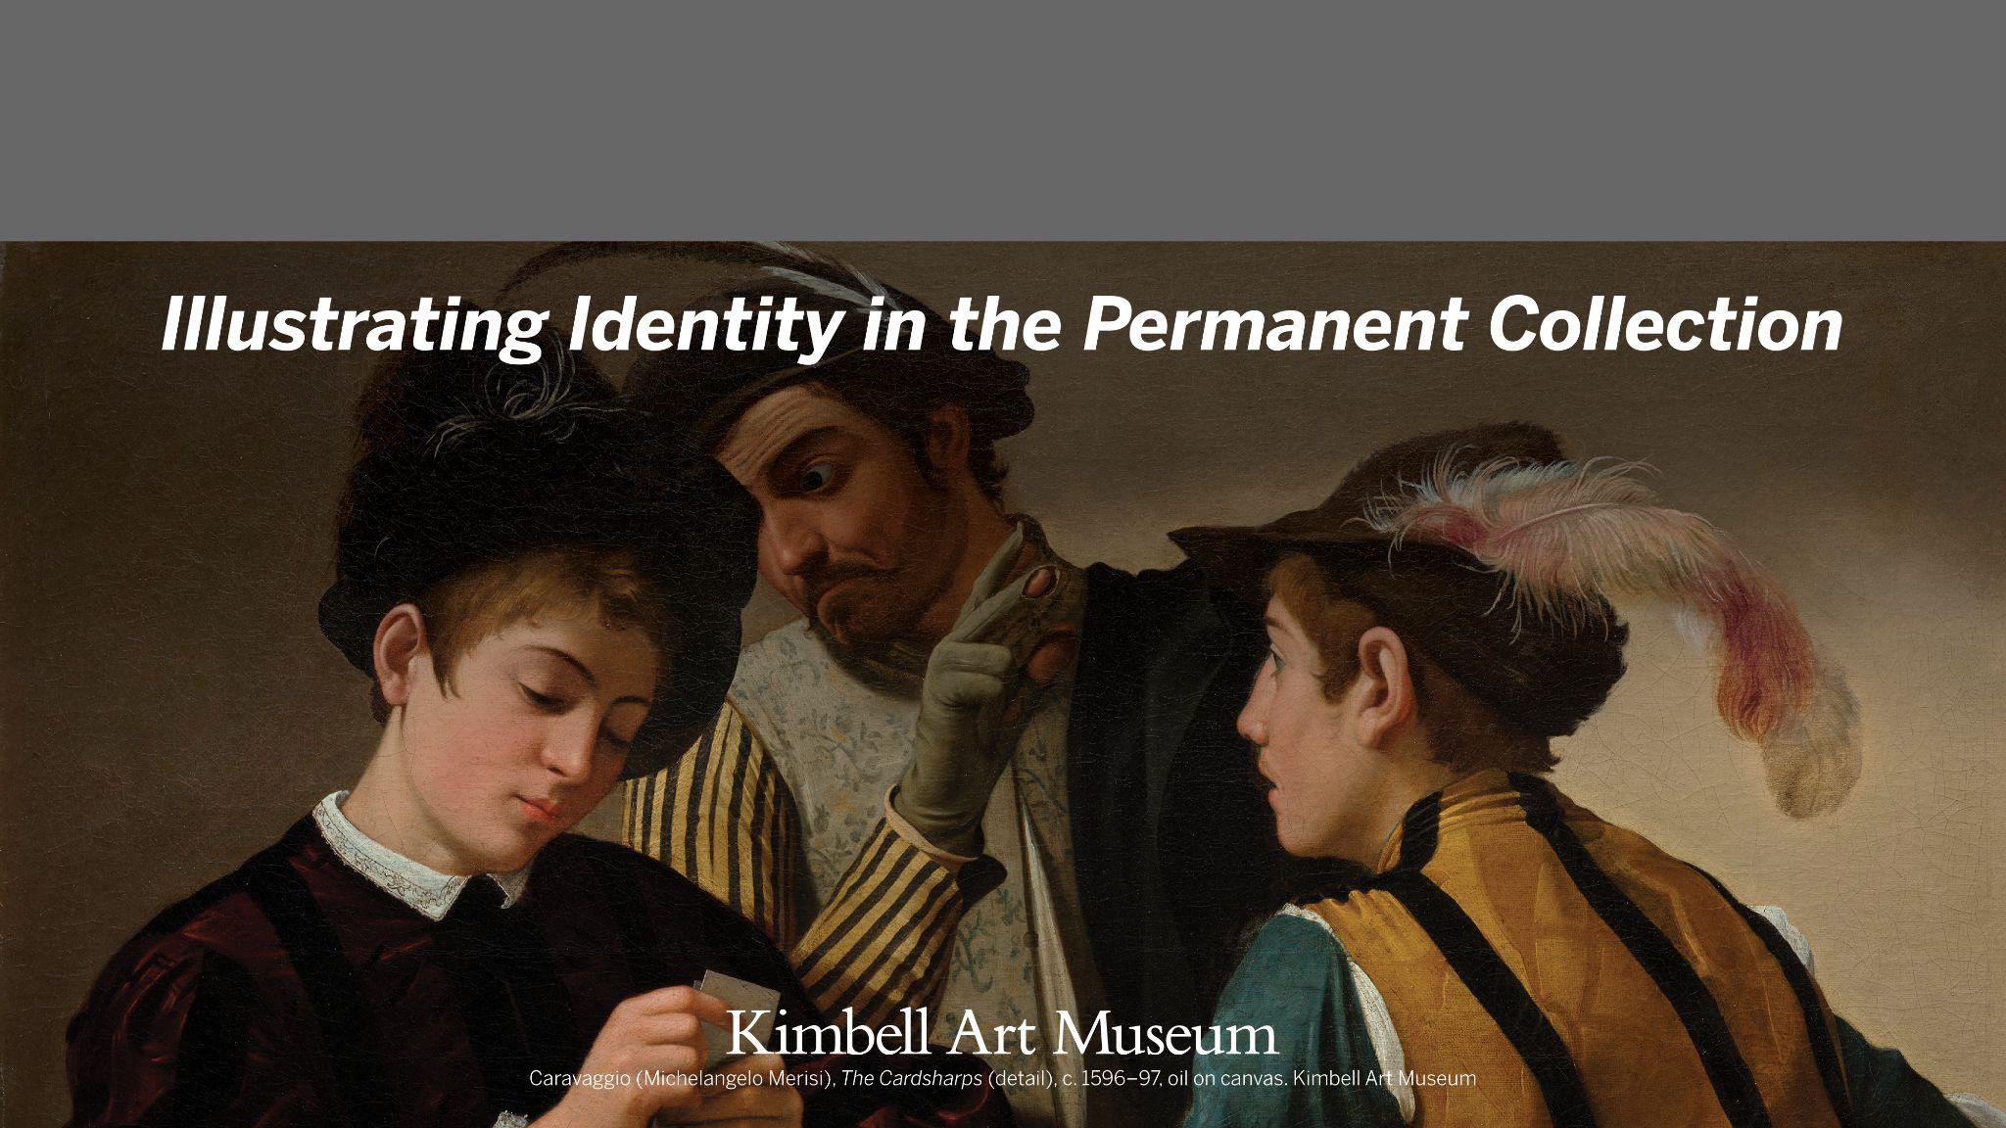
Kimbell Educator Packet

Slide 2
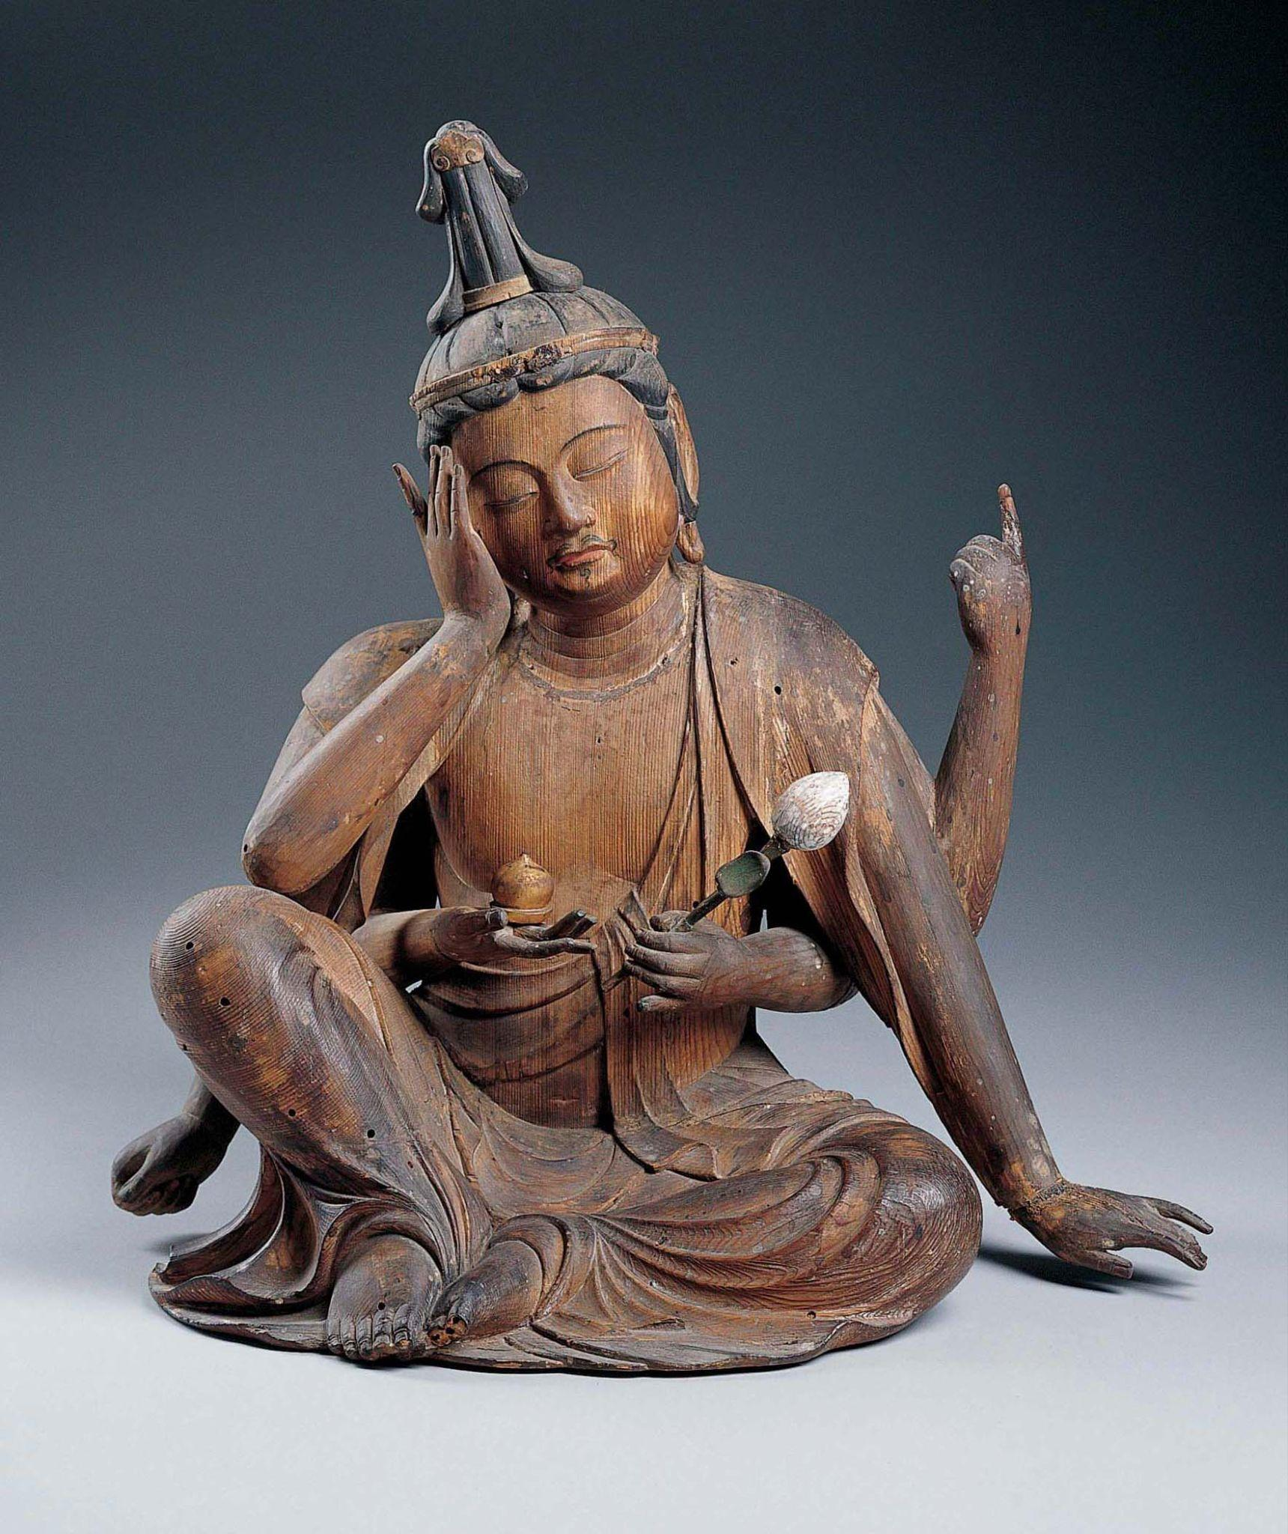
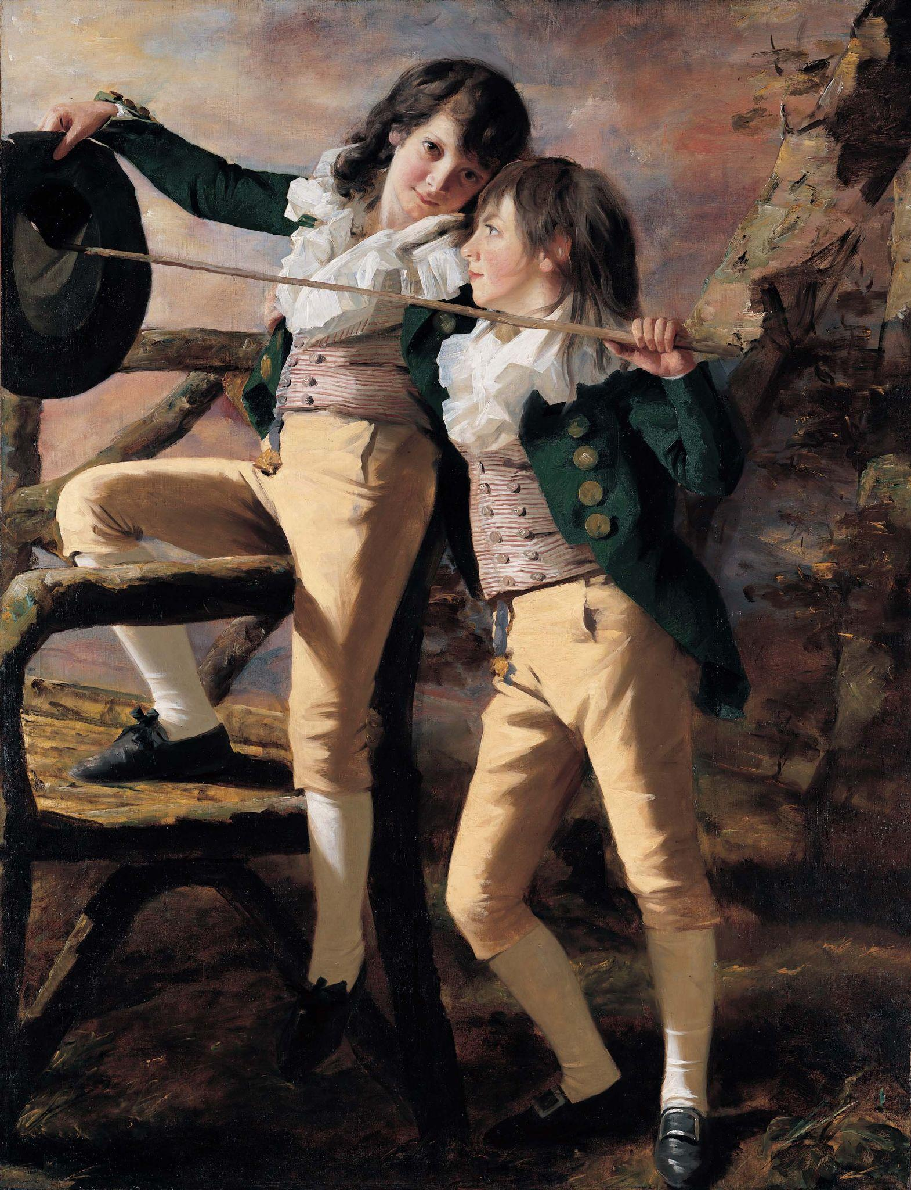
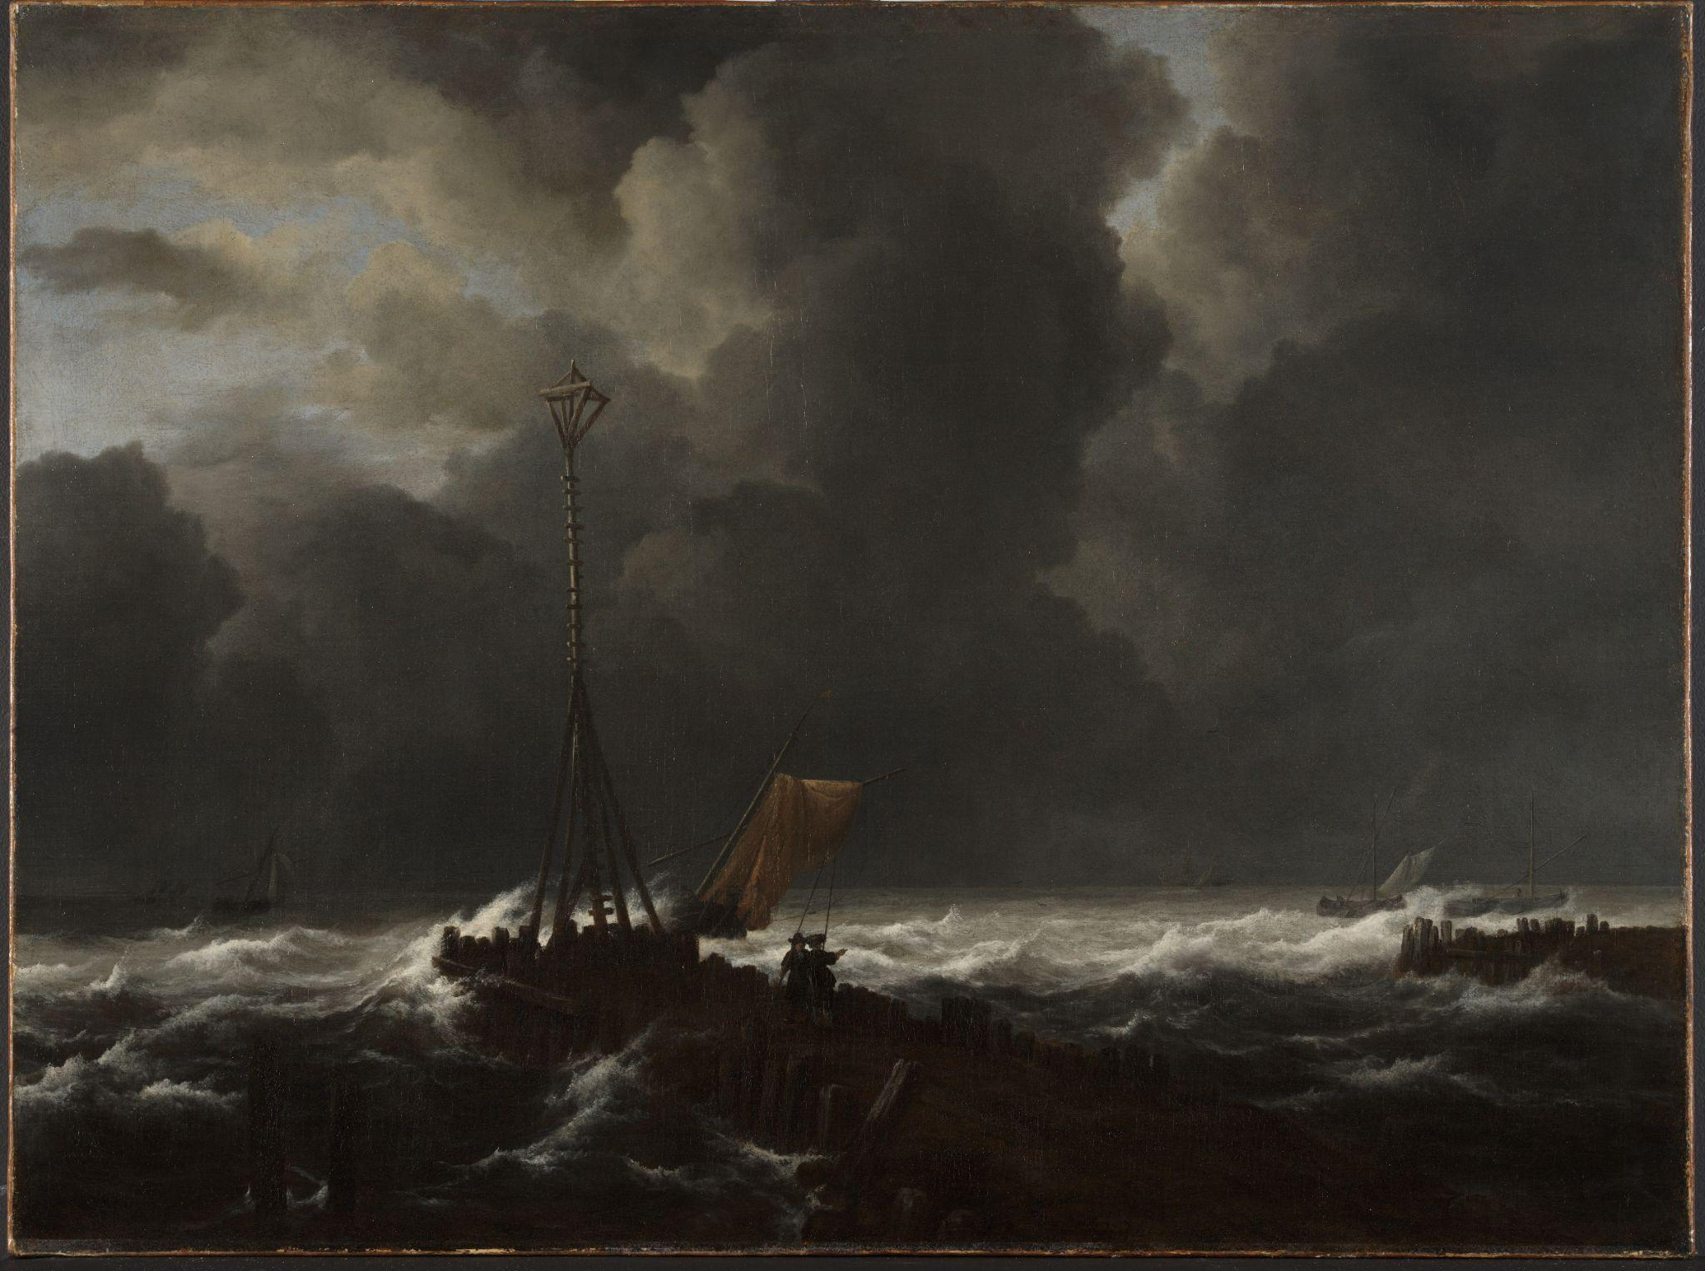
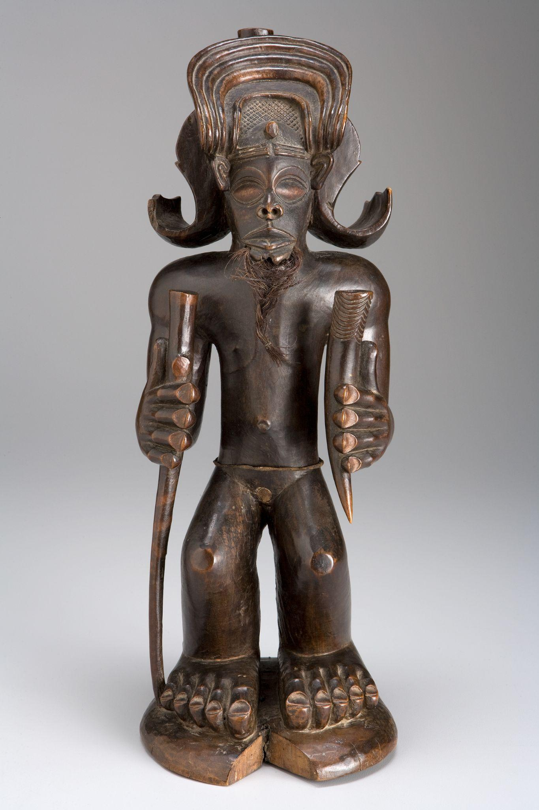
Illustrating Identity in the Permanent Collection
How do artists depict a person or group’s identity? How do we read images to learn more about the culture from where they came?
Explore artworks focused on:
Purposeful Poses
Symbolic Scenes
Connecting Collections
Japanese, Seated Nyoirin Kannon, c. 1230–50, wood with traces of gilt and pigment. Kimbell Art Museum; Henry Raeburn, The Allen Brothers (Portrait of James and John Lee Allen) (detail), early 1790s, oil on canvas. Kimbell Art Museum; Jacob van Ruisdael, Rough Sea at a Jetty (detail), 1650s, oil on canvas. Kimbell Art Museum; Chokwe​ people, Chibinda Ilunga​, mid-19th century, wood, hair, and hide​. Kimbell Art Museum

Slide 3
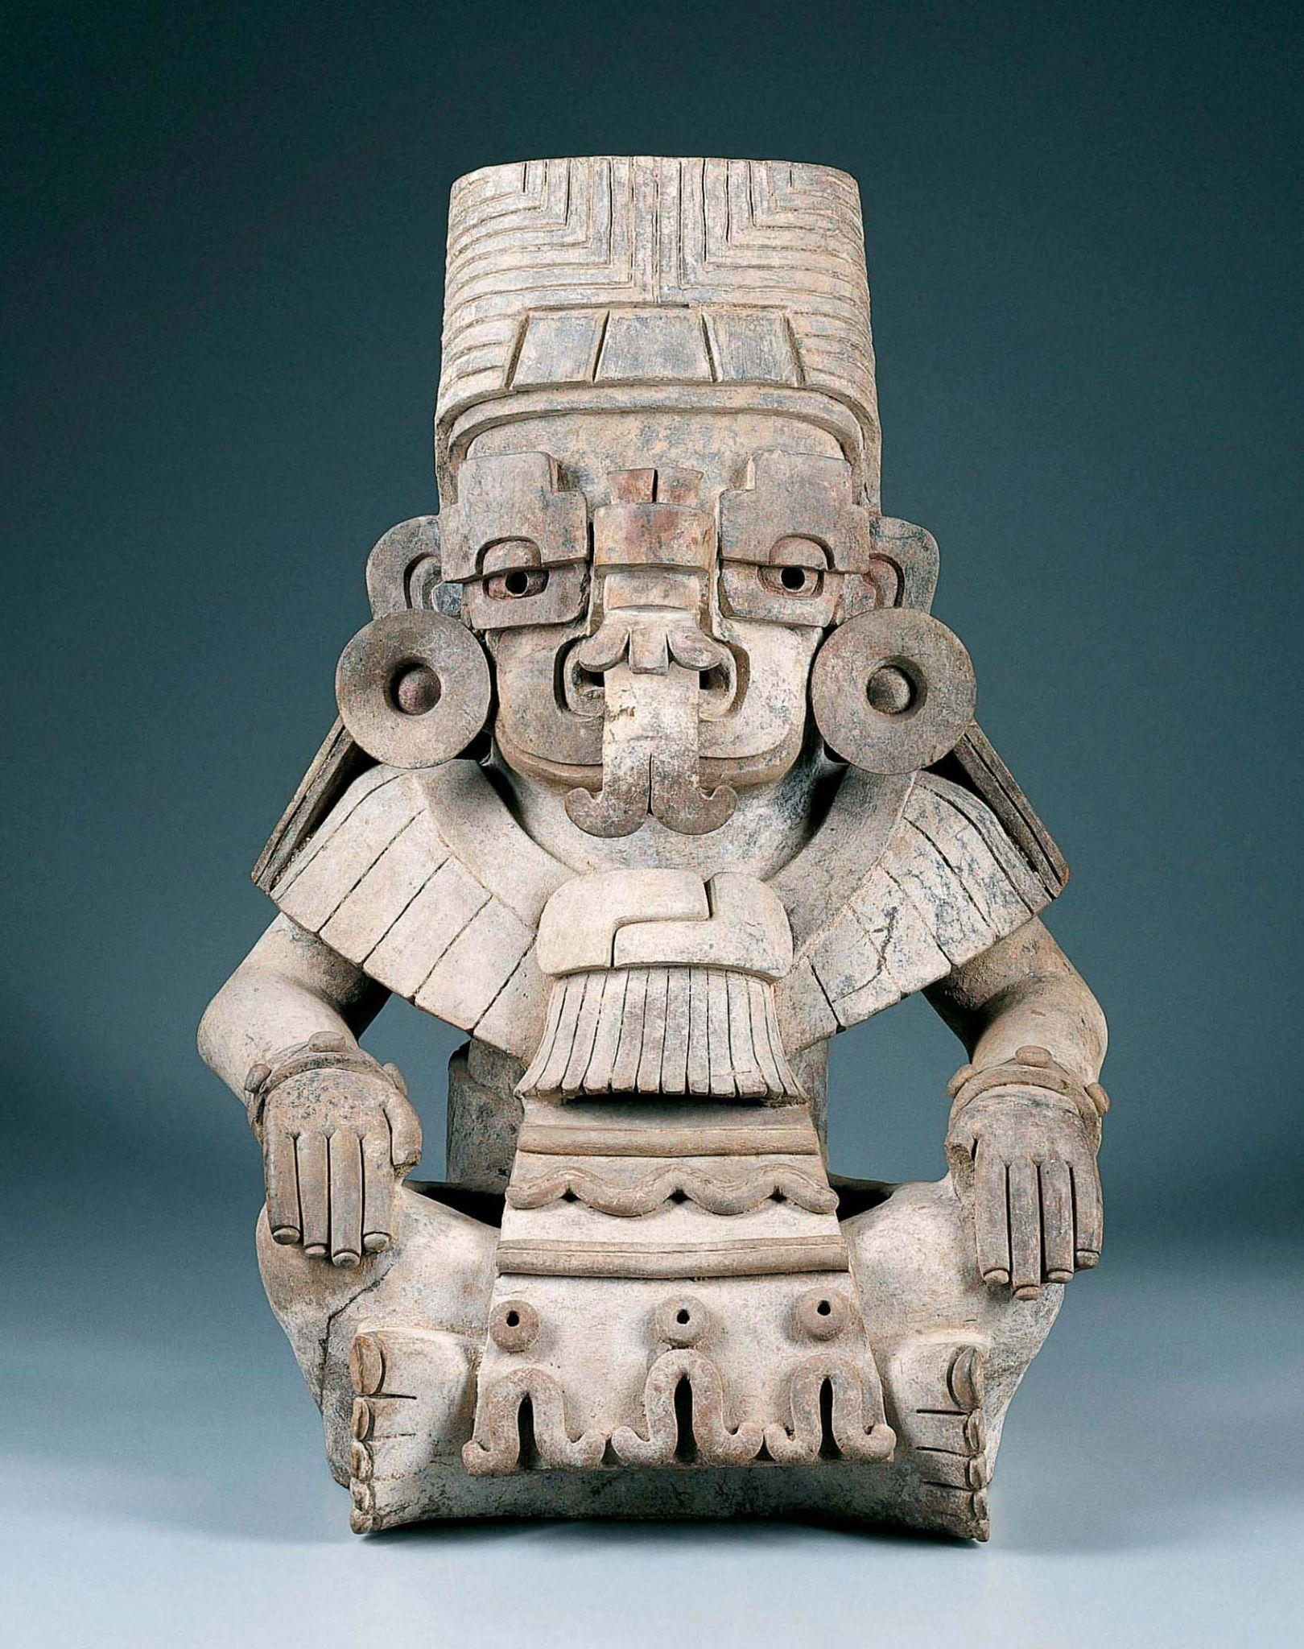
Purposeful Poses
What can we learn about a person by their pose?
Zapotec culture, Urn in the Form of Cociyo, ​God of Lightning and Rain​, c. AD 400–500, ceramic.​ Kimbell Art Museum

Slide 4
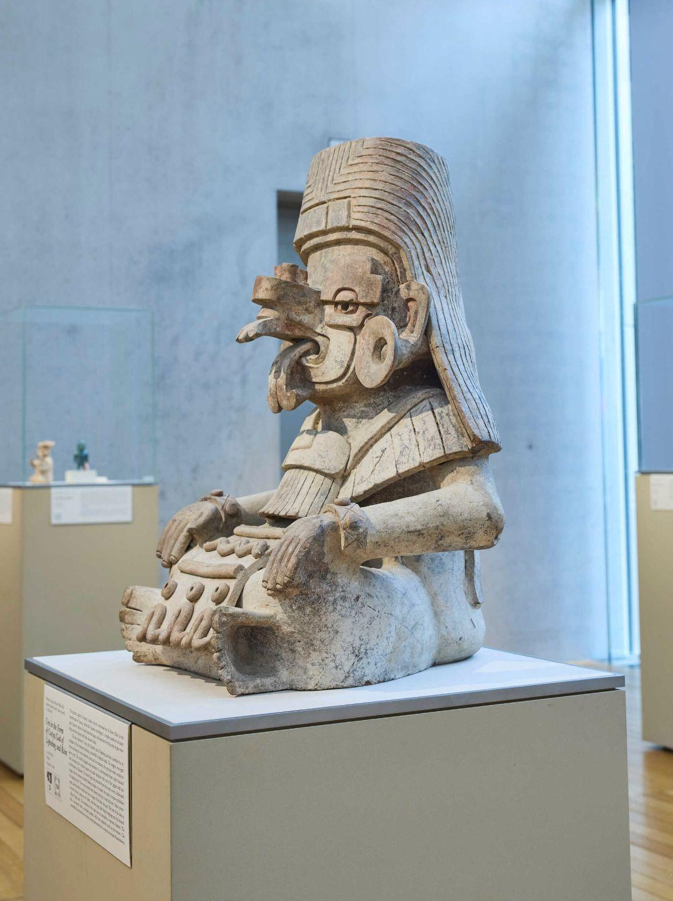
Zapotec culture, Urn in the Form of Cociyo, ​God of Lightning and Rain​, c. AD 400–500, ceramic.​ Kimbell Art Museum
Notes:
https://kimbellart.org/collection/ap-198509
The Zapotec civilization developed over a period of more than one thousand years in relative geographic isolation in the modern state of Oaxaca, in southern Mexico. The primary capital of Zapotec culture was the ceremonial site of Monte Albán, constructed on an artificially flattened mountaintop, where the Zapotecs worshipped a complex pantheon of nature gods. Zapotec culture is divided into four stages, each associated with the style of gray-ware effigy urns they placed with their honored dead. The urns depict both gods and important human beings, some in ritual garb impersonating gods.
This urn represents Cociyo, the Zapotec name for the Mesoamerican god of lightning and rain. In his Zapotec manifestation, he is identified by a combination of facial elements forming a powerfully sculptural mask. The stepped, two-part forms enclosing the eyes represent clouds and, by extension, the precious water needed to grow crops. The doubly plugged nasal extension is a development from earlier snouted deity elements that combine jaguar and snake allusions. The roar of the jaguar represents the reverberation of thunder. The three fangs that protrude from this snout cover a bifurcated tongue, like the almost invisibly flashing tongue of a snake, symbolizing a lightning bolt. The rest of the dress is as much that of a priest as of a deity, with the large disk-shaped earplugs and the knotted collar of high rank. The striations of the cape may represent feathers. The kilt is decorated with a wavelike pattern, with three attached tassels at the bottom. The ensemble thus echoes the various natural phenomena of a tropical mountain thunderstorm.

Slide 5
What are your first impressions of this figure? What details stand out to you? Where do you notice different types of lines, shapes, and patterns? What do you notice about his attire and accessories?
Describe Cociyo’s pose. What impression does this give you of his identity?
What details do you see in his nose and mouth? How would you describe the shape around his eyes?
Zapotec culture, Urn in the Form of Cociyo, ​God of Lightning and Rain​, c. AD 400–500, ceramic.​ Kimbell Art Museum
Notes:
https://kimbellart.org/collection/ap-198509
The Zapotec civilization developed over a period of more than one thousand years in relative geographic isolation in the modern state of Oaxaca, in southern Mexico. The primary capital of Zapotec culture was the ceremonial site of Monte Albán, constructed on an artificially flattened mountaintop, where the Zapotecs worshipped a complex pantheon of nature gods. Zapotec culture is divided into four stages, each associated with the style of gray-ware effigy urns they placed with their honored dead. The urns depict both gods and important human beings, some in ritual garb impersonating gods.
This urn represents Cociyo, the Zapotec name for the Mesoamerican god of lightning and rain. In his Zapotec manifestation, he is identified by a combination of facial elements forming a powerfully sculptural mask. The stepped, two-part forms enclosing the eyes represent clouds and, by extension, the precious water needed to grow crops. The doubly plugged nasal extension is a development from earlier snouted deity elements that combine jaguar and snake allusions. The roar of the jaguar represents the reverberation of thunder. The three fangs that protrude from this snout cover a bifurcated tongue, like the almost invisibly flashing tongue of a snake, symbolizing a lightning bolt. The rest of the dress is as much that of a priest as of a deity, with the large disk-shaped earplugs and the knotted collar of high rank. The striations of the cape may represent feathers. The kilt is decorated with a wavelike pattern, with three attached tassels at the bottom. The ensemble thus echoes the various natural phenomena of a tropical mountain thunderstorm.

Slide 6
Why might rainstorms have been so significant to the Zapotec people? What are the benefits and dangers of that kind of weather? Why create an artwork representing this powerful figure?
Imagine what Cociyo might say to you. What would he want to discuss? How would you respond to him?
Zapotec culture, Urn in the Form of Cociyo, ​God of Lightning and Rain​, c. AD 400–500, ceramic.​ Kimbell Art Museum
Notes:
https://kimbellart.org/collection/ap-198509
The Zapotec civilization developed over a period of more than one thousand years in relative geographic isolation in the modern state of Oaxaca, in southern Mexico. The primary capital of Zapotec culture was the ceremonial site of Monte Albán, constructed on an artificially flattened mountaintop, where the Zapotecs worshipped a complex pantheon of nature gods. Zapotec culture is divided into four stages, each associated with the style of gray-ware effigy urns they placed with their honored dead. The urns depict both gods and important human beings, some in ritual garb impersonating gods.
This urn represents Cociyo, the Zapotec name for the Mesoamerican god of lightning and rain. In his Zapotec manifestation, he is identified by a combination of facial elements forming a powerfully sculptural mask. The stepped, two-part forms enclosing the eyes represent clouds and, by extension, the precious water needed to grow crops. The doubly plugged nasal extension is a development from earlier snouted deity elements that combine jaguar and snake allusions. The roar of the jaguar represents the reverberation of thunder. The three fangs that protrude from this snout cover a bifurcated tongue, like the almost invisibly flashing tongue of a snake, symbolizing a lightning bolt. The rest of the dress is as much that of a priest as of a deity, with the large disk-shaped earplugs and the knotted collar of high rank. The striations of the cape may represent feathers. The kilt is decorated with a wavelike pattern, with three attached tassels at the bottom. The ensemble thus echoes the various natural phenomena of a tropical mountain thunderstorm.

Slide 7
Japanese, Seated Nyoirin Kannon, c. 1230–50, wood with traces of gilt and pigment. Kimbell Art Museum
Notes:
https://kimbellart.org/collection/ap-198515
Esoteric Buddhism was introduced into Japan in the ninth century by way of China. The Esoteric sect worshipped a vast number of deities in an expanded pantheon of new forms. The multiple heads and arms seen in Esoteric Buddhist sculpture symbolize the numerous powers of deities. The several forms of the bodhisattva Kannon reflect this complex theology. Kannon (in Sanskrit, Avalokiteshvara) is the bodhisattva of compassion, the most popular of all the Buddhist deities throughout Asia because of the boundless love he offered to all beings. The Nyoirin Kannon, a prominent deity in the Japanese Esoteric Buddhist pantheon, is one of the six “changed forms” of the bodhisattva, especially associated with the granting of desires. The world nyo-i refers to the cintamani wish-granting jewel; rin means “wheel” and refers to the turning of the wheel of the law. The Nyoirin Kannon was widely worshipped by those who hoped to gain riches and see their requests fulfilled.
This gracious image shows the deity seated in a pose of royal ease. Although drawings frequently depict him with two arms, the six-armed form was also popular in Japan. As in this sculpture, one hand is often shown touching the cheek, with a left arm braced against the lotus pedestal (now missing). Of the other four arms, one of the right hands holds the jewel, one of the left hands holds a lotus, the raised left arm originally had a wheel balanced on the upright finger, and the lowered right arm originally held a rosary.

Slide 8
Describe Kannon’s pose. How many arms does he have? What is he holding? What else is he doing with his hands? What would be the benefit of so many arms?
What does his facial expression tell us? How is he feeling in this moment?
What material is this? Where does it look weathered? What colors stand out?
Japanese, Seated Nyoirin Kannon, c. 1230–50, wood with traces of gilt and pigment. Kimbell Art Museum
Notes:
https://kimbellart.org/collection/ap-198515
Esoteric Buddhism was introduced into Japan in the ninth century by way of China. The Esoteric sect worshipped a vast number of deities in an expanded pantheon of new forms. The multiple heads and arms seen in Esoteric Buddhist sculpture symbolize the numerous powers of deities. The several forms of the bodhisattva Kannon reflect this complex theology. Kannon (in Sanskrit, Avalokiteshvara) is the bodhisattva of compassion, the most popular of all the Buddhist deities throughout Asia because of the boundless love he offered to all beings. The Nyoirin Kannon, a prominent deity in the Japanese Esoteric Buddhist pantheon, is one of the six “changed forms” of the bodhisattva, especially associated with the granting of desires. The world nyo-i refers to the cintamani wish-granting jewel; rin means “wheel” and refers to the turning of the wheel of the law. The Nyoirin Kannon was widely worshipped by those who hoped to gain riches and see their requests fulfilled.
This gracious image shows the deity seated in a pose of royal ease. Although drawings frequently depict him with two arms, the six-armed form was also popular in Japan. As in this sculpture, one hand is often shown touching the cheek, with a left arm braced against the lotus pedestal (now missing). Of the other four arms, one of the right hands holds the jewel, one of the left hands holds a lotus, the raised left arm originally had a wheel balanced on the upright finger, and the lowered right arm originally held a rosary.

Slide 9
Kannon is a powerful deity and granter of desires! If you could ask him to grant you one wish, what would it be, and why? What are your special powers? Do you have a hobby, talent, or skill you like to share with others?
What sort of skills/tools might you use to help your community? If you were like Kannon, what would you hold or do with your hands to communicate your gifts?
Read the story of the Nyoirin Kannon and learn about other important symbols in Buddhist art.
Japanese, Seated Nyoirin Kannon, c. 1230–50, wood with traces of gilt and pigment. Kimbell Art Museum
Notes:
https://kimbellart.org/collection/ap-198515
Esoteric Buddhism was introduced into Japan in the ninth century by way of China. The Esoteric sect worshipped a vast number of deities in an expanded pantheon of new forms. The multiple heads and arms seen in Esoteric Buddhist sculpture symbolize the numerous powers of deities. The several forms of the bodhisattva Kannon reflect this complex theology. Kannon (in Sanskrit, Avalokiteshvara) is the bodhisattva of compassion, the most popular of all the Buddhist deities throughout Asia because of the boundless love he offered to all beings. The Nyoirin Kannon, a prominent deity in the Japanese Esoteric Buddhist pantheon, is one of the six “changed forms” of the bodhisattva, especially associated with the granting of desires. The world nyo-i refers to the cintamani wish-granting jewel; rin means “wheel” and refers to the turning of the wheel of the law. The Nyoirin Kannon was widely worshipped by those who hoped to gain riches and see their requests fulfilled.
This gracious image shows the deity seated in a pose of royal ease. Although drawings frequently depict him with two arms, the six-armed form was also popular in Japan. As in this sculpture, one hand is often shown touching the cheek, with a left arm braced against the lotus pedestal (now missing). Of the other four arms, one of the right hands holds the jewel, one of the left hands holds a lotus, the raised left arm originally had a wheel balanced on the upright finger, and the lowered right arm originally held a rosary.

Slide 10
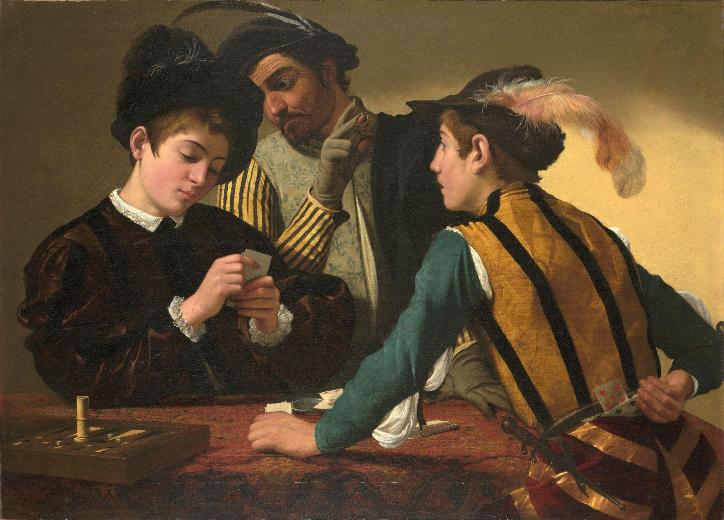
Caravaggio, The Cardsharps, c. 1596–97, oil on canvas. Kimbell Art Museum
Notes:
https://kimbellart.org/collection/ap-198706
Caravaggio was one of the pivotal figures in the history of Western art. In his short lifetime, he created a new, theatrical style that shocked some and inspired others to probe their subject matter for the drama of psychological relationships. Apprenticed in Milan, Caravaggio came to Rome in the early 1590s. There, his early masterpiece The Cardsharps came to the attention of the influential Cardinal Francesco Maria del Monte, who not only purchased it but also offered the artist quarters in his palace and introduced him to the elite stratum of Roman ecclesiastical society, which would lead to his first significant large-scale public commissions.
In The Cardsharps, the players are engaged in a game of primero, a forerunner of poker. The dupe, engrossed in his cards, is unaware that the older cardsharp signals his accomplice with a raised, gloved hand (the fingertips exposed, better to feel marked cards). The young cheat looks expectantly toward the boy and reaches behind his back to pull a hidden card from his breeches. Caravaggio structures the picture to allow us to witness everything, implicating us in the trickery. He has treated this subject not as a caricature of vice but in a novelistic way in which the interaction of gesture and glance evokes the drama of deception and lost innocence in the most human of terms. The Cardsharps spawned countless paintings on related themes by artists throughout Europe–not the least of which was Georges de La Tour’s Cheat with the Ace of Clubs, in the Kimbell. The Cardsharps was stamped on the back with the seal of Cardinal de Monte and inventoried among his possessions after his death in 1627. Its location had been unknown for some ninety years when it was rediscovered in 1987 in a European private collection.

Slide 11
What is happening in this picture? What do you notice first? Follow the eyes and gestures of each figure. How does your eye move around the painting?
Compare the characters and describe their poses and expressions. What is each man’s role? What do you notice about their costumes?
What types of lines do you see? How are the figures grouped? What shape do they create?
Caravaggio, The Cardsharps, c. 1596–97, oil on canvas. Kimbell Art Museum
Notes:
https://kimbellart.org/collection/ap-198706
Caravaggio was one of the pivotal figures in the history of Western art. In his short lifetime, he created a new, theatrical style that shocked some and inspired others to probe their subject matter for the drama of psychological relationships. Apprenticed in Milan, Caravaggio came to Rome in the early 1590s. There, his early masterpiece The Cardsharps came to the attention of the influential Cardinal Francesco Maria del Monte, who not only purchased it but also offered the artist quarters in his palace and introduced him to the elite stratum of Roman ecclesiastical society, which would lead to his first significant large-scale public commissions.
In The Cardsharps, the players are engaged in a game of primero, a forerunner of poker. The dupe, engrossed in his cards, is unaware that the older cardsharp signals his accomplice with a raised, gloved hand (the fingertips exposed, better to feel marked cards). The young cheat looks expectantly toward the boy and reaches behind his back to pull a hidden card from his breeches. Caravaggio structures the picture to allow us to witness everything, implicating us in the trickery. He has treated this subject not as a caricature of vice but in a novelistic way in which the interaction of gesture and glance evokes the drama of deception and lost innocence in the most human of terms. The Cardsharps spawned countless paintings on related themes by artists throughout Europe–not the least of which was Georges de La Tour’s Cheat with the Ace of Clubs, in the Kimbell. The Cardsharps was stamped on the back with the seal of Cardinal de Monte and inventoried among his possessions after his death in 1627. Its location had been unknown for some ninety years when it was rediscovered in 1987 in a European private collection.

Slide 12
Where do you see light and shadow? What other details do you see? What kind of game are they playing? Describe the space. Where are they?
Write a story from the perspective of one of the characters and share it with the class. What do you think will happen next? What would you do in this situation?
Caravaggio, The Cardsharps, c. 1596–97, oil on canvas. Kimbell Art Museum
Notes:
https://kimbellart.org/collection/ap-198706
Caravaggio was one of the pivotal figures in the history of Western art. In his short lifetime, he created a new, theatrical style that shocked some and inspired others to probe their subject matter for the drama of psychological relationships. Apprenticed in Milan, Caravaggio came to Rome in the early 1590s. There, his early masterpiece The Cardsharps came to the attention of the influential Cardinal Francesco Maria del Monte, who not only purchased it but also offered the artist quarters in his palace and introduced him to the elite stratum of Roman ecclesiastical society, which would lead to his first significant large-scale public commissions.
In The Cardsharps, the players are engaged in a game of primero, a forerunner of poker. The dupe, engrossed in his cards, is unaware that the older cardsharp signals his accomplice with a raised, gloved hand (the fingertips exposed, better to feel marked cards). The young cheat looks expectantly toward the boy and reaches behind his back to pull a hidden card from his breeches. Caravaggio structures the picture to allow us to witness everything, implicating us in the trickery. He has treated this subject not as a caricature of vice but in a novelistic way in which the interaction of gesture and glance evokes the drama of deception and lost innocence in the most human of terms. The Cardsharps spawned countless paintings on related themes by artists throughout Europe–not the least of which was Georges de La Tour’s Cheat with the Ace of Clubs, in the Kimbell. The Cardsharps was stamped on the back with the seal of Cardinal de Monte and inventoried among his possessions after his death in 1627. Its location had been unknown for some ninety years when it was rediscovered in 1987 in a European private collection.

Slide 13
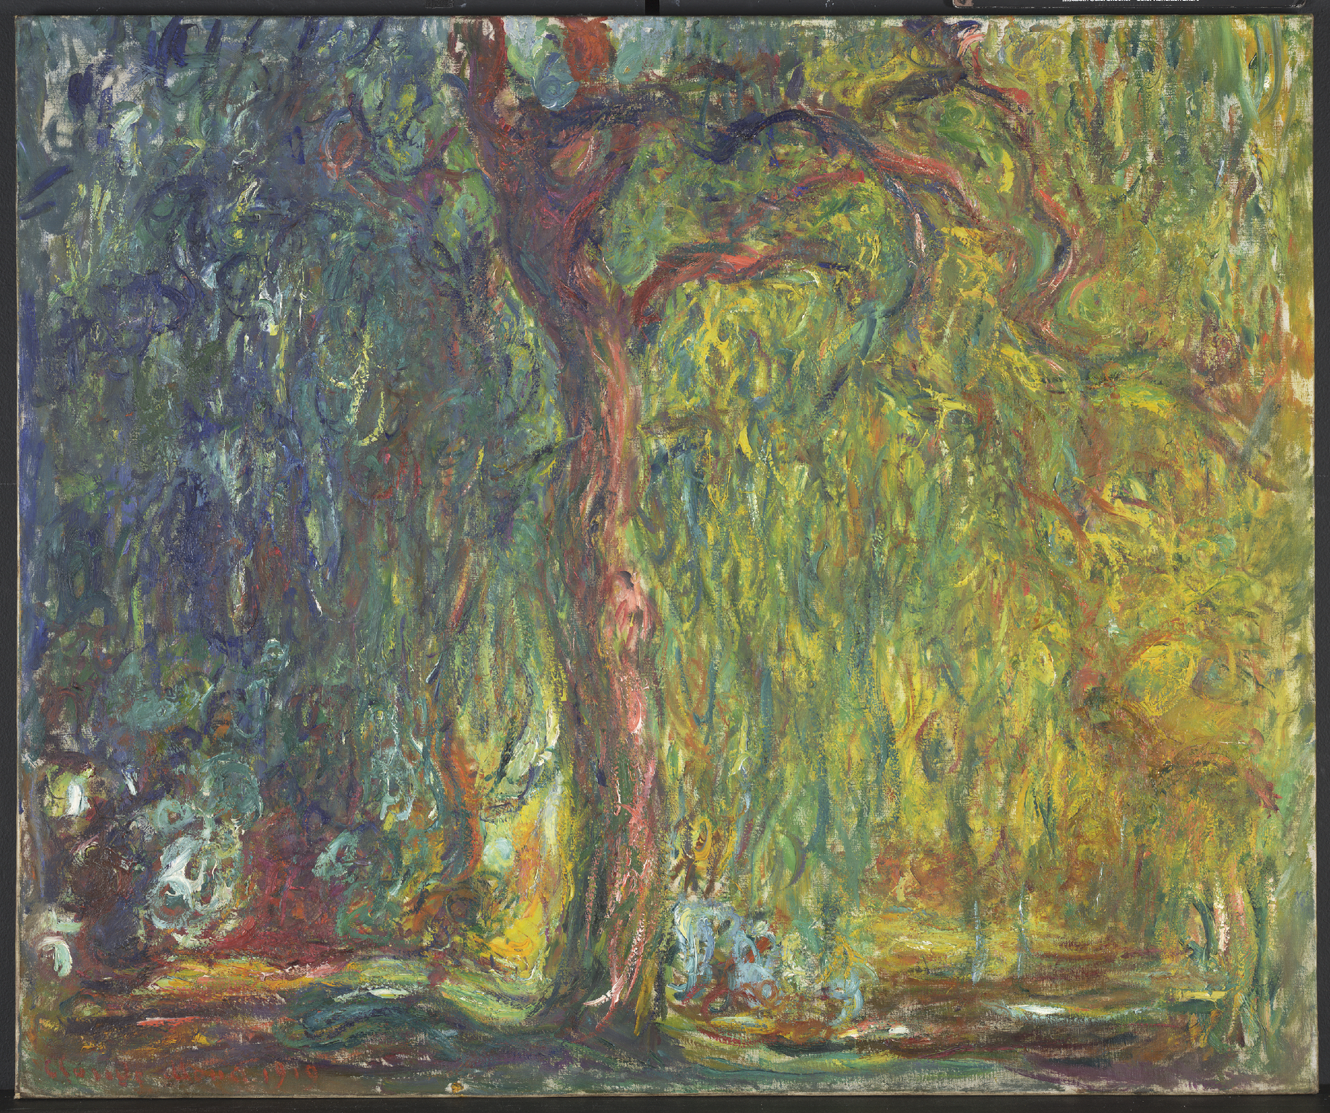
Symbolic Scenes
What does a person’s environment tell us about them?
Claude Monet, Weeping Willow (detail), 1918–19, oil on canvas. Kimbell Art Museum

Slide 14
Jacob van Ruisdael, Rough Sea at a Jetty, 1650s, oil on canvas. Kimbell Art Museum
Notes:
https://kimbellart.org/collection/ap-198901
Jacob van Ruisdael, the most influential and inventive landscape painter of the Dutch golden age, endowed the native tradition of realism with a newfound dramatic force. Recording the familiar wooded hills, flat farmlands, and coastal dunes of the Netherlands, his work went beyond the topographic accuracy of earlier generations to achieve a sense of the monumental grandeur of nature.
Among his most highly valued works, Ruisdael’s rare marine paintings reveal the scope of his genius, as they convey the transitory and changeable face of nature. Rough Sea at a Jetty represents the approach of a violent storm. In the foreground, a jetty extends a considerable distance into the sea. At its end is a rustic beacon to guide distressed ships into harbor. Two men with long poles stand nearby, ready to come to the aid of a vessel striving to make port through the tempestuous winds and waves that threaten its approach. A dramatic light breaks through the clouds beyond the beacon, suggesting the power of nature and perhaps alluding to the salvation that greets those who steer the proper course.

Slide 15
What do you see happening in this scene? How would you describe this weather? How would it feel to be standing on that narrow jetty? Have you ever been in a storm like this? Where would you feel most safe in weather like this?
How does Ruisdael create a sense of drama? What takes up most of the picture? What are the main colors? What lines do you see? Where do they lead your eye?
Jacob van Ruisdael, Rough Sea at a Jetty, 1650s, oil on canvas. Kimbell Art Museum
Notes:
https://kimbellart.org/collection/ap-198901
Jacob van Ruisdael, the most influential and inventive landscape painter of the Dutch golden age, endowed the native tradition of realism with a newfound dramatic force. Recording the familiar wooded hills, flat farmlands, and coastal dunes of the Netherlands, his work went beyond the topographic accuracy of earlier generations to achieve a sense of the monumental grandeur of nature.
Among his most highly valued works, Ruisdael’s rare marine paintings reveal the scope of his genius, as they convey the transitory and changeable face of nature. Rough Sea at a Jetty represents the approach of a violent storm. In the foreground, a jetty extends a considerable distance into the sea. At its end is a rustic beacon to guide distressed ships into harbor. Two men with long poles stand nearby, ready to come to the aid of a vessel striving to make port through the tempestuous winds and waves that threaten its approach. A dramatic light breaks through the clouds beyond the beacon, suggesting the power of nature and perhaps alluding to the salvation that greets those who steer the proper course.

Slide 16
What do you think will happen next? Where do you see light in this picture? Are there other possible light sources? Does the lighting have special meaning or significance?
Why were boats so important in the seventeenth century? Which nations were especially famous for their explorers and trade routes? What items do you think Dutch trade ships carried? (See Jacques de Gheyn’s Vase of Flowers with a Curtain.)
Jacob van Ruisdael, Rough Sea at a Jetty, 1650s, oil on canvas. Kimbell Art Museum
Notes:
https://kimbellart.org/collection/ap-198901
Jacob van Ruisdael, the most influential and inventive landscape painter of the Dutch golden age, endowed the native tradition of realism with a newfound dramatic force. Recording the familiar wooded hills, flat farmlands, and coastal dunes of the Netherlands, his work went beyond the topographic accuracy of earlier generations to achieve a sense of the monumental grandeur of nature.
Among his most highly valued works, Ruisdael’s rare marine paintings reveal the scope of his genius, as they convey the transitory and changeable face of nature. Rough Sea at a Jetty represents the approach of a violent storm. In the foreground, a jetty extends a considerable distance into the sea. At its end is a rustic beacon to guide distressed ships into harbor. Two men with long poles stand nearby, ready to come to the aid of a vessel striving to make port through the tempestuous winds and waves that threaten its approach. A dramatic light breaks through the clouds beyond the beacon, suggesting the power of nature and perhaps alluding to the salvation that greets those who steer the proper course.

Slide 17
Chart an imaginary five-day weather forecast for this picture, using a map of the Netherlands and recent meteorological reports.
Jacob van Ruisdael, Rough Sea at a Jetty, 1650s, oil on canvas. Kimbell Art Museum
Notes:
https://kimbellart.org/collection/ap-198901
Jacob van Ruisdael, the most influential and inventive landscape painter of the Dutch golden age, endowed the native tradition of realism with a newfound dramatic force. Recording the familiar wooded hills, flat farmlands, and coastal dunes of the Netherlands, his work went beyond the topographic accuracy of earlier generations to achieve a sense of the monumental grandeur of nature.
Among his most highly valued works, Ruisdael’s rare marine paintings reveal the scope of his genius, as they convey the transitory and changeable face of nature. Rough Sea at a Jetty represents the approach of a violent storm. In the foreground, a jetty extends a considerable distance into the sea. At its end is a rustic beacon to guide distressed ships into harbor. Two men with long poles stand nearby, ready to come to the aid of a vessel striving to make port through the tempestuous winds and waves that threaten its approach. A dramatic light breaks through the clouds beyond the beacon, suggesting the power of nature and perhaps alluding to the salvation that greets those who steer the proper course.

Slide 18
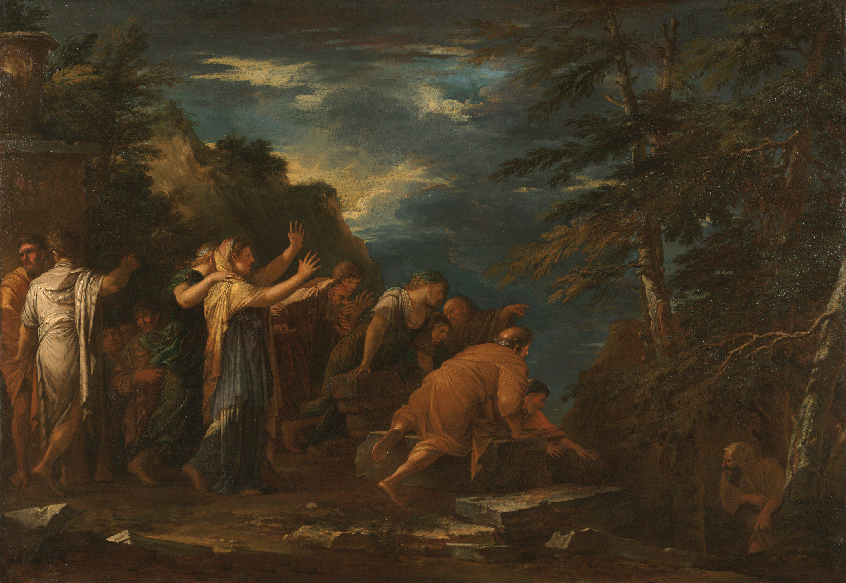
Salvator Rosa, Pythagoras Emerging from the Underworld, oil on canvas, 1662. Kimbell Art Museum

Slide 19
What do you see happening here? How would you describe the group of people on the left? The man on the right?
Choose a character from the scene and embody their pose. How does it make you feel?
Where does this story take place? What time of day is it? Where is the light focused? What is the overall mood?
Salvator Rosa, Pythagoras Emerging from the Underworld, oil on canvas, 1662. Kimbell Art Museum
Notes:
https://kimbellart.org/collection/ap-197022
Born and educated in Naples, Salvator Rosa was among the first artists to paint landscapes out of doors, adopting a bold, naturalistic manner. In Florence and in Rome, where he eventually settled, Rosa also gained a considerable reputation as a satirical poet and actor— and as an impetuous, individualistic personality. He was among the first artists to express a passionate appreciation for the awe-inspiring beauty of untamed nature, and his landscapes were invoked by later generations of admirers as expressions of the “sublime.” Here, Rosa’s distinctive landscape—with its jagged rocks, bowed trees, and livid skies—lends the painting a dramatic, otherworldly mood. Rosa was also fascinated by obscure subjects, particularly those featuring the occult practices of ancient philosophers. Pythagoras Emerging from the Underworld, which follows the literary account of Diogenes Laertius, shows the Greek philosopher leaving his underground dwelling, where he had spent some time in isolation. Here, Pythagoras’s stunned and credulous followers react to his claim that he witnessed the torture of the souls of Hesiod and Homer during his descent into Hades. In a letter of 1662, Rosa expressed great satisfaction with the Kimbell painting and its pendant, whose subjects had “never been touched by anyone.” When the two works were purchased by the important Sicilian collector Antonio Ruffo, Rosa demanded a considerable sum, telling Ruffo’s agent he “would rather die of hunger than reduce his price.”

Slide 20
How does the setting help inform the story and Pythagoras’s identity?
Write speech bubbles for the different characters. What might happen next?
Salvator Rosa, Pythagoras Emerging from the Underworld, oil on canvas, 1662. Kimbell Art Museum
Notes:
https://kimbellart.org/collection/ap-197022
Born and educated in Naples, Salvator Rosa was among the first artists to paint landscapes out of doors, adopting a bold, naturalistic manner. In Florence and in Rome, where he eventually settled, Rosa also gained a considerable reputation as a satirical poet and actor— and as an impetuous, individualistic personality. He was among the first artists to express a passionate appreciation for the awe-inspiring beauty of untamed nature, and his landscapes were invoked by later generations of admirers as expressions of the “sublime.” Here, Rosa’s distinctive landscape—with its jagged rocks, bowed trees, and livid skies—lends the painting a dramatic, otherworldly mood. Rosa was also fascinated by obscure subjects, particularly those featuring the occult practices of ancient philosophers. Pythagoras Emerging from the Underworld, which follows the literary account of Diogenes Laertius, shows the Greek philosopher leaving his underground dwelling, where he had spent some time in isolation. Here, Pythagoras’s stunned and credulous followers react to his claim that he witnessed the torture of the souls of Hesiod and Homer during his descent into Hades. In a letter of 1662, Rosa expressed great satisfaction with the Kimbell painting and its pendant, whose subjects had “never been touched by anyone.” When the two works were purchased by the important Sicilian collector Antonio Ruffo, Rosa demanded a considerable sum, telling Ruffo’s agent he “would rather die of hunger than reduce his price.”

Slide 21
Claude Monet, Weeping Willow, 1918–19, oil on canvas. Kimbell Art Museum
Notes:
https://kimbellart.org/collection/ap-199602
Monet had painted ten Weeping Willow paintings by 1919, apparently in mournful response to the mass tragedy of World War I. Due to the war, Monet’s luxurious compound at Giverny was for the most part emptied of his children’s families and his household staff, who were either called into service or moved away from the advancing German army. His surviving son and a stepson were in danger at the front. At times, Monet could hear artillery fire, but he refused to leave, preferring to share the fate of his gardens.
As a group, the Weeping Willow paintings are characterized by shadowy colors and writhing forms, as if Monet intended to express the grieving mood not simply with the subject, but also through an expressionist style of painting. They were among the few easel-scale paintings that Monet made after 1914, when he claimed his failing eyesight was best suited for working in larger formats. The tree portrayed in Weeping Willow had pride of place on the bank of Monet’s water garden, with its exotic water lilies. He depicted the trunks, cascading branches, and reflections of his and other willows in his greatest artistic legacy, the mural-scale Nymphéas canvases, which were his preoccupation from 1914 until his death.
Most of Monet’s works from the late teens were never finished and were retained in his studio at the time of his death. The Kimbell Weeping Willow, on the other hand, was signed and dated, and passed by 1924 into the collection of the Japanese Baron Kojiro Matsukata, one of the first collectors to recognize the genius of Monet’s last, expressionistic canvases.

Slide 22
Where do you think Monet painted this picture? What colors do you see? Do you think the actual tree had all these colors? What feelings do these colors express?
Let your eye follow the different brushstrokes and painted marks. How would you describe the artist’s movements across the painted surface?
Have you ever stood under a weeping willow tree, inside the cascading branches? How did it make you feel? What ideas do you associate with weeping willows?
Claude Monet, Weeping Willow, 1918–19, oil on canvas. Kimbell Art Museum
Notes:
https://kimbellart.org/collection/ap-199602
Monet had painted ten Weeping Willow paintings by 1919, apparently in mournful response to the mass tragedy of World War I. Due to the war, Monet’s luxurious compound at Giverny was for the most part emptied of his children’s families and his household staff, who were either called into service or moved away from the advancing German army. His surviving son and a stepson were in danger at the front. At times, Monet could hear artillery fire, but he refused to leave, preferring to share the fate of his gardens.
As a group, the Weeping Willow paintings are characterized by shadowy colors and writhing forms, as if Monet intended to express the grieving mood not simply with the subject, but also through an expressionist style of painting. They were among the few easel-scale paintings that Monet made after 1914, when he claimed his failing eyesight was best suited for working in larger formats. The tree portrayed in Weeping Willow had pride of place on the bank of Monet’s water garden, with its exotic water lilies. He depicted the trunks, cascading branches, and reflections of his and other willows in his greatest artistic legacy, the mural-scale Nymphéas canvases, which were his preoccupation from 1914 until his death.
Most of Monet’s works from the late teens were never finished and were retained in his studio at the time of his death. The Kimbell Weeping Willow, on the other hand, was signed and dated, and passed by 1924 into the collection of the Japanese Baron Kojiro Matsukata, one of the first collectors to recognize the genius of Monet’s last, expressionistic canvases.

Slide 23
Why might Monet have painted weeping willows after World War I? What can we learn about his identity during this time by experiencing this painting?
Compare this painting with Monet’s La Pointe de la Hève at Low Tide, painted over fifty years earlier, also in the Kimbell’s permanent collection.
Claude Monet, Weeping Willow, 1918–19, oil on canvas. Kimbell Art Museum
Notes:
https://kimbellart.org/collection/ap-199602
Monet had painted ten Weeping Willow paintings by 1919, apparently in mournful response to the mass tragedy of World War I. Due to the war, Monet’s luxurious compound at Giverny was for the most part emptied of his children’s families and his household staff, who were either called into service or moved away from the advancing German army. His surviving son and a stepson were in danger at the front. At times, Monet could hear artillery fire, but he refused to leave, preferring to share the fate of his gardens.
As a group, the Weeping Willow paintings are characterized by shadowy colors and writhing forms, as if Monet intended to express the grieving mood not simply with the subject, but also through an expressionist style of painting. They were among the few easel-scale paintings that Monet made after 1914, when he claimed his failing eyesight was best suited for working in larger formats. The tree portrayed in Weeping Willow had pride of place on the bank of Monet’s water garden, with its exotic water lilies. He depicted the trunks, cascading branches, and reflections of his and other willows in his greatest artistic legacy, the mural-scale Nymphéas canvases, which were his preoccupation from 1914 until his death.
Most of Monet’s works from the late teens were never finished and were retained in his studio at the time of his death. The Kimbell Weeping Willow, on the other hand, was signed and dated, and passed by 1924 into the collection of the Japanese Baron Kojiro Matsukata, one of the first collectors to recognize the genius of Monet’s last, expressionistic canvases.

Slide 24
Connecting Collections
What does a selection of objects tell us about a person’s identity?
Chokwe​, Chibinda Ilunga​, mid-19th century, wood, hair, and hide​. Kimbell Art Museum

Slide 25
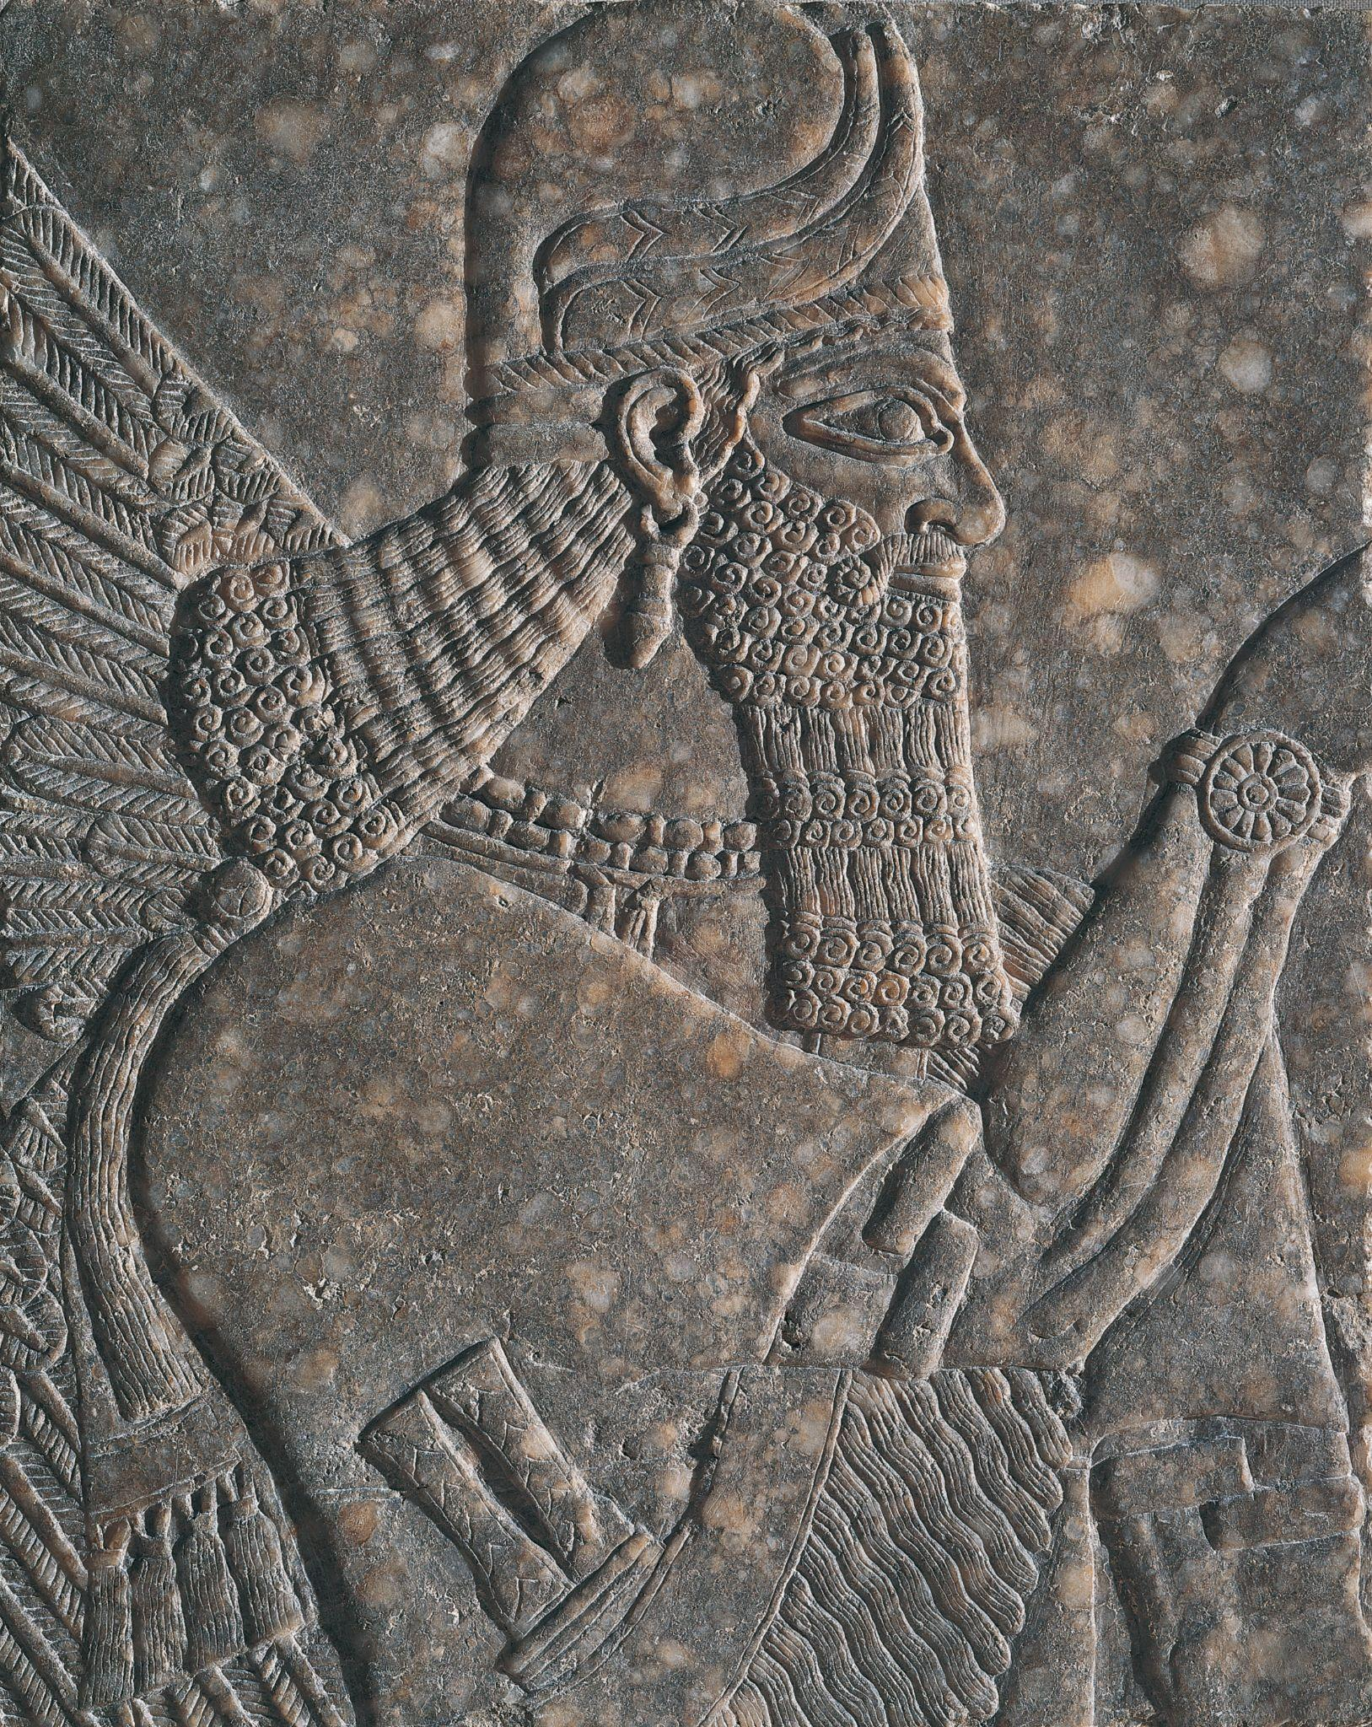
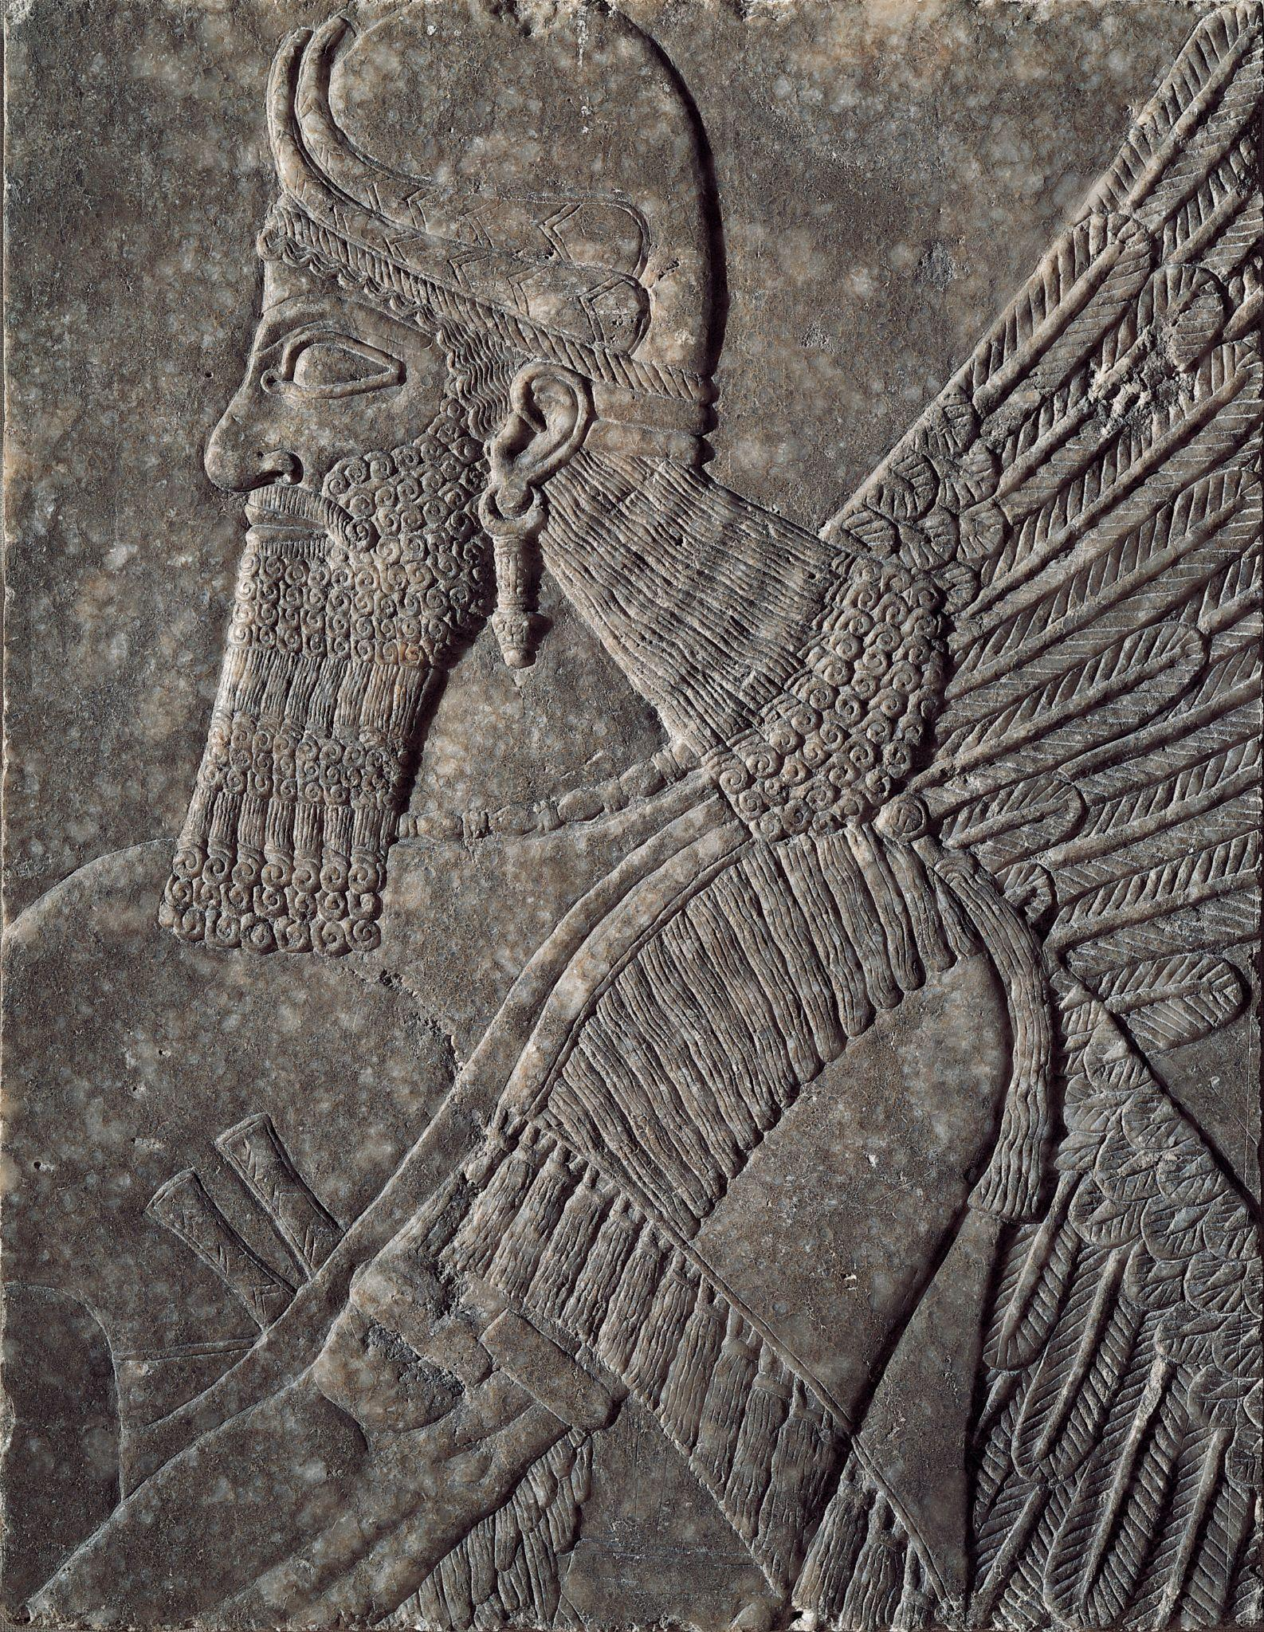
Assyrian, Pair of Winged Deities, gypsum, c. 874–860 BC. Kimbell Art Museum
Notes:
https://kimbellart.org/collection/ap-198104-ab
In 1845, the British archaeologist Austen Henry Layard uncovered the earliest of the surviving royal residences of the Assyrian kings at Nimrud, called Kalhu in ancient times. Now called the Northwest palace of Ashurnasirpal II–a king who reigned 883–859 BC–the structure, which consisted of a series of long, narrow rooms grouped around large courtyards, was lavishly decorated with monumental gateway figures and reliefs. Seven-foot-high stone slabs that lined the walls of many of the rooms were carved with elaborate narrative, mythological, and ritual scenes in low relief. The greatest and most original artistic achievement of the Assyrians, these images and accompanying inscriptions record the kings’ military campaigns and testify to their prowess as warriors and hunters as well as their sanctity as the representatives of the Assyrian pantheon on earth.
One of the most recurrent and potent images on these reliefs is the depiction of a magic purification or protective ritual in which winged griffin-demons (apkallu, “sages”) or winged anthropomorphic deities, holding ritual “buckets” and pinecone-shaped objects, flank a “Sacred Tree” that they sprinkle with holy water or pollen. The Kimbell’s winged deities are fragments of two such full-length figures enacting this magic ritual, sprinkling or pollinating the central tree motif. As such, each figure would originally have held a bucket in his left hand and a cone in his right. The deities, marked as divine by their wings and horned helmets, are conceived in the image of the monarch, reflecting his facial features, stance, and physical strength. Their exaggerated musculature and luxuriant, tightly curled hair and beards suggest something of the king’s vainglorious power and virility. These reliefs come from a room that may have been used by the king for ritual ablution.

Slide 26
What are some of the first things you notice about these figures? Which details catch your eye? Are they human? Why or why not?
How do we know that they are important or powerful? What other words would you use to describe them? How are they standing? What do you think they are doing?
Assyrian, Pair of Winged Deities, gypsum, c. 874–860 BC. Kimbell Art Museum
Notes:
https://kimbellart.org/collection/ap-198104-ab
In 1845, the British archaeologist Austen Henry Layard uncovered the earliest of the surviving royal residences of the Assyrian kings at Nimrud, called Kalhu in ancient times. Now called the Northwest palace of Ashurnasirpal II–a king who reigned 883–859 BC–the structure, which consisted of a series of long, narrow rooms grouped around large courtyards, was lavishly decorated with monumental gateway figures and reliefs. Seven-foot-high stone slabs that lined the walls of many of the rooms were carved with elaborate narrative, mythological, and ritual scenes in low relief. The greatest and most original artistic achievement of the Assyrians, these images and accompanying inscriptions record the kings’ military campaigns and testify to their prowess as warriors and hunters as well as their sanctity as the representatives of the Assyrian pantheon on earth.
One of the most recurrent and potent images on these reliefs is the depiction of a magic purification or protective ritual in which winged griffin-demons (apkallu, “sages”) or winged anthropomorphic deities, holding ritual “buckets” and pinecone-shaped objects, flank a “Sacred Tree” that they sprinkle with holy water or pollen. The Kimbell’s winged deities are fragments of two such full-length figures enacting this magic ritual, sprinkling or pollinating the central tree motif. As such, each figure would originally have held a bucket in his left hand and a cone in his right. The deities, marked as divine by their wings and horned helmets, are conceived in the image of the monarch, reflecting his facial features, stance, and physical strength. Their exaggerated musculature and luxuriant, tightly curled hair and beards suggest something of the king’s vainglorious power and virility. These reliefs come from a room that may have been used by the king for ritual ablution.

Slide 27
Imagine a large room filled with full-size figures like these. How would it feel to be in that space?
Draw the missing elements of the sculpture. What does the tree look like? How tall is it? How will you show the water being sprinkled on the tree?
Assyrian, Pair of Winged Deities, gypsum, c. 874–860 BC. Kimbell Art Museum
Notes:
https://kimbellart.org/collection/ap-198104-ab
In 1845, the British archaeologist Austen Henry Layard uncovered the earliest of the surviving royal residences of the Assyrian kings at Nimrud, called Kalhu in ancient times. Now called the Northwest palace of Ashurnasirpal II–a king who reigned 883–859 BC–the structure, which consisted of a series of long, narrow rooms grouped around large courtyards, was lavishly decorated with monumental gateway figures and reliefs. Seven-foot-high stone slabs that lined the walls of many of the rooms were carved with elaborate narrative, mythological, and ritual scenes in low relief. The greatest and most original artistic achievement of the Assyrians, these images and accompanying inscriptions record the kings’ military campaigns and testify to their prowess as warriors and hunters as well as their sanctity as the representatives of the Assyrian pantheon on earth.
One of the most recurrent and potent images on these reliefs is the depiction of a magic purification or protective ritual in which winged griffin-demons (apkallu, “sages”) or winged anthropomorphic deities, holding ritual “buckets” and pinecone-shaped objects, flank a “Sacred Tree” that they sprinkle with holy water or pollen. The Kimbell’s winged deities are fragments of two such full-length figures enacting this magic ritual, sprinkling or pollinating the central tree motif. As such, each figure would originally have held a bucket in his left hand and a cone in his right. The deities, marked as divine by their wings and horned helmets, are conceived in the image of the monarch, reflecting his facial features, stance, and physical strength. Their exaggerated musculature and luxuriant, tightly curled hair and beards suggest something of the king’s vainglorious power and virility. These reliefs come from a room that may have been used by the king for ritual ablution.

Slide 28
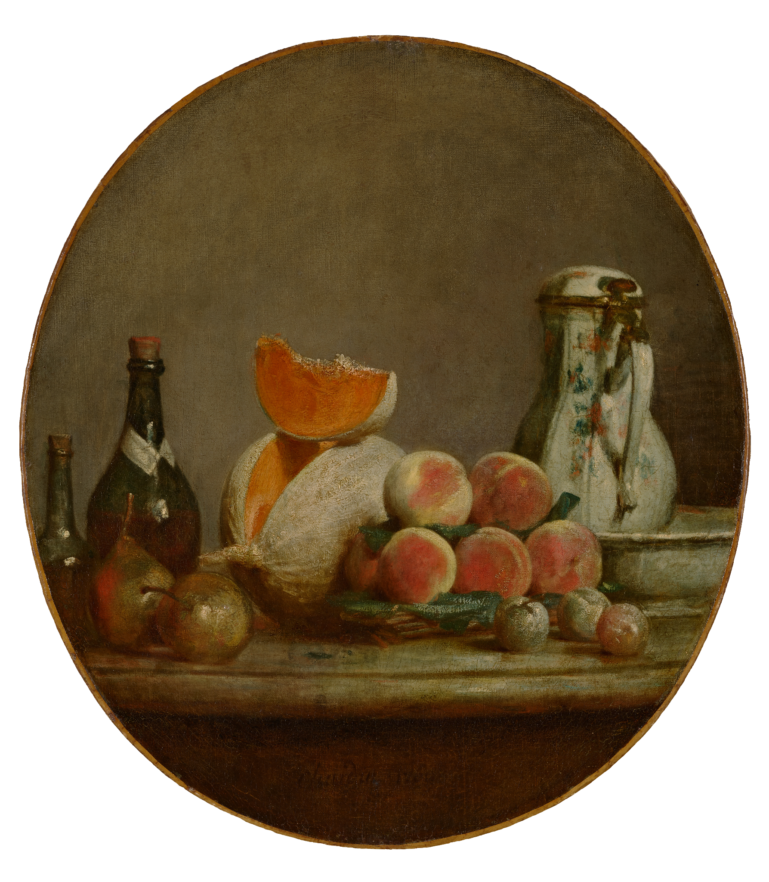
Jean Siméon Chardin, The Cut Melon, oil on canvas, 1760. Kimbell Art Museum, Fort Worth
Notes:
https://kimbellart.org/collection/ap-202502
Chardin is considered one of the greatest painters of still lifes in the history of art. The Cut Melon has long been recognized as one of the artist’s most remarkable works, representing the highpoint of his mastery of volume, color, and light. The distinctive oval canvas amplifies the rounded shapes within the composition, in which a bright orange piece of cantaloupe balances atop the melon from which it has been sliced. Rigorously structured, with carefully manipulated textured brushstrokes and subtle pigments, the composition nonetheless seems effortless and unstudied. With its beautifully balanced palette and ineffable technique, it calls to mind the words of Chardin’s astonished admirer Denis Diderot: “Such magic cannot be fathomed.”
In The Cut Melon, Chardin gives the painting’s elements the sense of volume and weight, but also an impression of lively buoyancy. Each object invites touch—sleek glass bottles, shiny pears and plums, the rough-skinned but luscious melon, and velvety peaches rendered in shades of yellow, pink, and red. The handle of the ceramic pitcher anchoring the composition at right is positioned toward the viewer, as if to be grasped.
The canvas was paired with another oval, The Jar of Apricots (1758, The Art Gallery of Ontario, Toronto), in the collection of Jacques Roëttiers, a famous silversmith, who lent them both to the annual Paris Salon in 1761. It was bought in the early nineteenth century by the painter François Marcille, who assembled a renowned collection of eighteenth-century French paintings, contributing to the revival of interest in Chardin and other artists. From his son Camille, The Cut Melon was purchased in 1876 by Baroness Charlotte de Rothschild, an arts patron and gifted watercolor painter, in whose family it remained until acquired by the Kimbell Art Foundation.

Slide 29
Why do artists paint still lifes?
Describe the different objects featured here. Which catches your eye first? Which textures most appeal to you? Describe how this scene might smell or taste.
Who do you think is the audience for this painting? Who might have consumed this edible arrangement after it was painted? What might their daily life have looked like? What might we learn about them from viewing this still life?
Jean Siméon Chardin, The Cut Melon, oil on canvas, 1760. Kimbell Art Museum, Fort Worth
Notes:
https://kimbellart.org/collection/ap-202502
Chardin is considered one of the greatest painters of still lifes in the history of art. The Cut Melon has long been recognized as one of the artist’s most remarkable works, representing the highpoint of his mastery of volume, color, and light. The distinctive oval canvas amplifies the rounded shapes within the composition, in which a bright orange piece of cantaloupe balances atop the melon from which it has been sliced. Rigorously structured, with carefully manipulated textured brushstrokes and subtle pigments, the composition nonetheless seems effortless and unstudied. With its beautifully balanced palette and ineffable technique, it calls to mind the words of Chardin’s astonished admirer Denis Diderot: “Such magic cannot be fathomed.”
In The Cut Melon, Chardin gives the painting’s elements the sense of volume and weight, but also an impression of lively buoyancy. Each object invites touch—sleek glass bottles, shiny pears and plums, the rough-skinned but luscious melon, and velvety peaches rendered in shades of yellow, pink, and red. The handle of the ceramic pitcher anchoring the composition at right is positioned toward the viewer, as if to be grasped.
The canvas was paired with another oval, The Jar of Apricots (1758, The Art Gallery of Ontario, Toronto), in the collection of Jacques Roëttiers, a famous silversmith, who lent them both to the annual Paris Salon in 1761. It was bought in the early nineteenth century by the painter François Marcille, who assembled a renowned collection of eighteenth-century French paintings, contributing to the revival of interest in Chardin and other artists. From his son Camille, The Cut Melon was purchased in 1876 by Baroness Charlotte de Rothschild, an arts patron and gifted watercolor painter, in whose family it remained until acquired by the Kimbell Art Foundation.

Slide 30
Sketch the objects you would select for your own still life. What might this collection say about your identity?
Jean Siméon Chardin, The Cut Melon, oil on canvas, 1760. Kimbell Art Museum, Fort Worth
Notes:
https://kimbellart.org/collection/ap-202502
Chardin is considered one of the greatest painters of still lifes in the history of art. The Cut Melon has long been recognized as one of the artist’s most remarkable works, representing the highpoint of his mastery of volume, color, and light. The distinctive oval canvas amplifies the rounded shapes within the composition, in which a bright orange piece of cantaloupe balances atop the melon from which it has been sliced. Rigorously structured, with carefully manipulated textured brushstrokes and subtle pigments, the composition nonetheless seems effortless and unstudied. With its beautifully balanced palette and ineffable technique, it calls to mind the words of Chardin’s astonished admirer Denis Diderot: “Such magic cannot be fathomed.”
In The Cut Melon, Chardin gives the painting’s elements the sense of volume and weight, but also an impression of lively buoyancy. Each object invites touch—sleek glass bottles, shiny pears and plums, the rough-skinned but luscious melon, and velvety peaches rendered in shades of yellow, pink, and red. The handle of the ceramic pitcher anchoring the composition at right is positioned toward the viewer, as if to be grasped.
The canvas was paired with another oval, The Jar of Apricots (1758, The Art Gallery of Ontario, Toronto), in the collection of Jacques Roëttiers, a famous silversmith, who lent them both to the annual Paris Salon in 1761. It was bought in the early nineteenth century by the painter François Marcille, who assembled a renowned collection of eighteenth-century French paintings, contributing to the revival of interest in Chardin and other artists. From his son Camille, The Cut Melon was purchased in 1876 by Baroness Charlotte de Rothschild, an arts patron and gifted watercolor painter, in whose family it remained until acquired by the Kimbell Art Foundation.

Slide 31
Henry Raeburn, The Allen Brothers (Portrait of James and John Lee Allen), early 1790s, oil on canvas. Kimbell Art Museum
Notes:
https://kimbellart.org/collection/ap-200205
Henry Raeburn was the leading portraitist in Edinburgh, Scotland, a center of the Enlightenment, from about 1790 until his death in 1823. The Allen Brothers dates from early in his career, when his portraits show a remarkably experimental approach to composition, poses, and lighting effects, as well as the free, virtuoso brushwork for which he is best known.
Like many of Raeburn’s patrons, the Allen brothers came from the Scottish landowning elite. John Lee Allen (born in 1781) and James Allen (born in 1783), the sons of John Allen of Inchmartine, were heirs to the considerable estates of Inchmartine and Errol on the north bank of the Tay estuary, near Perth. Despite their social status, the boys appear in an informal scenario, playing a game with a hat and a stick–presumably some form of mock fighting, perhaps a boyish version of jousting. The activity allows Raeburn to set off one against the other in a series of contrasts: the older boy standing and active, the younger seated (after a fashion) and passive; the older boy in profile and intent on his play, the younger in full face and apparently responding to the presence of the viewer.

Slide 32
Who do you think these boys are? What do their clothing and facial expressions tell us about them? Can you guess what they are thinking?
What are they doing? What is each boy holding? Can you imagine what might happen next?
Henry Raeburn, The Allen Brothers (Portrait of James and John Lee Allen), early 1790s, oil on canvas. Kimbell Art Museum
Notes:
https://kimbellart.org/collection/ap-200205
Henry Raeburn was the leading portraitist in Edinburgh, Scotland, a center of the Enlightenment, from about 1790 until his death in 1823. The Allen Brothers dates from early in his career, when his portraits show a remarkably experimental approach to composition, poses, and lighting effects, as well as the free, virtuoso brushwork for which he is best known.
Like many of Raeburn’s patrons, the Allen brothers came from the Scottish landowning elite. John Lee Allen (born in 1781) and James Allen (born in 1783), the sons of John Allen of Inchmartine, were heirs to the considerable estates of Inchmartine and Errol on the north bank of the Tay estuary, near Perth. Despite their social status, the boys appear in an informal scenario, playing a game with a hat and a stick–presumably some form of mock fighting, perhaps a boyish version of jousting. The activity allows Raeburn to set off one against the other in a series of contrasts: the older boy standing and active, the younger seated (after a fashion) and passive; the older boy in profile and intent on his play, the younger in full face and apparently responding to the presence of the viewer.

Slide 33
What overall shape do the brothers create? What kinds of lines do you see—vertical, horizontal, or diagonal? Where do they lead your eye?
Imagine an artist is painting a portrait of you with a sibling or a friend. What objects, shapes, and colors would the artist need to include to describe your personalities?
Henry Raeburn, The Allen Brothers (Portrait of James and John Lee Allen), early 1790s, oil on canvas. Kimbell Art Museum
Notes:
https://kimbellart.org/collection/ap-200205
Henry Raeburn was the leading portraitist in Edinburgh, Scotland, a center of the Enlightenment, from about 1790 until his death in 1823. The Allen Brothers dates from early in his career, when his portraits show a remarkably experimental approach to composition, poses, and lighting effects, as well as the free, virtuoso brushwork for which he is best known.
Like many of Raeburn’s patrons, the Allen brothers came from the Scottish landowning elite. John Lee Allen (born in 1781) and James Allen (born in 1783), the sons of John Allen of Inchmartine, were heirs to the considerable estates of Inchmartine and Errol on the north bank of the Tay estuary, near Perth. Despite their social status, the boys appear in an informal scenario, playing a game with a hat and a stick–presumably some form of mock fighting, perhaps a boyish version of jousting. The activity allows Raeburn to set off one against the other in a series of contrasts: the older boy standing and active, the younger seated (after a fashion) and passive; the older boy in profile and intent on his play, the younger in full face and apparently responding to the presence of the viewer.

Slide 34
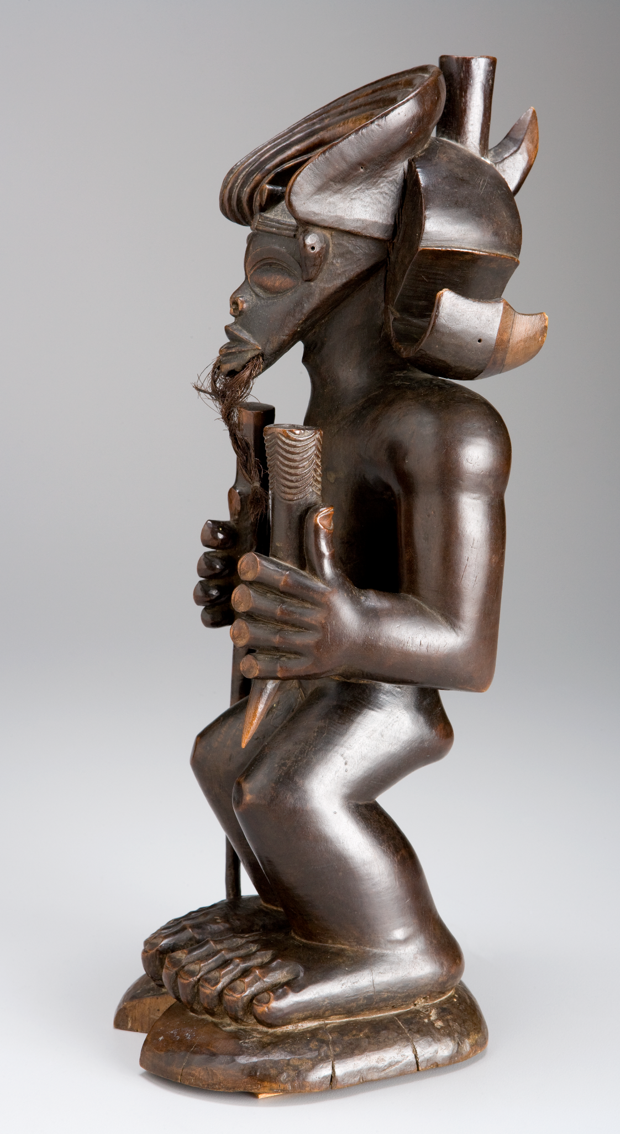
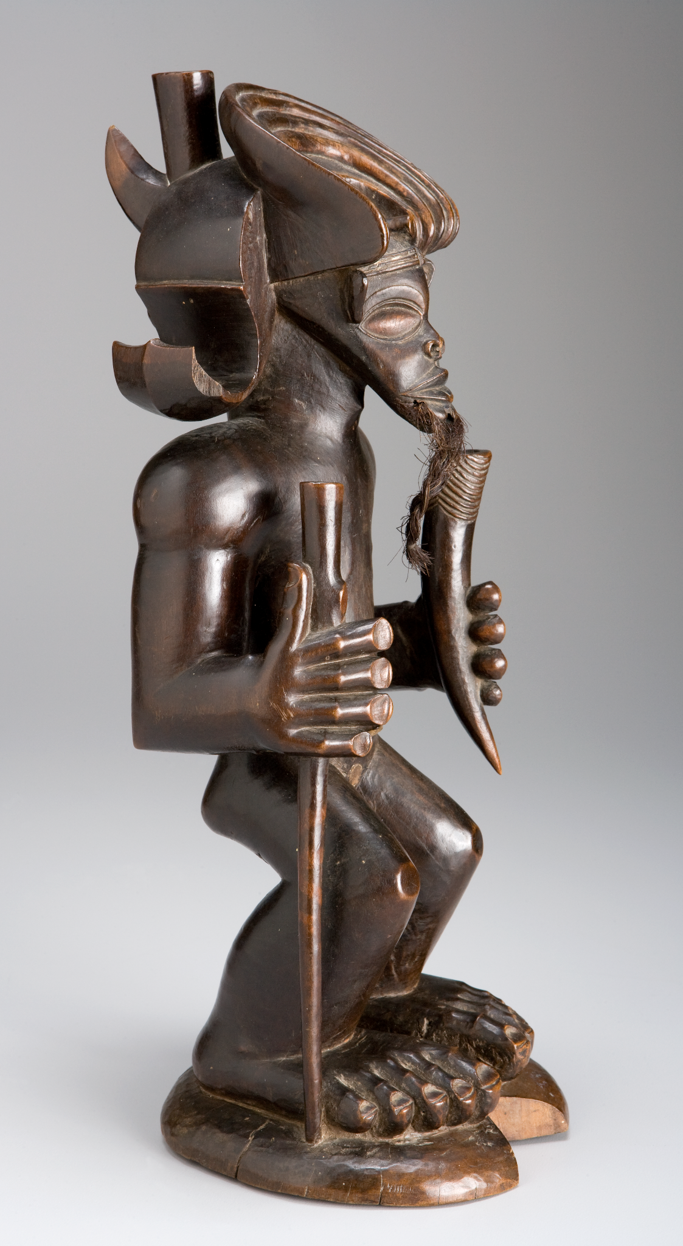
Chokwe people​, Chibinda Ilunga​, mid-19th century, wood, hair, and hide​. Kimbell Art Museum
Notes:
https://kimbellart.org/collection/ap-197805
In Central Africa, the role of chief is often linked with that of hunter. For the Chokwe people, the importance of the hunter stems from the myth of their founding hero, Chibinda Ilunga, the son of a great Luba chief and a passionate huntsman, who wooed and eventually married Lweji, a Lunda chieftainess. He introduced the Lunda to the concept of divine kingship and also taught their tribe the art of hunting. From their union, if rather indirectly, came the Mwata Yamvo rulers of the Lunda, to whom the Chokwe paid tribute and regularly furnished sculptors, who produced court art almost up to the present day. By association, Chibinda Ilunga became a culture hero and model for men in Chokwe society and especially for Chokwe chiefs. He came to represent the archetypal chief who maintains the well-being of his people.
As in much African art, the representation of the coiffure, headdress, and other ornaments serve to emphasize the figure’s status and identity. Chibinda Ilunga wears elaborate headgear with rolled side elements as a sign of his royal rank. He holds a wanderer’s staff and a carved antelope horn, which is a container for substances that supernaturally assist the hunt. The greatly enlarged hands and feet emphasize his physical strength and endurance, while the beard conveys his wisdom as an elder and ancestor.

Slide 35
What words would you use to describe his pose? What is unusual about his feet and hands? What would you do with such big hands and feet?
Describe Chibinda’s face. Do you recognize any shapes? What about his eyes? Why are they so large? What does the beard tell you about him?
What is Chibinda holding in each hand? How might he use these items? Carefully examine his headdress and describe its details. Is this an important person? What does this elaborate hat tell you about him?
Chokwe​ people, Chibinda Ilunga​, mid-19th century, wood, hair, and hide​. Kimbell Art Museum
Notes:
https://kimbellart.org/collection/ap-197805
In Central Africa, the role of chief is often linked with that of hunter. For the Chokwe people, the importance of the hunter stems from the myth of their founding hero, Chibinda Ilunga, the son of a great Luba chief and a passionate huntsman, who wooed and eventually married Lweji, a Lunda chieftainess. He introduced the Lunda to the concept of divine kingship and also taught their tribe the art of hunting. From their union, if rather indirectly, came the Mwata Yamvo rulers of the Lunda, to whom the Chokwe paid tribute and regularly furnished sculptors, who produced court art almost up to the present day. By association, Chibinda Ilunga became a culture hero and model for men in Chokwe society and especially for Chokwe chiefs. He came to represent the archetypal chief who maintains the well-being of his people.
As in much African art, the representation of the coiffure, headdress, and other ornaments serve to emphasize the figure’s status and identity. Chibinda Ilunga wears elaborate headgear with rolled side elements as a sign of his royal rank. He holds a wanderer’s staff and a carved antelope horn, which is a container for substances that supernaturally assist the hunt. The greatly enlarged hands and feet emphasize his physical strength and endurance, while the beard conveys his wisdom as an elder and ancestor.

Slide 36
Look for shapes and lines in and around this sculpture. How does your eye move around the figure? Where do you see straight lines? Curving lines? How is the front of the sculpture different from the side?
Imagine yourself as a legendary hero. What special skills and talents would you have? Write a story or draw a picture of your mighty deeds.
Chokwe​ people, Chibinda Ilunga​, mid-19th century, wood, hair, and hide​. Kimbell Art Museum
Notes:
https://kimbellart.org/collection/ap-197805
In Central Africa, the role of chief is often linked with that of hunter. For the Chokwe people, the importance of the hunter stems from the myth of their founding hero, Chibinda Ilunga, the son of a great Luba chief and a passionate huntsman, who wooed and eventually married Lweji, a Lunda chieftainess. He introduced the Lunda to the concept of divine kingship and also taught their tribe the art of hunting. From their union, if rather indirectly, came the Mwata Yamvo rulers of the Lunda, to whom the Chokwe paid tribute and regularly furnished sculptors, who produced court art almost up to the present day. By association, Chibinda Ilunga became a culture hero and model for men in Chokwe society and especially for Chokwe chiefs. He came to represent the archetypal chief who maintains the well-being of his people.
As in much African art, the representation of the coiffure, headdress, and other ornaments serve to emphasize the figure’s status and identity. Chibinda Ilunga wears elaborate headgear with rolled side elements as a sign of his royal rank. He holds a wanderer’s staff and a carved antelope horn, which is a container for substances that supernaturally assist the hunt. The greatly enlarged hands and feet emphasize his physical strength and endurance, while the beard conveys his wisdom as an elder and ancestor.

Slide 37
Art in order of appearance:
Japanese, Seated Nyoirin Kannon, c. 1230–50, wood with traces of gilt and pigment. Kimbell Art Museum
Henry Raeburn, The Allen Brothers (Portrait of James and John Lee Allen), early 1790s, oil on canvas. Kimbell Art Museum
Jacob van Ruisdael, Rough Sea at a Jetty, 1650s, oil on canvas. Kimbell Art Museum
Salvator Rosa, Pythagoras Emerging from the Underworld, oil on canvas, 1662. Kimbell Art Museum
Chokwe people​, Chibinda Ilunga​, mid-19th century, wood, hair, and hide​. Kimbell Art Museum
Zapotec culture, Urn in the Form of Cociyo, ​God of Lightning and Rain​, c. AD 400–500, ceramic.​ Kimbell Art Museum
Caravaggio, The Cardsharps, c. 1596–97, oil on canvas. Kimbell Art Museum
Claude Monet, Weeping Willow, 1918–19, oil on canvas. Kimbell Art Museum
Assyrian, Pair of Winged Deities, gypsum, c. 874–860 BC. Kimbell Art Museum
Jean Siméon Chardin, The Cut Melon, oil on canvas, 1760. Kimbell Art Museum, Fort Worth
© 2025 Kimbell Art Museum

