Slide 1
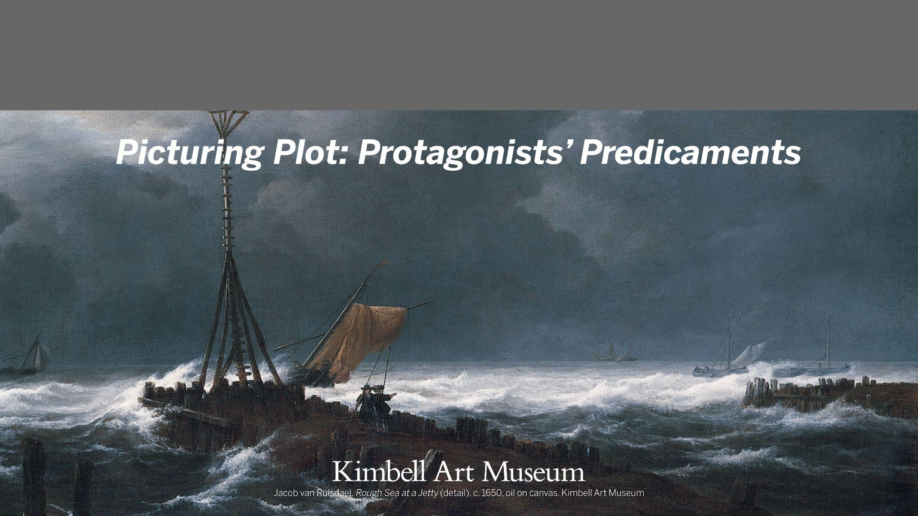
Kimbell Educator Packet

Slide 2
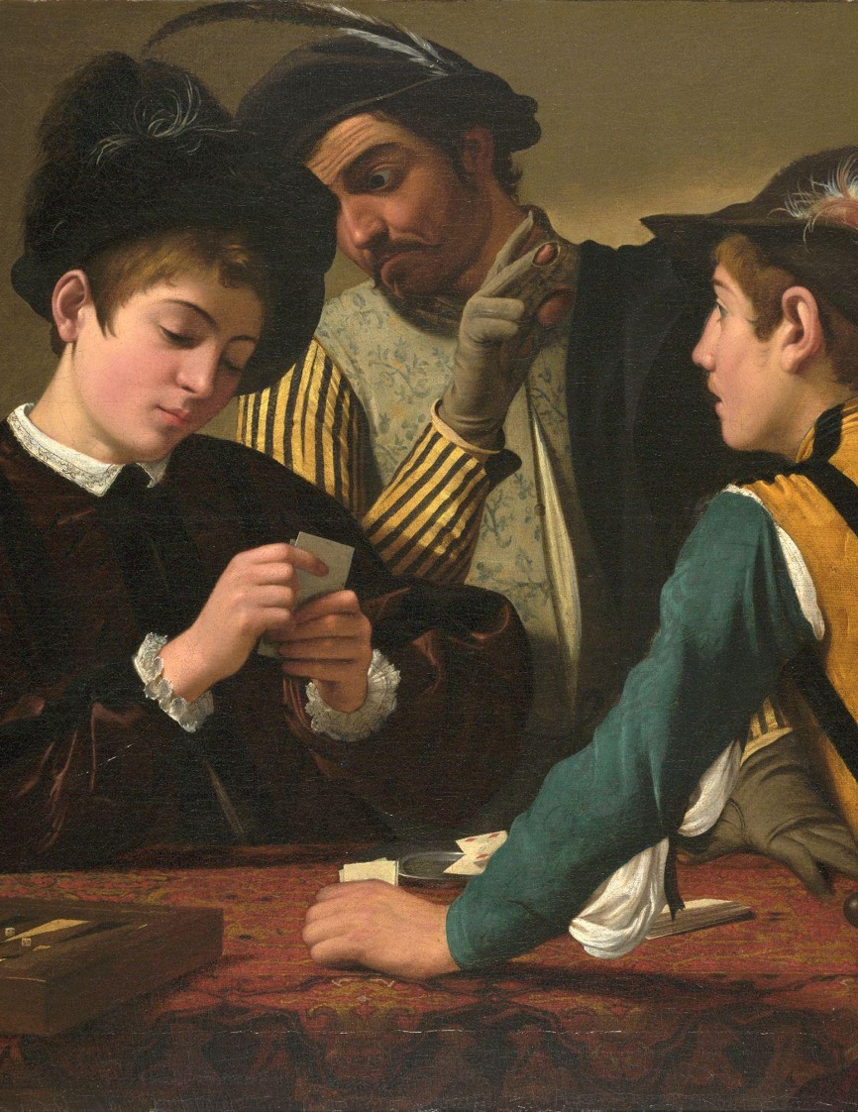
Picturing Plot:
Protagonists’ Predicaments
In order to have a good plot, protagonists must face conflict. Explore artworks that depict the seven types of literary conflict:
Character vs. Character
Character vs. Society
Character vs. Nature
Character vs. The Unknown
Character vs. Fate
Character vs. Self
Caravaggio, The Cardsharps (detail), c. 1595, oil on canvas. Kimbell Art Museum

Slide 3
Art TEKS
§117.111. Art, Grade 3 | §117.111.b.3.B. The student is expected to compare and contrast artworks created by historical and contemporary men and women, making connections to various cultures. §117.111.b.3.D. The student is expected to investigate the connections of visual art concepts to other disciplines. §117.111.b.4.B. The student is expected to use methods such as oral response or artist statements to identify main ideas found in collections of artworks created by self, peers, and major historical or contemporary artists in real or virtual portfolios, galleries, or art museums.
§117.203. Art, Middle School 2 | 117.117.b.1.D. The student is expected to understand and apply the expressive properties of artworks such as appropriation, meaning, narrative, message, and symbol using art vocabulary accurately. 117.117.b.3.B. The student is expected to analyze selected artworks to determine contemporary relevance in relationship to universal themes such as belief, cultural narrative, life cycles, the passage of time, identity, conflict, and cooperation. 117.117.b.4.B. The student is expected to analyze original artworks using a method of critique such as describing the artwork, analyzing the way it is organized, interpreting the artist’s intention, and evaluation the success of the artwork.
§117.303. Art, Level II | 117.117.c.2.D. The student is expected to create original artwork to communicate thoughts, feelings, ideas, or impressions. 117.117.c.3.B. The student is expected to analyze specific characteristics in artwork from a variety of cultures. 117.117.b.4.A. The student is expected to interpret, evaluate, and justify artistic decisions in artwork by self, peers, and other artists such as that in museums, local galleries, art exhibits, and websites.

Slide 4
English TEKS
§110.5. English Language Arts and Reading, Grade 3 | §110.23.b.8. The student is expected to infer the theme of a work, distinguishing theme from topic; explain the relationships among the major and minor characters; analyze plot elements, including the sequence of events, the conflict, and the resolution; and explain the influence of the setting on the plot. §110.23.b.10.A–B. The student is expected to explain the author’s purpose and message within a text; explain how the use of text structure contributes to the author’s purpose. §110.23.b.12.A. The student is expected to compose literary texts, including personal narratives and poetry, using genre characteristics and craft.
§110.23. English Language Arts and Reading, Grade 7 | §110.23.b.7.B–D. The student is expected to analyze how characters’ qualities influence events and resolution of the conflict; analyze plot elements, including the use of foreshadowing and suspense, to advance the plot; and analyze how the setting influences character and plot development. §110.23.b.9.A–B. The student is expected to explain the author’s purpose and message within a text; analyze how the use of text structure contributes to the author’s purpose. §110.23.b.11.A. The student is expected to compose literary texts such as personal narratives, fiction, and poetry using genre characteristics and craft.
§110.35. English Language Arts and Reading, English II | §110.35.c.1.D. The student is expected to participate collaboratively, building on the ideas of others, contributing relevant information, developing a plan for consensus building, and setting ground rules for decision making. §110.35.c.6. The student is expected to analyze how themes are developed through characterization and plot, including comparing similar themes in a variety of literary texts representing different cultures; analyze how authors develop complex yet believable characters, including archetypes, through historical and cultural settings and events; analyze isolated scenes and their contribution to the success of the plot as a whole; and analyze how historical and cultural settings influence characterization, plot, and theme across texts. §110.35.c.6. The student is expected to compose literary texts such as fiction and poetry using genre characteristics and craft.

Slide 5
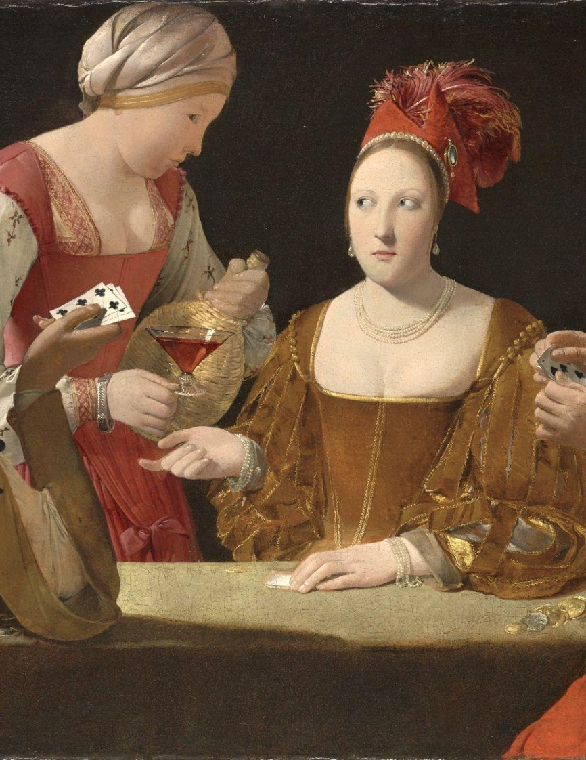
CHARACTER
VS. CHARACTER
A common example of external conflict, character versus character refers to the interactions of individuals or entities with differing outlooks/motives.
The struggle between the protagonist and antagonist can be mental, emotional, spiritual, and/or physical.
Georges de La Tour, The Cheat with the Ace of Clubs (detail)​, c. 1630–34​, oil on canvas. Kimbell Art Museum
Notes:
https://kimbellart.org/collection/ap-198106
For most of his life, Georges de La Tour remained in his native duchy of Lorraine, remote from the art center of Paris. Although he created some of the most visually compelling images of his age, soon after his death he fell into obscurity. It was only in the early twentieth century that La Tour’s oeuvre began to be rediscovered.
One of the greatest masterpieces of seventeenth-century French art, Cheat with the Ace of Clubs takes as its subject the danger of indulgence in wine, women, and gambling. While the theme harks back to Caravaggio’s influential Cardsharps, also in the Kimbell, the roots of this engaging morality play can be traced to earlier representations of the biblical subject of the prodigal son.
La Tour’s dazzling colors and elaborate costumes create a brilliant decorative tableau. His characters enact a psychological drama that unfolds through the cues of their sidelong gazes and the measured gestures that signal their next moves. The cheat tips his cards toward the viewer, who thereby becomes complicit in the scheme, knowing that in the next moment, the conniving trio of cheat, maidservant, and courtesan (identified by her low-cut bodice) will prevail. Another autograph version of this subject, Cheat with the Ace of Diamonds (Musée du
Louvre, Paris), displays abundant variations in details of color, clothing, and accessories.

Slide 6
Character vs. Character
EXAMPLES
One Hundred and One Dalmatians, by Walt Disney Productions (1961)
The Giving Tree, by Shel Silverstein (1964)
The Karate Kid, by Delphi II Productions and Columbia Pictures (1984)
The Princess Bride, by Act III Communications and 20th Century Fox (1987)
Holes, by Louis Sachar (1998)
Tangled, by Walt Disney Animation Studios (2010)
Black Panther, by Marvel Studios (2018)
CLASSROOM DISCUSSION
ACTIVITY
How would you describe the protagonist’s and antagonist’s personality, desires, and flaws? How do the characters compare?
What is the cause of the conflict? How does this disagreement develop over the course of the story?
How do secondary characters react? Does their engagement help or hurt?
Choose a character versus character conflict from one of the artworks reproduced on the next few slides. Break the students into small groups and assign each a character (protagonist, antagonist, or secondary character). Ask each group to write possible conflict resolutions facilitated by their character.

Slide 7
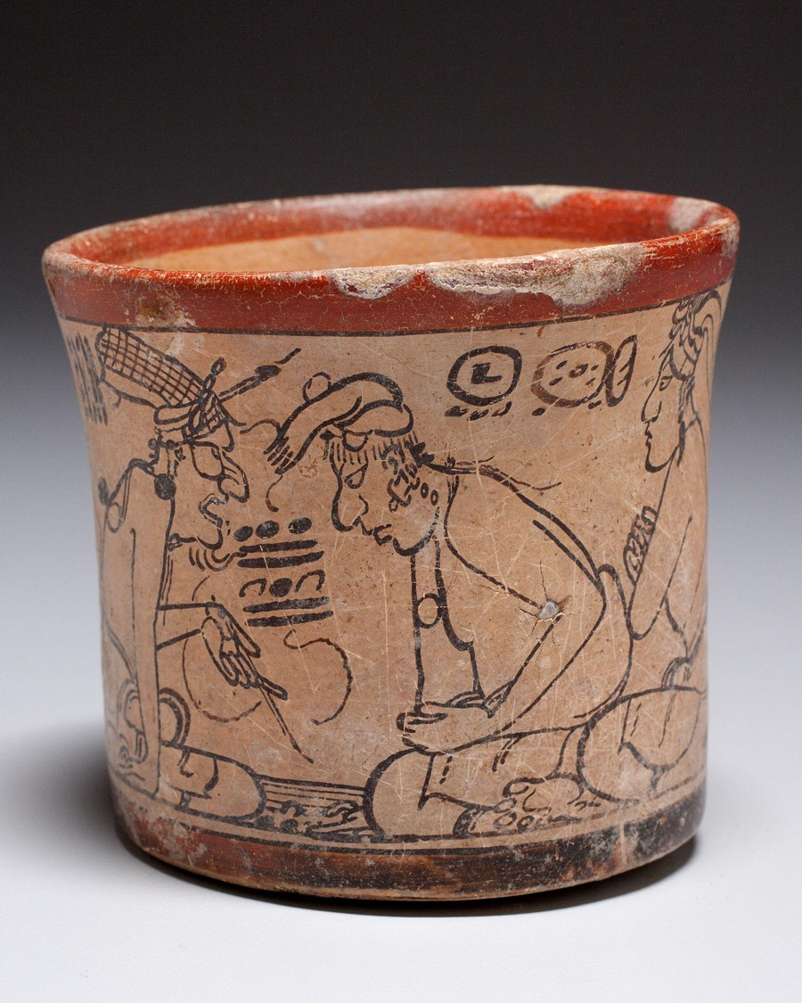
Maya, Codex-Style Vessel with Two Scenes of Itzam Instructing Young Pupils, c. 700–750, ceramic with monochrome decoration. Kimbell Art Museum
Notes:
https://kimbellart.org/collection/ap-200404
This celebrated vessel depicts two scenes with Itzam, an elderly deity associated with creation and Atlantean roles, in animated lessons with four pupils. The Itzam is recognizable by his aged features and his netted headdress with a brush wedged into the ties. In one scene, the Itzam is holding a pointer and reading from a folded codex placed in from of him. As he looks directly at the two individuals seated in rapt attention in front of him, he recites the bar and dot numbers attached to a speech thread, which may represent an arithmetical or calendrical calculation. In the second scene, the Itzam hunched intently forward and taps the ground as he speaks to two similarly attentive pupils, one a royal youth (ch’ok) wearing a turban and a second figure with a goatee. The Itzam’s spoken words appear as a group of glyphs connected to a speech thread that emanates from his mouth. The codex style takes its name from a small group of vessels painted with scenes of great realism in very fine monochromatic lines on cream backgrounds by artists who must have been primarily painters of codices, the folding-screen books that the Maya made from bark paper coated in stucco. These codex-style ceramics give an excellent idea of the high elegance and extraordinary delicacy that must have characterized ancient maya books, none of which have survived from the Classic period.

Slide 8
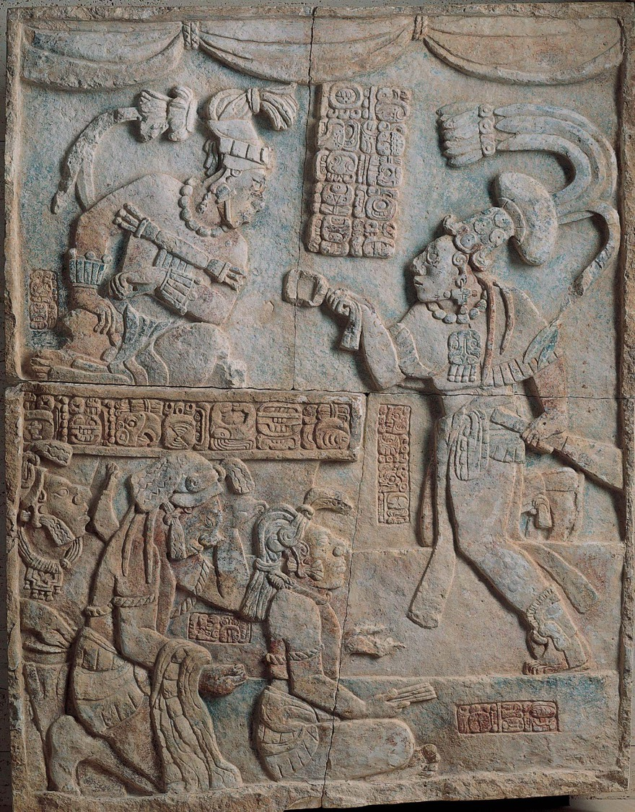
Maya, Presentation of Captives to a Maya Ruler​, c. AD 785, limestone with traces of paint. Kimbell Art Museum
Notes:
https://kimbellart.org/collection/ap-197107
This carved and painted relief panel shows the presentation of captives in a palace throne room, indicated by swag curtains at the top. The five figures are the king of Yaxchilan, Itzamnaaj Balam III, seated at top left; his sahal (a military chief), Aj Chak Maax, at the right; and three bound captives in the lower-left corner. The glyphic text, which gives a date of August 23, 783, records the capture of a lord named Balam-Ahau by Aj Chak Maax and a sacrificial blood-letting three days later under the auspices of the ruler. The three prisoners may be scribes from a captured city, as the one seated in front holds a “stick-bundle” normally associated with depictions of Maya scribes and all three wear headdresses with hun (book) knots. All but the leftmost captive are identified by name. The inscription on the throne front beneath the seated lord is carved with the king’s name and titles, but the glyphs are inscribed in reverse order, from right to left. The name of the artist responsible for sculpting this relief appears on the vertical panel of four glyphs under the sahal’s outstretched arm, perhaps indicating that the sahal was himself also the creator of this work.
The Kimbell relief, which comes from an unidentified site named Laxtunich, probably served as a wall panel inside a Maya building or as a lintel over an entrance. Lintels as large as this often recorded significant dynastic events. It is assumed that their placement at points of transition between the outside, secular world and an inside, more sacred realm was of primary importance.

Slide 9
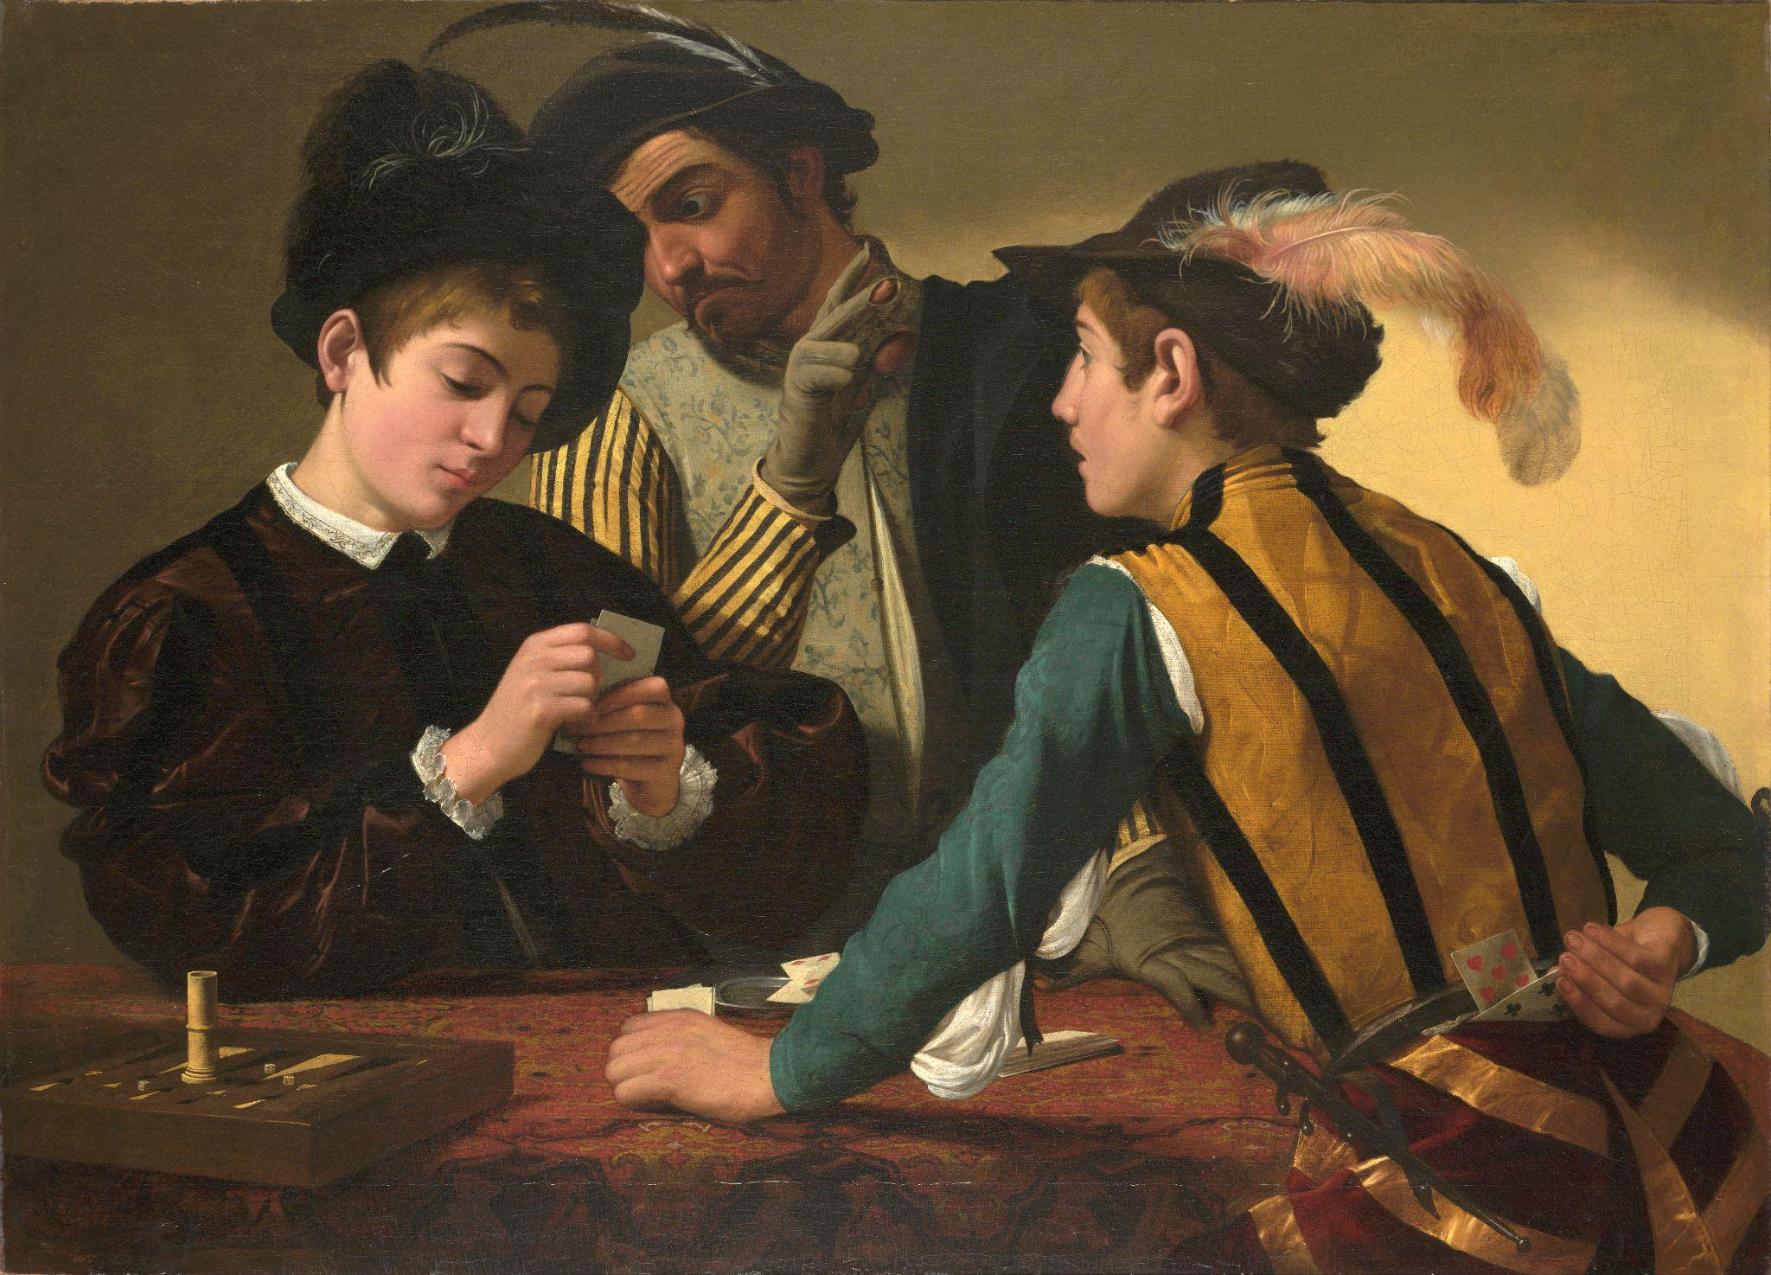
Caravaggio, The Cardsharps, c. 1596–97, oil on canvas. Kimbell Art Museum
Notes:
https://kimbellart.org/collection/ap-198706
Caravaggio was one of the pivotal figures in the history of Western art. In his short lifetime, he created a new, theatrical style that shocked some and inspired others to probe their subject matter for the drama of psychological relationships. Apprenticed in Milan, Caravaggio came to Rome in the early 1590s. There, his early masterpiece The Cardsharps came to the attention of the influential Cardinal Francesco Maria del Monte, who not only purchased it but also offered the artist quarters in his palace and introduced him to the elite stratum of Roman ecclesiastical society, which would lead to his first significant large-scale public commissions.
In The Cardsharps, the players are engaged in a game of primero, a forerunner of poker. The dupe, engrossed in his cards, is unaware that the older cardsharp signals his accomplice with a raised, gloved hand (the fingertips exposed, better to feel marked cards). The young cheat looks expectantly toward the boy and reaches behind his back to pull a hidden card from his breeches. Caravaggio structures the picture to allow us to witness everything, implicating us in the trickery. He has treated this subject not as a caricature of vice but in a novelistic way in which the interaction of gesture and glance evokes the drama of deception and lost innocence in the most human of terms. The Cardsharps spawned countless paintings on related themes by artists throughout Europe–not the least of which was Georges de La Tour’s Cheat with the Ace of Clubs, in the Kimbell. The Cardsharps was stamped on the back with the seal of Cardinal de Monte and inventoried among his possessions after his death.

Slide 10
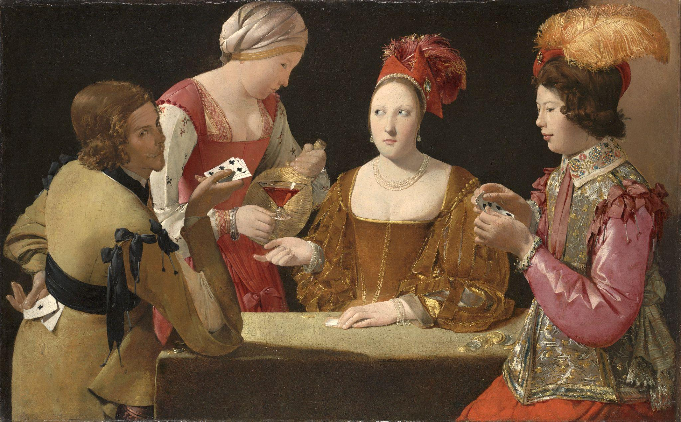
Georges de La Tour, The Cheat with the Ace of Clubs​, c. 1630–34​, oil on canvas. Kimbell Art Museum
Notes:
https://kimbellart.org/collection/ap-198106
For most of his life, Georges de La Tour remained in his native duchy of Lorraine, remote from the art center of Paris. Although he created some of the most visually compelling images of his age, soon after his death he fell into obscurity. It was only in the early twentieth century that La Tour’s oeuvre began to be rediscovered.
One of the greatest masterpieces of seventeenth-century French art, Cheat with the Ace of Clubs takes as its subject the danger of indulgence in wine, women, and gambling. While the theme harks back to Caravaggio’s influential Cardsharps, also in the Kimbell, the roots of this engaging morality play can be traced to earlier representations of the biblical subject of the prodigal son.
La Tour’s dazzling colors and elaborate costumes create a brilliant decorative tableau. His characters enact a psychological drama that unfolds through the cues of their sidelong gazes and the measured gestures that signal their next moves. The cheat tips his cards toward the viewer, who thereby becomes complicit in the scheme, knowing that in the next moment, the conniving trio of cheat, maidservant, and courtesan (identified by her low-cut bodice) will prevail. Another autograph version of this subject, Cheat with the Ace of Diamonds (Musée du Louvre, Paris), displays abundant variations in details of color, clothing, and accessories.

Slide 11
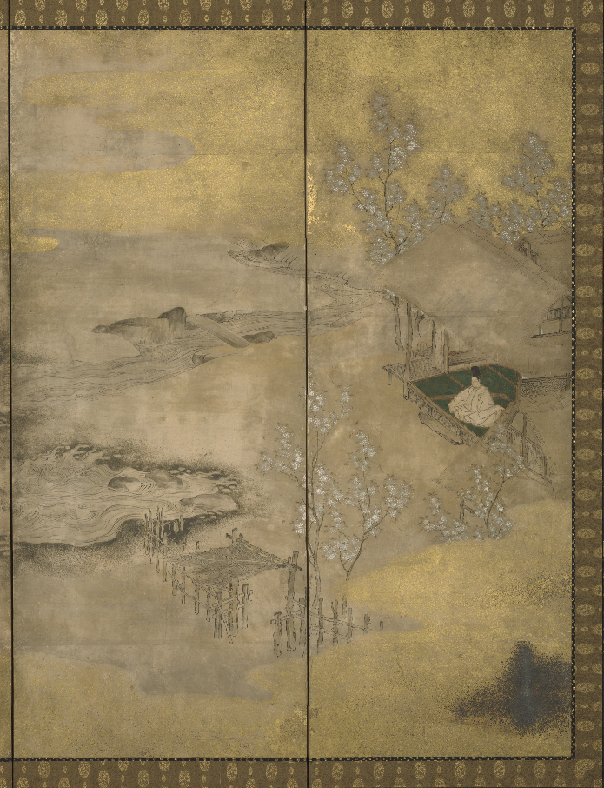
CHARACTER
VS. SOCIETY
In this external conflict, the protagonist disagrees with their government, cultural traditions, or societal constructs.
The character might be motivated by their sense of right and wrong, a need to survive, or a desire for freedom or justice.
Japanese, Genji in Exile at Suma, late 16th century, six-fold screen; ink, gold, silver, and pigments on paper. Kimbell Art Museum
Notes:
https://kimbellart.org/collection/ap-197111
In this melancholy scene, the large sea of rough, billowing waves, the lone nobleman seated in a rustic hut with only his books and koto as companions, and the dusky tones of ink and silver and gold suggest a remote locale. A windblown visitor dressed in a straw cape, who appears to have arrived in a small boat moored at the left, trudges along the shore to the hut. The green of the tatami mats and the white and pink of the blossoming cherry trees (indicating springtime) provide the only brightness in an otherwise somber composition reflecting the sense of isolation and the forlorn state of mind of the nobleman.
The subject of the screen is from the classic masterpiece of Japanese literature The Tale of Genji, written in the early eleventh century by Lady Murasaki Shikibu. The epic novel, comprised of fifty-four chapters, recounts the tumultuous romantic life of Hikaru Genji, the son of a Japanese emperor. The dramatic yet somber scene is based on chapters 12 and 13, Suma, and Akashi, in which Genji is exiled to the rural coastal town of Suma after he is discovered having an affair with the emperor’s consort. The mysterious visitor may represent a messenger sent by Genji’s lover to retrieve him, or he may be the Akashi Novitiate, who wishes to bring Genji to Akashi to marry his daughter. Both are described as arriving in Suma by boat in the midst of a raging storm.

Slide 12
Character vs. Society
EXAMPLES
The Great Gatsby, by F. Scott Fitzgerald (1925)
1984, by George Orwell (1949)
To Kill a Mockingbird, by Harper Lee (1960)
Robin Hood, by Walt Disney Productions (1973)
Aladdin, by Walt Disney Feature Animation (1992)
Mulan, by Walt Disney Feature Animation (1998)
The Hunger Games series, by Suzanne Collins (2008–2025)
The Maze Runner series, by James Dashner (2009–2020)
Zootopia, by Walt Disney Animation Studios (2016)
Coco, by Pixar Animation Studios (2017)
Encanto, by Walt Disney Animation Studios (2021)
CLASSROOM DISCUSSION
ACTIVITY
What are the values, norms, and behavioral expectations that the main character opposes?
Describe the protagonist’s personality and background. What is their motivation for pushing back?
What message or moral is taught through the resolution of this conflict?
Select an artwork reproduced on the next few slides. Decide who the protagonist is within the painting and write a manifesto from their perspective. What would they want to say to their society?

Slide 13
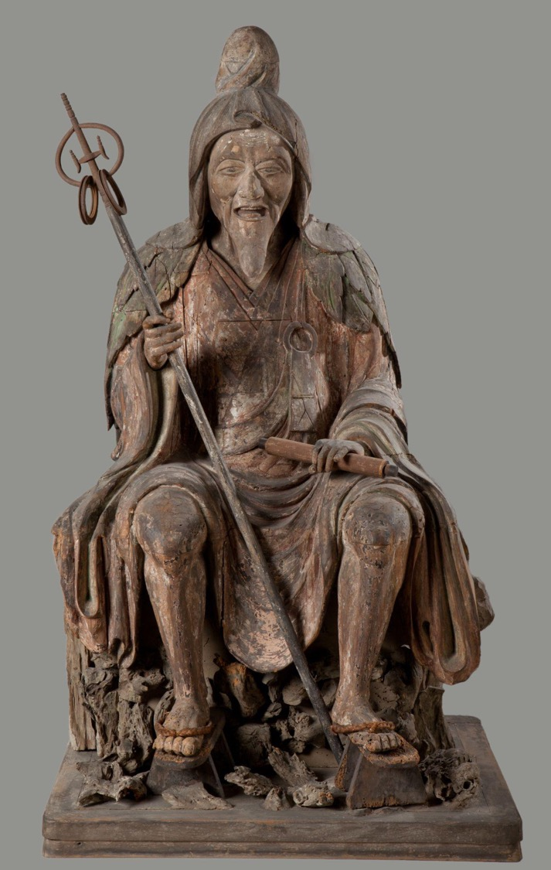
Japanese, En no Gyoja, c. 1300–1375, polychromed wood. Kimbell Art Museum
Notes:
https://kimbellart.org/collection/ap-198413
En no Gyoja was the legendary founder of the Shugendo sect, which emphasized the practice of religious austerities, and he thus came to represent the archetypical ascetic recluse. He is said to have died in the early eighth century after living a hermetic life in the mountains. Because he shunned the established religious orders in the capital at Nara in favor of a solitary, itinerant life in the southern mountains, subsequent generations of clerics and laymen came to regard him as a model for those who wished to pursue religious devotion in a secular world. During the thirteenth and fourteenth centuries in particular the devotees of austere religious practices claimed En no Gyoja as the patriarch of Shugendo.
This sculpture is one of a small number of posthumous portraits of En no Gyoja that survive. Since they were not produced until the Kamakura period, all such portraits are imaginary. This characteristic representation shows him as a bearded old man seated on a rocky ledge dressed in a monk’s robe with a hood and cloak of leaves—references to his secluded life in the mountains—holding a staff and sutra scroll in his hands. The eyes are fixed as if in a hypnotic gaze, and the mouth is open to expose the teeth and tongue, as if En no Gyoja were chanting the scriptures or delivering a lecture. Particular attention is paid to the signs of age and hardship in the priest’s wizened body—the sinuous musculature, wrinkled joints, and bony knees, legs, and feet.

Slide 14
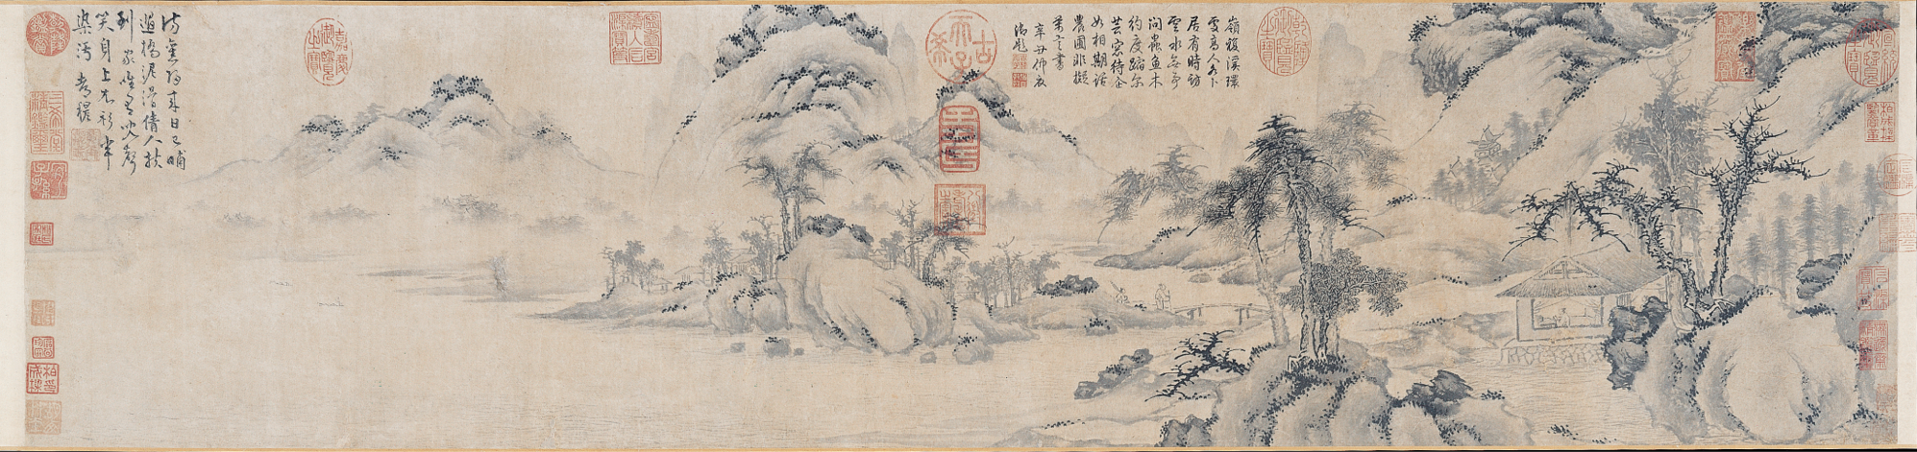
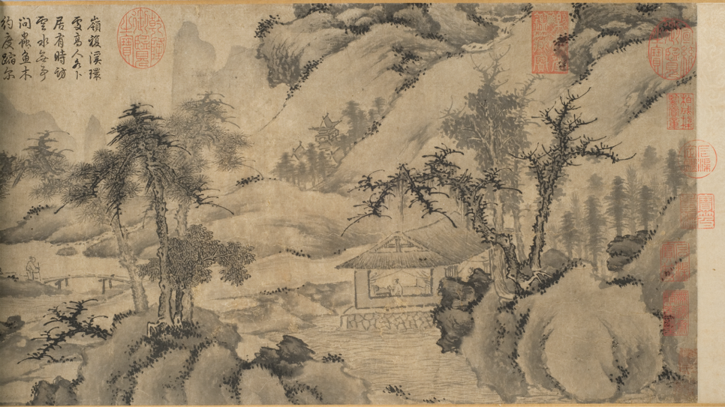
Zhu Derun, Returning from a Visit, c. mid-14th century, handscroll; ink on paper. Kimbell Art Museum
Notes:
https://kimbellart.org/collection/ap-197206
The Yuan dynasty (1279–1368), during which time the Mongols dominated China, was one of great distress for the Chinese. For the first time in their history, the entire country was under foreign control. With the abolishment of the traditional government careers of the scholar-gentry class, the literati retreated to their homes and supported themselves through painting. The Yuan dynasty thus represents a break in the continuity of Chinese landscape painting. A time of nostalgic return to the past, it also saw the emergence of new directions in the function of painting, which became not just representational, but a means of self-expression.
Zhu’s conservative style of rendering rocks and trees, as seen in this handscroll, is drawn from the early landscape masters of the tenth century. Starting at the right, the composition begins with a thatched house in a clearing among mountains and trees; inside a man sits reading, the head of a woman visible through a window. Continuing left, a path leads across a bridge to a village and then to distant mountains, which recede into the mist. A traveler and his servant approach the bridge, returning home. In keeping with the innovative character of Yuan-period works, Zhu has skillfully combined two earlier tenth-century modes of landscape painting. The sharp, spiky depiction of the gnarled trees follows the manner of Li Cheng and Guo Xi, while the soft, round forms of the rocks spotted with rich, black dots of vegetation are painted in the manner of Dong Yuan and Ju Ran. The theme of the scholar-official returning home to withdraw from the troubles of the world is common in Yuan painting, a reaction to the traumatic mood of the period.

Slide 15
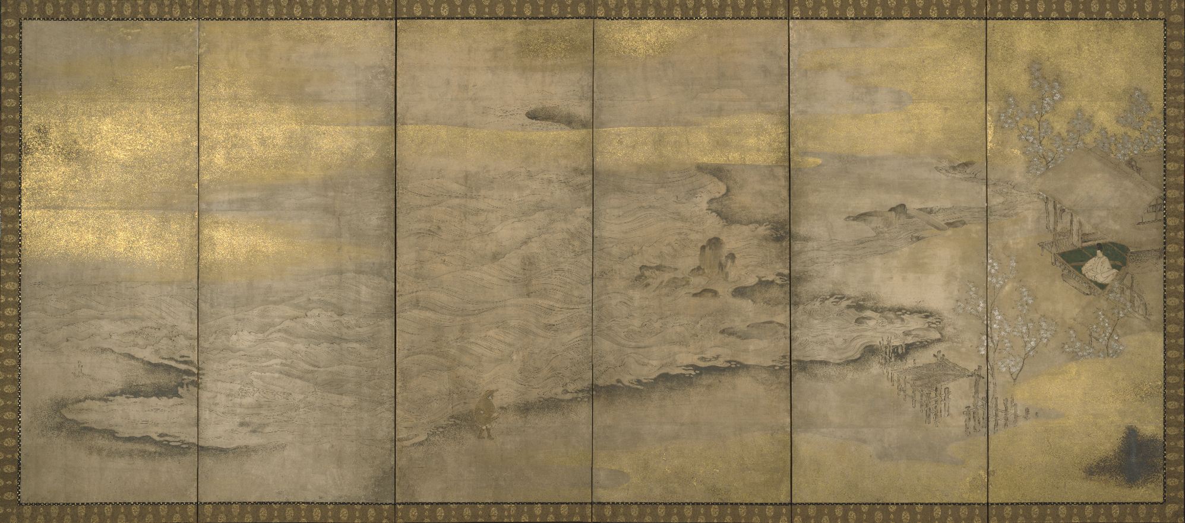
Japanese, Genji in Exile at Suma, late 16th century, six-fold screen; ink, gold, silver, and pigments on paper. Kimbell Art Museum
Notes:
https://kimbellart.org/collection/ap-197111
In this melancholy scene, the large sea of rough, billowing waves, the lone nobleman seated in a rustic hut with only his books and koto as companions, and the dusky tones of ink and silver and gold suggest a remote locale. A windblown visitor dressed in a straw cape, who appears to have arrived in a small boat moored at the left, trudges along the shore to the hut. The green of the tatami mats and the white and pink of the blossoming cherry trees (indicating springtime) provide the only brightness in an otherwise somber composition reflecting the sense of isolation and the forlorn state of mind of the nobleman.
The subject of the screen is from the classic masterpiece of Japanese literature The Tale of Genji, written in the early eleventh century by Lady Murasaki Shikibu. The epic novel, comprised of fifty-four chapters, recounts the tumultuous romantic life of Hikaru Genji, the son of a Japanese emperor. The dramatic yet somber scene is based on chapters 12 and 13, Suma and Akashi, in which Genji is exiled to the rural coastal town of Suma after he is discovered having an affair with the emperor’s consort. The mysterious visitor may represent a messenger sent by Genji’s lover to retrieve him, or he may be the Akashi Novitiate, who wishes to bring Genji to Akashi to marry his daughter. Both are described as arriving in Suma by boat in the midst of a raging storm.

Slide 16
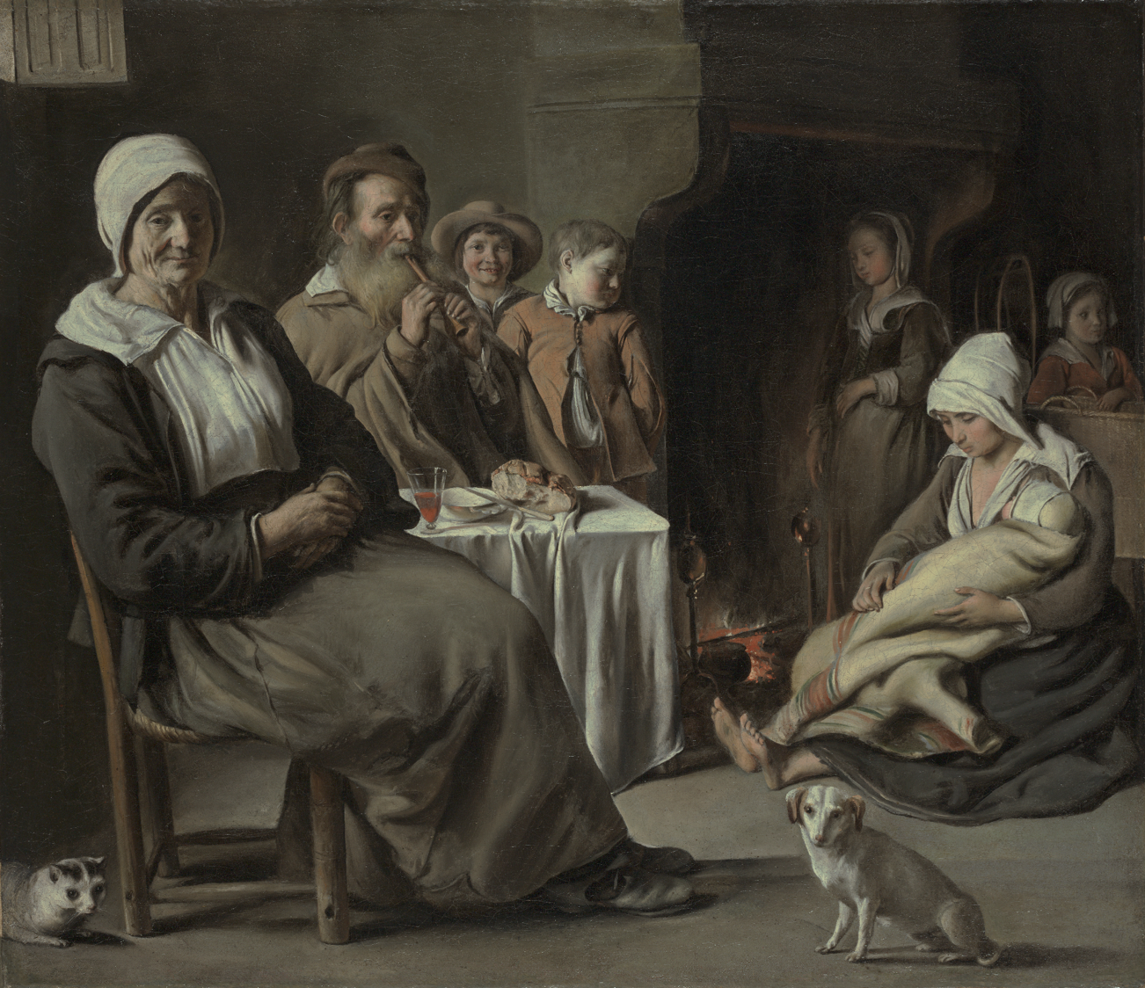
Louis (or Antoine?) Le Nain, Peasant Interior with an Old Flute Player, c. 1642, oil on canvas. Kimbell Art Museum
Notes:
https://kimbellart.org/collection/ap-198422
The Le Nain brothers—Antoine, Louis, and Mathieu—were born in Laon and settled in the artist’s community of Saint-Germaindes-Prés, in Paris, by 1629. The brothers were founding members of the Royal Academy of Painting and Sculpture in 1648, but Antoine and Louis died that same year, presumably of the plague. The Le Nain studio produced portraits and religious works as well as mythological and genre scenes. A group of peasant scenes characterized by their sensitive, subdued palette and emotional solemnity has traditionally been assigned to Louis, who has been regarded as the genius of the family.
In Peasant Interior with an Old Flute Player, an air of serenity surrounds the dignified group, still and silent but for the sound of the flute. Despite the artist’s clear sympathy with humble values, however, this scene is an idealized portrayal of peasant life. Wine in a crystal glass was not peasant fare. Together with the bread placed on the white tablecloth, the wine evidently alludes to the Eucharistic meal and Christian charity, exemplified by this humble household. Much remains to be learned about the Le Nains’ patrons, who may have included members of the pious religious groups in Paris and the outlying regions. The reforming clergy encouraged the devout to emulate the virtues of the idealized poor, such as simplicity, humility, and patience.

Slide 17
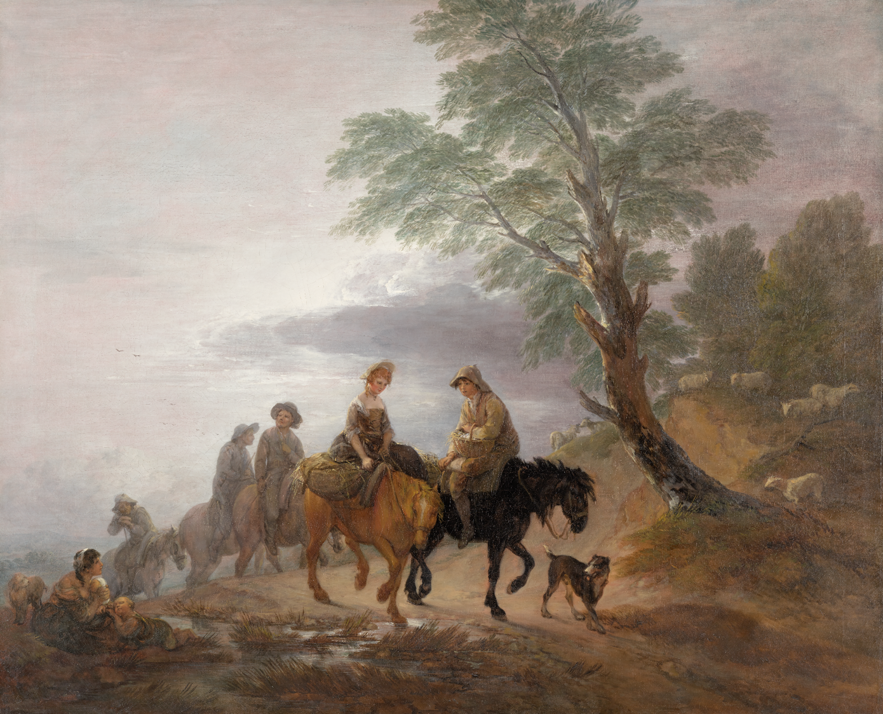
Thomas Gainsborough, Going to Market, Early Morning, c. 1773, oil on canvas. Kimbell Art Museum
Notes:
https://kimbellart.org/collection/ap-202301
This painting is a treasured example of a new type of British landscape painting invented by Thomas Gainsborough. The artist shows figures on horseback near the brow of a hill at the break of day, outlined against a misty sky. At the front of the group is a beautiful girl, riding sidesaddle, and a young man, both of whom have baskets of farm products to sell—eggs nestled in straw. Seated beside a stream, a poor woman with two children looks up at the passing riders. Gainsborough was born in the countryside but trained in London before settling in the fashionable city of Bath, where he was acclaimed, along with Sir Joshua Reynolds, as the leading British portrait painter of the age. At the same time, however, he pursued his passion for landscape painting, and in the last decades of his life, working through observation and memory, created imaginative compositions that appeal to the viewer’s sentiments.
Gainsborough’s early works were inspired by the old masters—the naturalistic landscapes of Dutch painters such as Jacob van Ruisdael, the vibrant color and fluent brushwork of Peter Paul Rubens, and the captivating Italianate light effects of Claude Lorrain. In his maturity, he worked on a large scale and introduced a modern element to the landscape: the contemporary social life of the countryside, observed firsthand. In Going to Market, the girl’s auburn ringlets and fine necklace might seem romanticized but may have been donned to attract customers. The shadowy riders in the background fit descriptions of colliers carrying sacks of coal by pack pony from coalfields nearby. In this magical picture, Gainsborough has reimagined the classical landscape tradition, enriching its dreamlike serenity with the vivid life-force of the English countryside.

Slide 18
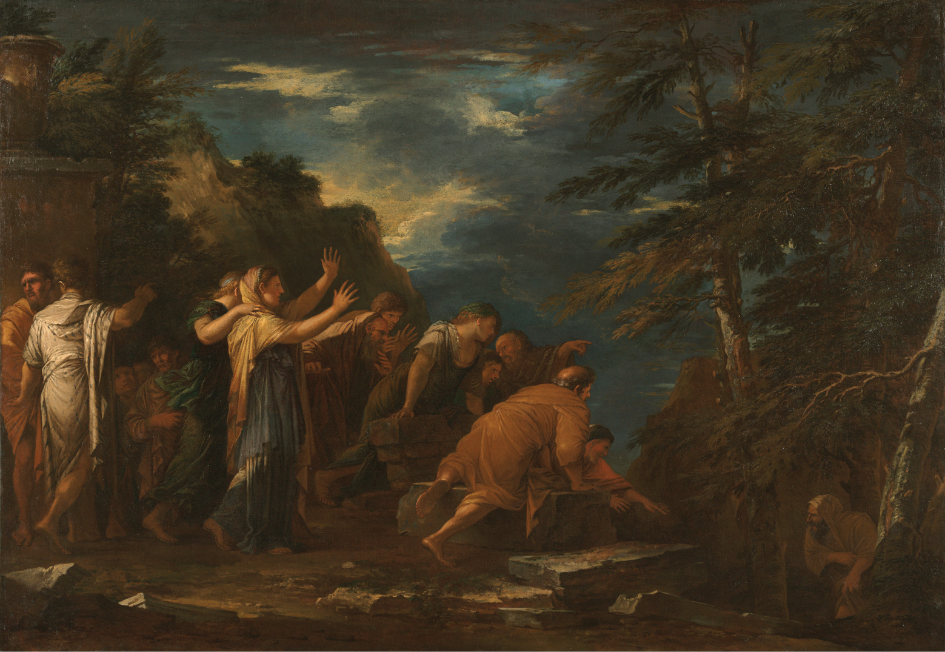
Salvator Rosa, Pythagoras Emerging from the Underworld, 1662, oil on canvas. Kimbell Art Museum
Notes:
https://kimbellart.org/collection/ap-197022
Born and educated in Naples, Salvator Rosa was among the first artists to paint landscapes out of doors, adopting a bold, naturalistic manner. In Florence and in Rome, where he eventually settled, Rosa also gained a considerable reputation as a satirical poet and actor— and as an impetuous, individualistic personality. He was among the first artists to express a passionate appreciation for the awe-inspiring beauty of untamed nature, and his landscapes were invoked by later generations of admirers as expressions of the “sublime.” Here, Rosa’s distinctive landscape—with its jagged rocks, bowed trees, and livid skies—lends the painting a dramatic, otherworldly mood. Rosa was also fascinated by obscure subjects, particularly those featuring the occult practices of ancient philosophers. Pythagoras Emerging from the Underworld, which follows the literary account of Diogenes Laertius, shows the Greek philosopher leaving his underground dwelling, where he had spent some time in isolation. Here, Pythagoras’s stunned and credulous followers react to his claim that he witnessed the torture of the souls of Hesiod and Homer during his descent into Hades. In a letter of 1662, Rosa expressed great satisfaction with the Kimbell painting and its pendant, whose subjects had “never been touched by anyone.” When the two works were purchased by the important Sicilian collector Antonio Ruffo, Rosa demanded a considerable sum, telling Ruffo’s agent he “would rather die of hunger than reduce his price.”

Slide 19
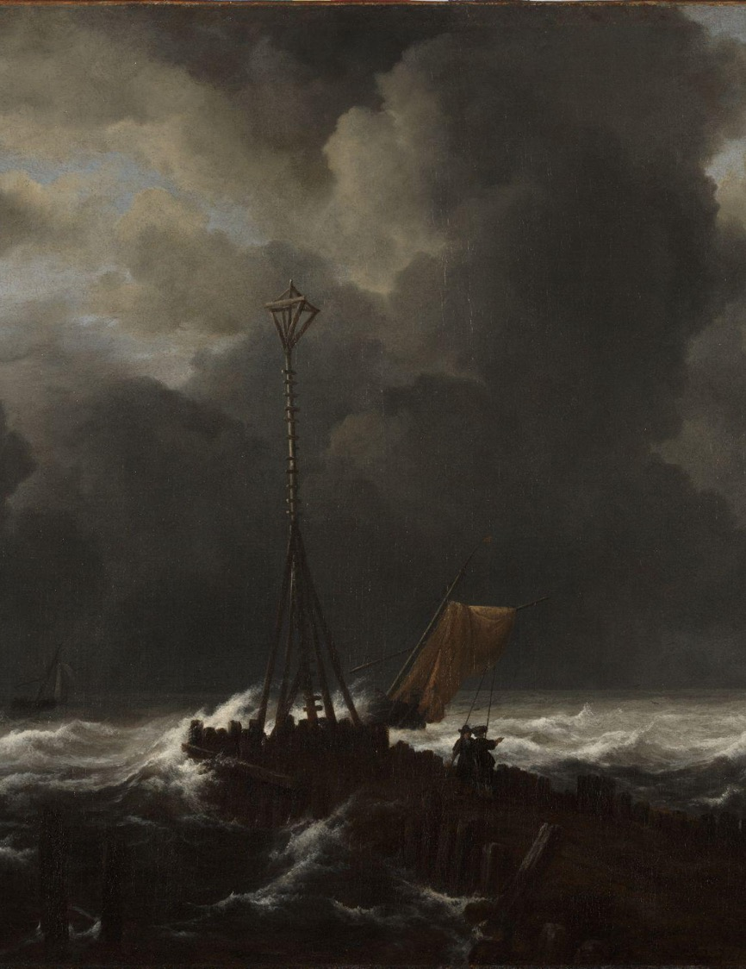
CHARACTER
VS. NATURE
In this external conflict, the protagonist is challenged by the weather, the wilderness (sometimes dangerous animals), a natural disaster, or disease.
Jacob van Ruisdael, Rough Sea at a Jetty (detail), 1650s, oil on canvas. Kimbell Art Museum
Notes:
https://kimbellart.org/collection/ap-198901
Jacob van Ruisdael, the most influential and inventive landscape painter of the Dutch golden age, endowed the native tradition of realism with a newfound dramatic force. Recording the familiar wooded hills, flat farmlands, and coastal dunes of the Netherlands, his work went beyond the topographic accuracy of earlier generations to achieve a sense of the monumental grandeur of nature.
Among his most highly valued works, Ruisdael’s rare marine paintings reveal the scope of his genius, as they convey the transitory and changeable face of nature. Rough Sea at a Jetty represents the approach of a violent storm. In the foreground, a jetty extends a considerable distance into the sea. At its end is a rustic beacon to guide distressed ships into harbor. Two men with long poles stand nearby, ready to come to the aid of a vessel striving to make port through the tempestuous winds and waves that threaten its approach. A dramatic light breaks through the clouds beyond the beacon, suggesting the power of nature and perhaps alluding to the salvation that greets those who steer the proper course.

Slide 20
Character vs. Nature
EXAMPLES
Moby-Dick, by Herman Melville (1851)
The Old Man and the Sea, by Ernest Hemingway (1952)
Life of Pi, by Yann Martel (2001)
Ice Age franchise, by Blue Sky Studios and 20th Century Fox (2002–2026)
Wolf in the Snow, by Matthew Cordell (2018)
CLASSROOM DISCUSSION
ACTIVITY
What is the setting for this conflict and how is the protagonist impacted by it?
How does nature become its own character in the story? Describe its goals and challenges.
How does the main character’s personality develop through their experience with the conflict?
How would you react in this situation? What decisions would you need to make to persevere?
Choose an artwork reproduced on the next few slides. Ask your students to sit in a circle. While looking at the same artwork, go around the circle and invite each student to add a sentence, creating a collaborative story.

Slide 21
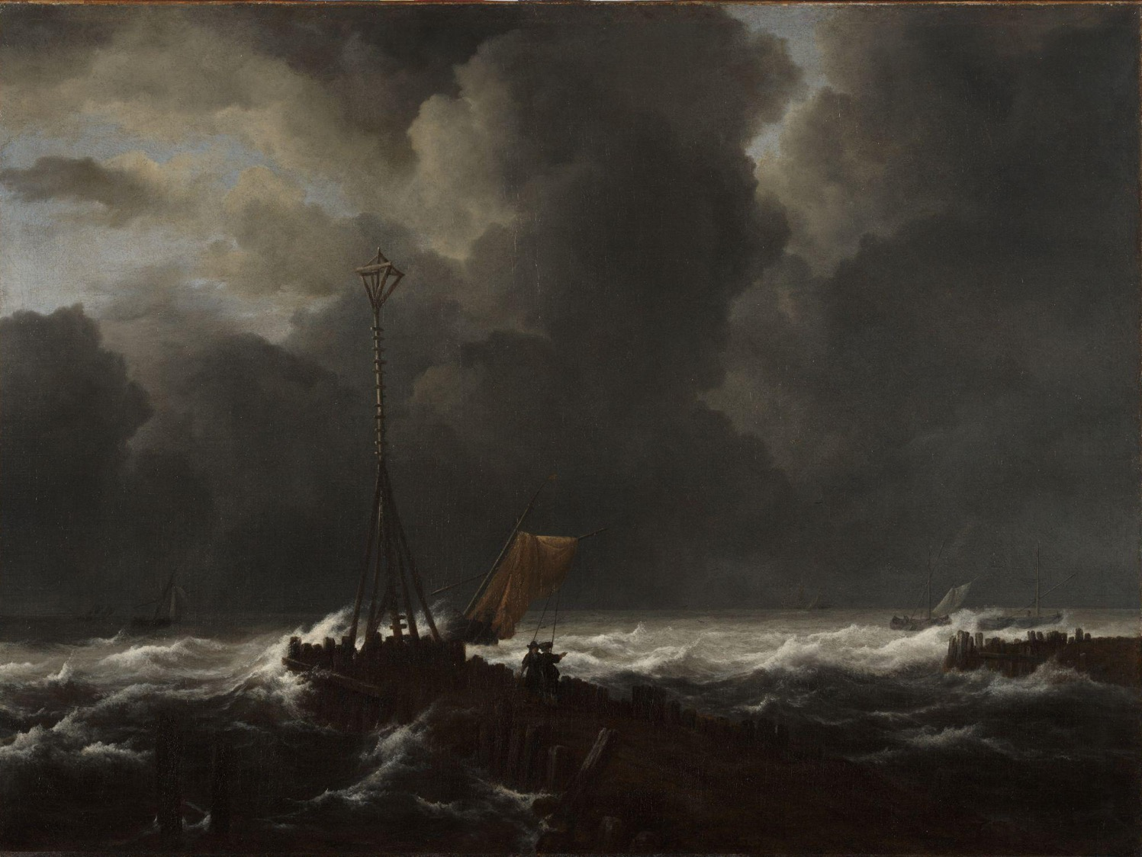
Jacob van Ruisdael, Rough Sea at a Jetty, 1650s, oil on canvas. Kimbell Art Museum
Notes:
https://kimbellart.org/collection/ap-198901
Jacob van Ruisdael, the most influential and inventive landscape painter of the Dutch golden age, endowed the native tradition of realism with a newfound dramatic force. Recording the familiar wooded hills, flat farmlands, and coastal dunes of the Netherlands, his work went beyond the topographic accuracy of earlier generations to achieve a sense of the monumental grandeur of nature.
Among his most highly valued works, Ruisdael’s rare marine paintings reveal the scope of his genius, as they convey the transitory and changeable face of nature. Rough Sea at a Jetty represents the approach of a violent storm. In the foreground, a jetty extends a considerable distance into the sea. At its end is a rustic beacon to guide distressed ships into harbor. Two men with long poles stand nearby, ready to come to the aid of a vessel striving to make port through the tempestuous winds and waves that threaten its approach. A dramatic light breaks through the clouds beyond the beacon, suggesting the power of nature and perhaps alluding to the salvation that greets those who steer the proper course.

Slide 22
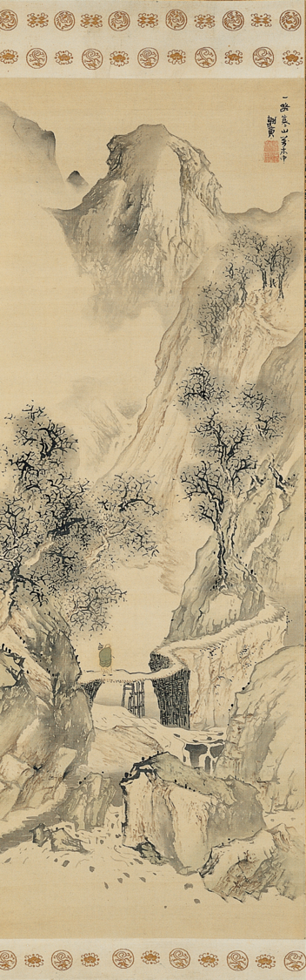
Yosa Buson, Landscape with a Solitary Traveler, c. 1780, hanging scroll; ink and light colors on silk. Kimbell Art Museum
Notes:
https://kimbellart.org/collection/ap-198118
The nanga (southern painting) school, also called bunjinga (literati painting), was one of the two most dynamic schools of Japanese painting during the eighteenth and early nineteenth centuries. In contrast to the sensuous school of native decorative art, called ukiyo-e (pictures of the floating world), the nanga school was the last manifestation of the centuries-old Japanese preoccupation with China. It was based on the monochrome-ink landscape styles of Chinese literati painters, modified according to Japanese taste, and was patronized principally by the cultivated upper strata of Japanese society living in Kyoto.
Yosa Buson, a famous poet and one of the two greatest painters of the nanga school, began his serious career as an artist in 1751, when he finally settled in Kyoto after a ten-year period of wandering. The signature Sha-in on the Kimbell’s painting is one that Buson used from 1778 until his death. This period is regarded as his most successful, when he best expresses his feeling for poetry through his painting.
This scroll depicts a landscape with a narrow road winding upward through the mountains. A solitary traveler wrapped in a green cloak crosses a footbridge constructed over a swollen, rushing stream. Inscribed on the scroll is the last line of a poem by the Chinese Tang-period poet Han Yu (768–824): A single path in cold mountains through the myriad streams. Using this as his theme, Buson evokes the sense of cold through the pale green and gray coloring, the leafless trees, and the traveler’s cloak.

Slide 23
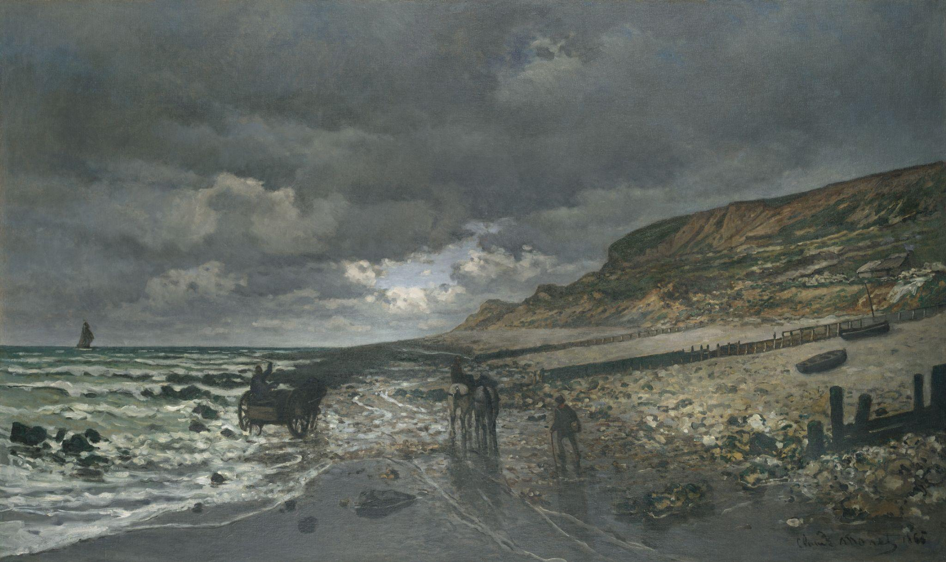
Claude Monet, La Pointe de la Hève at Low Tide, 1865, oil on canvas. Kimbell Art Museum
Notes:
https://kimbellart.org/collection/ap-196807
This magnificent beach scene near Le Havre, where Monet grew up, was one of two landscapes that launched his career when exhibited in Paris at the 1865 Salon. Monet developed this large showpiece in direct response to similar compositions submitted to the Salon of 1864 by Charles-François Daubigny and his son Karl. Daubigny had attempted to execute his Salon painting entirely on the spot, in what would soon become the orthodox practice for Impressionist landscapes. But in 1864, Monet still worked in a more traditional fashion: he first painted La Pointe de la Hève at the site as a portable-scale work then enlarged it at his Paris studio in early 1865. Most impressive in this large version is Monet’s rendition of the beach at low tide, the muted silvery tones of the foreground reflecting the low-hanging clouds stretching far away. The rocks at the right, described with brisk, creative brushwork, are especially indicative of Monet’s unique talents, which were increasingly evident as he emerged as the leading Impressionist landscape artist.
Monet insisted that an old black-and-white photograph of La Pointe de la Hève be included in a 1921 book about him. Perhaps as a result, this work from his youth was traced, and in 1923 a dealer friend brought it back to Giverny to keep the elderly artist company as he recovered from eye surgery.

Slide 24
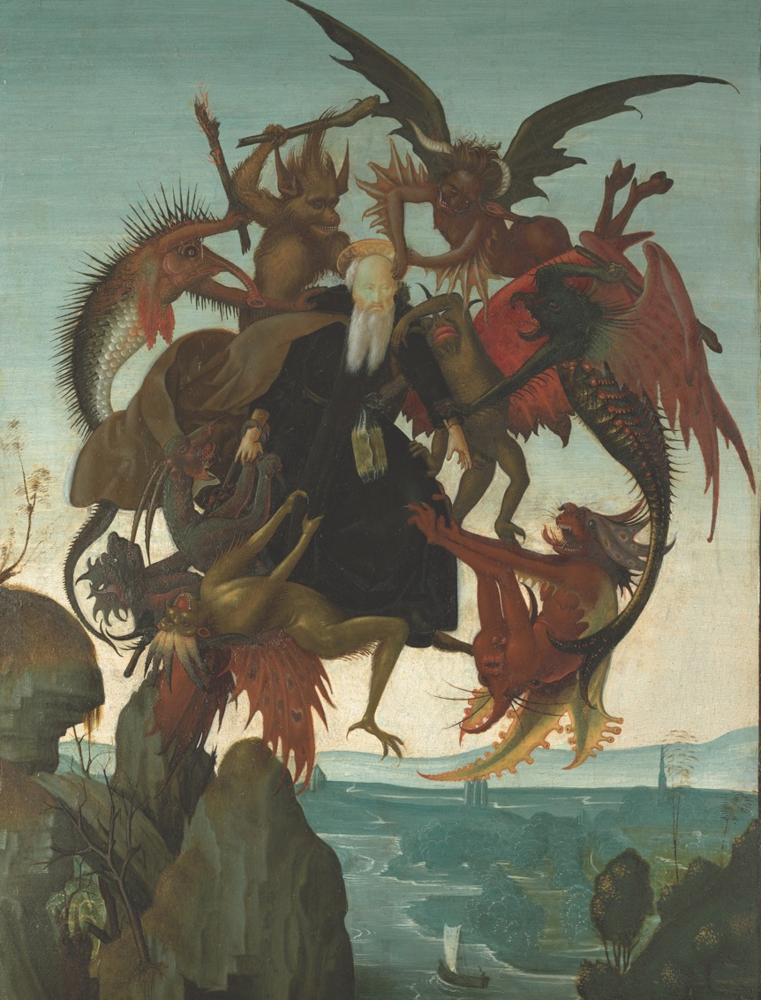
CHARACTER VS. THE UNKNOWN
Sometimes called “Character versus Supernatural,” in this external conflict, the main character faces phenomena such as witches, monsters, ghosts, aliens, vampires, werewolves, or gods.
Michelangelo Buonarroti, The Torment of Saint Anthony, 1487, tempera on panel. Kimbell Art Museum
Notes:
https://kimbellart.org/collection/ap-200901
This is the first known painting by Michelangelo, believed to have been painted when he was twelve years old. Although Michelangelo considered himself first and foremost a sculptor, he received his early training as a painter, in the workshop of Domenico Ghirlandaio (c. 1449–1494), a leading master in Florence. Michelangelo’s earliest biographers, Giorgio Vasari and Ascanio Condivi, tell us that, aside from some drawings, his first work was a painted copy of the engraving Saint Anthony Tormented by Demons by the fifteenth-century German master Martin Schongauer. The rare subject is found in the life of Saint Anthony the Great, written by Athanasius of Alexandria in the fourth century. It describes the Egyptian hermit-saint’s vision, in which he levitated into the air and was attacked by demons, whose torments he withstood.
Created when he was informally associated with Ghirlandaio’s workshop and under the guidance of an older friend, the artist Francesco Granacci, Michelangelo’s painting earned him widespread recognition. Writing when Michelangelo was still alive, both Vasari and Condivi recounted that to give the demonic creatures veracity, the artist studied the colorful scales and other parts of specimens from the fish market. Michelangelo subtly revised Schongauer’s composition, making it more compact and giving the monsters more animal-like features, notably adding fish scales to one of them. He also included a landscape that resembles the Arno River Valley around Florence. The work is one of only four easel paintings generally regarded as having come from his hand and the first painting by Michelangelo to enter an American collection.

Slide 25
Character vs. The Unknown
EXAMPLES
The Chronicles of Narnia, by C.S. Lewis (1950–1956)
Sleeping Beauty, by Walt Disney Productions (1959)
Jumanji, by Chris Van Allsburg (1981)
Ghostbusters, by Columbia-Delphi Productions and Black Rhino (1984)
Ender’s Game, by Tor Books (1985)
The Little Mermaid, by Walt Disney Feature Animation (1989)
Hocus Pocus, by Walt Disney Pictures (1993)
Spirited Away, by Studio Ghibli (2001)
Lilo & Stitch, by Walt Disney Feature Animation (2002)
Coraline, by Neil Gaiman (2002)
Over the Garden Wall, by Cartoon Network Studios (2014)
Stranger Things, by 21 Laps Entertainment and Monkey Massacre Productions (2016)
CLASSROOM DISCUSSION
ACTIVITY
What is the relationship between “the unknown” and the main character?
What are “the unknown”’s objectives and constraints?
Describe the different archetypes present in the story (hero, jester, caregiver, ruler, creator, innocent, sage, explorer, rebel, etc.). How do these characters aid or hinder the main character?
Choose an artwork from the next few slides and create a new painting from the perspective of the unknown entity. What are its goals and fears? How can you illustrate these ideas?

Slide 26
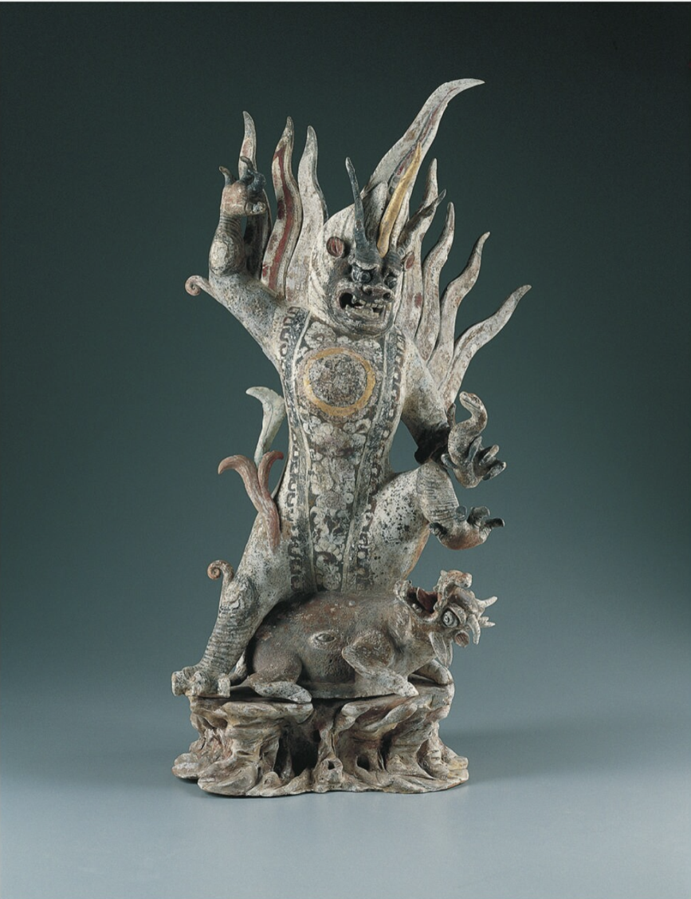
Chinese, Tang dynasty (AD 618–907), Court Lady, First half of the 8th century, Gray earthenware with painted polychrome decoration. Kimbell Art Museum.
Notes:
https://kimbellart.org/collection/ap-200102
The inclusion of fantastic animal guardians as part of the retinue of Chinese tomb figures began in the Northern Wei dynasty (AD 386–534) and continued into the Tang dynasty (AD 618–907). Also called earth spirits, or zhenmushou (grave-quelling beasts), these guardians took the form of fantastic hybrid creatures composed of various animal and, in some cases, human elements. They were placed in tombs in pairs to ward off any malevolent beings.
Brilliantly painted in pink, red, orange, and black and highlighted with gilding, the Kimbell’s fierce figure stands in a rampant posture of conquest as it subdues a snarling beast upon a rockwork base, its left arm entwined with a serpent. The spirit’s triple horns, bulging eyes, bare-teethed grimace, and sharp claws add to its ferocious appearance. Undulating flames emerge from its head, shoulders, and right leg. A gilded tondo, finely painted with a group of figures (possibly musicians, who may also be foreigners) and set against a luxuriant floral panel, embellishes the figure’s chest.
The composite elements of the Earth Spirit, such as the large horns, claws, fangs, and tiger stripes, presumably conferred upon it the fearsome qualities of these animals. The guardian is quelling evil in the form of the horned, hoofed beast that he tramples underfoot. The eye on the side of the beast’s belly may represent the “third eye,” an indication of the influence of Esoteric Buddhism prevalent during the early Tang period.

Slide 27

Michelangelo Buonarroti, The Torment of Saint Anthony, 1487, tempera on panel. Kimbell Art Museum
Notes:
https://kimbellart.org/collection/ap-200901
This is the first known painting by Michelangelo, believed to have been painted when he was twelve years old. Although Michelangelo considered himself first and foremost a sculptor, he received his early training as a painter, in the workshop of Domenico Ghirlandaio (c. 1449–1494), a leading master in Florence. Michelangelo’s earliest biographers, Giorgio Vasari and Ascanio Condivi, tell us that, aside from some drawings, his first work was a painted copy of the engraving Saint Anthony Tormented by Demons by the fifteenth-century German master Martin Schongauer. The rare subject is found in the life of Saint Anthony the Great, written by Athanasius of Alexandria in the fourth century. It describes the Egyptian hermit-saint’s vision, in which he levitated into the air and was attacked by demons, whose torments he withstood.
Created when he was informally associated with Ghirlandaio’s workshop and under the guidance of an older friend, the artist Francesco Granacci, Michelangelo’s painting earned him widespread recognition. Writing when Michelangelo was still alive, both Vasari and Condivi recounted that to give the demonic creatures veracity, he studied the colorful scales and other parts of specimens from the fish market. Michelangelo subtly revised Schongauer’s composition, making it more compact and giving the monsters more animal-like features, notably adding fish scales to one of them. He also included a landscape that resembles the Arno River Valley around Florence. The work is one of only four easel paintings generally regarded as having come from his hand and the first painting by Michelangelo to enter an American collection.

Slide 28
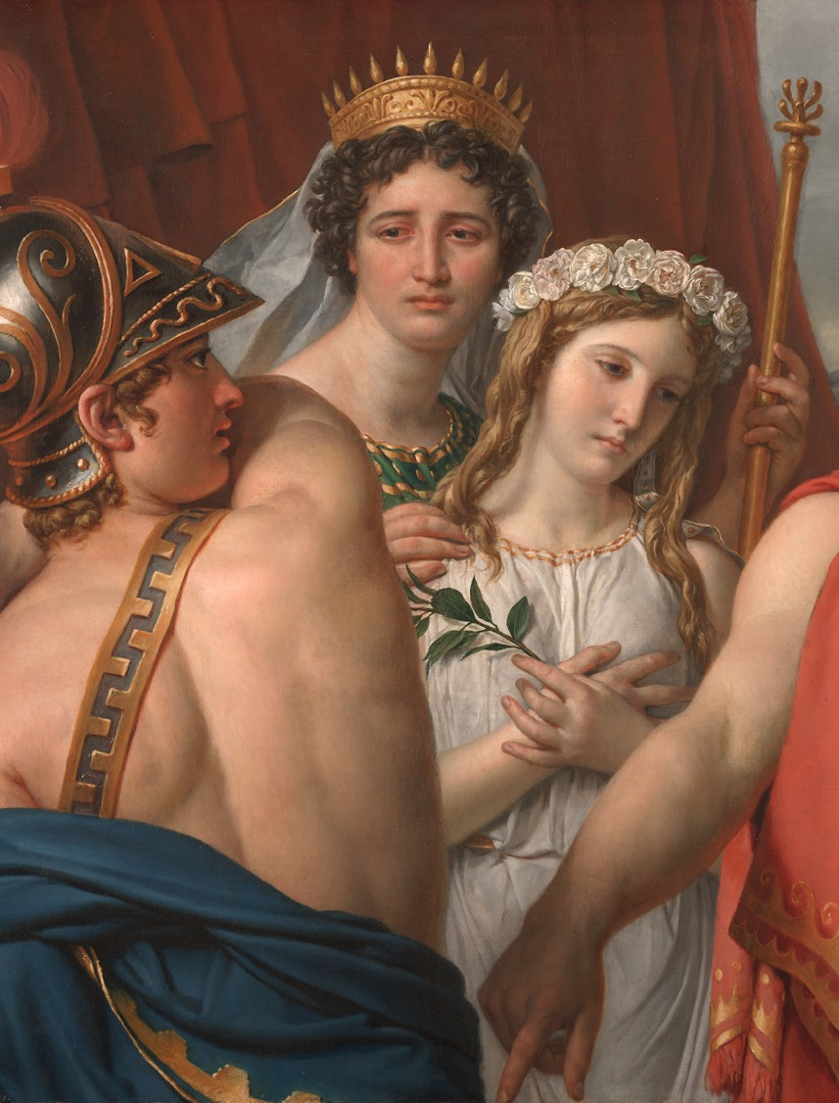
CHARACTER
VS. FATE
During a character versus fate conflict, the protagonist is at odds with their destiny or calling.
Jacques-Louis David, The Anger of Achilles​ (detail), 1819, oil on canvas. Kimbell Art Museum
Notes:
https://kimbellart.org/collection/ap-198007
The leading Neoclassical painter in Europe during the French Revolution and under Napoleon, David went into exile in Brussels after the Battle of Waterloo, in 1815. There, he painted and exhibited The Anger of Achilles, which he prized highly as the culmination of his career-long effort to recapture the perfection of ancient Greek art.
The subject of the painting, from the events that preceded the Trojan War, is drawn from Euripides’ ancient play Iphigenia in Aulis and Racine’s seventeenth-century dramatic version of the same story. Agamemnon, king of the Greeks, has just revealed that his daughter Iphigenia is not to be married to the youthful Achilles but sacrificed in order to appease the goddess Diana and so allow the Greek fleet to set sail for Troy. The complex episode challenged David to render a spectrum of emotions, from stoic courage and heroic resolve to grief and anger.
David’s seemingly speechless figures have scarcely enough room to act out the drama. They are observed from close up, vividly cropped at waist level rather than being seen full-length. Achilles angrily reaches for his sword, but Agamemnon’s magnetic gaze and his authoritative gesture appear to freeze Achilles’s outburst. Dressed as a bride, Iphigenia, who is portrayed like a Renaissance angel, clutches her heart, oblivious to the display of male confrontation. The reaction of her mother, Clytemnestra, mingling disappointment at Achilles’ inability to act with grief for her daughter, is apparently intended to mirror the mixed reactions that any spectator must feel as parental, spousal, and civic duties compete with one another.

Slide 29
Character vs. Fate
EXAMPLES
The Lion King, by Walt Disney Feature Animation (1994)
Hercules, by Walt Disney Feature Animation (1997)
Harry Potter series, by J.K. Rowling (1997–2007)
The Princess Diaries, by Meg Cabot (2000)
Avatar: The Last Airbender, by Nickelodeon Animation Studio (2005–2008)
Percy Jackson series, by Rick Riordan (2005–2024)
Moana, by Walt Disney Animation Studios (2016)
CLASSROOM DISCUSSION
ACTIVITY
How much does the protagonist know about their destiny? How does their disposition toward this calling change throughout the story?
How is the character’s fate foreshadowed?
How does the protagonist attempt to alter their destiny?
Choose an artwork reproduced on the next few slides and identify symbols that foreshadow the character’s destiny. Then, draw additional symbols that help hint at the plot.

Slide 30
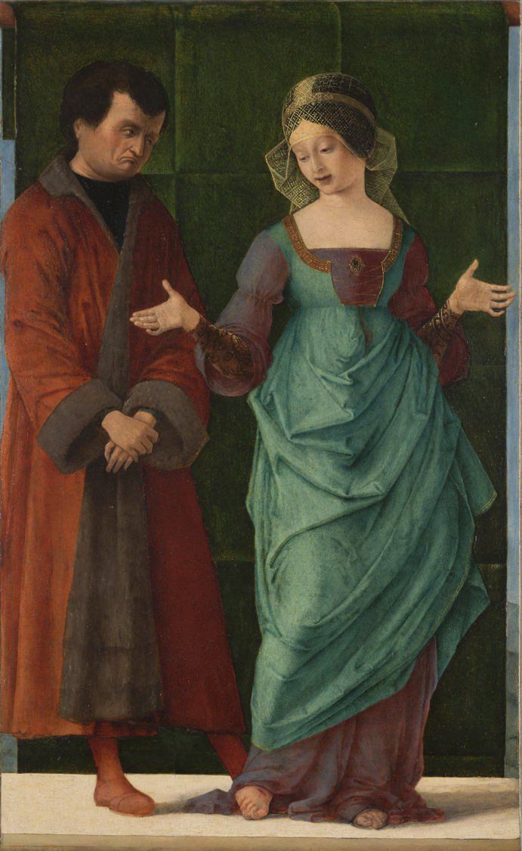
Ercole de’ Roberti, Portia and Brutus, c. 1486–90, tempera, possibly oil, and gold on panel. Kimbell Art Museum
Notes:
https://kimbellart.org/collection/ap-198605
Ercole de’ Roberti spent the latter half of his career at the court of Ercole I d’Este, Duke of Ferrara, painting altarpieces, small devotional works, portraits, and fresco cycles for the Este residences, as well as producing decorative objects like beds and carriages. Ercole’s panel is one of three known scenes of virtuous women that were likely painted for the duchess of Ferrara, Eleonora of Aragon. Depictions of female worthies who exemplified virtues such as chastity, fidelity, and patriotism were inspired by the writings of ancient authors, such as Valerius Maximus and Plutarch, and Renaissance texts, especially Boccaccio’s On Famous Women (1361–75). Here Portia, the wife of Marcus Junius Brutus, demonstrates her bravery and fortitude by wounding her foot with a razor the evening before her husband’s attempt to assassinate Julius Caesar. She explains that she inflicted the wound herself to confirm that she would be ready to endure death should the plan not succeed. Eleonora may have installed Ercole’s exquisitely painted works in her own suite of rooms in the Castello Vecchio of Ferrara, refurbished around 1490.

Slide 31
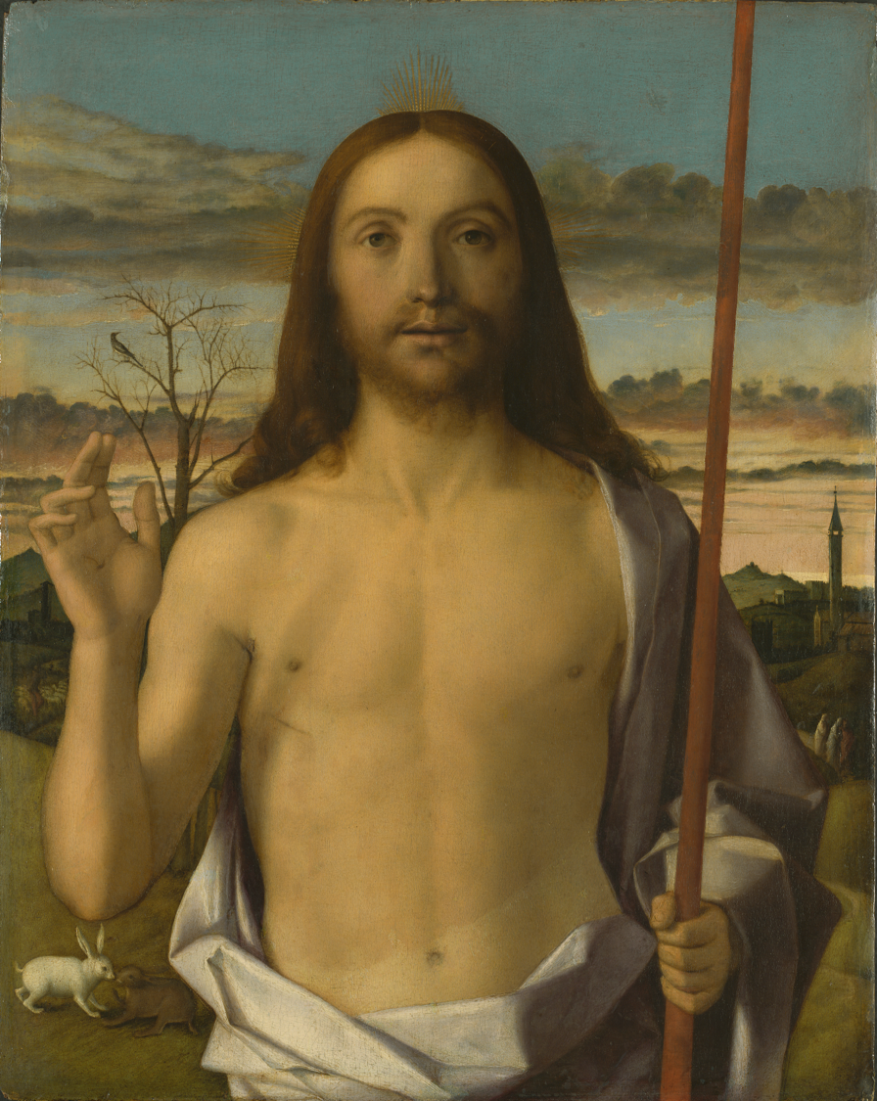
Giovanni Bellini, Christ Blessing, c. 1500, tempera, oil, and gold on panel. Kimbell Art Museum
Notes:
https://kimbellart.org/collection/ap-196707
Bellini’s Christ Blessing vividly portrays the central mystery of the Christian faith: the Incarnation, when Christ—fully human and fully divine—was sent to earth to redeem humankind. Here, the Resurrected Savior faces the worshipper with a level gaze. He raises his right hand in blessing while his left grips the red staff of the banner of the Resurrection (the white flag with a red cross, denoting his triumph over death, is out of view). Golden rays of light emanate from his head, signaling his divinity. A cool, lavender-white drapery encircles his warm flesh, incandescent with a preternatural beauty. The message of Christian compassion is conveyed by the wounds visible on his hand and chest, while the shadow cast by his raised arm serves to confirm the reality of the Resurrection. For greater immediacy, the devotional image is brought close to the picture plane.
Various motifs in the landscape allude to the Resurrection and its meaning. The withered tree with the solitary bird probably stands for the Old Covenant, out of which the New Covenant would grow. The pair of rabbits signify regeneration, while the shepherd tending his flock is a reminder that Christ is the Good Shepherd (John 10:14). The three robed figures at the picture’s right edge are undoubtedly the three Marys hurrying to tell the disciples of the empty tomb. The distant bell tower denotes that salvation is found through Christ’s sacrifice and the Church. Since the early Christian era, Christ had been identified with the sun god, Apollo. Like “Sol Invictus,” the never-vanquished Sun, the risen Savior is victorious over death as he presides here like a classical hero over the landscape, dappled by the dawning light.

Slide 32
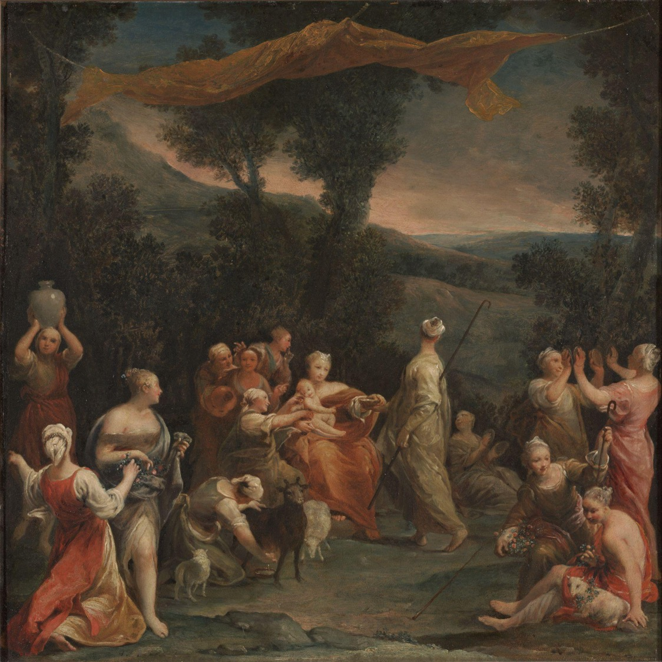
Giuseppe Maria Crespi, Jupiter Among the Corybantes, c. 1730, oil on copper. Kimbell Art Museum
Notes:
https://kimbellart.org/collection/ap-198417
Giuseppe Maria Crespi, the most innovative Bolognese painter of his day, was especially acclaimed for his intimate genre scenes. This fresh approach also infuses his paintings of classical subjects, like Jupiter Among the Corybantes, where Crespi paints a bevy of young women in graceful attitudes who attend to the infant god Jupiter. To avert the prophecy that a son would succeed him, Saturn habitually devoured his male children, and so his wife took the infant Jupiter to Crete to be reared by the Corybantes. In Crespi’s own words, the nymphs, “thinking that his cries might reveal him, as is usual with babies, devised a plan to beat out a certain cadence, which they called Bactili, and so in unison they clanged little cymbals made of bronze, so that the cries of the infant Jupiter could not reach the ears of Saturn.”
The painting, executed on copper, retains its delicate, transparent glazes and vibrant colors, especially in the apricot and cherry draperies of the figures and the canopy billowing overhead, perhaps intended to shield Jupiter from Saturn’s Olympian gaze. The melodious composition is arranged like musical notes, the dainty, ovoid heads of the maidens echoing the forms of the diminutive cymbals, vessels, and floral wreaths they hold.

Slide 33
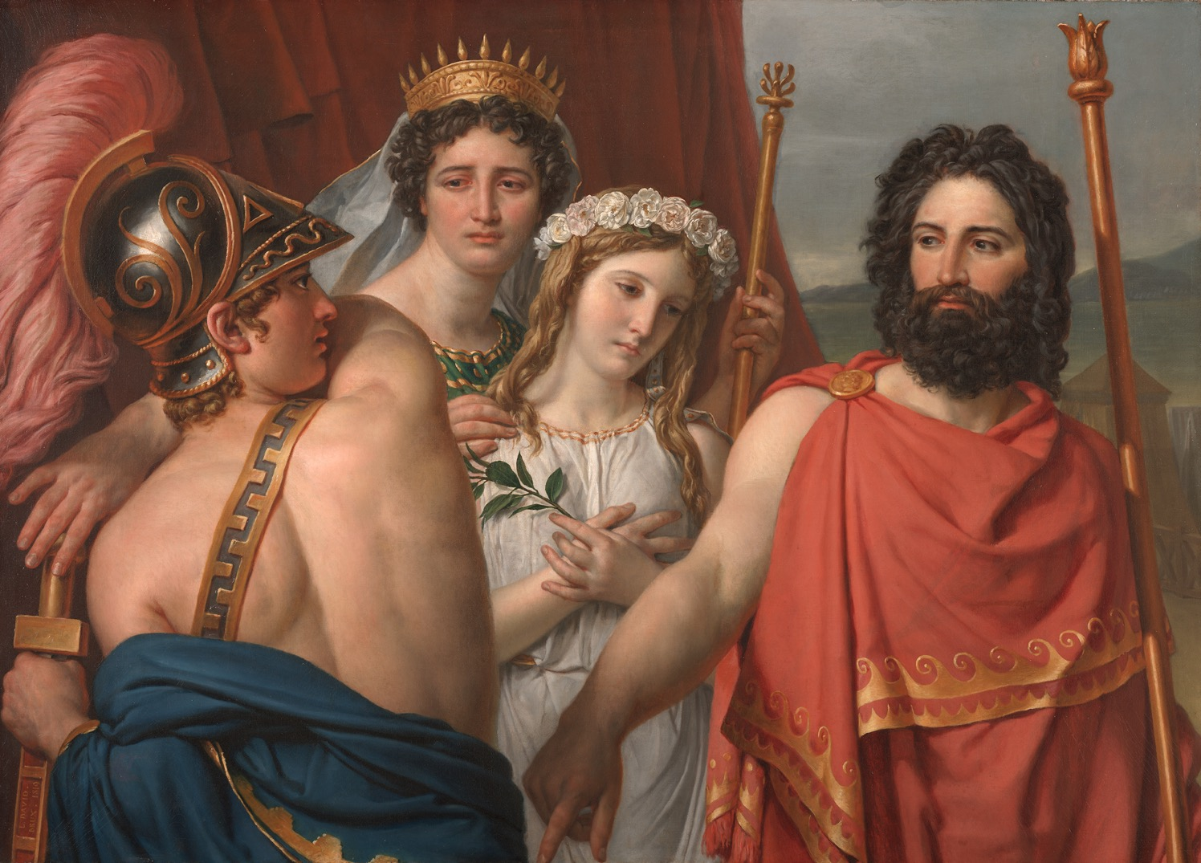
Jacques-Louis David, The Anger of Achilles​, 1819, oil on canvas. Kimbell Art Museum
Notes:
https://kimbellart.org/collection/ap-198007
The leading Neoclassical painter in Europe during the French Revolution and under Napoleon, David went into exile in Brussels after the Battle of Waterloo, in 1815. There, he painted and exhibited The Anger of Achilles, which he prized highly as the culmination of his career-long effort to recapture the perfection of ancient Greek art.
The subject of the painting, from the events that preceded the Trojan War, is drawn from Euripides’ ancient play Iphigenia in Aulis and Racine’s seventeenth-century dramatic version of the same story. Agamemnon, king of the Greeks, has just revealed that his daughter Iphigenia is not to be married to the youthful Achilles but sacrificed in order to appease the goddess Diana and so allow the Greek fleet to set sail for Troy. The complex episode challenged David to render a spectrum of emotions, from stoic courage and heroic resolve to grief and anger.
David’s seemingly speechless figures have scarcely enough room to act out the drama. They are observed from close up, vividly cropped at waist level rather than being seen full-length. Achilles angrily reaches for his sword, but Agamemnon’s magnetic gaze and his authoritative gesture appear to freeze Achilles’s outburst. Dressed as a bride, Iphigenia, who is portrayed like a Renaissance angel, clutches her heart, oblivious to the display of male confrontation. The reaction of her mother, Clytemnestra, mingling disappointment at Achilles’ inability to act with grief for her daughter, is apparently intended to mirror the mixed reactions that any spectator must feel as parental, spousal, and civic duties compete with one another.

Slide 34
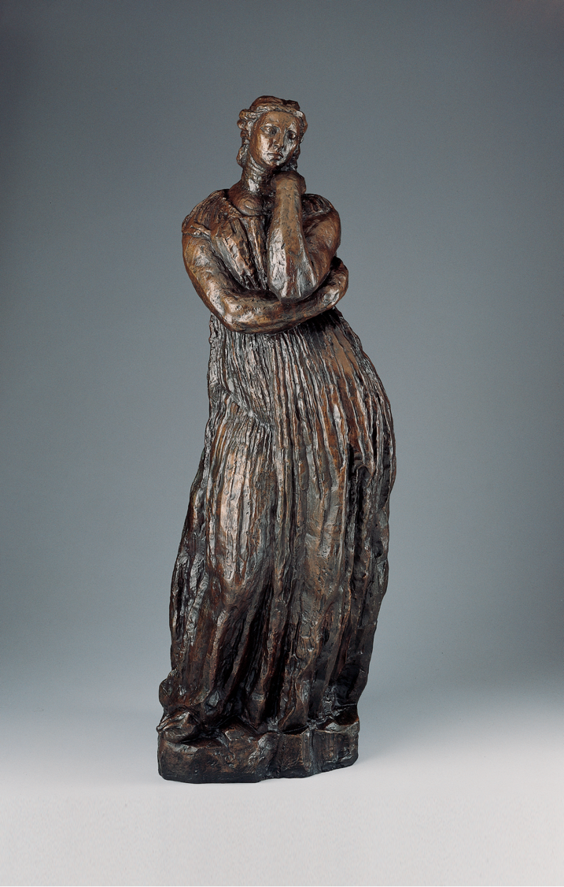
Antoine Bourdelle, Penelope, 1909, cast bronze, dark green patina. Kimbell Art Museum
Notes:
https://kimbellart.org/collection/ap-196903
Bourdelle is generally acclaimed as the most important heir to the sculptor Auguste Rodin, in whose studio he was an assistant from 1893 until 1908. Upon his separation from Rodin, however, Bourdelle sought direct inspiration in the work of the famous Neoclassical painter Ingres, a native of the sculptor’s own hometown, Montauban. Bourdelle sculpted a portrait of Ingres in 1908 while developing Penelope, the pose for which, based on ancient Roman models, was among Ingres’s favorites.
In Bourdelle’s earliest treatments of the theme, Penelope held a spindle to identify her as the steadfast wife of Odysseus, who, in Homer’s epic account of the Trojan War, endures the long absence of her warrior husband by weaving a shroud. In the fully evolved Kimbell model, the figure’s identity as Penelope is manifest only from the ancient Greek costume and meditative pose. By eliminating the spindle prop and bringing the woman’s arms close to her body, the artist made her form more architectural: the heavy woolen pleats of Penelope’s chiton are like the fluting on a Doric column. Such monolithic simplicity was an ideal in early twentieth-century sculpture, from Rodin to Aristide Maillol and Constantin Brancusi.

Slide 35
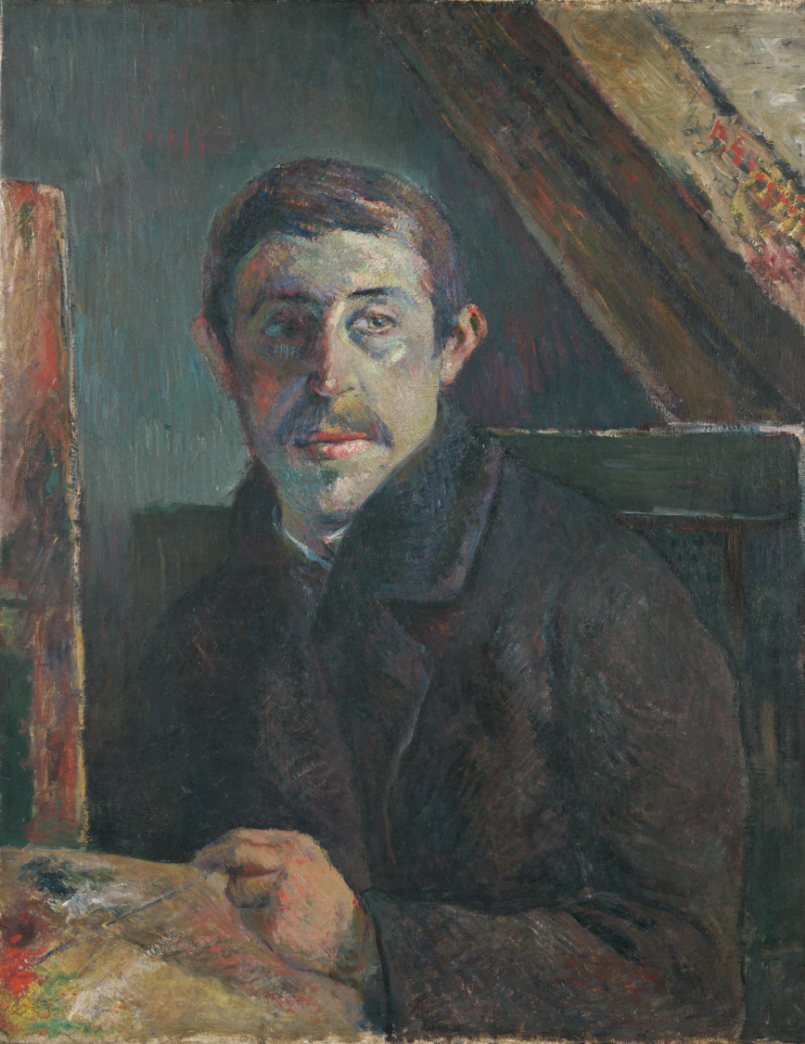
CHARACTER
VS. SELF
An internal conflict, character versus self focuses on opposition the character faces which comes from within.
This conflict often stems from a moral clash of beliefs, feelings, or desires.
Sometimes this internal quandary leads to the protagonist needing to make a difficult choice.
Paul Gauguin, Self-Portrait, 1885, oil on canvas. Kimbell Art Museum
Notes:
https://kimbellart.org/collection/ap-199703
Gauguin assumed his role as renegade artist in 1885, the year in which he undertook this portrait. Then, rather than remain jobless in Copenhagen with his Danish wife and their five children, the former Parisian stockbroker decided to return to the French capital to follow his restless artistic conscience. Whether painted in Denmark, on the eve of his separation from his family, or in Paris, embarking on a new phase of his career, this painting is the first of the many self-portraits in which Gauguin sought to explore his dark inner psyche.
Scientific examination of the painting has revealed that at first Gauguin portrayed himself in profile and included reproductions of his own paintings in the background. Turned to confront the viewer in the final work, he paints his image as if seen in a mirror. His body seems crowded in an attic space with a slanted beam, and cold, with the lapels of his heavy jacket wrapped together. Only his piercing eye escapes the bleak atmosphere.
Gauguin, who regularly assumed roles in his self-portaits, may indeed have intended to present himself here as a prisoner. When he later made a self-portrait for his new friend Vincent van Gogh in 1888, he explained: “It is the face of an outlaw, ill-clad and powerful like Jean Valjean [the criminal hero of Victor Hugo’s Les Miserables], with an inner nobility and gentleness. . . As for this Jean Valjean, whom society has oppressed, cast out—for all his love and vigor—is he not equally a symbol of the contemporary Impressionist painter?”

Slide 36
Character vs. Self
EXAMPLES
Hamlet, by William Shakespeare (1599–1601)
A Christmas Carol, by Charles Dickens (1843)
Alice in Wonderland, by Lewis Carroll (1865)
A House for Hermit Crab, by Eric Carle (1987)
The Perks of Being a Wallflower, by Stephen Chbosky (1999)
The Rainbow Fish, by Marcus Pfister (1999)
Frozen, by Walt Disney Animation Studios (2013)
The Adventures of Beekle: The Unimaginary Friend, by Dan Santat (2014)
Bluey, by Ludo Studio (2018–present)
Big, by Vashti Harrison (2024)
CLASSROOM DISCUSSION
ACTIVITY
What is the cause of the main character’s internal conflict?
How does the character’s emotional state change throughout the course of the story?
How do the setting and secondary characters influence the protagonist’s sense of self?
Choose a character from an artwork reproduced on the next few slides and write a diary entry from their perspective. What is the character feeling? What happened to make them feel this way? What will they plan to do next?

Slide 37
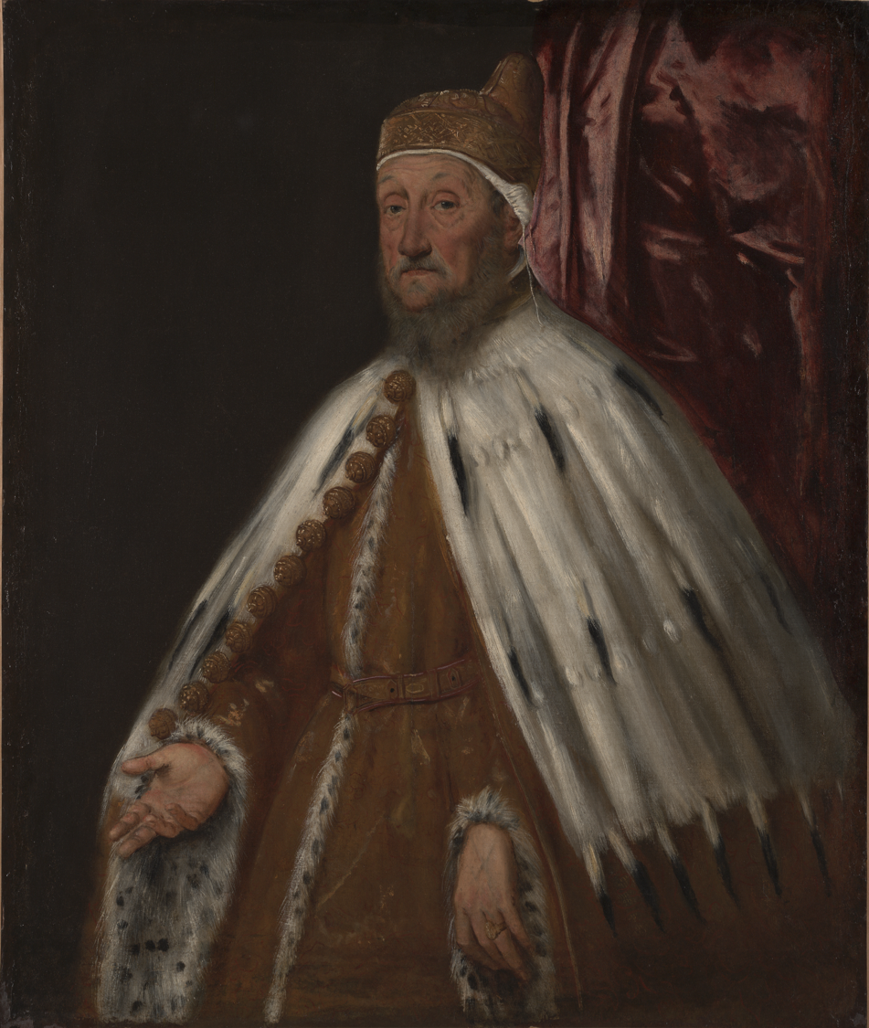
Tintoretto (Jacopo Robusti), Portrait of Doge Pietro Loredan, 1567–70, oil on canvas. Kimbell Art Museum
Notes:
https://kimbellart.org/collection/ap-198608
A prolific master of religious and historical works, as well as portraits, Tintoretto developed a rapid, often impetuous manner of painting that was both expressive and expedient. Here he captures the dignity, prudence, and calm equanimity befitting “the most serene prince” of the Venetian Republic. In 1567, the eighty-five-year old Pietro Loredan (1482–1570) had been elected doge by his fellow councillors. Tintoretto portrays him in his ceremonial dress: the gold brocade, fur-trimmed robe; the ermine cape with golden harness-bell buttons; and the distinctive corno dogale (doge’s hat) worn over a white linen cap.
During his brief three-year reign, Loredan presided over famine, pestilence, a great fire at the Arsenal, and the onset of war with the Turks over the possession of Cyprus. Tintoretto shows his subject ruddy faced and world-weary, giving physical expression to the weight of his obligations and tempering the formality of an official portrait.
Tintoretto’s technical facility is evident especially in the vigorously modeled face and the swift, sure strokes of the cape. This proficient style recommended Tintoretto to the Republic’s officials, who typically commissioned a number of portraits upon their election. Another version of this portrait, now in the National Gallery of Victoria, Melbourne, is probably the first version, painted from life, from which was derived the official portrait displayed in the Doge’s Palace and destroyed in a fire in 1577. The Kimbell version is possibly the painting that belonged to the Loredan family, mentioned in the will of the doge’s son Alvise.

Slide 38
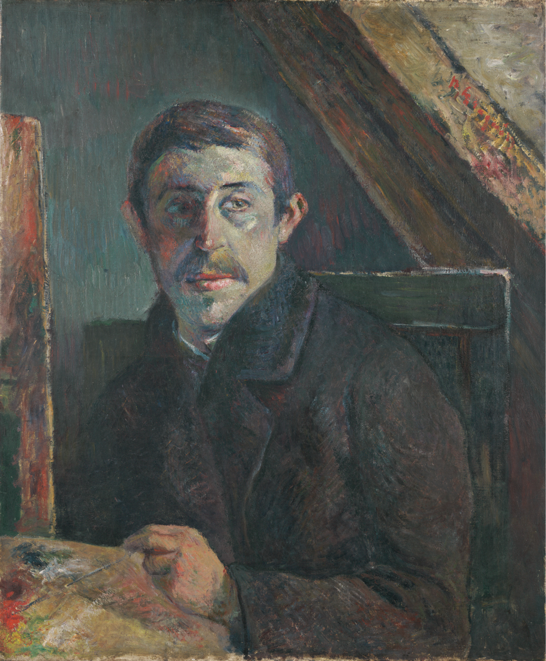
Paul Gauguin, Self-Portrait, 1885, oil on canvas. Kimbell Art Museum
Notes:
https://kimbellart.org/collection/ap-199703
Gauguin assumed his role as renegade artist in 1885, the year in which he undertook this portrait. Then, rather than remain jobless in Copenhagen with his Danish wife and their five children, the former Parisian stockbroker decided to return to the French capital to follow his restless artistic conscience. Whether painted in Denmark, on the eve of his separation from his family, or in Paris, embarking on a new phase of his career, this painting is the first of many self-portraits in which Gauguin sought to explore his dark inner psyche.
Scientific examination of the painting has revealed that at first Gauguin portrayed himself in profile and included reproductions of his own paintings in the background. Turned to confront the viewer in the final work, he paints his image as if seen in a mirror. He seems to be crowded into an attic space with a slanted beam and cold, with the lapels of his heavy jacket wrapped together. Only his piercing eye escapes the bleak atmosphere.
Gauguin, who regularly assumed roles in his self-portraits, may indeed have intended to present himself here as a prisoner. When he later made a self-portrait for his new friend Vincent van Gogh in 1888, he explained: “It is the face of an outlaw, ill-clad and powerful like Jean Valjean [the criminal hero of Victor Hugo’s Les Miserables], with an inner nobility and gentleness. . . As for this Jean Valjean, whom society has oppressed, cast out—for all his love and vigor—is he not equally a symbol of the contemporary Impressionist painter?”

Slide 39
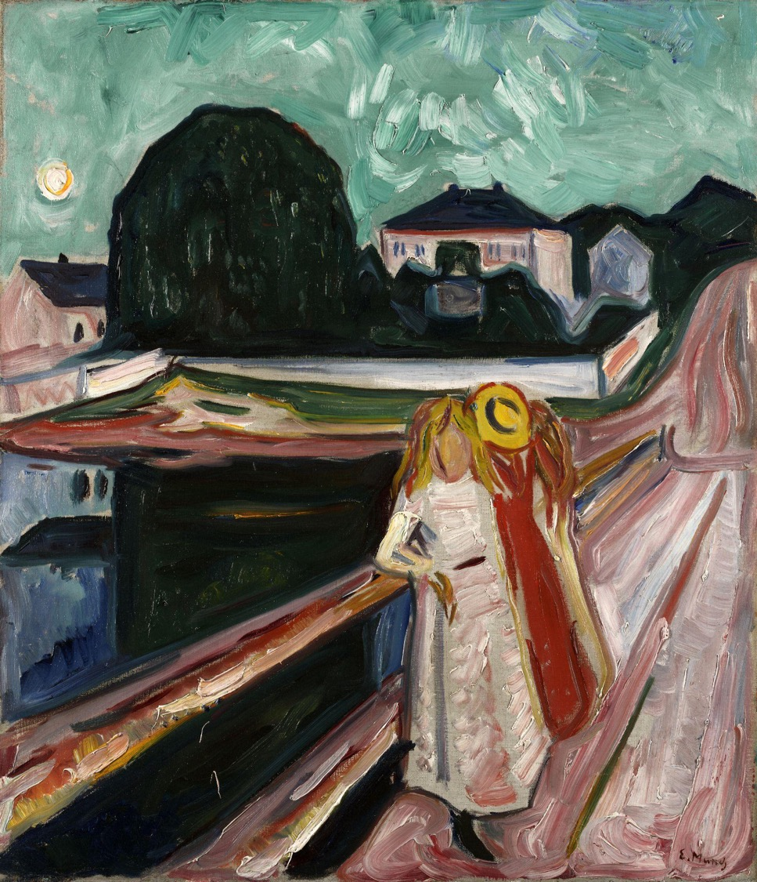
Edvard Munch, Girls on a Bridge, c. 1904, oil on canvas. Kimbell Art Museum
Notes:
https://kimbellart.org/collection/ap-196606
In 1889, Munch started spending periods of time at the Norwegian resort of Åsgårdstrand, popular at that time with many artists and writers. In 1901, Munch used a pier as the foreground in a painting of a group of women with the houses of Åsgårdstrand in the background, resulting in the first version of Girls on a Bridge (National Gallery, Oslo).
Here, exaggerating line and color to create haunting, even ominous, moods, Munch portrays a world charged with emotions and anxieties. It is the setting, rather than the girls’ poses and expressions, that suggests they may be brooding about their identities or desires. They appear absorbed, like the painter, in their observations of the townscape under a full moon. The foremost girl turns away from her friends toward the viewer, but her face is blank, an emotional riddle.
Following the lead of modern artists such as Monet and Renoir, who in the early 1890s began to play multiple variations on a single compositional idea, Munch painted many versions of Girls on the Pier over the course of several decades, as well as half a dozen closely related works with older female figures in the same setting. In all these, Munch depicted the pier with slanting lines receding dramatically into the background space. Among the Girls on the Pier variations, the Kimbell’s is one of the most freely painted. When it was acquired by the Kimbell in 1966, as one of the first twentieth-century paintings in the collection, it was thought to be one of the earliest variants in the series; recent authors have suggested that it was painted in the first half of the 1930’s. It was first exhibited, and sold, in 1936.

Slide 40
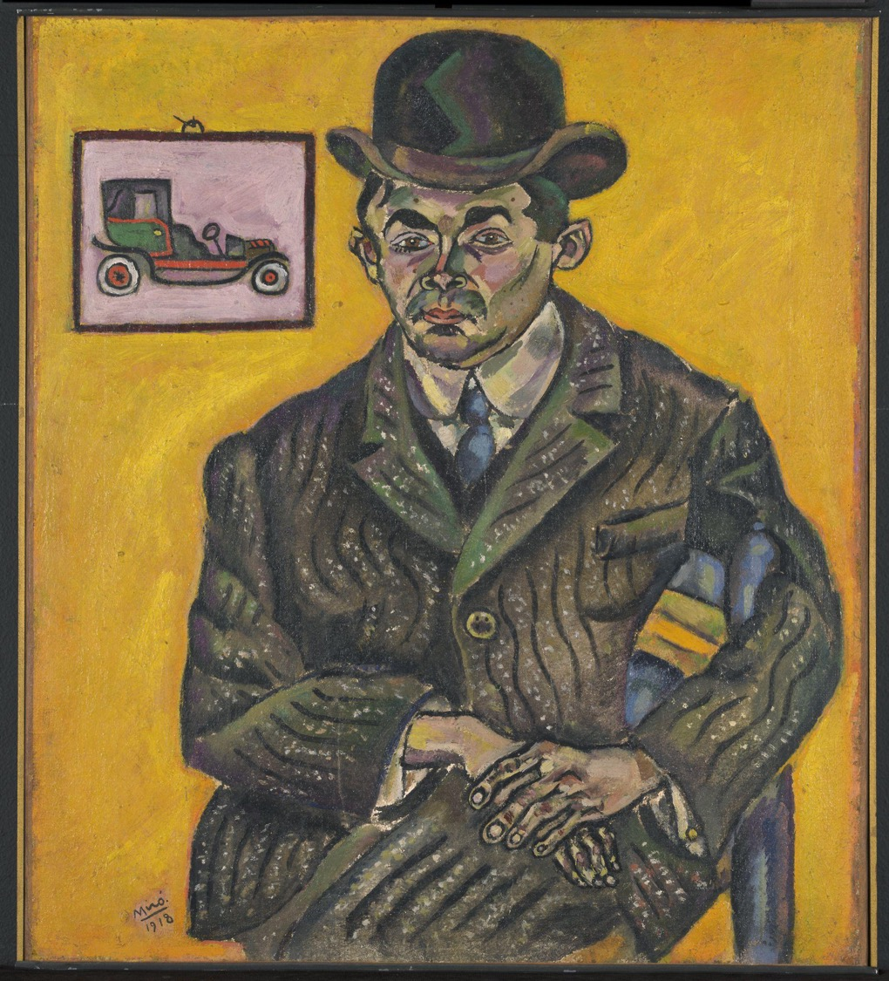
Joan Miró, Portrait of Heriberto Casany, 1918, oil on canvas. Kimbell Art Museum
Notes:
https://kimbellart.org/collection/ap-198409
“Here in Barcelona, we lack courage,” Miró wrote in late 1917 to his studio-mate Enric Ricart. “We, the younger generation, could get together and exhibit every year... and pronounce virile manifestos...We have to be men of action.” Miró and his friends banded together, calling themselves the “Courbets” in honor of the controversial French Realist. Their devotion to modern French painting notwithstanding, the Courbets were committed both to radical pictorial innovation and to Catalan tradition. Among the three works that Miró presented when the Courbets first showed together in 1918, this portrait of his art-school friend Heriberto Casany, with his spindly fingers and the undulating folds in his tweed suit jacket, resembles saints depicted in medieval Catalan frescoes. Casany’s attribute is quintessentially modern: a framed cartoonlike image of an automobile, which apparently refers to his father’s cab-rental business.
Treated in Fauvist fashion, with disconcerting green, yellow, and violet shadows, Casany’s schematized features appear animated with a life force. As Miró explained later, “even in my portraits, where I tried to capture the immobility of presence...I tried to get the vibration of the creative spirit into my work.” Miró’s treatment of his friend’s fine haberdashery, his rending of the stripes and texture with undulating lines and white specks, makes the inanimate tweed as vividly “alive” as the sitter. Just such attention to minute details would become the basis for the highly poetic, pulsating pictorial language Miró developed in the following decades to evoke tilled fields, starry nights, and the abundance of nature.

Slide 41
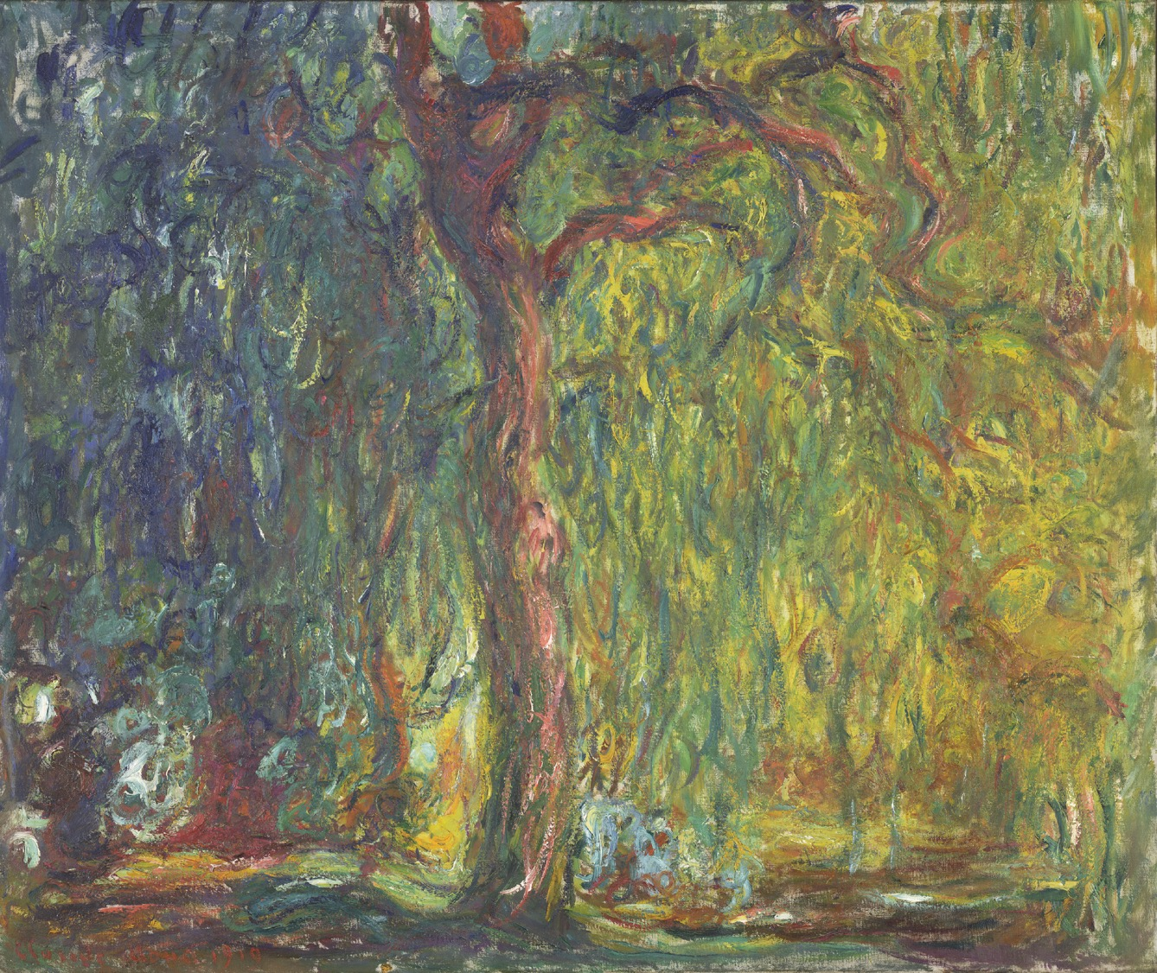
Claude Monet, Weeping Willow, 1918–19, oil on canvas. Kimbell Art Museum
Notes:
https://kimbellart.org/collection/ap-199602
Monet had painted ten Weeping Willow paintings by 1919, apparently in mournful response to the mass tragedy of World War I. Due to the war, Monet’s luxurious compound at Giverny was for the most part emptied of his children’s families and his household staff, who were either called into service or moved away from the advancing German army. His surviving son and a stepson were in danger at the front. At times, Monet could hear artillery fire, but he refused to leave, preferring to share the fate of his gardens.
As a group, the Weeping Willow paintings are characterized by shadowy colors and writhing forms, as if Monet intended to express the grieving mood not simply with the subject, but also through an expressionist style of painting. They were among the few easel-scale paintings that Monet made after 1914, when he claimed his failing eyesight was best suited for working in larger formats. The tree portrayed in Weeping Willow had pride of place on the bank of Monet’s water garden, with its exotic water lilies. He depicted the trunks, cascading branches, and reflections of his and other willows in his greatest artistic legacy, the mural-scale Nymphéas canvases, which were his preoccupation from 1914 until his death.
Most of Monet’s works from the late teens were never finished and were retained in his studio at the time of his death. The Kimbell Weeping Willow, on the other hand, was signed and dated, and passed by 1924 into the collection of the Japanese Baron Kojiro Matsukata, one of the first collectors to recognize the genius of Monet’s last, expressionistic canvases.

Slide 42
Art in order of appearance:
Jacob van Ruisdael, Rough Sea at a Jetty, 1650s, oil on canvas. Kimbell Art Museum, Fort Worth AP 1989.01
Caravaggio, The Cardsharps, c. 1596–97, oil on canvas. Kimbell Art Museum, Fort Worth AP 1987.06
Georges de La Tour, The Cheat with the Ace of Clubs​, c. 1630–34​, oil on canvas. Kimbell Art Museum, Fort Worth AP 1981.06
Maya, Codex-Style Vessel with Two Scenes of Itzam Instructing Young Pupils, c. 700–750, ceramic with monochrome decoration. Kimbell Art Museum, Fort Worth AP 2004.04
Maya, Presentation of Captives to a Maya Ruler​, c. AD 785, limestone with traces of paint. Kimbell Art Museum, Fort Worth AP 1971.07
Japanese, Genji in Exile at Suma, late 16th century, six-fold screen; ink, gold, silver, and pigments on paper. Kimbell Art Museum, Fort Worth AP 1971.11
Japanese, En no Gyoja, c. 1300–1375, polychromed wood. Kimbell Art Museum, Fort Worth AP 1984.13
Zhu Derun, Returning from a Visit, c. mid-14th century, handscroll; ink on paper. Kimbell Art Museum, Fort Worth AP 1972.06
Louis (or Antoine?) Le Nain, Peasant Interior with an Old Flute Player, c. 1642, oil on canvas. Kimbell Art Museum, Fort Worth AP 1984.22
Thomas Gainsborough, Going to Market, Early Morning, c. 1773, oil on canvas. Kimbell Art Museum, Fort Worth AP 2023.01
Salvator Rosa, Pythagoras Emerging from the Underworld, 1662, oil on canvas. Kimbell Art Museum, Fort Worth AP 1970.22
Yosa Buson, Landscape with a Solitary Traveler, c. 1780, hanging scroll; ink and light colors on silk. Kimbell Art Museum, Fort Worth AP 1981.18
© 2025 Kimbell Art Museum

Slide 43
Art in order of appearance:
Claude Monet, La Pointe de la Hève at Low Tide, 1865, oil on canvas. Kimbell Art Museum, Fort Worth AP 1968.07
Michelangelo Buonarroti, The Torment of Saint Anthony, 1487, tempera on panel. Kimbell Art Museum, Fort Worth AP 2009.01
Jacques-Louis David, The Anger of Achilles​, 1819, oil on canvas. Kimbell Art Museum, Fort Worth AP 1980.07
Ercole de’ Roberti, Portia and Brutus, c. 1486–90, tempera, possibly oil, and gold on panel. Kimbell Art Museum, Fort Worth AP 1986.05
Giovanni Bellini, Christ Blessing, c. 1500, tempera, oil, and gold on panel. Kimbell Art Museum, Fort Worth AP 1967.07
Giuseppe Maria Crespi, Jupiter Among the Corybantes, c. 1730, oil on copper. Kimbell Art Museum, Fort Worth AP 1984.17
Antoine Bourdelle, Penelope, 1909, cast bronze, dark green patina. Kimbell Art Museum, Fort Worth AP 1969.03
Paul Gauguin, Self-Portrait, 1885, oil on canvas. Kimbell Art Museum, Fort Worth AP 1997.03
Tintoretto (Jacopo Robusti), Portrait of Doge Pietro Loredan, 1567–70, oil on canvas. Kimbell Art Museum, Fort Worth AP 1986.08
Edvard Munch, Girls on a Bridge, c. 1904, oil on canvas. Kimbell Art Museum, Fort Worth AP 1966.06
Joan Miró, Portrait of Heriberto Casany, 1918, oil on canvas. Kimbell Art Museum, Fort Worth AP 1984.09
Claude Monet, Weeping Willow, 1918–19, oil on canvas. Kimbell Art Museum, Fort Worth AP 1996.02
© 2025 Kimbell Art Museum

