Slide 1
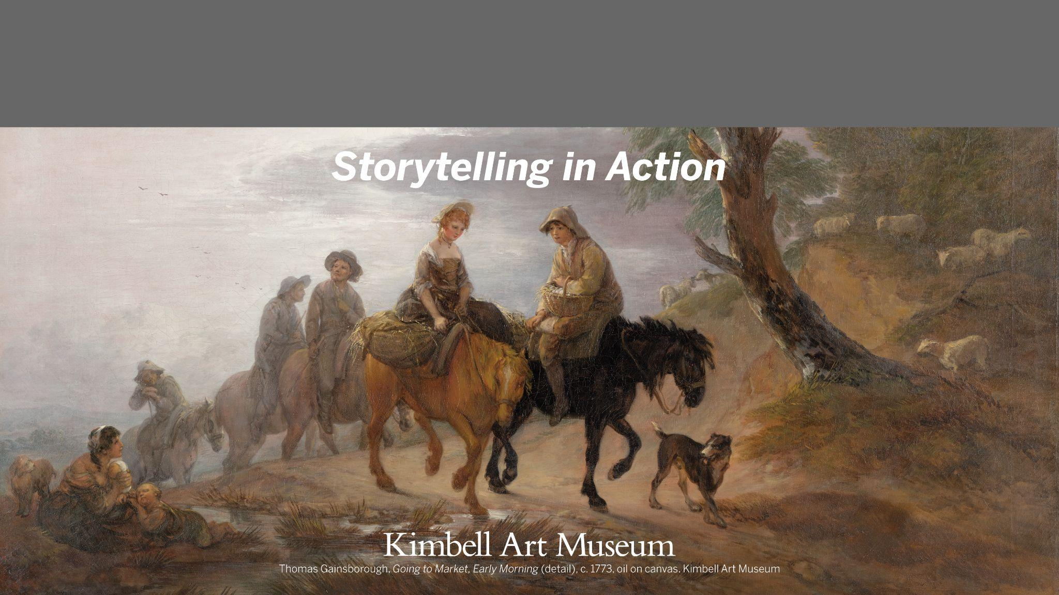
Kimbell Educator Packet

Slide 2
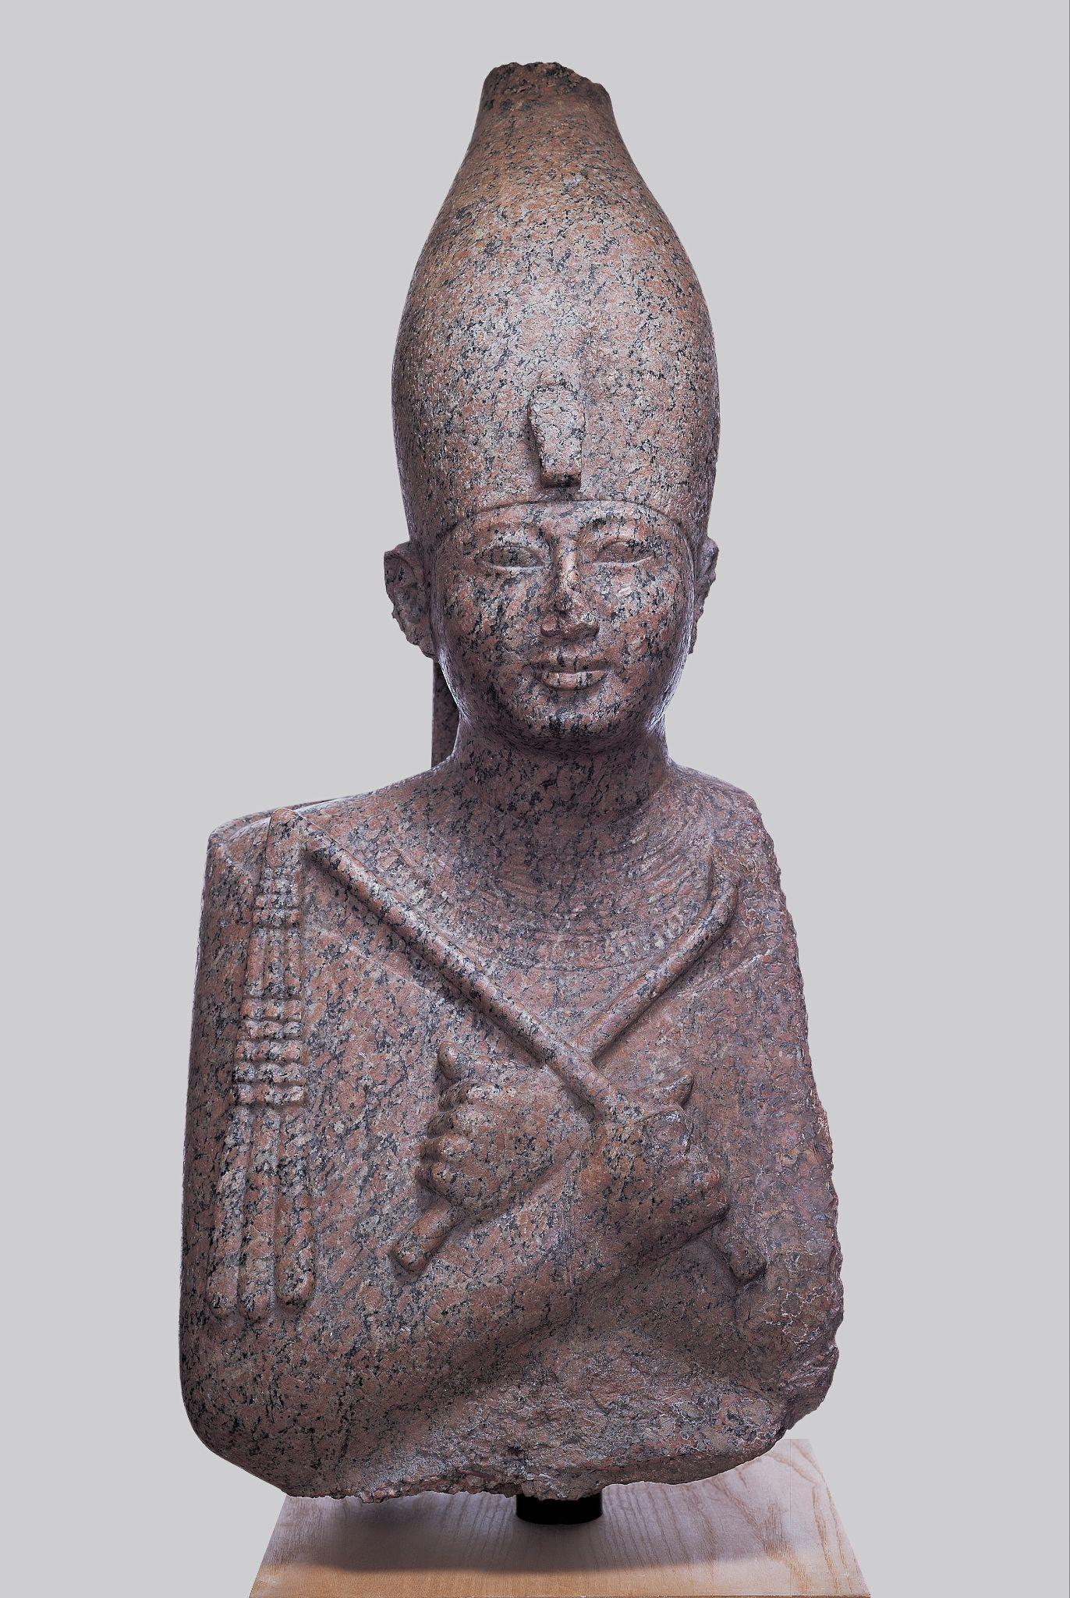
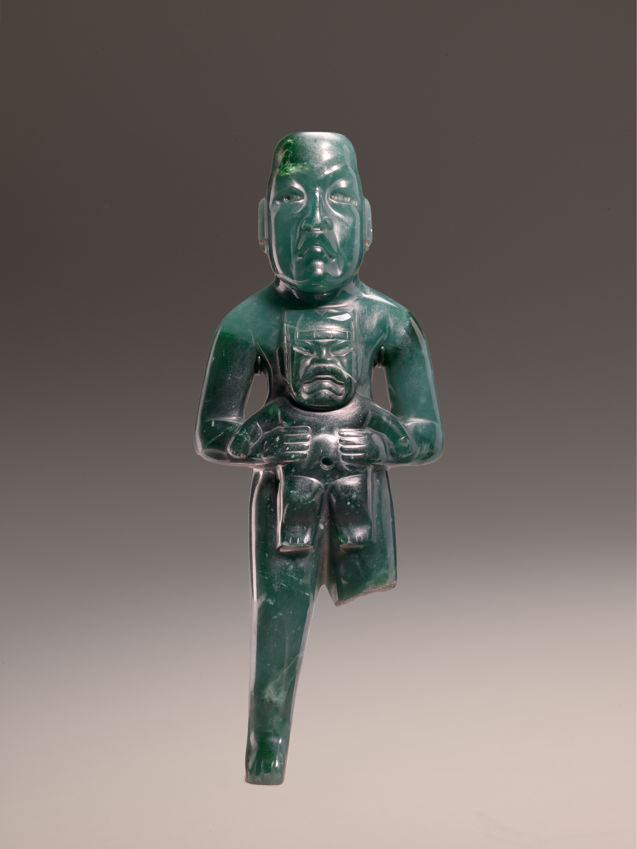
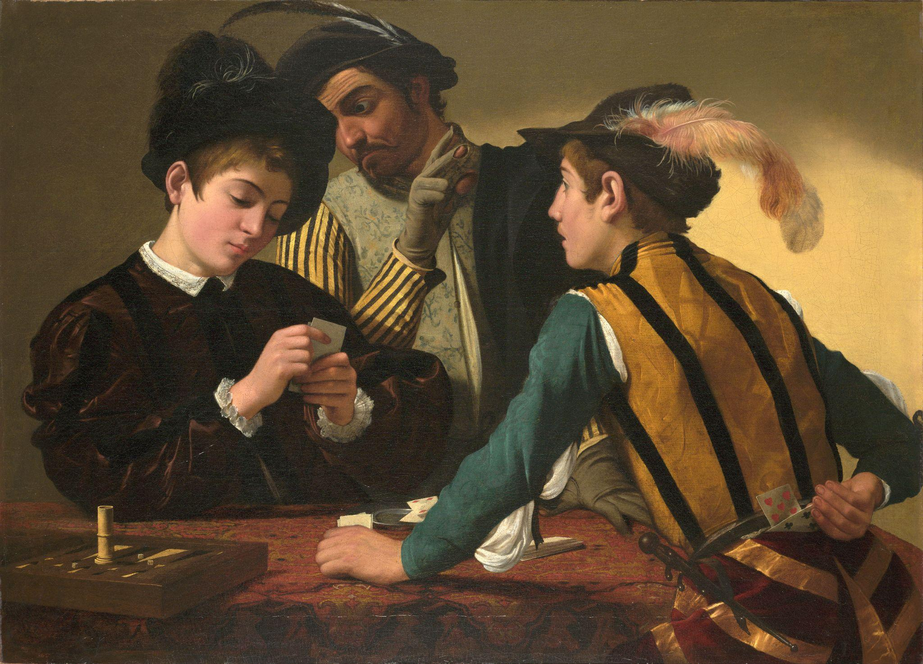
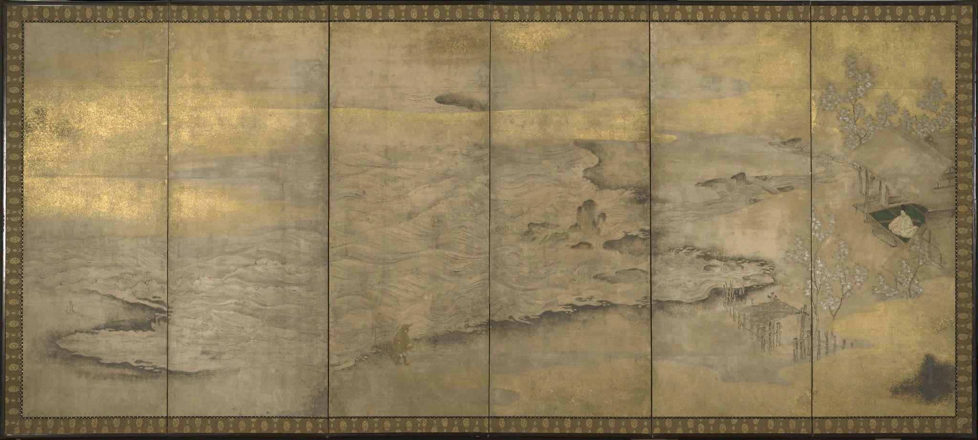
Storytelling in Action
Artists across cultures and history have told stories through the visual arts.
Explore artworks focused on:
Main Characters: Leaders and Power
Setting the Stage: Landscapes and Seascapes
Narratives in Action

Slide 3
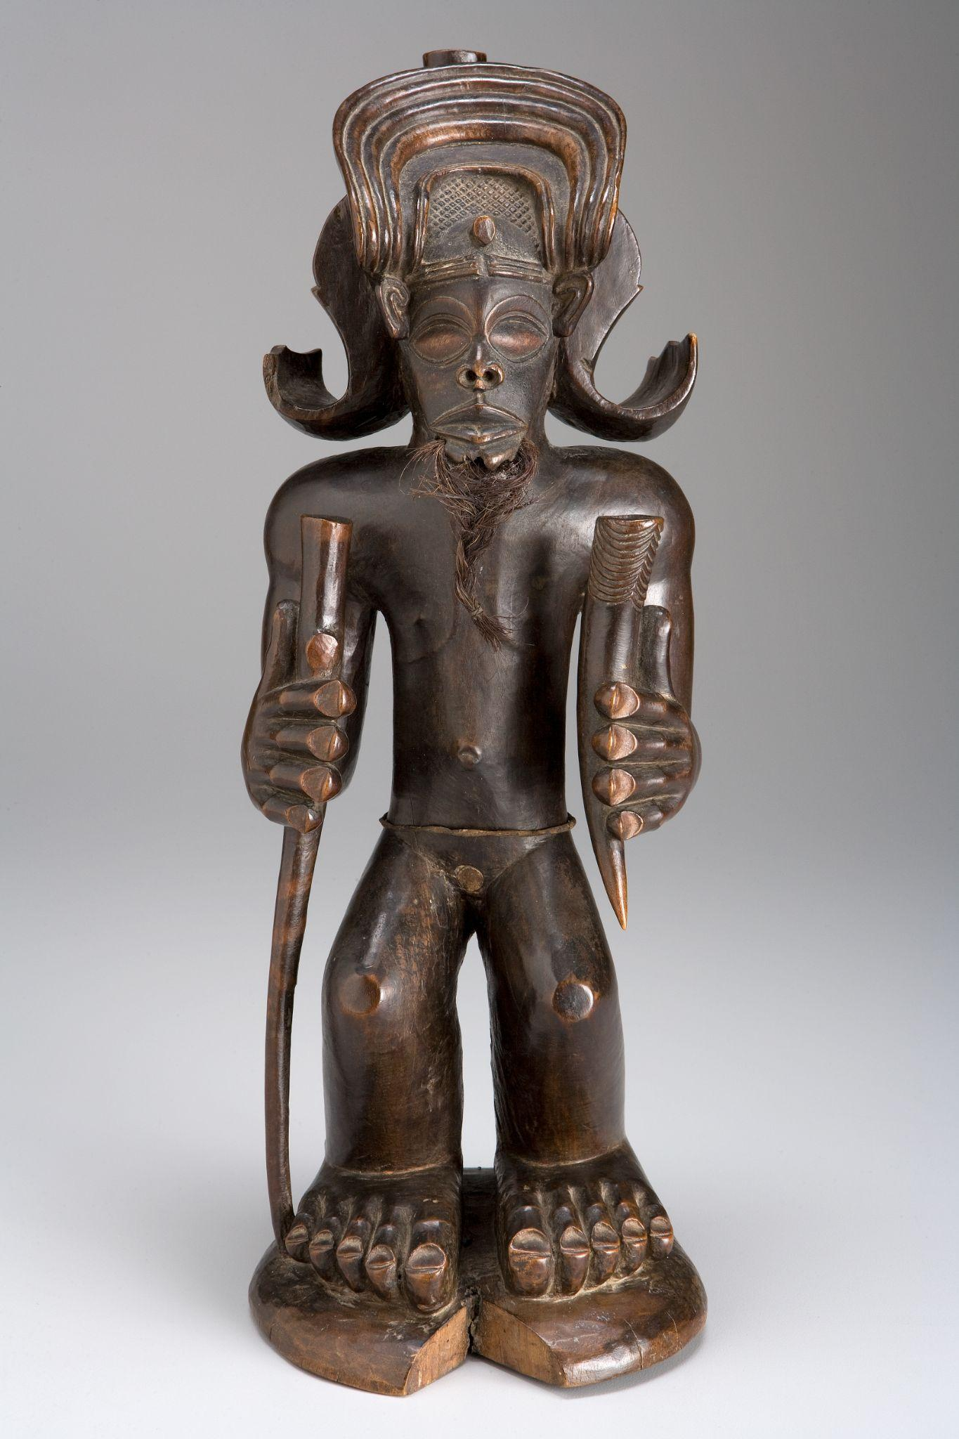
Main Characters:
Leaders and Power
How have artists highlighted significant figures within their communities?
What can we learn about leadership and power dynamics in history by studying artworks?
Chokwe people, Chibinda Ilunga, mid-19th century, wood, hair, and hide. Kimbell Art Museum

Slide 4
Egyptian, Portrait Statue of Pharaoh Amenhotep II, c. 1400 BC, recarved for Ramesses II (the Great) c. 1250 BC, limestone with traces of original painted decoration. Kimbell Art Museum
Notes:
https://kimbellart.org/collection/ap-198204
This regal figure of Amenhotep II shows him holding the traditional insignia of kingship against his chest—the scepter in the form of a crook in his left hand and the flail or whip in his right. He wears Upper (i.e., southern) Egypt’s distinctive crown, embellished by the uraeus cryptogram, or royal cobra, and a broad collar composed of five bands. His body is enveloped in the jubilee robe—worn by kings at festivals, particularly the Sed-festival—in which he was physically and spiritually rejuvenated. Usually the Sed-festival was observed after a reign of thirty years. Since most pharaohs never reached their thirtieth year, however, some, including Amenhotep II, celebrated it prematurely.
The sculpture was originally part of a larger figure seated on a throne, which was excavated in 1896 at the Temple of Mut at South Karnak. Fragments of the throne that are now lost bore inscriptions of Ramesses II (“the Great”), who lived more than a century after Amenhotep II. Ramesses usurped this and many other sculptures of his predecessors and converted them into images of himself. In this case, Amenhotep’s eyebrows were erased and his eyes, nose, and mouth slightly reshaped to make them resemble those of Ramesses.

Slide 5
What clues tell you that this is from ancient Egypt? Describe what the figure is wearing.
What accessories catch your eye? Who do you think he might be? Why?
Try standing in the same pose. How does this make you look and feel?
What other types of items do people include in portraits to show their status or interests?
Egyptian, Portrait Statue of Pharaoh Amenhotep II, c. 1400 BC, recarved for Ramesses II (the Great) c. 1250 BC, limestone with traces of original painted decoration. Kimbell Art Museum
Notes:
https://kimbellart.org/collection/ap-198204
This regal figure of Amenhotep II shows him holding the traditional insignia of kingship against his chest—the scepter in the form of a crook in his left hand and the flail or whip in his right. He wears Upper (i.e., southern) Egypt’s distinctive crown, embellished by the uraeus cryptogram, or royal cobra, and a broad collar composed of five bands. His body is enveloped in the jubilee robe—worn by kings at festivals, particularly the Sed-festival—in which he was physically and spiritually rejuvenated. Usually the Sed-festival was observed after a reign of thirty years. Since most pharaohs never reached their thirtieth year, however, some, including Amenhotep II, celebrated it prematurely.
The sculpture was originally part of a larger figure seated on a throne, which was excavated in 1896 at the Temple of Mut at South Karnak. Fragments of the throne that are now lost bore inscriptions of Ramesses II (“the Great”), who lived more than a century after Amenhotep II. Ramesses usurped this and many other sculptures of his predecessors and converted them into images of himself. In this case, Amenhotep’s eyebrows were erased and his eyes, nose, and mouth slightly reshaped to make them resemble those of Ramesses.

Slide 6
What material is this? How do you think this looked when it was first made? How is granite different from wood or clay?
Create your own Egyptian-style collar necklace. What decorations would impress others with your supreme authority?
Egyptian, Portrait Statue of Pharaoh Amenhotep II, c. 1400 BC, recarved for Ramesses II (the Great) c. 1250 BC, limestone with traces of original painted decoration. Kimbell Art Museum
Notes:
https://kimbellart.org/collection/ap-198204
This regal figure of Amenhotep II shows him holding the traditional insignia of kingship against his chest—the scepter in the form of a crook in his left hand and the flail or whip in his right. He wears Upper (i.e., southern) Egypt’s distinctive crown, embellished by the uraeus cryptogram, or royal cobra, and a broad collar composed of five bands. His body is enveloped in the jubilee robe—worn by kings at festivals, particularly the Sed-festival—in which he was physically and spiritually rejuvenated. Usually the Sed-festival was observed after a reign of thirty years. Since most pharaohs never reached their thirtieth year, however, some, including Amenhotep II, celebrated it prematurely.
The sculpture was originally part of a larger figure seated on a throne, which was excavated in 1896 at the Temple of Mut at South Karnak. Fragments of the throne that are now lost bore inscriptions of Ramesses II (“the Great”), who lived more than a century after Amenhotep II. Ramesses usurped this and many other sculptures of his predecessors and converted them into images of himself. In this case, Amenhotep’s eyebrows were erased and his eyes, nose, and mouth slightly reshaped to make them resemble those of Ramesses.

Slide 7
Olmec people, Standing Figure Holding a Were-Jaguar Baby, c. 900–300 BC, jade (jadeite). Kimbell Art Museum
Notes:
https://kimbellart.org/collection/ap-202302
The Olmecs were Mesoamerica’s mother culture and earliest civilization. In addition to hewing monumental stone sculpture and modeling animated figures in clay, Olmec lapidaries mastered the art of working hard stones to fashion exquisite figures, masks, celts, and personal ornaments for the ruling elite. Olmec style is also represented by composite supernatural creatures ranging from realistic to abstract.
This masterfully carved jade statuette depicts an unclothed, standing Olmec male figure, possibly a ruler, holding an infant were-jaguar, a supernatural creature that is part human and part jaguar. The baby displays the features typical of an Olmec were-jaguar: a V-shaped cleft in its head; slanted, almond-shaped eyes; a foreshortened, broad nose; and a fangless gaping mouth with downturned fleshy lips. A headband with two nodules and pleated ear ornaments at the sides link the were-jaguar baby with the Olmec Supernatural, who controlled the rain and the growth of maize. The physical association between the male figure and the supernatural being in this statuette would have validated the figure's authority, demonstrating his shamanic capabilities and access to the supernatural through ritual performances. Effigies such as this, carved from precious materials, were empowered objects and may have been animated in rituals or deposited in burials or caches with other magical objects in sacred precincts. The ruler’s missing left leg may have been broken in such a ritual.
In the ancient Mesoamerican world, jade was highly prized for its rich green color, which was closely associated with maize and the attendant ideas of sustenance, fertility, preciousness, and enduring life.

Slide 8
What is your first impression of these figures? Describe their poses and expressions.
What ideas do you associate with jaguars? What sounds and movements do they make?
Why do you think rainstorms were so significant to the Olmecs? What are the benefits and dangers of that kind of weather? Why might a leader be shown holding this powerful figure?
Olmec people, Standing Figure Holding a Were-Jaguar Baby, c. 900–300 BC, jade (jadeite). Kimbell Art Museum
Notes:
https://kimbellart.org/collection/ap-202302
The Olmecs were Mesoamerica’s mother culture and earliest civilization. In addition to hewing monumental stone sculpture and modeling animated figures in clay, Olmec lapidaries mastered the art of working hard stones to fashion exquisite figures, masks, celts, and personal ornaments for the ruling elite. Olmec style is also represented by composite supernatural creatures ranging from realistic to abstract.
This masterfully carved jade statuette depicts an unclothed, standing Olmec male figure, possibly a ruler, holding an infant were-jaguar, a supernatural creature that is part human and part jaguar. The baby displays the features typical of an Olmec were-jaguar: a V-shaped cleft in its head; slanted, almond-shaped eyes; a foreshortened, broad nose; and a fangless gaping mouth with downturned fleshy lips. A headband with two nodules and pleated ear ornaments at the sides link the were-jaguar baby with the Olmec Supernatural, who controlled the rain and the growth of maize. The physical association between the male figure and the supernatural being in this statuette would have validated the figure's authority, demonstrating his shamanic capabilities and access to the supernatural through ritual performances. Effigies such as this, carved from precious materials, were empowered objects and may have been animated in rituals or deposited in burials or caches with other magical objects in sacred precincts. The ruler’s missing left leg may have been broken in such a ritual.
In the ancient Mesoamerican world, jade was highly prized for its rich green color, which was closely associated with maize and the attendant ideas of sustenance, fertility, preciousness, and enduring life.

Slide 9
What material is this? Describe its color and texture.
Research the Olmecs and compare this sculpture to others created by them.
Olmec people, Standing Figure Holding a Were-Jaguar Baby, c. 900–300 BC, jade (jadeite). Kimbell Art Museum
Notes:
https://kimbellart.org/collection/ap-202302
The Olmecs were Mesoamerica’s mother culture and earliest civilization. In addition to hewing monumental stone sculpture and modeling animated figures in clay, Olmec lapidaries mastered the art of working hard stones to fashion exquisite figures, masks, celts, and personal ornaments for the ruling elite. Olmec style is also represented by composite supernatural creatures ranging from realistic to abstract.
This masterfully carved jade statuette depicts an unclothed, standing Olmec male figure, possibly a ruler, holding an infant were-jaguar, a supernatural creature that is part human and part jaguar. The baby displays the features typical of an Olmec were-jaguar: a V-shaped cleft in its head; slanted, almond-shaped eyes; a foreshortened, broad nose; and a fangless gaping mouth with downturned fleshy lips. A headband with two nodules and pleated ear ornaments at the sides link the were-jaguar baby with the Olmec Supernatural, who controlled the rain and the growth of maize. The physical association between the male figure and the supernatural being in this statuette would have validated the figure's authority, demonstrating his shamanic capabilities and access to the supernatural through ritual performances. Effigies such as this, carved from precious materials, were empowered objects and may have been animated in rituals or deposited in burials or caches with other magical objects in sacred precincts. The ruler’s missing left leg may have been broken in such a ritual.
In the ancient Mesoamerican world, jade was highly prized for its rich green color, which was closely associated with maize and the attendant ideas of sustenance, fertility, preciousness, and enduring life.

Slide 10
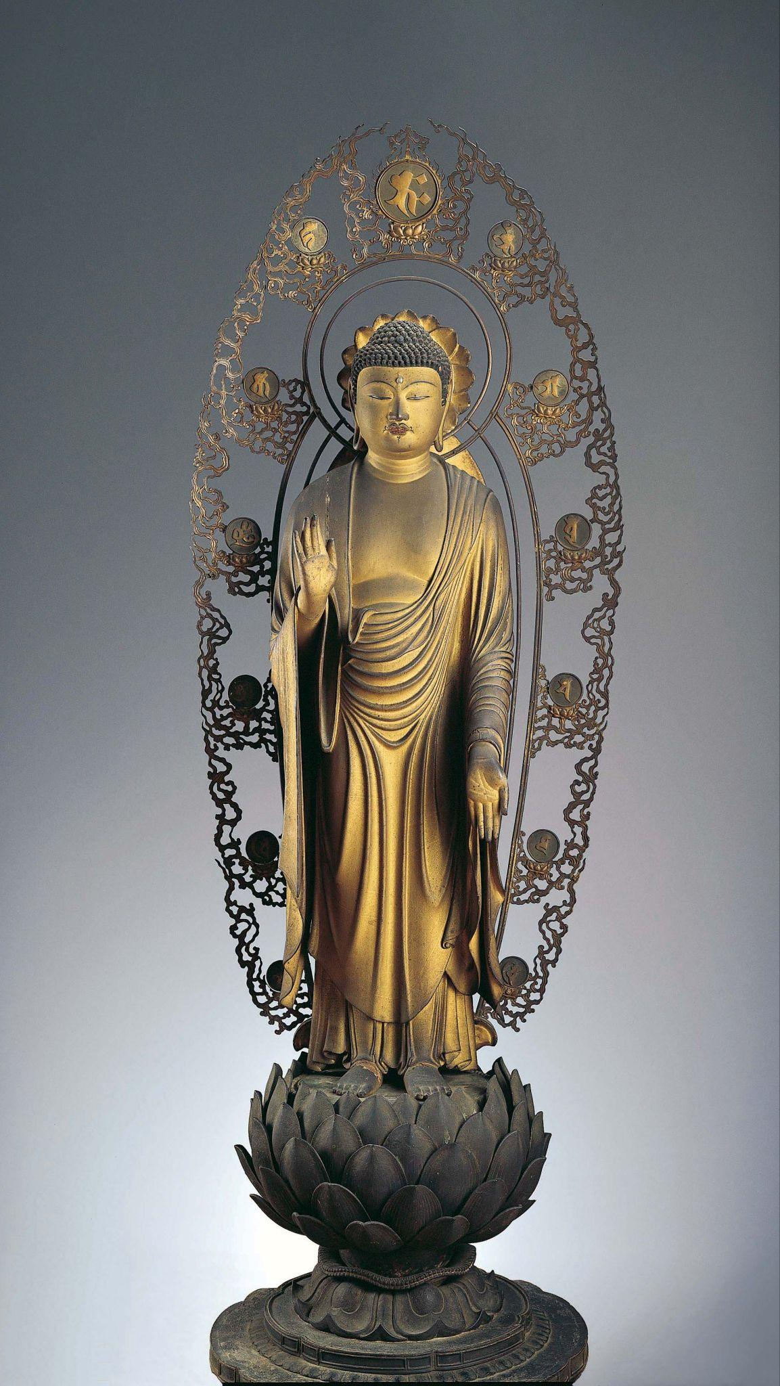
Kaikei, Standing Shaka Buddha, c. 1210, gilt and lacquered wood. Kimbell Art Museum
Notes:
https://kimbellart.org/collection/ap-198401-abc
Kaikei, the great master sculptor of the Kamakura period (1185–1333), together with his contemporary Unkei (died 1223), established the Kei school, the primary school of sculpture that produced statuary for the major temples in Nara and Kyoto. Together they created a new, realistic style that revitalized Buddhist sculpture. Especially important among Kaikei sculptures is a distinctive style of refined, graceful Buddha, clothed in deeply folded and decoratively draped robes.
Kaikei produced many Buddha images, particularly of Amida (Amitabha), the Lord of the Western Paradise. The Kimbell’s sculpture is a rare image of the historical Buddha, Shaka (Shakyamuni), who is identified by the abhayamudra (gesture of reassurance or granting of the “absence of fear”) of the right hand. His left foot advancing, the Buddha appears to move forward to greet the devotee with an expression of gentle and profound compassion. The beautifully proportioned figure is wrapped in an elegant, rhythmically folding robe that ripples across the stomach and cascades over the arms. Entirely covered with gold lacquer, the robe is further embellished with a floral and geometric pattern of fine-cut gold leaf.
The Kamakura period saw a revival of the historical Buddha in a new type of image—as a divine savior who descends from heaven to meet the faithful. This image, called “Shaka raigo,” is documented in paintings of the early thirteenth century that show the Buddha standing on a lotus pedestal atop a cloud, his hand raised in the gesture of fearlessness. The Kimbell statue is a rare example of this type in three-dimensional form and the only known image of Shaka created by Kaikei.

Slide 11
What are some of the first things you notice about this beautiful sculpture?
Does anyone recognize the figure? What clues help us to know this is a religious sculpture?
What words would you use to describe the Buddha’s expression and pose? What clothing details do you see?
Kaikei, Standing Shaka Buddha, c. 1210, gilt and lacquered wood. Kimbell Art Museum
Notes:
https://kimbellart.org/collection/ap-198401-abc
Kaikei, the great master sculptor of the Kamakura period (1185–1333), together with his contemporary Unkei (died 1223), established the Kei school, the primary school of sculpture that produced statuary for the major temples in Nara and Kyoto. Together they created a new, realistic style that revitalized Buddhist sculpture. Especially important among Kaikei sculptures is a distinctive style of refined, graceful Buddha, clothed in deeply folded and decoratively draped robes.
Kaikei produced many Buddha images, particularly of Amida (Amitabha), the Lord of the Western Paradise. The Kimbell’s sculpture is a rare image of the historical Buddha, Shaka (Shakyamuni), who is identified by the abhayamudra (gesture of reassurance or granting of the “absence of fear”) of the right hand. His left foot advancing, the Buddha appears to move forward to greet the devotee with an expression of gentle and profound compassion. The beautifully proportioned figure is wrapped in an elegant, rhythmically folding robe that ripples across the stomach and cascades over the arms. Entirely covered with gold lacquer, the robe is further embellished with a floral and geometric pattern of fine-cut gold leaf.
The Kamakura period saw a revival of the historical Buddha in a new type of image—as a divine savior who descends from heaven to meet the faithful. This image, called “Shaka raigo,” is documented in paintings of the early thirteenth century that show the Buddha standing on a lotus pedestal atop a cloud, his hand raised in the gesture of fearlessness. The Kimbell statue is a rare example of this type in three-dimensional form and the only known image of Shaka created by Kaikei.

Slide 12
What do you notice about the other parts of the sculpture? What natural forms do you recognize?
What is he standing on? What shape is the base of the pedestal? For what purpose do you think this was created?
Read the story of the Buddha and learn about other important symbols in Buddhist art.
Kaikei, Standing Shaka Buddha, c. 1210, gilt and lacquered wood. Kimbell Art Museum
Notes:
https://kimbellart.org/collection/ap-198401-abc
Kaikei, the great master sculptor of the Kamakura period (1185–1333), together with his contemporary Unkei (died 1223), established the Kei school, the primary school of sculpture that produced statuary for the major temples in Nara and Kyoto. Together they created a new, realistic style that revitalized Buddhist sculpture. Especially important among Kaikei sculptures is a distinctive style of refined, graceful Buddha, clothed in deeply folded and decoratively draped robes.
Kaikei produced many Buddha images, particularly of Amida (Amitabha), the Lord of the Western Paradise. The Kimbell’s sculpture is a rare image of the historical Buddha, Shaka (Shakyamuni), who is identified by the abhayamudra (gesture of reassurance or granting of the “absence of fear”) of the right hand. His left foot advancing, the Buddha appears to move forward to greet the devotee with an expression of gentle and profound compassion. The beautifully proportioned figure is wrapped in an elegant, rhythmically folding robe that ripples across the stomach and cascades over the arms. Entirely covered with gold lacquer, the robe is further embellished with a floral and geometric pattern of fine-cut gold leaf.
The Kamakura period saw a revival of the historical Buddha in a new type of image—as a divine savior who descends from heaven to meet the faithful. This image, called “Shaka raigo,” is documented in paintings of the early thirteenth century that show the Buddha standing on a lotus pedestal atop a cloud, his hand raised in the gesture of fearlessness. The Kimbell statue is a rare example of this type in three-dimensional form and the only known image of Shaka created by Kaikei.

Slide 13
Chokwe people, Chibinda Ilunga, mid-19th century, wood, hair, and hide. Kimbell Art Museum
Notes:
https://kimbellart.org/collection/ap-197805
In Central Africa, the role of chief is often linked with that of hunter. For the Chokwe people, the importance of the hunter stems from the myth of their founding hero, Chibinda Ilunga, the son of a great Luba chief and a passionate huntsman, who wooed and eventually married Lweji, a Lunda chieftainess. He introduced the Lunda to the concept of divine kingship and also taught their tribe the art of hunting. From their union, if rather indirectly, came the Mwata Yamvo rulers of the Lunda, to whom the Chokwe paid tribute and regularly furnished sculptors, who produced court art almost up to the present day. By association, Chibinda Ilunga became a culture hero and model for men in Chokwe society and especially for Chokwe chiefs. He came to represent the archetypal chief who maintains the well-being of his people.
As in much African art, the representation of the coiffure, headdress, and other ornaments serve to emphasize the figure’s status and identity. Chibinda Ilunga wears elaborate headgear with rolled side elements as a sign of his royal rank. He holds a wanderer’s staff and a carved antelope horn, which is a container for substances that supernaturally assist the hunt. The greatly enlarged hands and feet emphasize his physical strength and endurance, while the beard conveys his wisdom as an elder and ancestor.

Slide 14
What words would you use to describe this figure’s pose? What is emphasized on this sculpture? What does that tell you about this hero figure?
Notice the shapes and details on Chibinda’s face. What might his large eyes or beard tell you about him?
Describe how Chibinda might use the objects he holds. What does his elaborate hat tell you?
Chokwe people, Chibinda Ilunga, mid-19th century, wood, hair, and hide. Kimbell Art Museum
Notes:
https://kimbellart.org/collection/ap-197805
In Central Africa, the role of chief is often linked with that of hunter. For the Chokwe people, the importance of the hunter stems from the myth of their founding hero, Chibinda Ilunga, the son of a great Luba chief and a passionate huntsman, who wooed and eventually married Lweji, a Lunda chieftainess. He introduced the Lunda to the concept of divine kingship and also taught their tribe the art of hunting. From their union, if rather indirectly, came the Mwata Yamvo rulers of the Lunda, to whom the Chokwe paid tribute and regularly furnished sculptors, who produced court art almost up to the present day. By association, Chibinda Ilunga became a culture hero and model for men in Chokwe society and especially for Chokwe chiefs. He came to represent the archetypal chief who maintains the well-being of his people.
As in much African art, the representation of the coiffure, headdress, and other ornaments serve to emphasize the figure’s status and identity. Chibinda Ilunga wears elaborate headgear with rolled side elements as a sign of his royal rank. He holds a wanderer’s staff and a carved antelope horn, which is a container for substances that supernaturally assist the hunt. The greatly enlarged hands and feet emphasize his physical strength and endurance, while the beard conveys his wisdom as an elder and ancestor.

Slide 15
Look for shapes and lines in and around this sculpture. How does your eye move around the figure? Where do you see straight lines? Curving lines?
Imagine yourself as a legendary hero. What special skills and talents would you have? Write a story relating one of your mighty deeds.
Chokwe people, Chibinda Ilunga, mid-19th century, wood, hair, and hide. Kimbell Art Museum
Notes:
https://kimbellart.org/collection/ap-197805
In Central Africa, the role of chief is often linked with that of hunter. For the Chokwe people, the importance of the hunter stems from the myth of their founding hero, Chibinda Ilunga, the son of a great Luba chief and a passionate huntsman, who wooed and eventually married Lweji, a Lunda chieftainess. He introduced the Lunda to the concept of divine kingship and also taught their tribe the art of hunting. From their union, if rather indirectly, came the Mwata Yamvo rulers of the Lunda, to whom the Chokwe paid tribute and regularly furnished sculptors, who produced court art almost up to the present day. By association, Chibinda Ilunga became a culture hero and model for men in Chokwe society and especially for Chokwe chiefs. He came to represent the archetypal chief who maintains the well-being of his people.
As in much African art, the representation of the coiffure, headdress, and other ornaments serve to emphasize the figure’s status and identity. Chibinda Ilunga wears elaborate headgear with rolled side elements as a sign of his royal rank. He holds a wanderer’s staff and a carved antelope horn, which is a container for substances that supernaturally assist the hunt. The greatly enlarged hands and feet emphasize his physical strength and endurance, while the beard conveys his wisdom as an elder and ancestor.

Slide 16
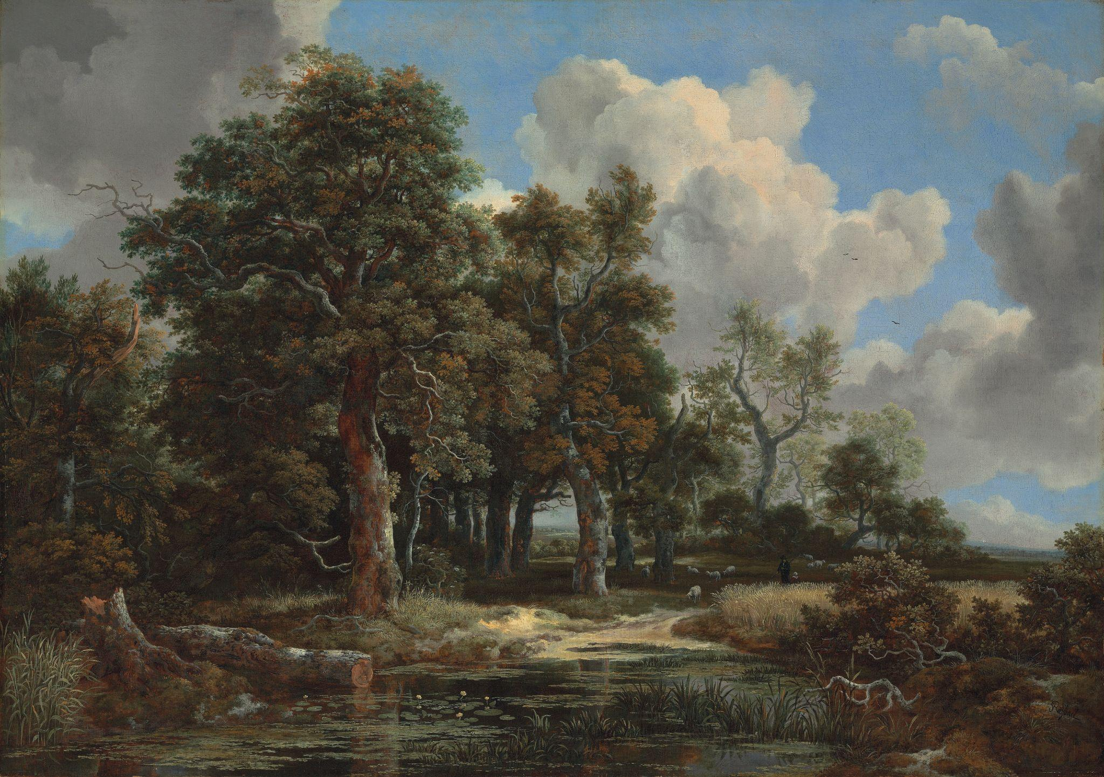
Setting the Stage:
Landscapes and Seascapes
What role does an environment play within a story?
How might the setting impact the characters?
How do landscapes and seascapes compare across cultures and time periods?
Jacob van Ruisdael, Edge of a Forest with a Grainfield, c. 1656, oil on canvas. Kimbell Art Museum

Slide 17
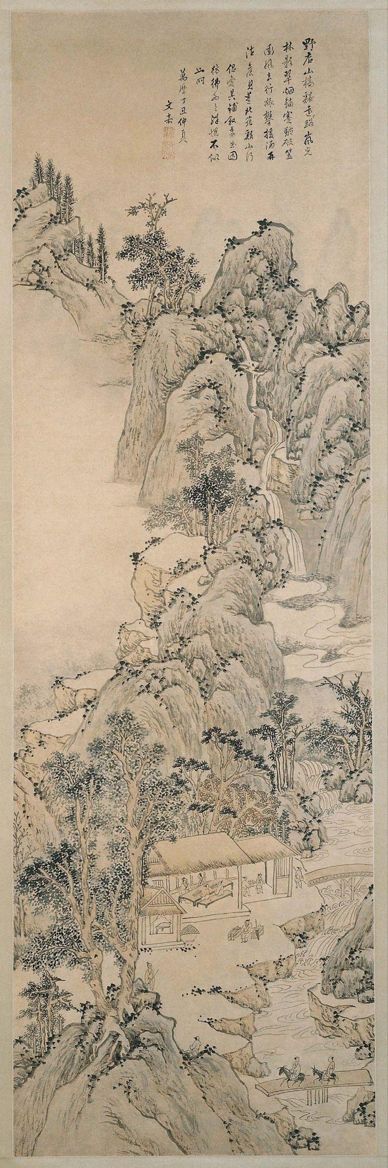
Wen Jia, Landscape in the Style of Dong Yuan, 1577,
hanging scroll; ink and light colors on paper. Kimbell Art Museum
Notes:
https://kimbellart.org/collection/ap-198001
Wen Jia, son of the Wu school literati artist Wen Zhengming (1470–1559), was a recognized poet, critic, and connoisseur of painting and a model Confucian. His paintings, the earliest of which were done when he was in his late fifties, are characterized by meticulous brushwork, cool coloring, and a conservative temperament.
This scroll is one of Wen Jia’s largest extant paintings and depicts a tall, narrow landscape crowded with wooded mountains, winding paths, torrents, and leafy trees executed in ink and pale colors. Two travelers on horseback cross a bridge to an inn, above which towers a mountain partially concealed by clouds. The rocks at upper left have no geological relationship to the mountain and appear to float above the mist.
The painting illustrates the interest of Wu school artists in the work of earlier masters: Wen Jia’s inscription states that the composition was inspired by a specific painting by the tenth-century master Dong Yuan. The bold, rocky mass that curves up the center of the painting is reminiscent of the mountains in many Northern Song (960–1127) landscapes. The use of dots for foliage, and of long hemp-fiber strokes to give texture to the rocks, recalls the technique of the founder of the Wu school, Shen Zhou (1427–1509).

Slide 18
Where do your eyes travel when looking at this scroll? How does Wen Jia use movement within the artwork?
What do you see happening in and around the building?
What types of sounds do you think you would hear in this environment? Smells? How would you feel if you were in this scene?
Wen Jia, Landscape in the Style of Dong Yuan, 1577,
hanging scroll; ink and light colors on paper. Kimbell Art Museum
Notes:
https://kimbellart.org/collection/ap-198001
Wen Jia, son of the Wu school literati artist Wen Zhengming (1470–1559), was a recognized poet, critic, and connoisseur of painting and a model Confucian. His paintings, the earliest of which were done when he was in his late fifties, are characterized by meticulous brushwork, cool coloring, and a conservative temperament.
This scroll is one of Wen Jia’s largest extant paintings and depicts a tall, narrow landscape crowded with wooded mountains, winding paths, torrents, and leafy trees executed in ink and pale colors. Two travelers on horseback cross a bridge to an inn, above which towers a mountain partially concealed by clouds. The rocks at upper left have no geological relationship to the mountain and appear to float above the mist.
The painting illustrates the interest of Wu school artists in the work of earlier masters: Wen Jia’s inscription states that the composition was inspired by a specific painting by the tenth-century master Dong Yuan. The bold, rocky mass that curves up the center of the painting is reminiscent of the mountains in many Northern Song (960–1127) landscapes. The use of dots for foliage, and of long hemp-fiber strokes to give texture to the rocks, recalls the technique of the founder of the Wu school, Shen Zhou (1427–1509).

Slide 19
Describe the type of brushstrokes Wen Jia used.
Devise a new title for this artwork based on the landscape’s most important aspects and overall mood.
Paint your own landscape. Who and what will you include? Experiment with short and long brushstrokes.
Wen Jia, Landscape in the Style of Dong Yuan, 1577,
hanging scroll; ink and light colors on paper. Kimbell Art Museum
Notes:
https://kimbellart.org/collection/ap-198001
Wen Jia, son of the Wu school literati artist Wen Zhengming (1470–1559), was a recognized poet, critic, and connoisseur of painting and a model Confucian. His paintings, the earliest of which were done when he was in his late fifties, are characterized by meticulous brushwork, cool coloring, and a conservative temperament.
This scroll is one of Wen Jia’s largest extant paintings and depicts a tall, narrow landscape crowded with wooded mountains, winding paths, torrents, and leafy trees executed in ink and pale colors. Two travelers on horseback cross a bridge to an inn, above which towers a mountain partially concealed by clouds. The rocks at upper left have no geological relationship to the mountain and appear to float above the mist.
The painting illustrates the interest of Wu school artists in the work of earlier masters: Wen Jia’s inscription states that the composition was inspired by a specific painting by the tenth-century master Dong Yuan. The bold, rocky mass that curves up the center of the painting is reminiscent of the mountains in many Northern Song (960–1127) landscapes. The use of dots for foliage, and of long hemp-fiber strokes to give texture to the rocks, recalls the technique of the founder of the Wu school, Shen Zhou (1427–1509).

Slide 20
Japanese, Genji in Exile at Suma, late 16th century, six-fold screen; ink, gold, silver, and pigments on paper. Kimbell Art Museum
Notes:
https://kimbellart.org/collection/ap-197111
In this melancholy scene, the large sea of rough, billowing waves, the lone nobleman seated in a rustic hut with only his books and koto as companions, and the dusky tones of ink and silver and gold suggest a remote locale. A windblown visitor dressed in a straw cape, who appears to have arrived in a small boat moored at the left, trudges along the shore to the hut. The green of the tatami mats and the white and pink of the blossoming cherry trees (indicating springtime) provide the only brightness in an otherwise somber composition reflecting the sense of isolation and the forlorn state of mind of the nobleman.
The subject of the screen is from the classic masterpiece of Japanese literature The Tale of Genji, written in the early eleventh century by Lady Murasaki Shikibu. The epic novel, comprised of fifty-four chapters, recounts the tumultuous romantic life of Hikaru Genji, the son of a Japanese emperor. The dramatic yet somber scene is based on chapters 12 and 13, Suma and Akashi, in which Genji is exiled to the rural coastal town of Suma after he is discovered having an affair with the emperor’s consort. The mysterious visitor may represent a messenger sent by Genji’s lover to retrieve him, or he may be the Akashi Novitiate, who wishes to bring Genji to Akashi to marry his daughter. Both are described as arriving in Suma by boat in the midst of a raging storm.

Slide 21
Where do you think this scene takes place? What takes up most of the picture? Describe the movement of the ocean waves and the sounds you might hear.
Would you like to visit? What colors do you notice? How would you describe the weather?
Japanese, Genji in Exile at Suma, late 16th century, six-fold screen; ink, gold, silver, and pigments on paper. Kimbell Art Museum
Notes:
https://kimbellart.org/collection/ap-197111
In this melancholy scene, the large sea of rough, billowing waves, the lone nobleman seated in a rustic hut with only his books and koto as companions, and the dusky tones of ink and silver and gold suggest a remote locale. A windblown visitor dressed in a straw cape, who appears to have arrived in a small boat moored at the left, trudges along the shore to the hut. The green of the tatami mats and the white and pink of the blossoming cherry trees (indicating springtime) provide the only brightness in an otherwise somber composition reflecting the sense of isolation and the forlorn state of mind of the nobleman.
The subject of the screen is from the classic masterpiece of Japanese literature The Tale of Genji, written in the early eleventh century by Lady Murasaki Shikibu. The epic novel, comprised of fifty-four chapters, recounts the tumultuous romantic life of Hikaru Genji, the son of a Japanese emperor. The dramatic yet somber scene is based on chapters 12 and 13, Suma and Akashi, in which Genji is exiled to the rural coastal town of Suma after he is discovered having an affair with the emperor’s consort. The mysterious visitor may represent a messenger sent by Genji’s lover to retrieve him, or he may be the Akashi Novitiate, who wishes to bring Genji to Akashi to marry his daughter. Both are described as arriving in Suma by boat in the midst of a raging storm.

Slide 22
Who is in this picture? What are they doing? What will happen next?
The Japanese term for a folding screen is byôbu, meaning “protection from the wind.” How did it earn that name? How was it used, and where?
Japanese, Genji in Exile at Suma, late 16th century, six-fold screen; ink, gold, silver, and pigments on paper. Kimbell Art Museum
Notes:
https://kimbellart.org/collection/ap-197111
In this melancholy scene, the large sea of rough, billowing waves, the lone nobleman seated in a rustic hut with only his books and koto as companions, and the dusky tones of ink and silver and gold suggest a remote locale. A windblown visitor dressed in a straw cape, who appears to have arrived in a small boat moored at the left, trudges along the shore to the hut. The green of the tatami mats and the white and pink of the blossoming cherry trees (indicating springtime) provide the only brightness in an otherwise somber composition reflecting the sense of isolation and the forlorn state of mind of the nobleman.
The subject of the screen is from the classic masterpiece of Japanese literature The Tale of Genji, written in the early eleventh century by Lady Murasaki Shikibu. The epic novel, comprised of fifty-four chapters, recounts the tumultuous romantic life of Hikaru Genji, the son of a Japanese emperor. The dramatic yet somber scene is based on chapters 12 and 13, Suma and Akashi, in which Genji is exiled to the rural coastal town of Suma after he is discovered having an affair with the emperor’s consort. The mysterious visitor may represent a messenger sent by Genji’s lover to retrieve him, or he may be the Akashi Novitiate, who wishes to bring Genji to Akashi to marry his daughter. Both are described as arriving in Suma by boat in the midst of a raging storm.

Slide 23
Research another famous historical event and create a picture that shows an important episode from that story.
Japanese, Genji in Exile at Suma, late 16th century, six-fold screen; ink, gold, silver, and pigments on paper. Kimbell Art Museum
Notes:
https://kimbellart.org/collection/ap-197111
In this melancholy scene, the large sea of rough, billowing waves, the lone nobleman seated in a rustic hut with only his books and koto as companions, and the dusky tones of ink and silver and gold suggest a remote locale. A windblown visitor dressed in a straw cape, who appears to have arrived in a small boat moored at the left, trudges along the shore to the hut. The green of the tatami mats and the white and pink of the blossoming cherry trees (indicating springtime) provide the only brightness in an otherwise somber composition reflecting the sense of isolation and the forlorn state of mind of the nobleman.
The subject of the screen is from the classic masterpiece of Japanese literature The Tale of Genji, written in the early eleventh century by Lady Murasaki Shikibu. The epic novel, comprised of fifty-four chapters, recounts the tumultuous romantic life of Hikaru Genji, the son of a Japanese emperor. The dramatic yet somber scene is based on chapters 12 and 13, Suma and Akashi, in which Genji is exiled to the rural coastal town of Suma after he is discovered having an affair with the emperor’s consort. The mysterious visitor may represent a messenger sent by Genji’s lover to retrieve him, or he may be the Akashi Novitiate, who wishes to bring Genji to Akashi to marry his daughter. Both are described as arriving in Suma by boat in the midst of a raging storm.

Slide 24
Jacob van Ruisdael, Edge of a Forest with a Grainfield, c. 1656, oil on canvas. Kimbell Art Museum
Notes:
https://kimbellart.org/collection/ap-201401
Jacob van Ruisdael, one of the greatest landscape painters of all time, flourished in the latter half of the seventeenth century, Holland’s “Golden Age.” Ruisdael began painting in his teenage years and moved to Amsterdam in 1655. Paintings from this period in his life typically emphasize the majestic power of natural forms—noble trees and cloud-filled skies—and an increased mastery of light effects to give those forms emotional resonance. A prolific artist, he completed some seven hundred paintings over the three decades of his career. Edge of a Forest is ranked as one of his highest achievements, from the years of his greatest genius.
A grove of old oak and elm trees stands beside a pool or a stream, at the intersection of a sandy road or path. Tall timbers reach towards a cloudy sky. Every detail attests to the artist’s keen eye and his love of natural variety and incident. Everywhere he leads the viewer towards something to he thinks should be noticed: a broken branch lies bent in the lower right, pointing the way into the canvas; a puddle of water in the sandy road reflects the bark of the tree above it; delicate flowers of a water lily poke their heads above the water; a bush is in flower in the shadowy glade beside one of the trees, while silvery-green leaves shine between patches of ivy green. These myriad details, however, do not distract from the impressive unity of the whole—the sense of nature, in its grandeur, captured by a painter who truly loves it.

Slide 25
Describe how your eye moves through this landscape. What details appear as you explore different areas? What do you notice about the people and animals in this scene?
Describe the textures and brushstrokes that Ruisdael used to describe the trees, grasses, water, ground, etc. Are they rough, glassy, sandy, or soft?
Jacob van Ruisdael, Edge of a Forest with a Grainfield, c. 1656, oil on canvas. Kimbell Art Museum
Notes:
https://kimbellart.org/collection/ap-201401
Jacob van Ruisdael, one of the greatest landscape painters of all time, flourished in the latter half of the seventeenth century, Holland’s “Golden Age.” Ruisdael began painting in his teenage years and moved to Amsterdam in 1655. Paintings from this period in his life typically emphasize the majestic power of natural forms—noble trees and cloud-filled skies—and an increased mastery of light effects to give those forms emotional resonance. A prolific artist, he completed some seven hundred paintings over the three decades of his career. Edge of a Forest is ranked as one of his highest achievements, from the years of his greatest genius.
A grove of old oak and elm trees stands beside a pool or a stream, at the intersection of a sandy road or path. Tall timbers reach towards a cloudy sky. Every detail attests to the artist’s keen eye and his love of natural variety and incident. Everywhere he leads the viewer towards something to he thinks should be noticed: a broken branch lies bent in the lower right, pointing the way into the canvas; a puddle of water in the sandy road reflects the bark of the tree above it; delicate flowers of a water lily poke their heads above the water; a bush is in flower in the shadowy glade beside one of the trees, while silvery-green leaves shine between patches of ivy green. These myriad details, however, do not distract from the impressive unity of the whole—the sense of nature, in its grandeur, captured by a painter who truly loves it.

Slide 26
Where does sunlight enter the picture? Look for areas of light and dark. What effects do they create? How would you describe the mood of this scene?
Collect leaves, scraps of bark, rocks, and other natural objects. Use paper and crayons to create rubbings of these objects. What textures do they make?
Jacob van Ruisdael, Edge of a Forest with a Grainfield, c. 1656, oil on canvas. Kimbell Art Museum
Notes:
https://kimbellart.org/collection/ap-201401
Jacob van Ruisdael, one of the greatest landscape painters of all time, flourished in the latter half of the seventeenth century, Holland’s “Golden Age.” Ruisdael began painting in his teenage years and moved to Amsterdam in 1655. Paintings from this period in his life typically emphasize the majestic power of natural forms—noble trees and cloud-filled skies—and an increased mastery of light effects to give those forms emotional resonance. A prolific artist, he completed some seven hundred paintings over the three decades of his career. Edge of a Forest is ranked as one of his highest achievements, from the years of his greatest genius.
A grove of old oak and elm trees stands beside a pool or a stream, at the intersection of a sandy road or path. Tall timbers reach towards a cloudy sky. Every detail attests to the artist’s keen eye and his love of natural variety and incident. Everywhere he leads the viewer towards something to he thinks should be noticed: a broken branch lies bent in the lower right, pointing the way into the canvas; a puddle of water in the sandy road reflects the bark of the tree above it; delicate flowers of a water lily poke their heads above the water; a bush is in flower in the shadowy glade beside one of the trees, while silvery-green leaves shine between patches of ivy green. These myriad details, however, do not distract from the impressive unity of the whole—the sense of nature, in its grandeur, captured by a painter who truly loves it.

Slide 27
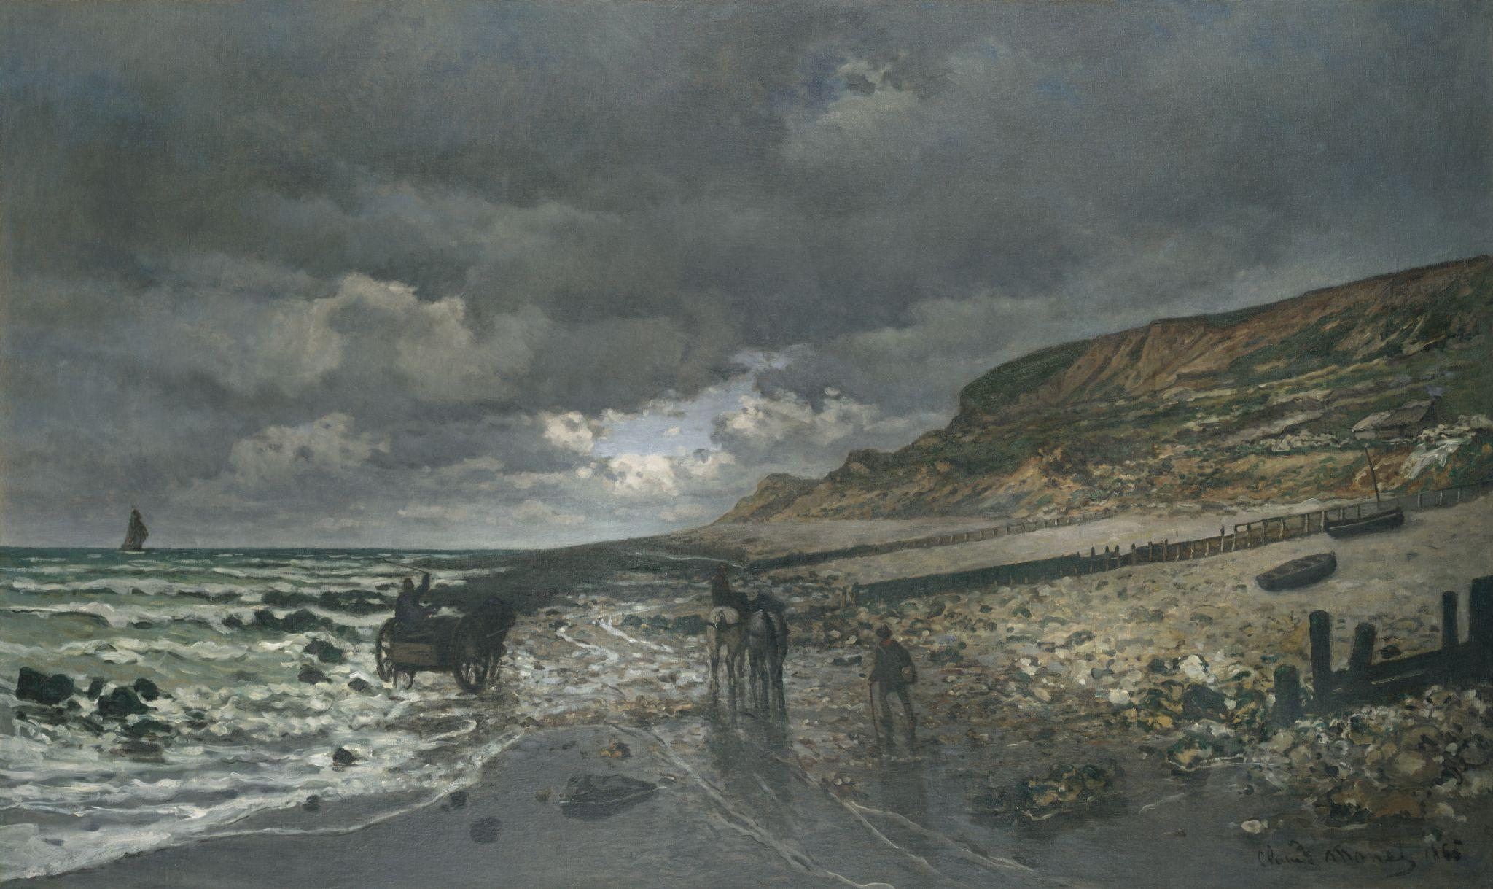
Claude Monet, La Pointe de la Hève at Low Tide, 1865, oil on canvas. Kimbell Art Museum
Notes:
https://kimbellart.org/collection/ap-196807
This magnificent beach scene near Le Havre, where Monet grew up, was one of two landscapes that launched his career when exhibited in Paris at the 1865 Salon. Monet developed this large showpiece in direct response to similar compositions submitted to the Salon of 1864 by Charles-François Daubigny and his son Karl. Daubigny had attempted to execute his Salon painting entirely on the spot, in what would soon become the orthodox practice for Impressionist landscapes. But in 1864, Monet still worked in a more traditional fashion: he first painted La Pointe de la Hève at the site as a portable-scale work then enlarged it at his Paris studio in early 1865. Most impressive in this large version is Monet’s rendition of the beach at low tide, the muted silvery tones of the foreground reflecting the low-hanging clouds stretching far away. The rocks at the right, described with brisk, creative brushwork, are especially indicative of Monet’s unique talents, which were increasingly evident as he emerged as the leading Impressionist landscape artist.
Monet insisted that an old black-and-white photograph of La Pointe de la Hève be included in a 1921 book about him. Perhaps as a result, this work from his youth was tracked down, and in 1923 a dealer friend brought it back to Giverny to keep the elderly artist company as he recovered from eye surgery.

Slide 28
Notice the different colors and textures in this composition. What kind of day is this? Where would you like to be in this scene? Imagine the sounds, smells, and tastes you might experience.
What kinds of movement are happening? How do diagonals help to organize the picture? What other lines does Monet use to guide your eye around this scene?
What time of day is this? What makes you say that? Where do you notice light on different surfaces?
Claude Monet, La Pointe de la Hève at Low Tide, 1865, oil on canvas. Kimbell Art Museum
Notes:
https://kimbellart.org/collection/ap-196807
This magnificent beach scene near Le Havre, where Monet grew up, was one of two landscapes that launched his career when exhibited in Paris at the 1865 Salon. Monet developed this large showpiece in direct response to similar compositions submitted to the Salon of 1864 by Charles-François Daubigny and his son Karl. Daubigny had attempted to execute his Salon painting entirely on the spot, in what would soon become the orthodox practice for Impressionist landscapes. But in 1864, Monet still worked in a more traditional fashion: he first painted La Pointe de la Hève at the site as a portable-scale work then enlarged it at his Paris studio in early 1865. Most impressive in this large version is Monet’s rendition of the beach at low tide, the muted silvery tones of the foreground reflecting the low-hanging clouds stretching far away. The rocks at the right, described with brisk, creative brushwork, are especially indicative of Monet’s unique talents, which were increasingly evident as he emerged as the leading Impressionist landscape artist.
Monet insisted that an old black-and-white photograph of La Pointe de la Hève be included in a 1921 book about him. Perhaps as a result, this work from his youth was tracked down, and in 1923 a dealer friend brought it back to Giverny to keep the elderly artist company as he recovered from eye surgery.

Slide 29
What might this picture suggest about Monet’s background and interests? Why do you think he selected this painting for the annual Salon, the largest art exhibition in Paris at the time?
Compare this painting with Monet’s Weeping Willow, painted over fifty years later, also in the Kimbell’s permanent collection.
Claude Monet, La Pointe de la Hève at Low Tide, 1865, oil on canvas. Kimbell Art Museum
Notes:
https://kimbellart.org/collection/ap-196807
This magnificent beach scene near Le Havre, where Monet grew up, was one of two landscapes that launched his career when exhibited in Paris at the 1865 Salon. Monet developed this large showpiece in direct response to similar compositions submitted to the Salon of 1864 by Charles-François Daubigny and his son Karl. Daubigny had attempted to execute his Salon painting entirely on the spot, in what would soon become the orthodox practice for Impressionist landscapes. But in 1864, Monet still worked in a more traditional fashion: he first painted La Pointe de la Hève at the site as a portable-scale work then enlarged it at his Paris studio in early 1865. Most impressive in this large version is Monet’s rendition of the beach at low tide, the muted silvery tones of the foreground reflecting the low-hanging clouds stretching far away. The rocks at the right, described with brisk, creative brushwork, are especially indicative of Monet’s unique talents, which were increasingly evident as he emerged as the leading Impressionist landscape artist.
Monet insisted that an old black-and-white photograph of La Pointe de la Hève be included in a 1921 book about him. Perhaps as a result, this work from his youth was tracked down, and in 1923 a dealer friend brought it back to Giverny to keep the elderly artist company as he recovered from eye surgery.

Slide 30
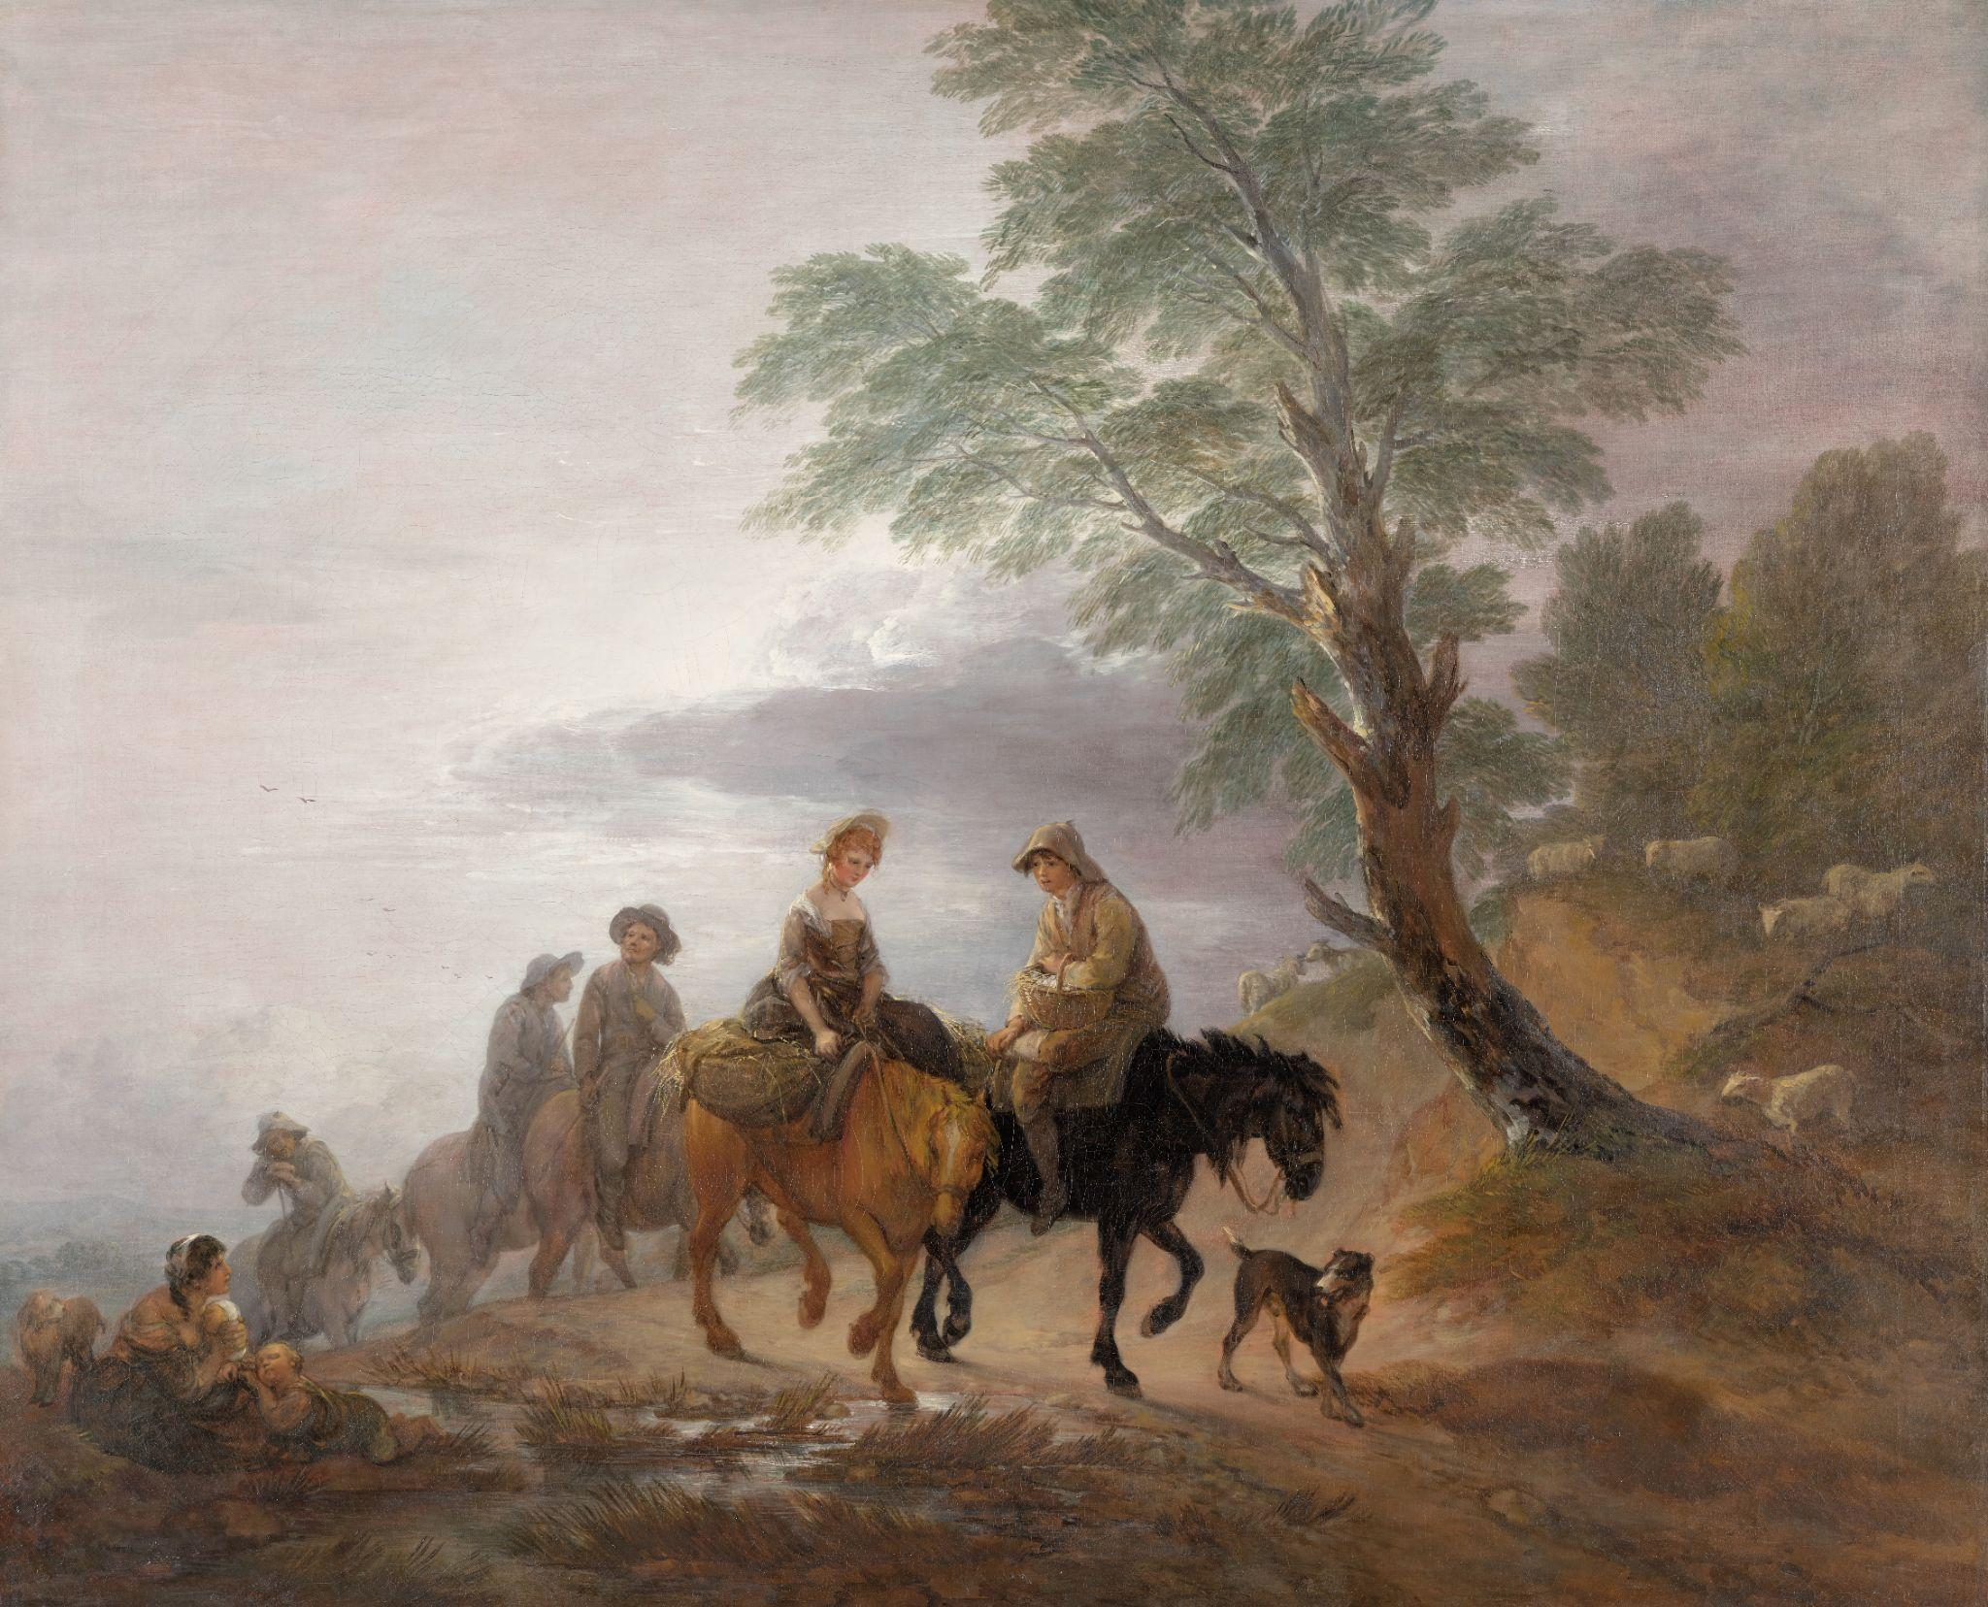
Narratives in Action
Why might artists illustrate stories?
How do artists focus the viewer on the most important parts of the scene?
What clues do artists use to suggest what will happen next?
How do characters and settings come together to tell stories?
Thomas Gainsborough, Going to Market, Early Morning, c. 1773, oil on canvas. Kimbell Art Museum

Slide 31
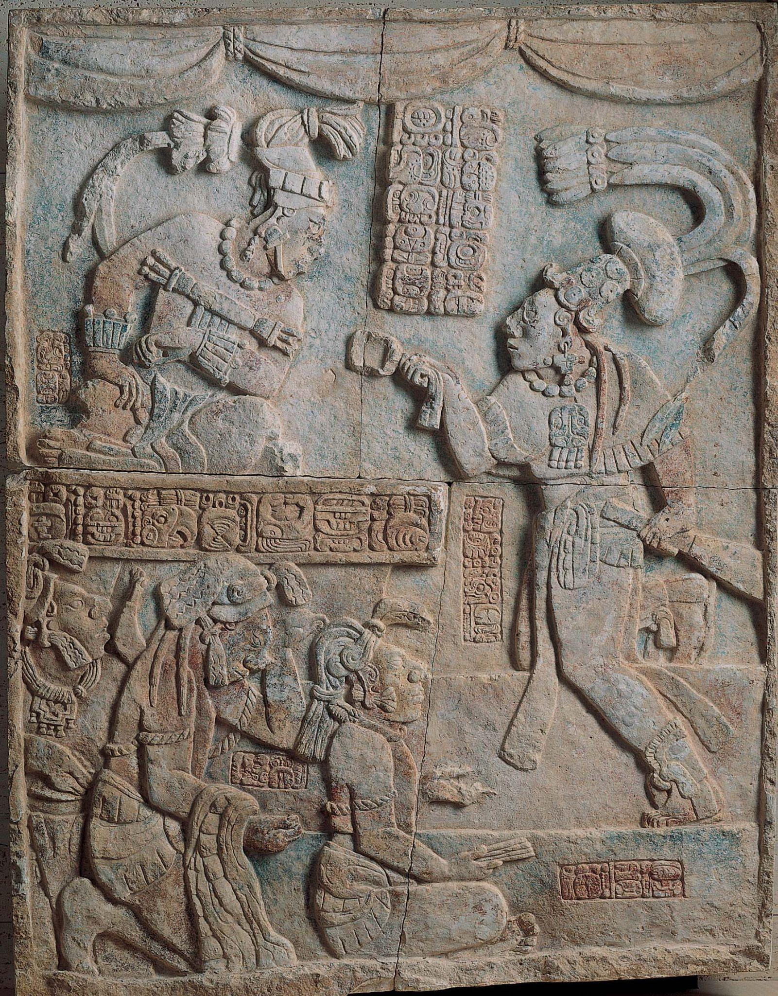
Maya, Presentation of Captives to a Maya Ruler, c. AD 785, limestone with traces of paint. Kimbell Art Museum
Notes:
https://kimbellart.org/collection/ap-197107
This carved and painted relief panel shows the presentation of captives in a palace throne room, indicated by swag curtains at the top. The five figures are the king of Yaxchilan, Itzamnaaj Balam III, seated at top left; his sahal (a military chief), Aj Chak Maax, at the right; and three bound captives in the lower-left corner. The glyphic text, which gives a date of August 23, 783, records the capture of a lord named Balam-Ahau by Aj Chak Maax and a sacrificial bloodletting three days later under the auspices of the ruler. The three prisoners may be scribes from a captured city, as the one seated in front holds a “stick-bundle” normally associated with depictions of Maya scribes and all three wear headdresses with hun (book) knots. All but the leftmost captive are identified by name. The inscription on the throne front beneath the seated lord is carved with the king’s name and titles, but the glyphs are inscribed in reverse order, from right to left. The name of the artist responsible for sculpting this relief appears on the vertical panel of four glyphs under the sahal’s outstretched arm, perhaps indicating that the sahal was himself also the creator of this work.
The Kimbell relief, which comes from an unidentified site named Laxtunich, probably served as a wall panel inside a Maya building or as a lintel over an entrance. Lintels as large as this often recorded significant dynastic events. It is assumed that their placement at points of transition between the outside, secular world and an inside, more sacred realm was of primary importance.

Slide 32
What do you see happening in this picture? Where is this place? Who is the most important person? How can you tell?
What differences do you notice in each figure’s clothing? What is happening to the figures at the bottom? Describe their gestures and expressions.
Where do you see Maya writing or glyphs? What information would be useful for understanding this artwork?
Maya, Presentation of Captives to a Maya Ruler, c. AD 785, limestone with traces of paint. Kimbell Art Museum
Notes:
https://kimbellart.org/collection/ap-197107
This carved and painted relief panel shows the presentation of captives in a palace throne room, indicated by swag curtains at the top. The five figures are the king of Yaxchilan, Itzamnaaj Balam III, seated at top left; his sahal (a military chief), Aj Chak Maax, at the right; and three bound captives in the lower-left corner. The glyphic text, which gives a date of August 23, 783, records the capture of a lord named Balam-Ahau by Aj Chak Maax and a sacrificial bloodletting three days later under the auspices of the ruler. The three prisoners may be scribes from a captured city, as the one seated in front holds a “stick-bundle” normally associated with depictions of Maya scribes and all three wear headdresses with hun (book) knots. All but the leftmost captive are identified by name. The inscription on the throne front beneath the seated lord is carved with the king’s name and titles, but the glyphs are inscribed in reverse order, from right to left. The name of the artist responsible for sculpting this relief appears on the vertical panel of four glyphs under the sahal’s outstretched arm, perhaps indicating that the sahal was himself also the creator of this work.
The Kimbell relief, which comes from an unidentified site named Laxtunich, probably served as a wall panel inside a Maya building or as a lintel over an entrance. Lintels as large as this often recorded significant dynastic events. It is assumed that their placement at points of transition between the outside, secular world and an inside, more sacred realm was of primary importance.

Slide 33
Where do you think this was originally placed? What message does it send to visitors?
Investigate how the Maya used glyphs to represent words and sounds.
Maya, Presentation of Captives to a Maya Ruler, c. AD 785, limestone with traces of paint. Kimbell Art Museum
Notes:
https://kimbellart.org/collection/ap-197107
This carved and painted relief panel shows the presentation of captives in a palace throne room, indicated by swag curtains at the top. The five figures are the king of Yaxchilan, Itzamnaaj Balam III, seated at top left; his sahal (a military chief), Aj Chak Maax, at the right; and three bound captives in the lower-left corner. The glyphic text, which gives a date of August 23, 783, records the capture of a lord named Balam-Ahau by Aj Chak Maax and a sacrificial bloodletting three days later under the auspices of the ruler. The three prisoners may be scribes from a captured city, as the one seated in front holds a “stick-bundle” normally associated with depictions of Maya scribes and all three wear headdresses with hun (book) knots. All but the leftmost captive are identified by name. The inscription on the throne front beneath the seated lord is carved with the king’s name and titles, but the glyphs are inscribed in reverse order, from right to left. The name of the artist responsible for sculpting this relief appears on the vertical panel of four glyphs under the sahal’s outstretched arm, perhaps indicating that the sahal was himself also the creator of this work.
The Kimbell relief, which comes from an unidentified site named Laxtunich, probably served as a wall panel inside a Maya building or as a lintel over an entrance. Lintels as large as this often recorded significant dynastic events. It is assumed that their placement at points of transition between the outside, secular world and an inside, more sacred realm was of primary importance.

Slide 34
Caravaggio, The Cardsharps, c. 1596–97, oil on canvas. Kimbell Art Museum
Notes:
https://kimbellart.org/collection/ap-198706
Caravaggio was one of the pivotal figures in the history of Western art. In his short lifetime, he created a new, theatrical style that shocked some and inspired others to probe their subject matter for the drama of psychological relationships. Apprenticed in Milan, Caravaggio came to Rome in the early 1590s. There, his early masterpiece The Cardsharps came to the attention of the influential Cardinal Francesco Maria del Monte, who not only purchased it but also offered the artist quarters in his palace and introduced him to the elite stratum of Roman ecclesiastical society, which would lead to his first significant large-scale public commissions.
In The Cardsharps, the players are engaged in a game of primero, a forerunner of poker. The dupe, engrossed in his cards, is unaware that the older cardsharp signals his accomplice with a raised, gloved hand (the fingertips exposed, better to feel marked cards). The young cheat looks expectantly toward the boy and reaches behind his back to pull a hidden card from his breeches. Caravaggio structures the picture to allow us to witness everything, implicating us in the trickery. He has treated this subject not as a caricature of vice but in a novelistic way in which the interaction of gesture and glance evokes the drama of deception and lost innocence in the most human of terms. The Cardsharps spawned countless paintings on related themes by artists throughout Europe–not the least of which was Georges de La Tour’s Cheat with the Ace of Clubs, also in the Kimbell’s collection. The Cardsharps was stamped on the back with the seal of Cardinal de Monte and inventoried among his possessions after his death.

Slide 35
What is happening in this picture? What do you notice first? Follow the eyes and gestures of each figure. How does your eye move around the painting?
Compare the characters and describe their actions and expressions. What is each man’s role? What do you notice about their costumes?
Where do you see light and shadow? What other details do you see? What kind of game are they playing? Describe the space. Where are they?
Caravaggio, The Cardsharps, c. 1596–97, oil on canvas. Kimbell Art Museum
Notes:
https://kimbellart.org/collection/ap-198706
Caravaggio was one of the pivotal figures in the history of Western art. In his short lifetime, he created a new, theatrical style that shocked some and inspired others to probe their subject matter for the drama of psychological relationships. Apprenticed in Milan, Caravaggio came to Rome in the early 1590s. There, his early masterpiece The Cardsharps came to the attention of the influential Cardinal Francesco Maria del Monte, who not only purchased it but also offered the artist quarters in his palace and introduced him to the elite stratum of Roman ecclesiastical society, which would lead to his first significant large-scale public commissions.
In The Cardsharps, the players are engaged in a game of primero, a forerunner of poker. The dupe, engrossed in his cards, is unaware that the older cardsharp signals his accomplice with a raised, gloved hand (the fingertips exposed, better to feel marked cards). The young cheat looks expectantly toward the boy and reaches behind his back to pull a hidden card from his breeches. Caravaggio structures the picture to allow us to witness everything, implicating us in the trickery. He has treated this subject not as a caricature of vice but in a novelistic way in which the interaction of gesture and glance evokes the drama of deception and lost innocence in the most human of terms. The Cardsharps spawned countless paintings on related themes by artists throughout Europe–not the least of which was Georges de La Tour’s Cheat with the Ace of Clubs, also in the Kimbell’s collection. The Cardsharps was stamped on the back with the seal of Cardinal de Monte and inventoried among his possessions after his death.

Slide 36
What do you think will happen next? What would you do in this situation? How does Caravaggio create a sense of drama?
Write a story from the perspective of one of the characters.
Caravaggio, The Cardsharps, c. 1596–97, oil on canvas. Kimbell Art Museum
Notes:
https://kimbellart.org/collection/ap-198706
Caravaggio was one of the pivotal figures in the history of Western art. In his short lifetime, he created a new, theatrical style that shocked some and inspired others to probe their subject matter for the drama of psychological relationships. Apprenticed in Milan, Caravaggio came to Rome in the early 1590s. There, his early masterpiece The Cardsharps came to the attention of the influential Cardinal Francesco Maria del Monte, who not only purchased it but also offered the artist quarters in his palace and introduced him to the elite stratum of Roman ecclesiastical society, which would lead to his first significant large-scale public commissions.
In The Cardsharps, the players are engaged in a game of primero, a forerunner of poker. The dupe, engrossed in his cards, is unaware that the older cardsharp signals his accomplice with a raised, gloved hand (the fingertips exposed, better to feel marked cards). The young cheat looks expectantly toward the boy and reaches behind his back to pull a hidden card from his breeches. Caravaggio structures the picture to allow us to witness everything, implicating us in the trickery. He has treated this subject not as a caricature of vice but in a novelistic way in which the interaction of gesture and glance evokes the drama of deception and lost innocence in the most human of terms. The Cardsharps spawned countless paintings on related themes by artists throughout Europe–not the least of which was Georges de La Tour’s Cheat with the Ace of Clubs, also in the Kimbell’s collection. The Cardsharps was stamped on the back with the seal of Cardinal de Monte and inventoried among his possessions after his death.

Slide 37
Thomas Gainsborough, Going to Market, Early Morning, c. 1773, oil on canvas. Kimbell Art Museum
Notes:
https://kimbellart.org/collection/ap-202301
This painting is a treasured example of a new type of British landscape painting invented by Thomas Gainsborough. The artist shows figures on horseback near the brow of a hill at the break of day, outlined against a misty sky. At the front of the group is a beautiful girl, riding sidesaddle, and a young man, both of whom have baskets of farm products to sell—eggs nestled in straw. Seated beside a stream, a poor woman with two children looks up at the passing riders. Gainsborough was born in the countryside but trained in London before settling in the fashionable city of Bath, where he was acclaimed, along with Sir Joshua Reynolds, as the leading British portrait painter of the age. At the same time, however, he pursued his passion for landscape painting, and in the last decades of his life, working through observation and memory, created imaginative compositions that appeal to the viewer’s sentiments.
Gainsborough’s early works were inspired by the old masters—the naturalistic landscapes of Dutch painters such as Jacob van Ruisdael, the vibrant color and fluent brushwork of Peter Paul Rubens, and the captivating Italianate light effects of Claude Lorrain. In his maturity, he worked on a large scale and introduced a modern element to the landscape: the contemporary social life of the countryside, observed firsthand. In Going to Market, the girl’s auburn ringlets and fine necklace might seem romanticized but may have been donned to attract customers. The shadowy riders in the background fit descriptions of colliers carrying sacks of coal by pack pony from coalfields nearby. In this magical picture, Gainsborough has reimagined the classical landscape tradition, enriching its dreamlike serenity with the vivid life-force of the English countryside.

Slide 38
What is happening in this painting? What do you notice first? Follow the eyes and gestures of each figure. How does your eye move around?
Compare the characters and describe their actions and expressions. How are they feeling? What is each person’s role? What do you notice about their attire?
How does the artist suggest time of day? Describe where you see light and shadow. What else can you discover about this setting?
Thomas Gainsborough, Going to Market, Early Morning, c. 1773, oil on canvas. Kimbell Art Museum
Notes:
https://kimbellart.org/collection/ap-202301
This painting is a treasured example of a new type of British landscape painting invented by Thomas Gainsborough. The artist shows figures on horseback near the brow of a hill at the break of day, outlined against a misty sky. At the front of the group is a beautiful girl, riding sidesaddle, and a young man, both of whom have baskets of farm products to sell—eggs nestled in straw. Seated beside a stream, a poor woman with two children looks up at the passing riders. Gainsborough was born in the countryside but trained in London before settling in the fashionable city of Bath, where he was acclaimed, along with Sir Joshua Reynolds, as the leading British portrait painter of the age. At the same time, however, he pursued his passion for landscape painting, and in the last decades of his life, working through observation and memory, created imaginative compositions that appeal to the viewer’s sentiments.
Gainsborough’s early works were inspired by the old masters—the naturalistic landscapes of Dutch painters such as Jacob van Ruisdael, the vibrant color and fluent brushwork of Peter Paul Rubens, and the captivating Italianate light effects of Claude Lorrain. In his maturity, he worked on a large scale and introduced a modern element to the landscape: the contemporary social life of the countryside, observed firsthand. In Going to Market, the girl’s auburn ringlets and fine necklace might seem romanticized but may have been donned to attract customers. The shadowy riders in the background fit descriptions of colliers carrying sacks of coal by pack pony from coalfields nearby. In this magical picture, Gainsborough has reimagined the classical landscape tradition, enriching its dreamlike serenity with the vivid life-force of the English countryside.

Slide 39
Imagine a journey that starts early in the day. How would you prepare?
Draw a picture that shows their destination. What will they do next?
Thomas Gainsborough, Going to Market, Early Morning, c. 1773, oil on canvas. Kimbell Art Museum
Notes:
https://kimbellart.org/collection/ap-202301
This painting is a treasured example of a new type of British landscape painting invented by Thomas Gainsborough. The artist shows figures on horseback near the brow of a hill at the break of day, outlined against a misty sky. At the front of the group is a beautiful girl, riding sidesaddle, and a young man, both of whom have baskets of farm products to sell—eggs nestled in straw. Seated beside a stream, a poor woman with two children looks up at the passing riders. Gainsborough was born in the countryside but trained in London before settling in the fashionable city of Bath, where he was acclaimed, along with Sir Joshua Reynolds, as the leading British portrait painter of the age. At the same time, however, he pursued his passion for landscape painting, and in the last decades of his life, working through observation and memory, created imaginative compositions that appeal to the viewer’s sentiments.
Gainsborough’s early works were inspired by the old masters—the naturalistic landscapes of Dutch painters such as Jacob van Ruisdael, the vibrant color and fluent brushwork of Peter Paul Rubens, and the captivating Italianate light effects of Claude Lorrain. In his maturity, he worked on a large scale and introduced a modern element to the landscape: the contemporary social life of the countryside, observed firsthand. In Going to Market, the girl’s auburn ringlets and fine necklace might seem romanticized but may have been donned to attract customers. The shadowy riders in the background fit descriptions of colliers carrying sacks of coal by pack pony from coalfields nearby. In this magical picture, Gainsborough has reimagined the classical landscape tradition, enriching its dreamlike serenity with the vivid life-force of the English countryside.

Slide 40
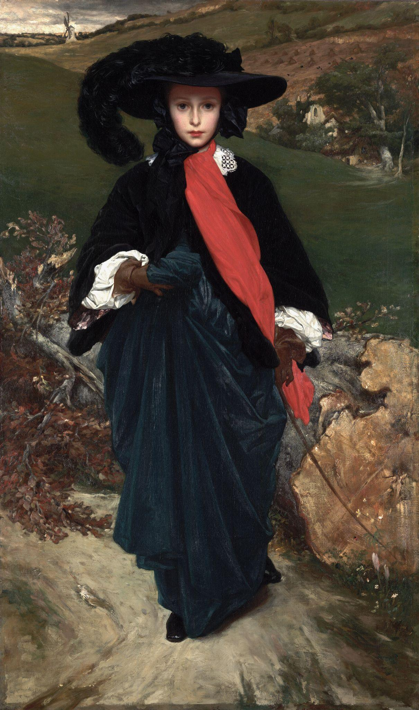
Frederic Leighton, Portrait of May Sartoris, c. 1860, oil on canvas. Kimbell Art Museum
Notes:
https://kimbellart.org/collection/acf-196403
The striking portrait represents Mary Theodosia (May) Sartoris around age fifteen. She looks out of the painting with inscrutable wide eyes. As much as the sitter herself, however, the subject of the painting seems to be her extraordinary costume. Though no horse is in sight, May carries a riding crop and gathers up the skirts of her dark blue riding habit. Her hair is hidden under a broad-brimmed black hat tied at her chin in a bow and topped with an ostrich feather; her black jacket with its white lace collar is boldly accented with a long scarlet scarf.
Leighton’s close friendship with May’s mother, the opera singer Adelaide Sartoris, began in Rome in 1853. Leighton had spent most of his childhood in Germany and Italy, where he became committed to the revival of the Renaissance style. Indeed, he made his reputation in 1885 when Queen Victoria purchased his history painting depicting Cimabue, Giotto, and other Renaissance art pioneers. Leighton would go on to be knighted by the queen in 1878; he was elevated to the peerage in 1896, only a day before his death.
This portrait owes a debt to the art of the past—to British royal portraits by Anthony van Dyck, for example—but has numerous counterparts among the images of pensive females painted in the 1850s by such leading English Pre-Raphaelite painters as John Everett Millais. The background landscape, presumably the Sartoris family properties in Hampshire, includes a windmill, a field with rows of stacked wheat, and a country church. A felled tree behind the sitter allows Leighton to indulge in varied painterly effects, while the invocation of autumn invites meditation on the seasons and the passage of time, accentuating the fragile beauty of the young girl.

Slide 41
Choose three words to describe this figure. What does her costume suggest about her? How would you describe her expression?
What colors or shapes do you notice first? How do they lead your eye around?
Where do you think this is? What details do you notice in the background? How would you describe the season and time of day?
Frederic Leighton, Portrait of May Sartoris, c. 1860, oil on canvas. Kimbell Art Museum
Notes:
https://kimbellart.org/collection/acf-196403
The striking portrait represents Mary Theodosia (May) Sartoris around age fifteen. She looks out of the painting with inscrutable wide eyes. As much as the sitter herself, however, the subject of the painting seems to be her extraordinary costume. Though no horse is in sight, May carries a riding crop and gathers up the skirts of her dark blue riding habit. Her hair is hidden under a broad-brimmed black hat tied at her chin in a bow and topped with an ostrich feather; her black jacket with its white lace collar is boldly accented with a long scarlet scarf.
Leighton’s close friendship with May’s mother, the opera singer Adelaide Sartoris, began in Rome in 1853. Leighton had spent most of his childhood in Germany and Italy, where he became committed to the revival of the Renaissance style. Indeed, he made his reputation in 1885 when Queen Victoria purchased his history painting depicting Cimabue, Giotto, and other Renaissance art pioneers. Leighton would go on to be knighted by the queen in 1878; he was elevated to the peerage in 1896, only a day before his death.
This portrait owes a debt to the art of the past—to British royal portraits by Anthony van Dyck, for example—but has numerous counterparts among the images of pensive females painted in the 1850s by such leading English Pre-Raphaelite painters as John Everett Millais. The background landscape, presumably the Sartoris family properties in Hampshire, includes a windmill, a field with rows of stacked wheat, and a country church. A felled tree behind the sitter allows Leighton to indulge in varied painterly effects, while the invocation of autumn invites meditation on the seasons and the passage of time, accentuating the fragile beauty of the young girl.

Slide 42
How do the textures in her costume compare to the textures in the landscape?
Write a story from this girl’s point of view. Use details as clues to help shape your narrative.
Frederic Leighton, Portrait of May Sartoris, c. 1860, oil on canvas. Kimbell Art Museum
Notes:
https://kimbellart.org/collection/acf-196403
The striking portrait represents Mary Theodosia (May) Sartoris around age fifteen. She looks out of the painting with inscrutable wide eyes. As much as the sitter herself, however, the subject of the painting seems to be her extraordinary costume. Though no horse is in sight, May carries a riding crop and gathers up the skirts of her dark blue riding habit. Her hair is hidden under a broad-brimmed black hat tied at her chin in a bow and topped with an ostrich feather; her black jacket with its white lace collar is boldly accented with a long scarlet scarf.
Leighton’s close friendship with May’s mother, the opera singer Adelaide Sartoris, began in Rome in 1853. Leighton had spent most of his childhood in Germany and Italy, where he became committed to the revival of the Renaissance style. Indeed, he made his reputation in 1885 when Queen Victoria purchased his history painting depicting Cimabue, Giotto, and other Renaissance art pioneers. Leighton would go on to be knighted by the queen in 1878; he was elevated to the peerage in 1896, only a day before his death.
This portrait owes a debt to the art of the past—to British royal portraits by Anthony van Dyck, for example—but has numerous counterparts among the images of pensive females painted in the 1850s by such leading English Pre-Raphaelite painters as John Everett Millais. The background landscape, presumably the Sartoris family properties in Hampshire, includes a windmill, a field with rows of stacked wheat, and a country church. A felled tree behind the sitter allows Leighton to indulge in varied painterly effects, while the invocation of autumn invites meditation on the seasons and the passage of time, accentuating the fragile beauty of the young girl.

Slide 43
Art in order of appearance:
Thomas Gainsborough, Going to Market, Early Morning, c. 1773, oil on canvas. Kimbell Art Museum, Fort Worth, AP 2023.01
Egyptian, Portrait Statue of Pharaoh Amenhotep II, c. 1400 BC, recarved for Ramesses II (the Great) c. 1250 BC, limestone, with traces of original painted decoration. Kimbell Art Museum, Fort Worth, AP 1982.04
Olmec people, Standing Figure Holding a Were-Jaguar Baby, c. 900–300 BC, jade (Jadeite). Kimbell Art Museum, Fort Worth, AP 2023.02
Caravaggio, The Cardsharps, c. 1596–97, oil on canvas. Kimbell Art Museum, Fort Worth, AP 1987.06
Japanese, Genji in Exile at Suma, late 16th century, six-fold screen; ink, gold, silver, and pigments on paper. Kimbell Art Museum, Fort Worth, AP 1971.11
Chokwe people, Chibinda Ilunga, mid-19th century, wood, hair, and hide. Kimbell Art Museum, Fort Worth, AP 1978.05
Kaikei, Standing Shaka Buddha, c. 1210, gilt and lacquered wood. Kimbell Art Museum, Fort Worth, AP 1984.01 a,b,c
Jacob van Ruisdael, Edge of a Forest with a Grainfield, c. 1656, oil on canvas. Kimbell Art Museum, Fort Worth, AP 2014.01
Wen Jia, Landscape in the Style of Dong Yuan, 1577, hanging scroll; ink and light colors on paper. Kimbell Art Museum, Fort Worth, AP 1980.01
Claude Monet, La Pointe de la Hève at Low Tide, 1865, oil on canvas. Kimbell Art Museum, Fort Worth, AP 1968.07
Maya, Presentation of Captives to a Maya Ruler, c. AD 785, limestone with traces of paint. Kimbell Art Museum, Fort Worth, AP 1971.07
Frederic Leighton, Portrait of May Sartoris, c. 1860, oil on canvas. Kimbell Art Museum, Fort Worth, ACF 1964.03
© 2025 Kimbell Art Museum

