Slide 1
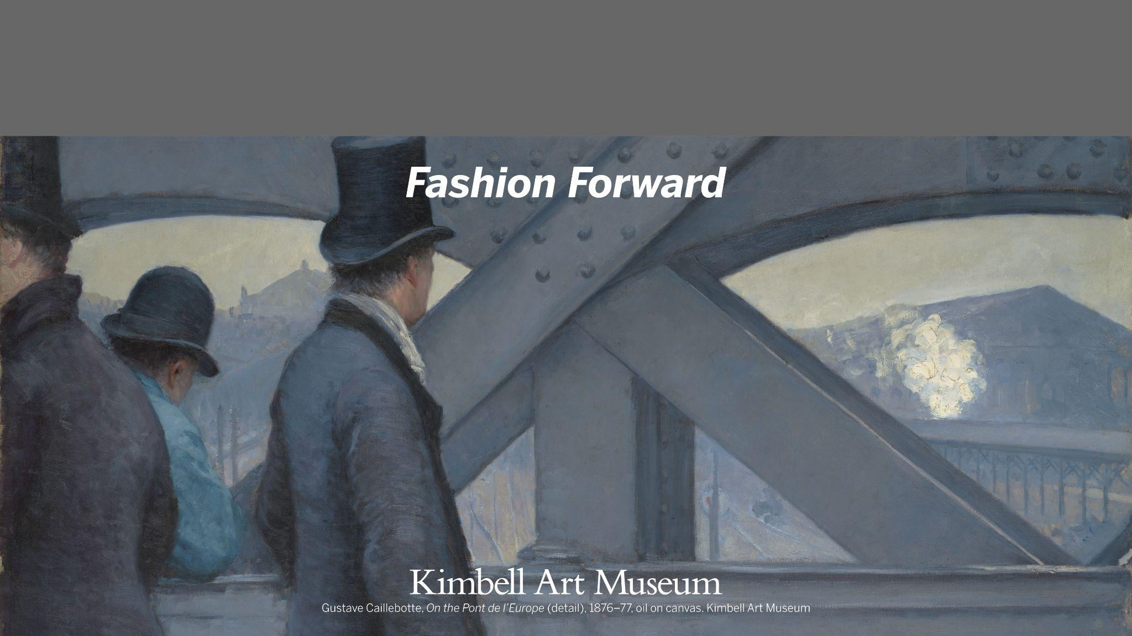
Kimbell Educator Packet
Notes:
https://kimbellart.org/collection/ap-198201

Slide 2
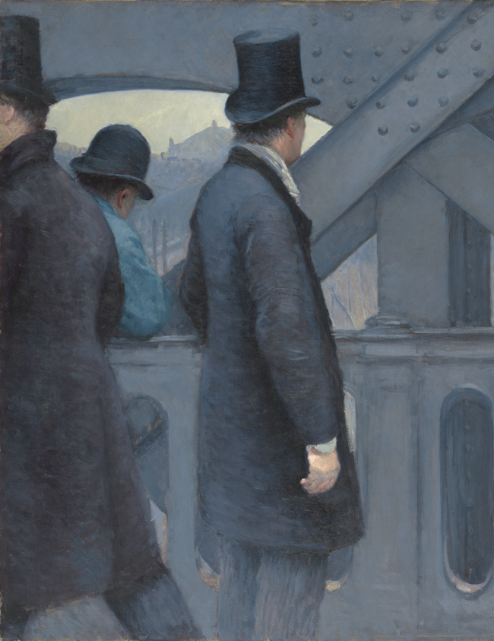
Fashion Forward
Explore trends in fashion:
Types of Fashion
  Career
  Divine Figures
  Fashion Influences
  Rulers
  Social Status
Collaborative Fashion Lesson Plan
Gustave Caillebotte, On the Pont de l’Europe (detail), 1876–77, oil on canvas. Kimbell Art Museum
Notes:
https://kimbellart.org/collection/ap-198201

Slide 3
Art TEKS
§117.111. Art, Grade 3 | §117.111.b.1.B. The student is expected to use appropriate vocabulary when discussing the elements of art, including line, shape, color, texture, form, space, and value, and the principles of design, including emphasis, repetition/pattern, movement/rhythm, contrast/variety, balance, proportion, and unity §117.111.b.3.B. The student is expected to compare and contrast artworks created by historical and contemporary men and women, making connections to various cultures. §117.111.b.4.A. The student is expected to evaluate the elements of art, principles of design, or expressive qualities in artworks of self, peers, and historical and contemporary artists.
§117.203. Art, Middle School 2 | 117.203.b.1.B–C. The student is expected to compare and contrast the elements of art, including line, shape, color, texture, form, space, and value, as the fundamentals of art in personal artworks using vocabulary accurately; The student is expected to compare and contrast the principles of design, including emphasis, repetition/pattern, movement/rhythm, contrast/variety, balance, proportion, and unity, in personal artworks using vocabulary accurately. 117.203.b.2.B. The student is expected to apply the art-making process to solve problems and generate design solutions. 117.203.b.4.A. The student is expected to create written or oral responses about personal or collaborative artworks addressing purpose, technique, organization, judgment, and personal expression.
§117.303. Art, Level II | 117.303.c.2.B. The student is expected to apply design skills in creating practical applications, clarifying presentations, and examining consumer choices in order to make successful design decisions. 117.303.c.3.B. The student is expected to analyze specific characteristics in artwork from a variety of cultures. 117.303.b.4.A. The student is expected to create written or oral responses about personal or collaborative artworks addressing purpose, technique, organization, judgment, and personal expression.

Slide 4
Fashion Design TEKS
§130.102. Arts, Audio/Video Technology, and Communications, Fashion Design I | §130.102.c.6. The student is expected to analyze the history of the fashion, textiles, and apparel field; and compare fashion history relative to current fashion trends.
§130.103. Arts, Audio/Video Technology, and Communications, Fashion Design I Lab | §130.103.c.4. The student is expected to employ critical-thinking skills independently and in groups; and employ interpersonal skills in groups to solve problems. §130.103.c.6. The student is expected to compare fashion history relative to current fashions trends; and evaluate how historical events and attitudes influence fashion trends. §130.103.c.18B. The student is expected to apply design principles and elements when designing and constructing apparel.
Social Studies TEKS
§113.42. World History Studies, Grade 10 | §110.23.d.25 A The student is expected to analyze examples of how art, architecture, literature, music, and drama reflect the history of the cultures in which they are produced

Slide 5
English TEKS
§110.4. English Language Arts and Reading, Speech, Grade 2 | §110.4.b.9.E The student is expected to recognize characteristics of persuasive text, including stating what the author is trying to persuade the reader to think or do.
§110.26. English Language Arts and Reading, Speech, Middle School | §110.26.b.5.C–D The student is expected to plan, research, organize, prepare, and present a persuasive speech; demonstrate persuasive skills in informal or formal argumentation, discussions, or debates.
§110.58. English Language Arts and Reading, Communication Applications, High School | §110.58.b.14.J–K The student is expected to make group presentations to inform, persuade, or motivate an audience; make individual presentations to inform, persuade, or motivate an audience.

Slide 6
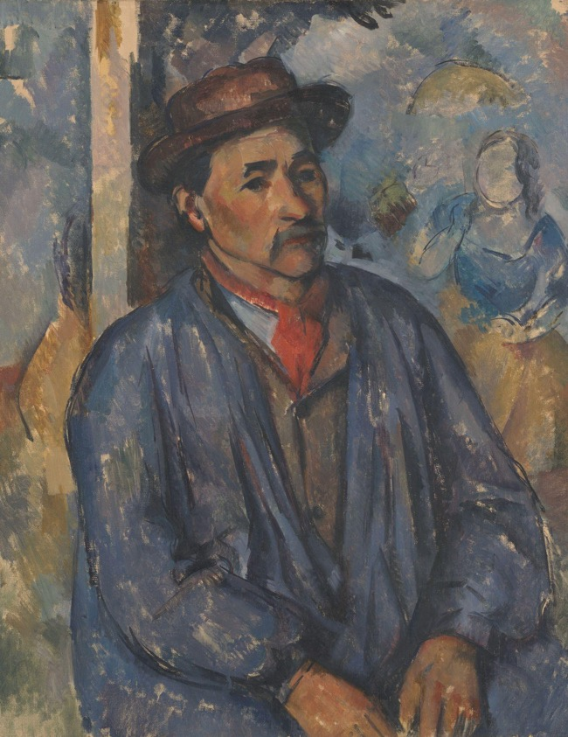
CAREER
Clothing and accessories often indicate an individual’s profession. Work uniforms can help designate someone as part of a specific organization or company, and sometimes uniforms are designed to assist a worker at their job.
Paul Cézanne, Man in a Blue Smock (detail), c. 1896–97, oil on canvas. Kimbell Art Museum
Notes:
https://kimbellart.org/collection/apg-198003
Around 1890, Cézanne began enlisting workers from his family’s estate in the south of France to pose for his paintings. Here, the worker wears a blue smock. During the industrial revolution, the worker’s coat was typically worn over clothing; they contained large pockets to hold tools and were dyed with synthetic blue. This distinctive color eventually led to the term in the United States: “blue-collar worker.”

Slide 7
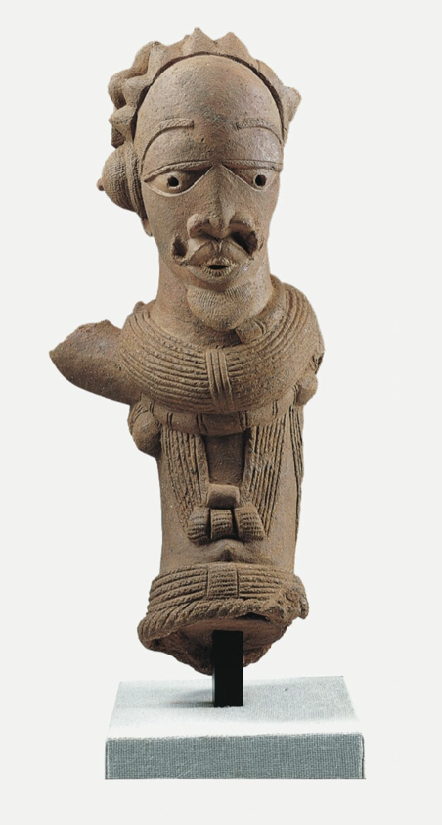
Nok culture, Male Figure, c. 195 BC–AD 205, terracotta. Kimbell Art Museum
Notes:
https://kimbellart.org/collection/ap-199603
The importance of jewelry in Nok culture is illustrated by this figure’s lavish array of necklaces, jewelry, and beaded chains. The horn, slung around the back of the shoulders, may identify the figure as a spiritual specialist (shaman).

Slide 8
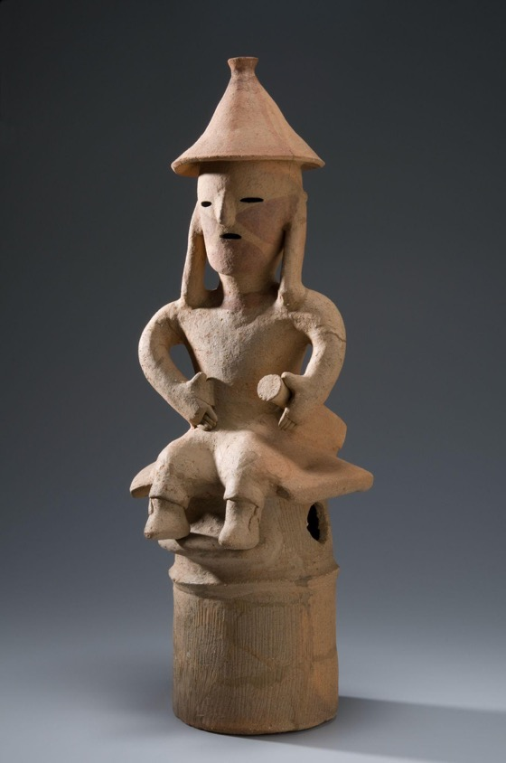
Japanese, Haniwa Seated Man, c. AD 500, low-fired clay with cinnabar pigment. Kimbell Art Museum
Notes:
https://kimbellart.org/collection/ap-197202
Haniwa, which means “circle (or tube) of clay,” is the term given to large numbers of hollow clay cylinders that were placed in and around the bases of large earthen mounds covering Japanese royal tombs. Although this figure’s status and function remain unknown, his distinctive conical cap and the sword at his side suggest a low-ranking soldier.

Slide 9
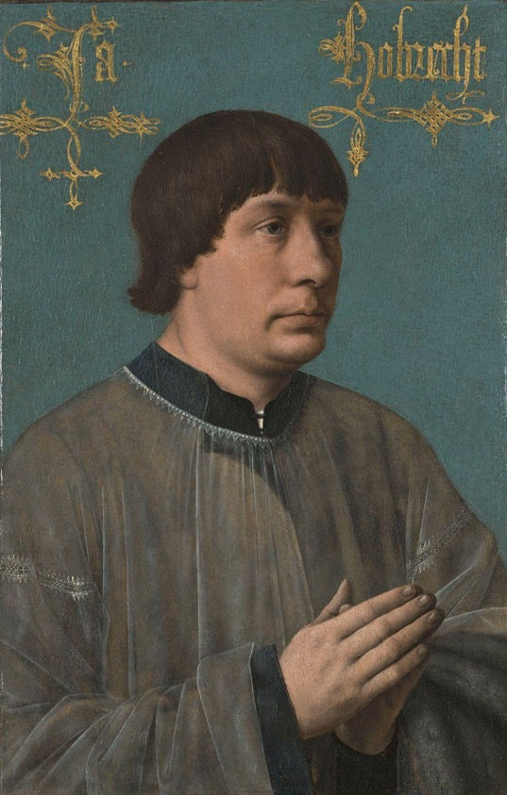
Quinten Metsys, Portrait of Jacob Obrecht, 1496, tempera, oil, and gold on panel. Kimbell Art Museum
Notes:
https://kimbellart.org/collection/ap-199302
Jacob Obrecht (1457/58–1505) was a renowned choirmaster and one of the greatest composers of his age. In this portrait, Obrecht wears a fine lace-trimmed surplice layered on top of a black cassock (identifying him as a clergy member). Draped over his arm is a soft gray fur of the almuce (the badge of office of a canon, including the choral clergy). Originally, the almuce was worn as a hood when it was cold, but it was later draped over the arm as a status symbol.

Slide 10
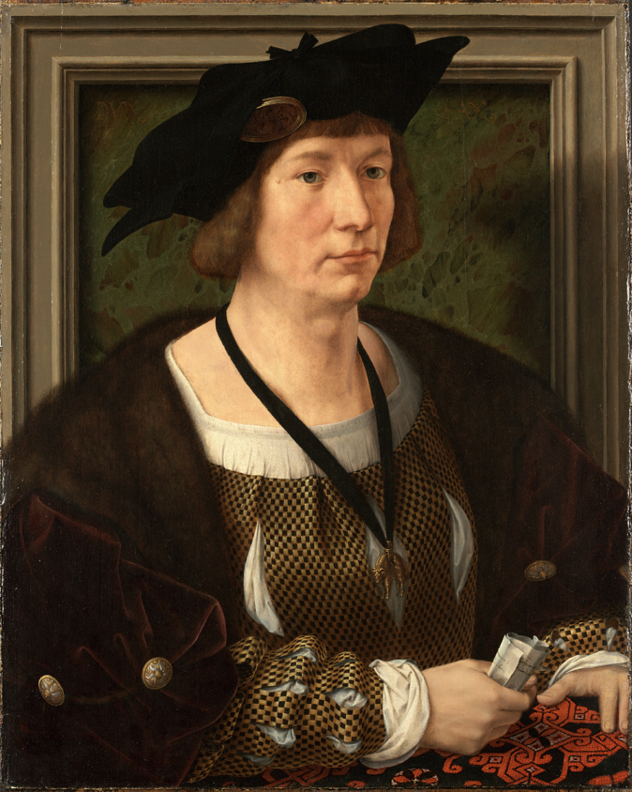
Jan Gossart, called Mabuse, Portrait of Hendrik III, Count of Nassau-Breda, c. 1516–17, oil on panel. Kimbell Art Museum
Notes:
https://kimbellart.org/collection/ap-197930
Hendrik III, Count of Nassau-Breda, was an advisor and tutor for the Habsburg court of the Holy Roman Empire. In this portrait, he wears a checkered doublet woven with black and gold metal threads. The doublet has been cut to reveal his undergarment. Hendrik III’s velvet cloak is adorned with a fur collar and gold buttons. Around his neck, the count wears a pendant of the Order of the Golden Fleece, the elite chivalric order dedicated to the defense of the church.

Slide 11
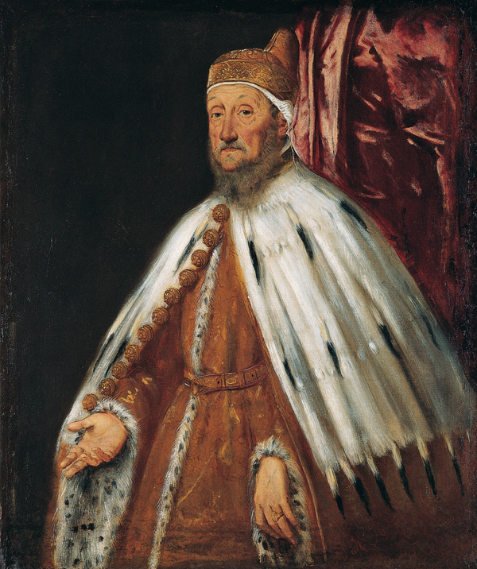
Tintoretto (Jacopo Robusti), Portrait of Doge Pietro Loredan, 1567–70, oil on canvas. Kimbell Art Museum
Notes:
https://kimbellart.org/collection/ap-198608
In 1567, the eighty-five-year-old Pietro Loredan (1482–1570) was elected doge of the Venetian Republic by his fellow councillors to break a deadlock. Tintoretto portrays him in his ceremonial dress: the gold brocade, fur-trimmed robe; the ermine cape with golden harness-bell buttons; and the distinctive corno dogale (doge’s hat) worn over a white linen cap.

Slide 12
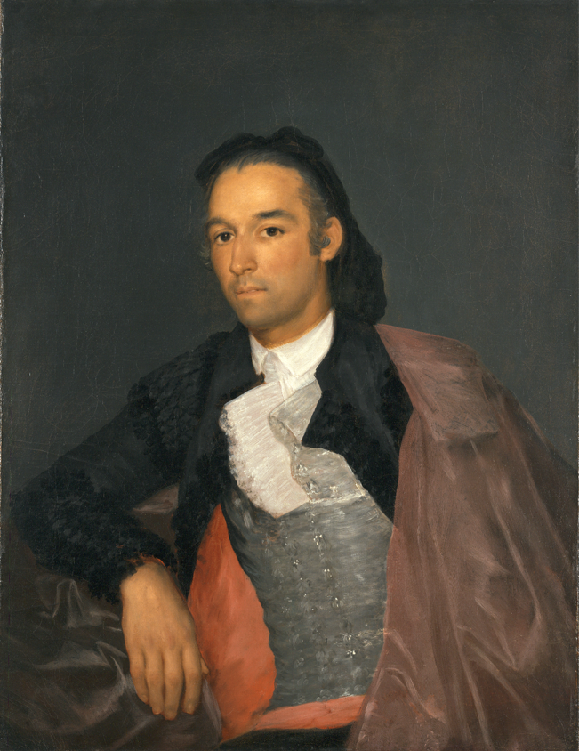
Francisco de Goya, Portrait of the Matador Pedro Romero, c. 1795–98, oil on canvas. Kimbell Art Museum
Notes:
https://kimbellart.org/collection/ap-196612
Pedro Romero (1754–1839) was a famous Spanish bullfighter known for his skilled maneuvering of his cape. Here, Romero wears a bright white shirt, silver-toned waistcoat, and a black jacket lined with red fabric. A heavy cape (known as a capote de brega) rests over his left shoulder. Later matador costumes incorporated decorative metallic embroidery, earning the name traje de luces (suit of lights).

Slide 13
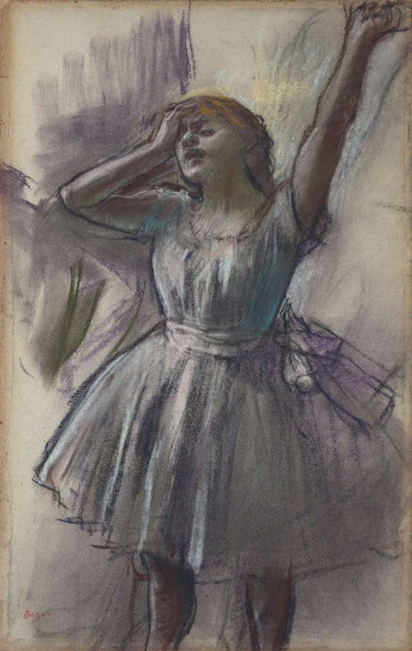
Edgar Degas, Dancer Stretching, c. 1882–85, pastel on pale blue gray paper. Kimbell Art Museum
Notes:
https://kimbellart.org/collection/ap-196804
In the late nineteenth century, French ballerinas often wore costumes constructed of a white or silk bodice and a tutu composed of layers of muslin, gauze, and tulle, which were stiffened with starch. The above-the-knee tutu emerged as a new fashion choice in the late nineteenth century.

Slide 14
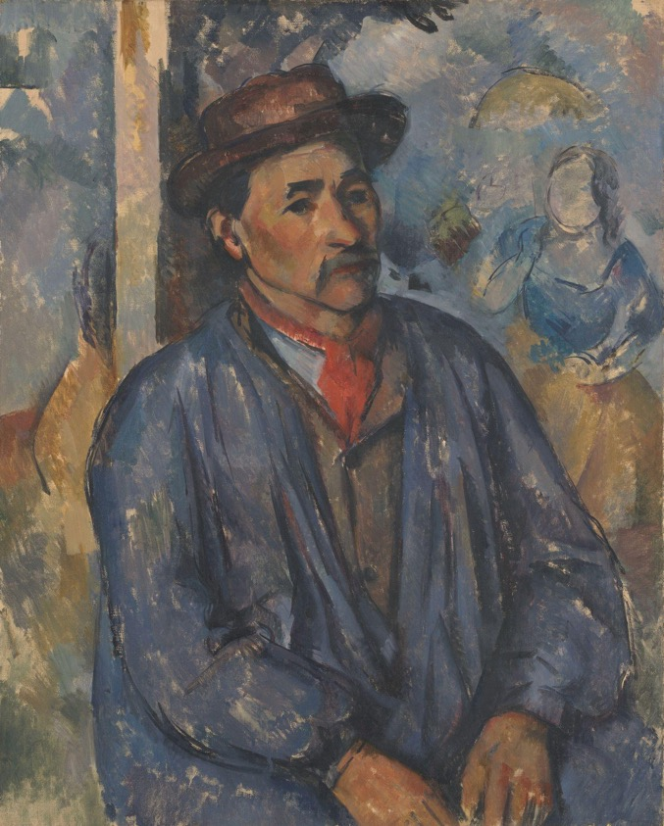
Paul Cézanne, Man in a Blue Smock, c. 1896–97, oil on canvas. Kimbell Art Museum
Notes:
https://kimbellart.org/collection/apg-198003
Around 1890, Cézanne began enlisting workers from his family’s estate in the south of France to pose for his paintings. Here, the worker wears a blue smock. During the industrial revolution, workers’ coats were typically worn over clothing; they contained large pockets to hold tools and were dyed with synthetic blue. This distinctive color eventually led to the term in the United States: “blue-collar worker.”

Slide 15
Career
CLASSROOM DISCUSSION
Describe the different work uniforms you see in this section. How does each person’s clothing represent their profession?
Which accessories appear to be decorative/symbolic and which appear to be utilitarian?
How do these historical uniforms compare to contemporary ones?
If you had to choose one of these uniforms to wear, which one would you select and why?
ACTIVITY
Choose one of the artworks from this section. Imagine what the person’s daily routine would look like in this attire. What role does the individual’s outfit play in their job?

Slide 16
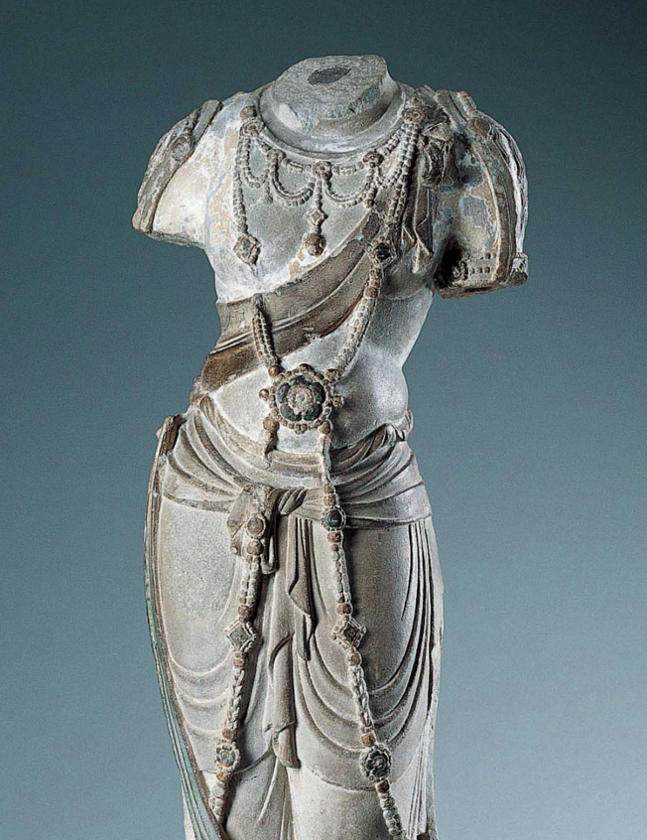
DIVINE FIGURES
Divine figures wear specific fashion that often relates to spiritual beliefs.
Chinese, Bodhisattva Torso (detail), c. AD 775–800, stone, traces of gesso and pigment. Kimbell Art Museum
Notes:
https://kimbellart.org/collection/ap-198701
This Tang dynasty torso represents a bodhisattva attendant to the Buddha, one of a class of divine beings who put off their own final nirvana to help humankind on the path to enlightenment. This bodhisattva torso has a simple skirt with a scarf across the chest and a long, elaborate necklace. The skirt, or dhoti, is gathered and loosely tied at the waist. The thin drapery reflects continuing Indian influence, here of the Gupta period (AD 320–600). The necklace, crossed in front and looped around the sides to the back, is crisply carved with individual beads and studded with medallions.

Slide 17
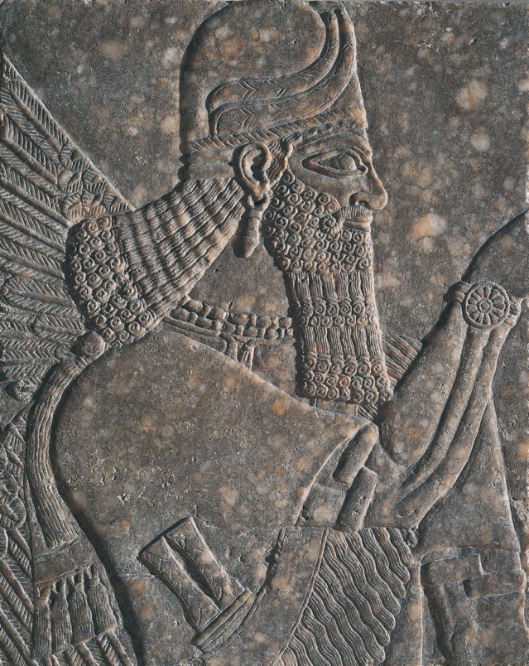
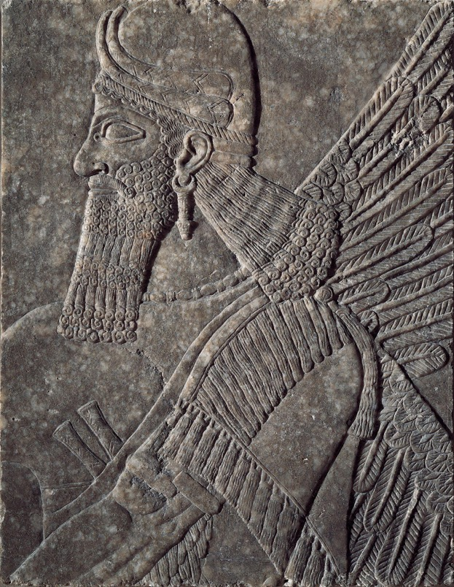
Assyrian, Pair of Winged Deities, c. 874–860 BC, gypsum.
Kimbell Art Museum
Notes:
https://kimbellart.org/collection/ap-198104-ab
These Assyrian deities, marked as divine by their wings and horned helmets, are conceived in the image of the monarch Ashurnasirpal II (reigned 883–859 BC). These divine figures reflect the king’s facial features, stance, and physical strength. Their exaggerated musculature and luxuriant, tightly curled hair and beards suggest something of the king’s vainglorious power and virility. Their tasseled fringes and wrist rosettes also correspond to depictions of the king.

Slide 18
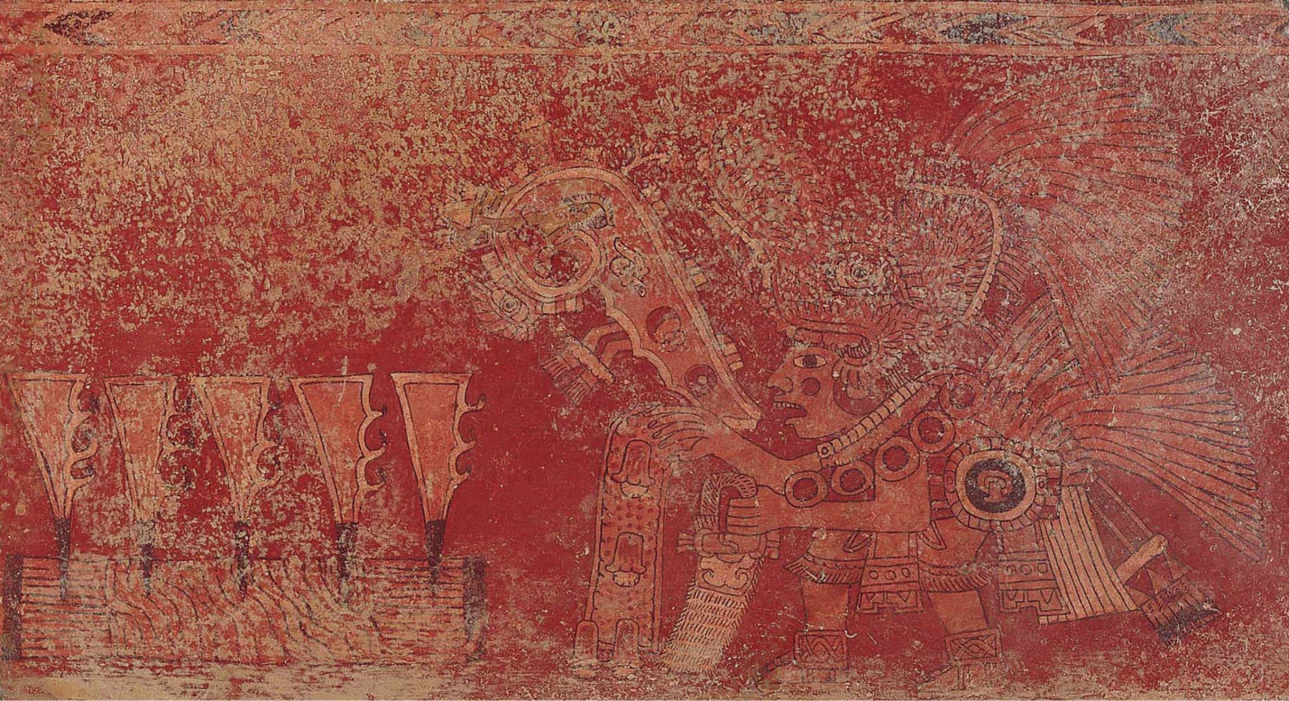
Teotihuacán culture, Singing Priest or God, c. AD 400–600, fresco. Kimbell Art Museum
Notes:
https://kimbellart.org/collection/ap-197216
A priest or god costumed in an elaborately plumed headdress performs a ceremony involving singing. The officiating figure holds an incense bag in his left hand, while flower-decorated water streams from his right. Proceeding from his mouth is a large speech scroll edged with vegetation (probably meaning “flowery song”); the hearts, jade, and other symbols in the scroll may represent the song’s content.

Slide 19
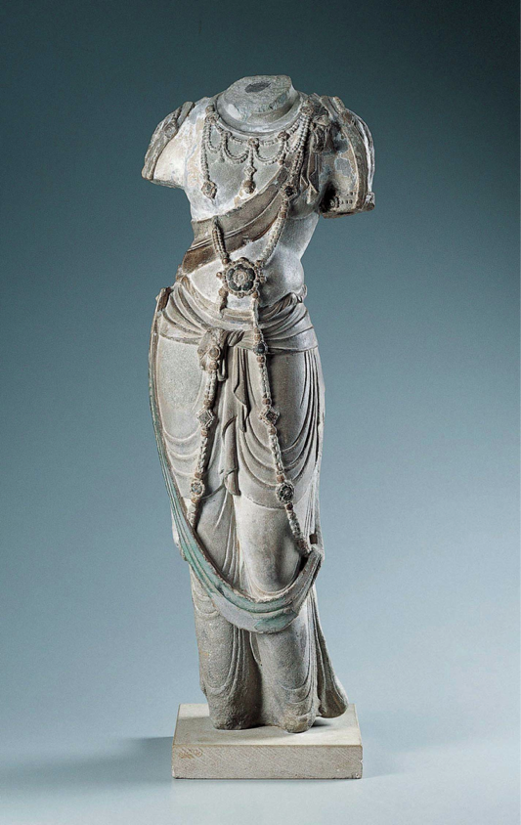
Chinese, Bodhisattva Torso, c. AD 775–800, stone, traces of gesso and pigment. Kimbell Art Museum
Notes:
https://kimbellart.org/collection/ap-198701
This Tang dynasty torso represents a bodhisattva attendant to the Buddha, one of a class of divine beings who put off their own final nirvana to help humankind on the path to enlightenment. This bodhisattva torso has a simple skirt with a scarf across the chest and a long, elaborate necklace. The skirt, or dhoti, is gathered and loosely tied at the waist. The thin drapery reflects continuing Indian influence, here of the Gupta period (AD 320–600). The necklace, crossed in front and looped around the sides to the back, is crisply carved with individual beads and studded with medallions.

Slide 20
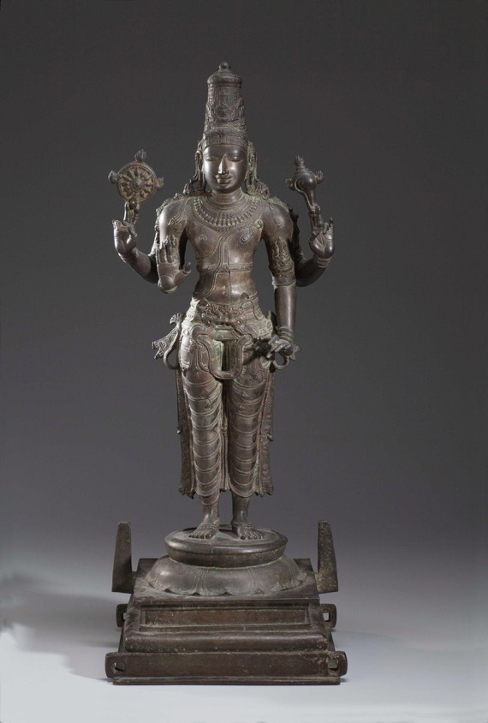
Indian, Vishnu, 13th century, bronze. Kimbell Art Museum
Notes:
https://kimbellart.org/collection/ag-197001
In the Hindu pantheon, Vishnu is the Preserver, a benevolent god who keeps the world safe from natural calamities and protects the righteous and conquers evil. His attributes are mainly weapons or objects related to battle. In this image, Vishnu stands rigidly in a frontal pose called samabhanga, the traditional posture for the god. He is magnificently attired in a richly draped and elaborately fastened skirt (dhoti), ornate jewelry, and a tall regal crown. His multiple arms symbolize his manifold powers. The lower right hand makes the gesture of reassurance (abhayamudra), the lower left the boon-giving gesture (ahuyavaramudra). The other two arms hold his attributes––in the upper right a wheel-shaped discus thrown in war to cut down the enemy, and in the upper left a conch shell battle trumpet used to strike terror into the heart of the enemy.

Slide 21
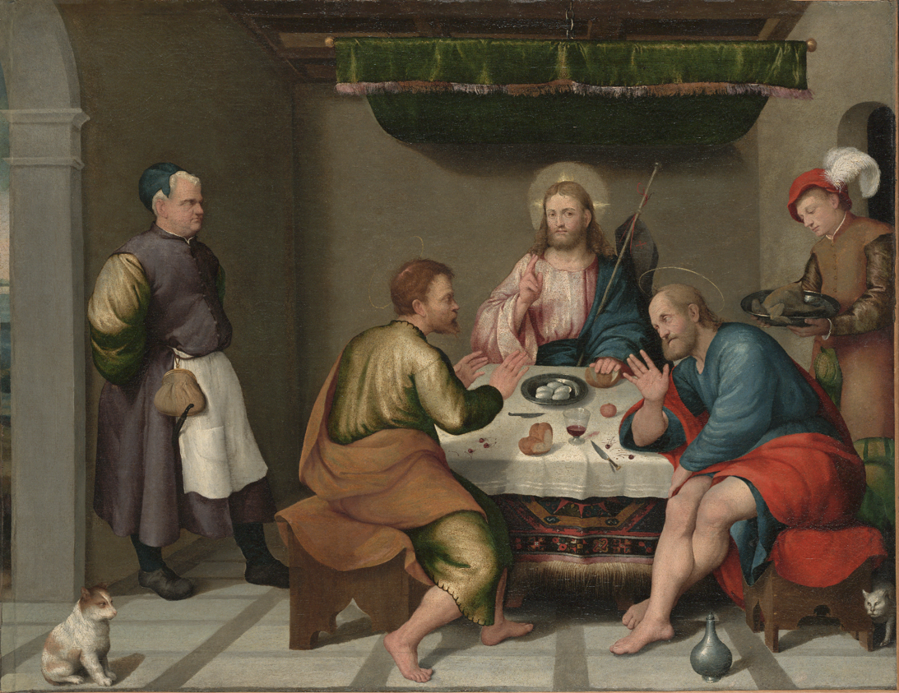
Jacopo Bassano (Jacopo dal Ponte), The Supper at Emmaus, c. 1538,
oil on canvas.
Kimbell Art Museum
Notes:
https://kimbellart.org/collection/apx-198903
In this biblical scene, Jesus Christ reveals himself to two of his disciples, who failed to recognize him as they traveled on the road to Emmaus. The three figures sit at a table in an inn as Christ blesses and breaks bread. Distinguished by their contemporary dress, the well-fed innkeeper with a large purse and the plumed serving boy attend to mundane affairs, unaware of the divine mystery unfolding before them.

Slide 22
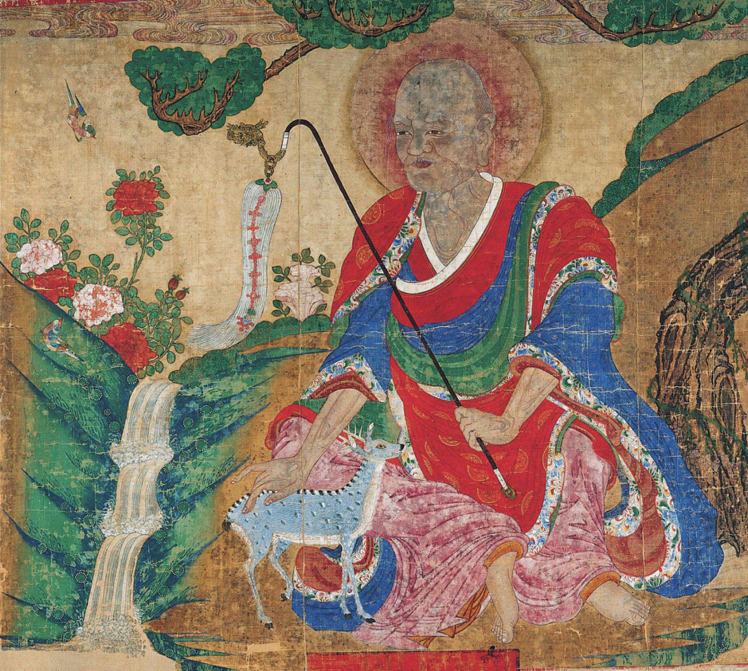
Korean, Arhat and Deer late 17th century, ink, mineral pigments, and gold on silk. Kimbell Art Museum
Notes:
https://kimbellart.org/collection/ap-199506
The sparsely bearded figure of an old man holding a walking staff resembles depictions of San Shin, the Mountain Spirit, who was the most popular deity in the Shamanist pantheon. However, his bald head, surrounded by a halo, and his monk’s robes suggest a Buddhist holy man, or arhat (in Korean, nahan).

Slide 23
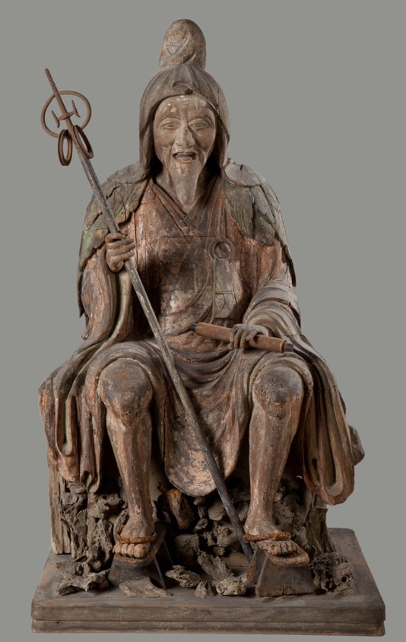
Japanese, En no Gyoja, c. 1300–1375, polychromed wood. Kimbell Art Museum
Notes:
https://kimbellart.org/collection/ap-198413
En no Gyoja was the legendary founder of the Shugendo sect, which emphasized the practice of religious austerities, and he thus came to represent the archetypical recluse. He is said to have died in the early eighth century after living a hermetic life in the mountains. Subsequent generations of clerics and laymen came to regard him as a model for those who wished to pursue religious devotion in a secular world.
This sculpture belongs to a small number of surviving posthumous depictions of En no Gyoja. This characteristic representation shows him as a bearded old man seated on a rocky ledge dressed in a monk’s robe with a hood and cloak of leaves—references to his secluded life in the mountains—holding a staff and sutra scroll in his hands.

Slide 24
Divine Figures
CLASSROOM DISCUSSION
Describe the divine figures’ clothing. What makes it appear special or unique?
Where can you find spiritual symbols on their clothing and accessories?
How does divine figures’ clothing compare across religions?
ACTIVITY
Draw a detail from one of the divine figures’ outfits. What lines, textures, or patterns do you notice?

Slide 25
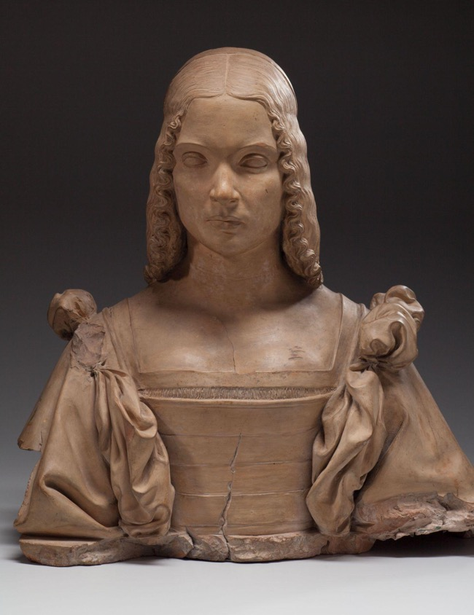
FASHION INFLUENCERS
While social media influencers are a product of the last two decades, fashion influencers have existed throughout history and across cultures. These individuals set fashion trends that influenced others.
Attributed to Gian Cristoforo Romano, Portrait of a Woman, Possibly Isabella d’Este (detail), c. 1500, terracotta, formerly polychromed. Kimbell Art Museum
Notes:
https://kimbellart.org/collection/ap-200401
Marchioness of Mantua, Isabella d’Este (1474–1539) cultivated an illustrious court and commissioned artworks from renowned artists in Renaissance Italy. This portrait bust depicts a dress that was popular from 1500 to 1510s; it would have included an undergarment camicia (Italian for chemise) made from linen, a velvet bodice, and large detachable sleeves that would have been tied into bows at the shoulder with lace or ribbons. The bodice would likely have been embroidered, and the outfit would have been completed with a long, fine cloth worn on the head tied with a headband.

Slide 26
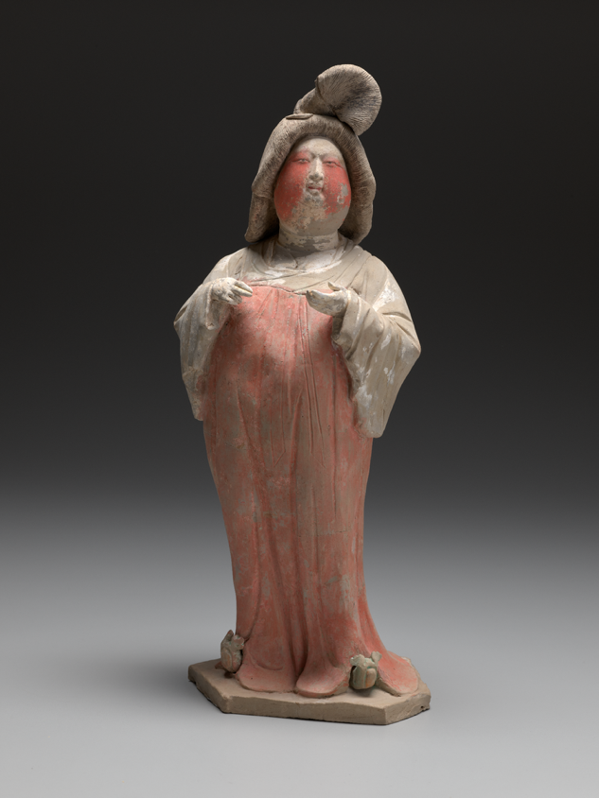
Chinese, Court Lady, first half of the 8th century AD, gray earthenware with painted polychrome decoration. Kimbell Art Museum
Notes:
https://kimbellart.org/collection/ap-200101
In Tang dynasty China, each court lady’s ensemble began with the short robe (shan), made from a single cut of silk fabric, or the jacket (ru), as the foundation on which the artist layered more pieces. By the first decade of the eighth century, monochrome skirts in hues of red, ochre, and mauve were most popular.
At the beginning of the Kaiyuan period (713–741), the emperor’s female horse-riding attendants all wore hu hats. Elites and commoners imitated the palace attendants. After a short time, women started to expose their hair, which was tied in topknots (gaoji), when they rode horses. Yang Guifei, the imperial consort of the emperor Xuanzong (reigned 712–56), created a new hair trend when she fell off her horse. This led to a new style referred to as “falling-off-the-horse-bun.”

Slide 27
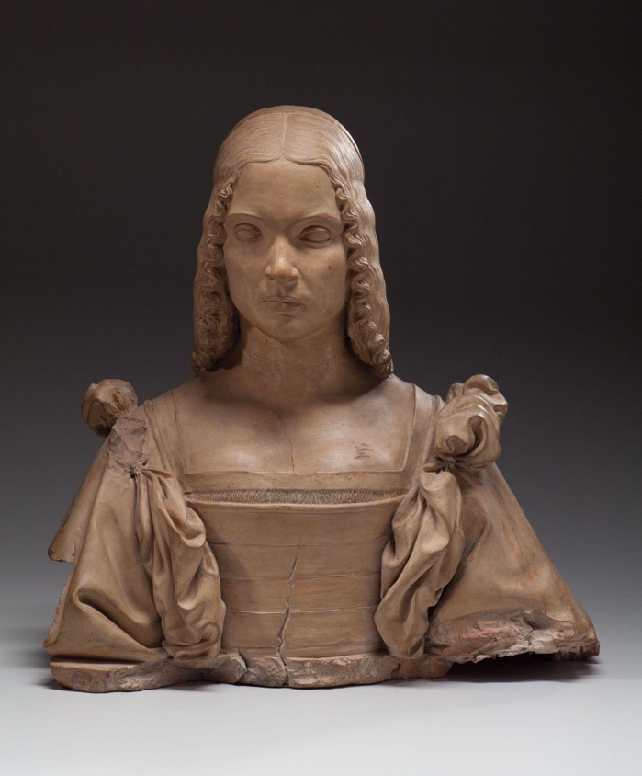
Attributed to Gian Cristoforo Romano, Portrait of a Woman, Possibly Isabella d’Este, c. 1500, terracotta, formerly polychromed. Kimbell Art Museum
Notes:
https://kimbellart.org/collection/ap-200401
Marchioness of Mantua, Isabella d’Este (1474–1539) cultivated an illustrious court and commissioned artworks from renowned artists in Renaissance Italy. This portrait bust depicts a dress that was popular from 1500 to 1510s; it would have included an undergarment camicia (Italian for chemise) made from linen, a velvet bodice, and large detachable sleeves that would have been tied into bows at the shoulder with lace or ribbons. The bodice would likely have been embroidered, and the outfit would have been completed with a long, fine cloth worn on the head and tied with a headband.

Slide 28
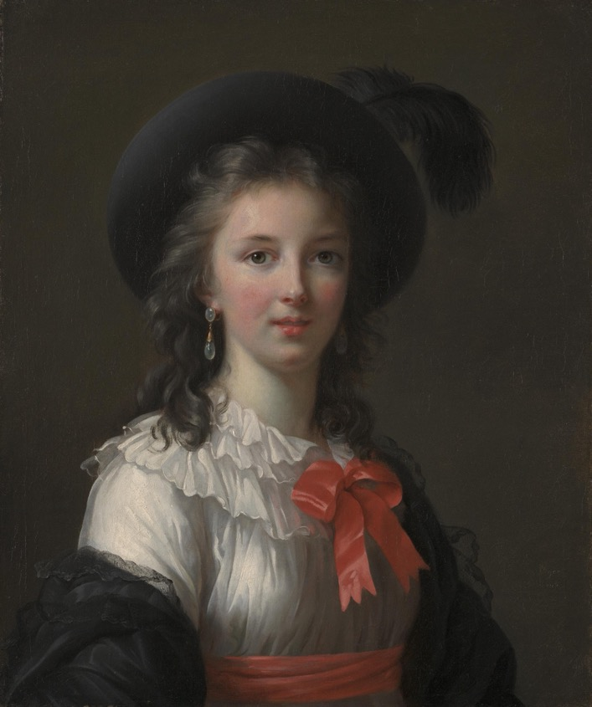
Elisabeth Louise Vigée Le Brun, Self-Portrait, c. 1781, oil on canvas. Kimbell Art Museum
Notes:
https://kimbellart.org/collection/ack-194902
While not necessarily a fashion influencer herself, Vigée Le Brun was a court painter for Queen Marie Antoinette, who inspired trends in French fashion. Here, Vigée Le Brun wears a chemise à la reine, which was a lightweight dress that became popular due to its ability to be washed and its loose fit (without hoops). While Marie Antoinette wasn’t the first to be depicted in this style dress, Vigée Le Brun’s 1783 portrait of her in it led to her becoming permanently associated with it, hence “chemise of the queen.”

Slide 29
Fashion Influencers
CLASSROOM DISCUSSION
Of the influencers’ outfits featured in this section, which one stands out most to you? What makes it appealing? Would you want to wear it?
Imagine how the different fabrics might feel. What considerations might have gone into producing these outfits?
Which fashion trends are popular today? What or who do you think made them popular?
What do you think makes a fashion influencer successful?
ACTIVITY
With a partner, design a social media campaign for a figure from one of these artworks. If they lived today, how would they influence their followers to join a new trend?

Slide 30
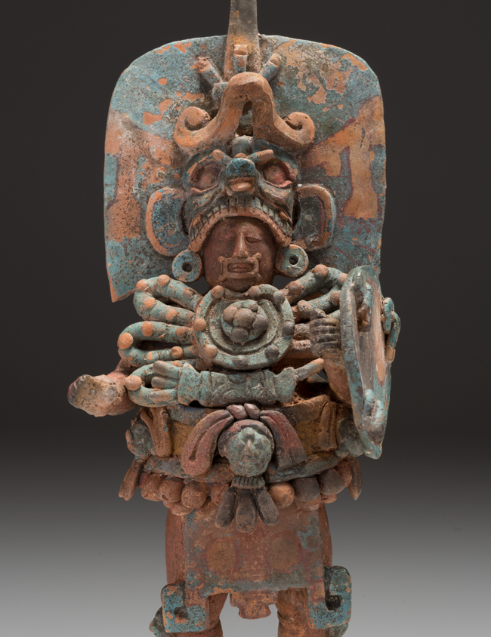
RULERS
Throughout history, leaders have dressed to impress, conveying authority through their unique style.
Maya culture, Standing Ruler (detail), AD 600–800, ceramic with traces of paint. Kimbell Art Museum
Notes:
https://kimbellart.org/collection/ap-198403
This figurine vividly evokes a Maya lord costumed to impersonate a dynastic ancestor. The figure’s wide belt once supported a backrack of feathers, and his knee-length apron is marked with a symbol of the World Tree, the central axis of the Maya world. Elements of the complex costume below the headdress recur in other portrayals of Maya rulers; they define and reiterate his rank, and his position in the cosmos.

Slide 31
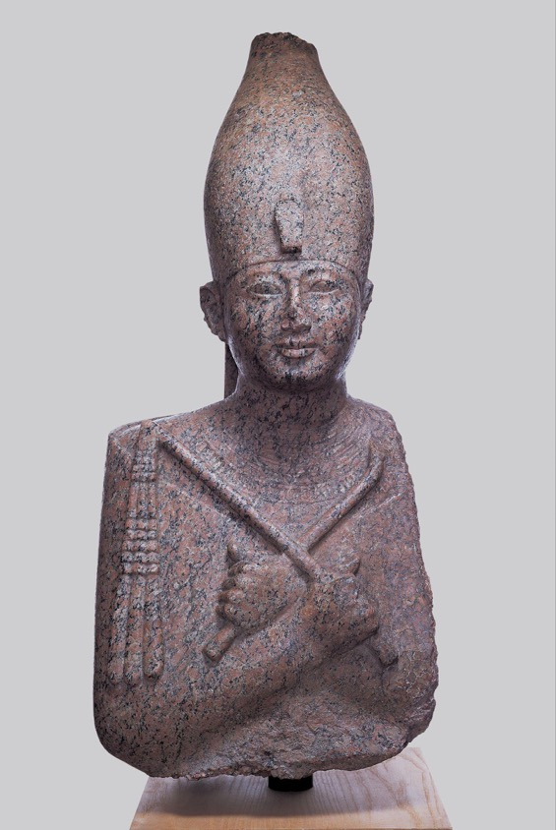
Egyptian, Portrait Statue of Pharaoh Amenhotep II, c. 1400 BC, recarved for Ramesses II (the Great) c. 1250 BC, red granite. Kimbell Art Museum
Notes:
https://kimbellart.org/collection/ap-198204
This figure wears Upper (i.e., southern) Egypt’s distinctive crown, embellished by the uraeus cryptogram, or royal cobra, and a broad collar composed of five bands. His body is enveloped in the jubilee robe—worn by kings at festivals, particularly the Sed-festival—in which he was physically and spiritually rejuvenated. Usually the Sed-festival was observed after a reign of thirty years. Since most pharaohs never reached their thirtieth year, however, some celebrated it prematurely, including Amenhotep II.

Slide 32
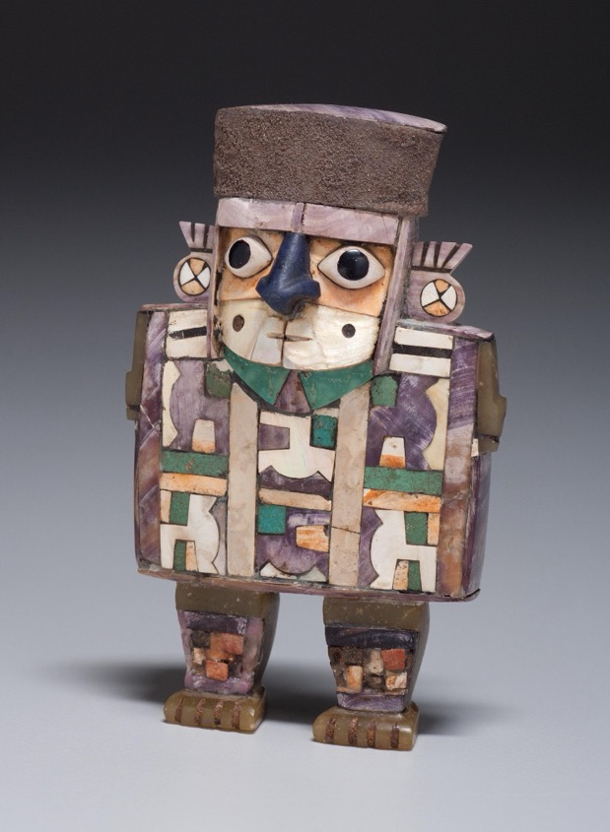
Wari culture, Standing Dignitary, c. AD 600–1000, wood with shell-and-stone inlay and silver. Kimbell Art Museum
Notes:
https://kimbellart.org/collection/ap-200204
This Wari dignitary’s torso is cloaked in a long ceremonial tunic decorated in an interlocking tapestry weave with three rows of a simplified and abstracted zoomorphic motif, which can be read as feline (jaguar or puma) heads or as standing llamas. The wearing of a court tapestry tunic identified one’s rank in the Wari empire, and the emphasis on the elaborateness of this costume suggests that the figure represented was a dignitary of some status. In life, tunics were worn as ceremonial garb, and in death they were placed over the wearer’s mummy bale. In shell and stone inlay, the complex textile patterns of the tunic are inevitably simplified.

Slide 33
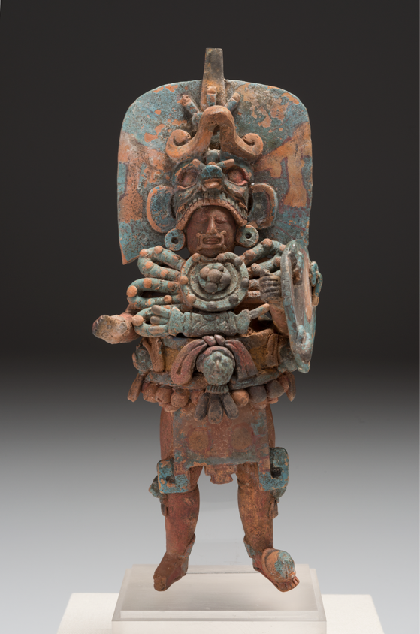
Maya culture, Standing Ruler, AD 600–800, ceramic with traces of paint. Kimbell Art Museum
Notes:
https://kimbellart.org/collection/ap-198403
This figurine vividly evokes a Maya lord costumed to impersonate a dynastic ancestor. The figure’s wide belt once supported a backrack of feathers, and his knee-length apron is marked with a symbol of the World Tree, the central axis of the Maya world. Elements of the complex costume below the headdress recur in other portrayals of Maya rulers; they define and reiterate his rank and his position in the cosmos.

Slide 34
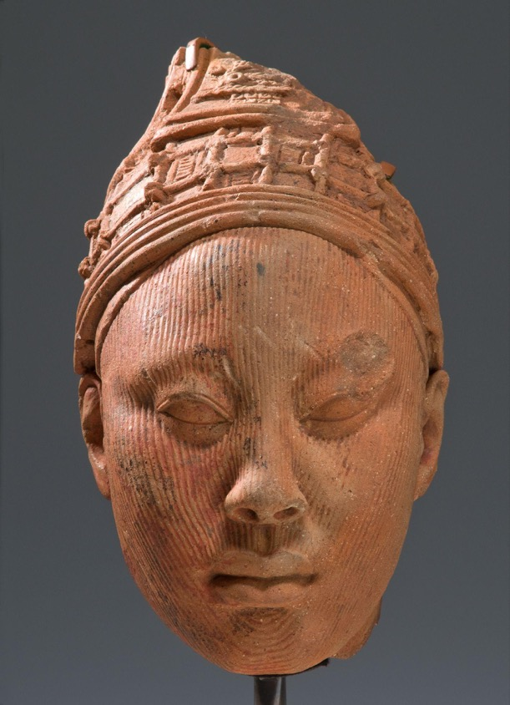
Ife culture, Head, possibly a King,
12th–14th century, terracotta with residue of red pigment and traces
of mica. Kimbell Art Museum
Notes:
https://kimbellart.org/collection/ap-199404
The square crown, formed of four rectangular aprons overlying a conical form and embellished with a network of intersecting beads, is unparalleled in any other known examples of Ife art. Like the vast majority of Ife heads in terra-cotta, the Kimbell example seems to have been broken from a full-length figure. The serene and dignified countenance, as well as the elaborate crown, suggests that this head represents an Ife king (Oni).

Slide 35
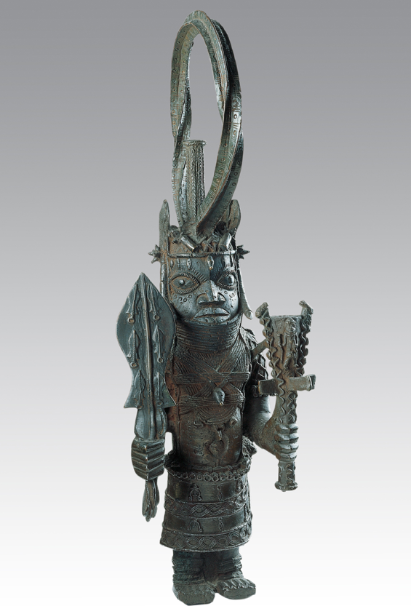
Benin, Standing Oba, late 18th century, bronze (or brass). Kimbell Art Museum
Notes:
https://kimbellart.org/collection/ap-197004
In the Benin kingdom in West Africa, the Oba (king) would wear a tunic embellished with regal motifs and a headdress. In this depiction of an oba, the figure wears a kilt with depictions of swords and Portuguese soldiers, referencing the extensive trade between the two groups. The oba’s headdress was tall so that it would point toward the celestial realm, and it was composed of coral beads as acknowledgment of the god Okolun (“owner of the ocean”).

Slide 36
Rulers
CLASSROOM DISCUSSION
Describe one of the ruler’s clothing and accessories. What about the figure’s attire identifies them as a leader?
How might a ruler’s clothing differ from their followers’ clothing?
Compare accessories from different cultures. For example, how does an Ife king’s headdress compare to an Egyptian pharaoh’s headdress?
What clothing or accessories do you think convey authority today?
ACTIVITY
Draw yourself as a ruler. What outfit or accessories would you wear to convey authority?

Slide 37
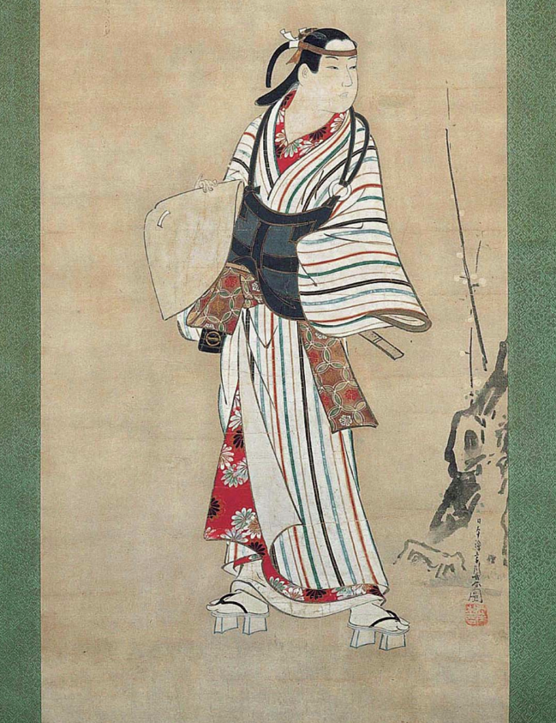
SOCIAL STATUS
In artworks, fashion differences can provide clues to the story being told.
Miyagawa Choshun, A Young Dandy (detail), c. 1740, hanging scroll; ink and light colors on paper. Kimbell Art Museum
Notes:
https://kimbellart.org/collection/ap-198406
In this scroll, a stylish young man wears an eye-catching striped kimono worn over a red undergarment and a brown sash. His accessories—a peaked straw hat, wooden clogs, flute in his sash, and kesa, or square apron that is part of a priest’s costume—indicate that he is affecting the look of a komuso, or mendicant flute player.

Slide 38
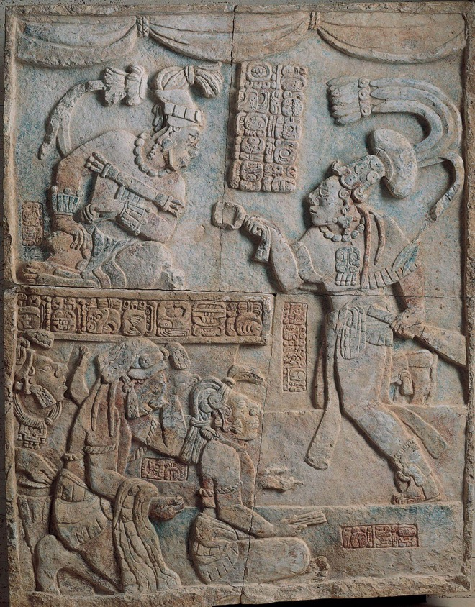
Maya, Presentation of Captives to a Maya Ruler, c. AD 785, limestone with traces of paint. Kimbell Art Museum
Notes:
https://kimbellart.org/collection/ap-197107
Five people interact in this narrative scene created by the ancient Maya peoples. The figures are the Yaxchilan king, seated at top left, his sahal (a military chief) on the right, and three bound captives in the lower left. The three prisoners may be scribes; the one in front holds a “stick-bundle” associated with Maya scribes, and all three wear headdresses with hun (book) knots. The ancient Maya wore headwear to provide protection from the sun and more elaborate headdresses depicted status. Decorative elements such as quetzal feathers and jade were precious materials reflecting high status.

Slide 39
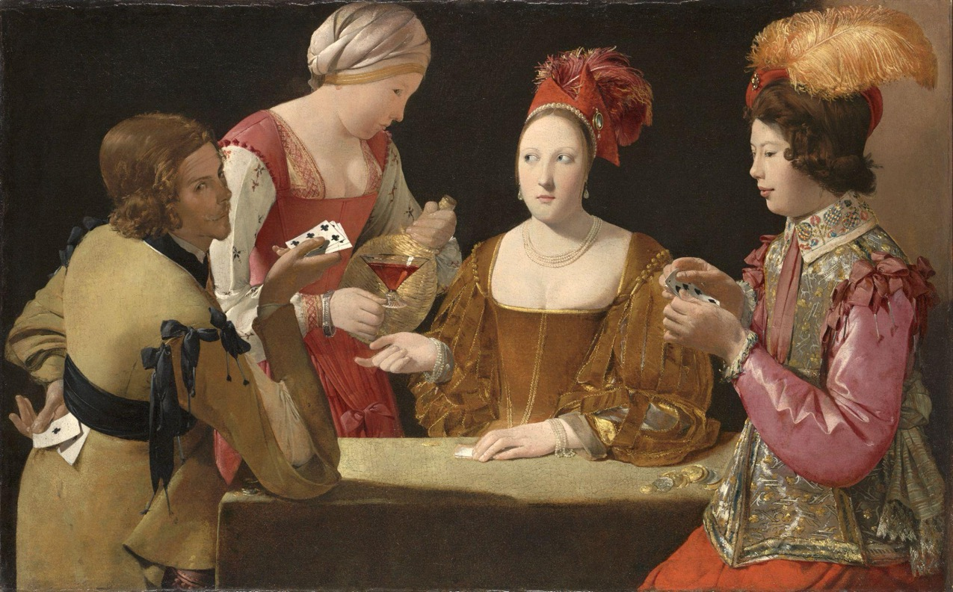
Georges de La Tour, The Cheat with the Ace of Clubs​, c. 1630–34​, oil on canvas. Kimbell Art Museum
Notes:
https://kimbellart.org/collection/ap-198106
Differing costumes offer important clues in this narrative scene of card players. On the far right, a young man wears a silk and metal brocade doublet with an embroidered collar. His sleeves are made of silk and attach with ribbons. The man on the far left, the cheat, wears a plain, buff jerkin, a leather coat preferred by soldiers. His cut sleeves allow easier movement. The seated woman wears an expensive velvet dress with a low neckline (atypical of the time and possibly implying ill-intent). Her sleeves are slashed into panes, a new fashion trend, and are trimmed with gold and lined with satin. The servant wears a linen headdress and a dress with embroidered details.

Slide 40
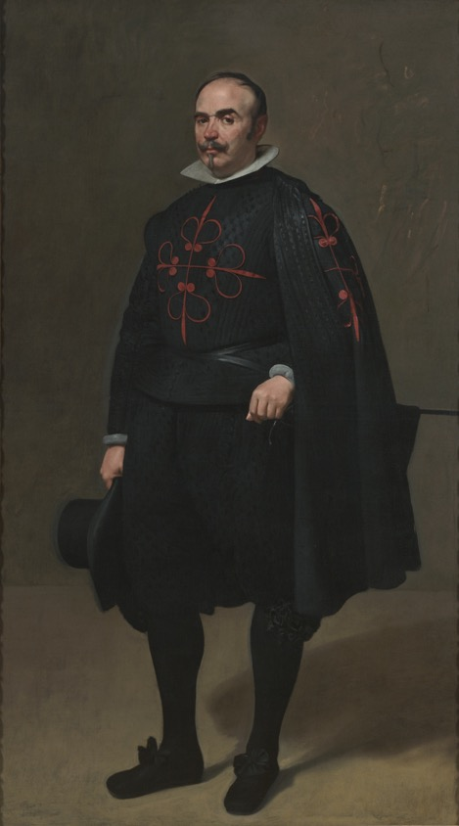
Diego Velázquez, Portrait of Don Pedro de Barberana, c. 1631–33, oil on canvas. Kimbell Art Museum
Notes:
https://kimbellart.org/collection/ap-198114
Don Pedro de Barberana y Aparregui (1579–1649) was a council member of King Philip IV of Spain. In 1623, Philip IV introduced a sumptuary law (pragmática) aimed at reducing expenditure on luxury imported fabrics such as fine lace (along with gold and silver braid—the flow of precious metals from South America had begun to dry up); lace collars for men were to be replaced by the golilla, a stiffened plain collar; and the king set the example himself. Conquest in Mexico introduced red dye harvested from cochineal insects; logwood, another export to Europe from the Americas, made a deep, intense black dye.

Slide 41
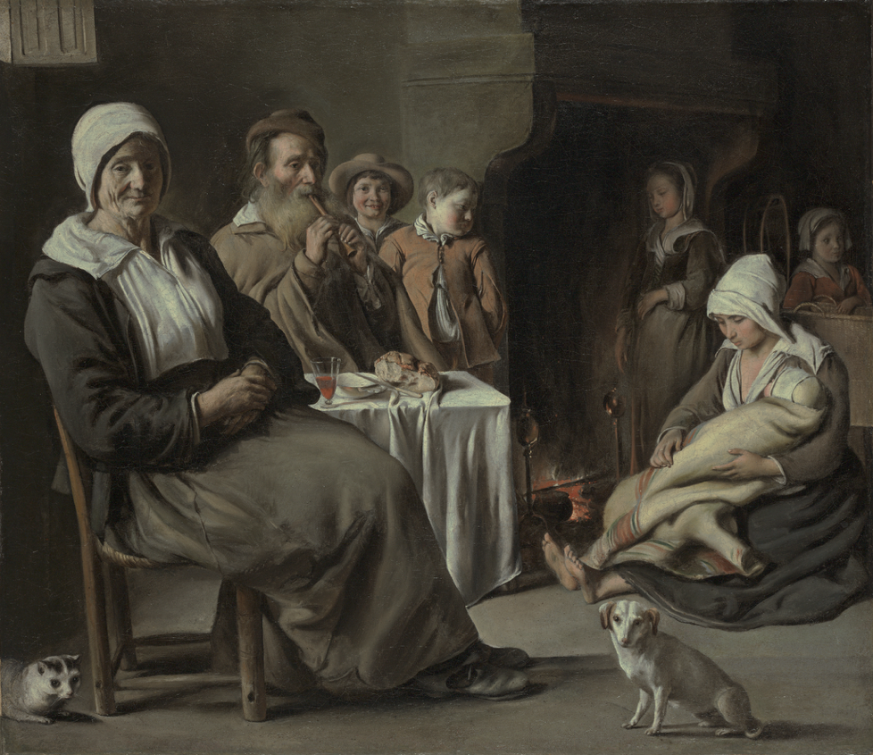
Louis (or Antoine?) Le Nain, Peasant Interior with an Old Flute Player, c. 1642, oil on canvas. Kimbell Art Museum
Notes:
https://kimbellart.org/collection/ap-198422
This scene depicts a group of people gathered around a table. Their clothing and environment suggest they are of lower economic standing. The figures wear simple clothing that has been mended, and some are bare-footed. Their exceptionally clean clothing suggests the artist’s idealization of a humble, yet devout family.

Slide 42
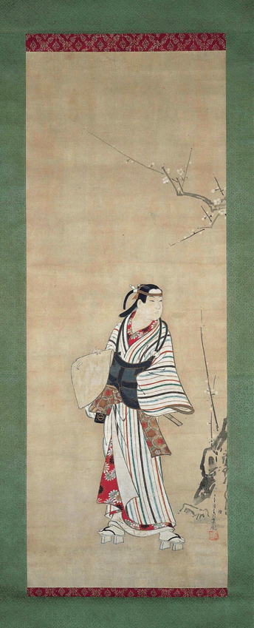
Miyagawa Choshun, A Young Dandy, c. 1740, hanging scroll; ink and light colors on paper. Kimbell Art Museum
Notes:
https://kimbellart.org/collection/ap-198406
In this scroll, a stylish young man wears an eye-catching striped kimono worn over a red undergarment and a brown sash. His accessories—a peaked straw hat, wooden clogs, flute in his sash, and kesa, or square apron that is part of a priest’s costume—indicate that he is affecting the look of a komuso, or mendicant flute player.

Slide 43
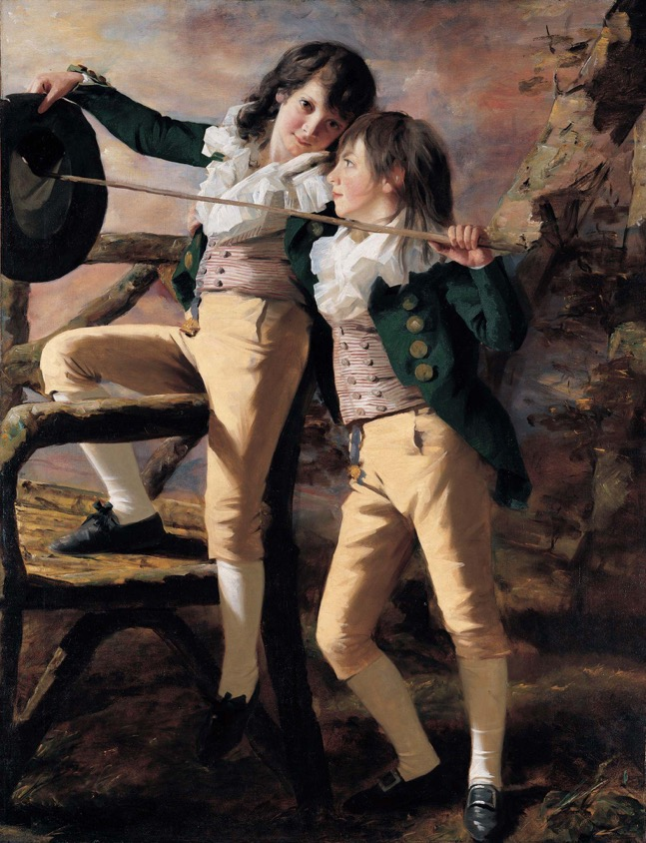
Henry Raeburn, The Allen Brothers (Portrait of James and John Lee Allen), early 1790s, oil on canvas. Kimbell Art Museum
Notes:
https://kimbellart.org/collection/ap-200205
John Lee Allen and James Allen were heirs to the considerable estates of Inchmartine and Errol on the north bank of the Tay estuary, near Perth. Despite their social status, the boys appear in an informal scenario, playing a game with a hat and a stick. Children in the eighteenth century often dressed as small adults. These boys wear steeply cut coats and double-breasted waistcoats, both of which were on the cutting edge of fashion. Their watch fobs hang down from the watch pockets in their leather pants. The open, wide-ruffled collar was reserved for young boys, while men wore high, tight collars.

Slide 44
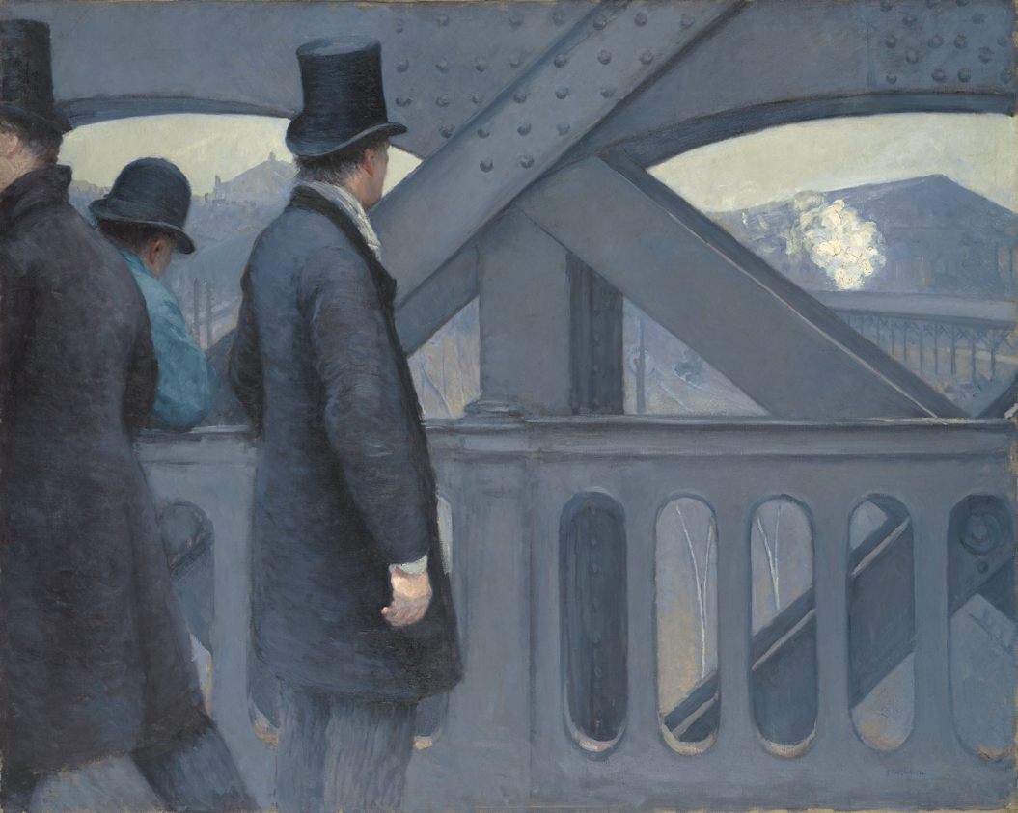
Gustave Caillebotte, On the Pont de l’Europe, 1876–77, oil on canvas.
Kimbell Art Museum
Notes:
https://kimbellart.org/collection/ap-198201
The man on the right wears a smartly tailored ensemble complete with a brushed top hat and a fitted frock coat, paired with a scarf and gloves. The poet Charles Baudelaire (1821–1867) wrote that a true urbanite should be a passionate spectator or flâneur, a man about town who blends into the crowd. Next to the flâneur leans a man wearing a blue smock, the uniform of the building trades. He wears a bowler hat, which signals that he, too, can afford some luxuries. All three men wear clothing that indicates they are part of the middle class.

Slide 45
Social Status
CLASSROOM DISCUSSION
Select an artwork from this section and study the clothing and accessories featured. Do these visual clues help tell the story?
How does “high status” clothing compare across cultures and time periods?
Which contemporary accessories do you view as “high status”? What makes you see them this way?
ACTIVITY
Feel different types of fabric. What ideas do you associate with each? How do these associations impact how you read an artwork?

Slide 46
Collaborative Fashion Lesson Plan
Stage 1 Desired Results
ESTABLISHED GOALS The student will TEKS Art II §117.303.c.3B analyze specific characteristics in artwork from a variety of cultures; TEKS Art II §117.303.c.2B Apply design skills in creating practical applications, clarifying presentations, and examining consumer choices in order to make successful design decisions. TEKS Art III §117.304.c.2E Collaborate to create original works of art. | Transfer
 | Students will be able to independently use their learning to… · Observe fashion trends in visual history.
 | Meaning
 | UNDERSTANDINGS Students will understand that… Fashion is impacted by its surrounding culture and time period. | ESSENTIAL QUESTIONS What role does cultural context play in fashion? How are trends formed? How and why does fashion change over time? What does attire tell us about the individual or group? (personality, social status, job, etc.) How do historical fashion trends compare to contemporary ones?
 | Acquisition
 | Students will know… The cultural factors that impact fashion in Tang China, Classic Maya, the Benin Kingdom, and 17th-century Spain and France. How to visually analyze an artwork to study clothing and accessories. What fabrics have been used in Tang China, Classic Maya, the Benin Kingdom, and seventeenth-century Spain and France. | Students will be skilled at… Creating forms with fabric.

Slide 47
Stage 2 - Evidence
Evaluative Criteria | Assessment Evidence
 | PERFORMANCE TASK(S): Using fashion elements from the permanent collection and contemporary fashion trends, work collaboratively to design an outfit.
Stage 3 – Learning Plan
Summary of Key Learning Events and Instruction · Part I: Art History Introduction o Warm-up Students write down current fashion trends on index cards. Collect the index cards for review. o Google Slides presentation What role does cultural context play in fashion? How are trends formed? How and why does fashion change over time? What does attire tell us about the individual or group? (personality, social status, job, etc.) How do historical fashion trends compare to contemporary ones?

Slide 48
Stage 3 – Learning Plan
Summary of Key Learning Events and Instruction · · Part II: Studio Activity o Introduction Today, we’ll be doing a design challenge incorporating historical fashion with contemporary fashion to create a new design. Show outfit prototypes. Explain the three fashion cards used to inspire the outfits. o Brainstorming & Sketching Partners draw three fashion cards: 1) outfit base, 2) accessory, and 3) current fashion trend With their partner, students brainstorm an outfit that incorporates these three fashion elements. ketch out a design. o Demo. Fashion Assembly Techniques Tape, staples, wire, and hot glue (high school) or cut paper and scissors (elementary) o Work Time Assemble outfits o Fashion Show Line up all outfits for a class photo. Optional—students share their designs, explaining their client.

Slide 49
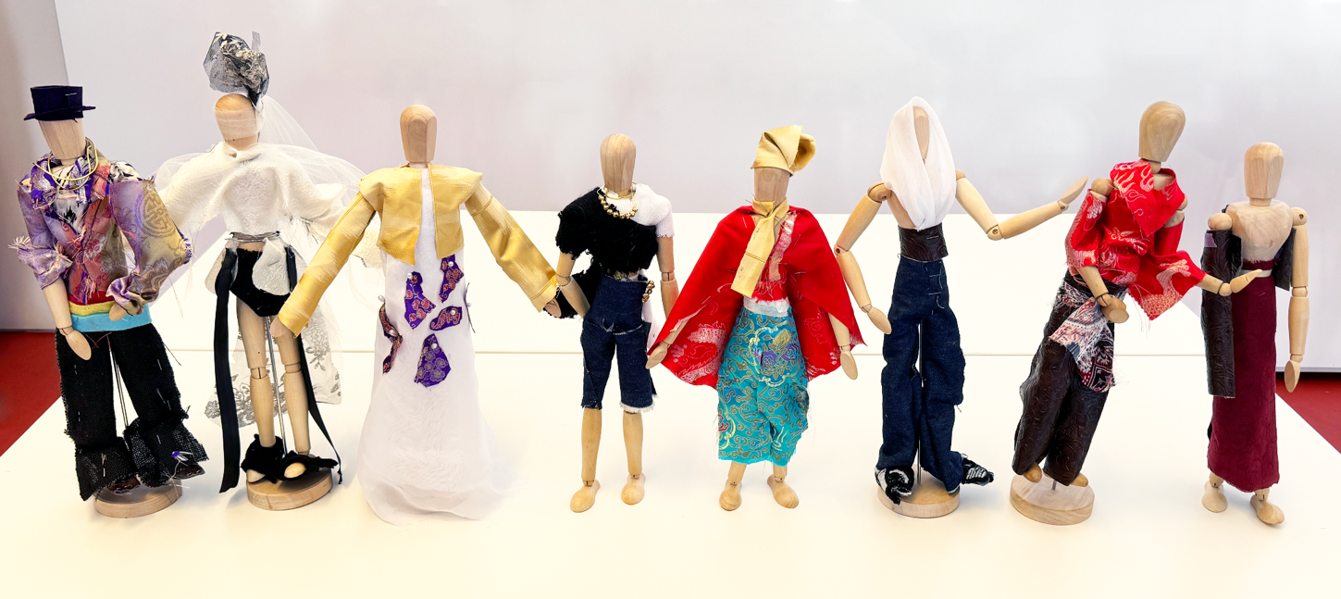
High School Examples

Slide 50
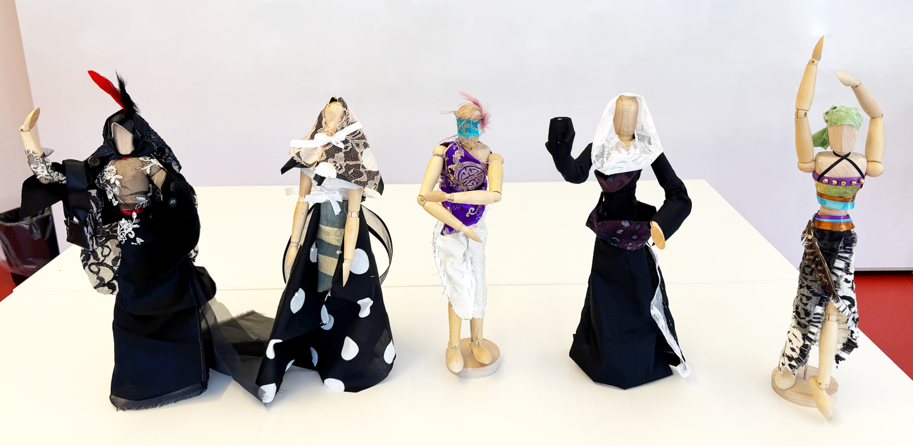
High School Examples

Slide 51
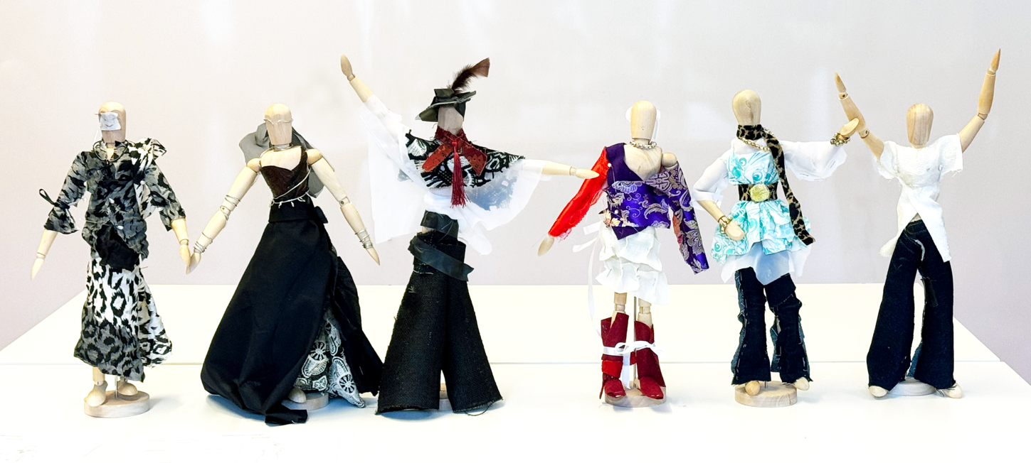
High School Examples

Slide 52
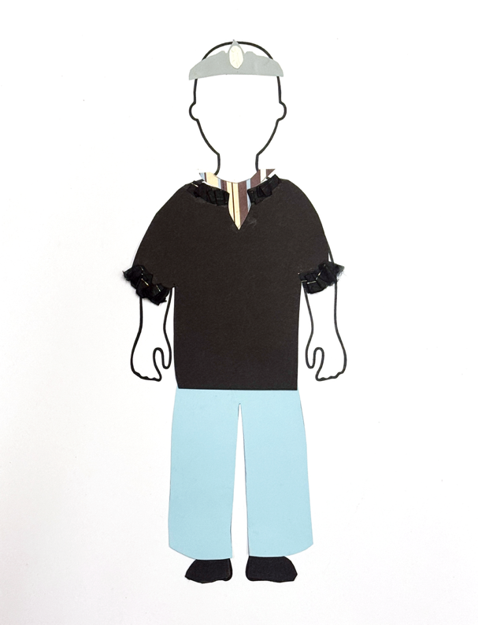
Elementary Example

Slide 53
Art in order of appearance:
Gustave Caillebotte, On the Pont de l’Europe, 1876–77, oil on canvas. Kimbell Art Museum, Fort Worth AP 1982.01
Paul Cézanne, Man in a Blue Smock, c. 1896–97, oil on canvas. Kimbell Art Museum, Fort Worth APg 1980.03
Nok culture, Male Figure, c. 195 BC–AD 205, terracotta. Kimbell Art Museum, Fort Worth AP 1996.03
Japanese, Haniwa Seated Man, c. AD 500, low-fired clay with cinnabar pigment. Kimbell Art Museum, Fort Worth AP 1972.02
Quinten Metsys, Portrait of Jacob Obrecht, 1496, tempera, oil, and gold on panel. Kimbell Art Museum, Fort Worth AP 1993.02
Jan Gossart, called Mabuse, Portrait of Hendrik III, Count of Nassau-Breda, c. 1516–17, oil on panel. Kimbell Art Museum, Fort Worth AP 1979.30
Tintoretto (Jacopo Robusti), Portrait of Doge Pietro Loredan, 1567–70, oil on canvas. Kimbell Art Museum, Fort Worth SP 1986.08
Francisco de Goya, Portrait of the Matador Pedro Romero, c. 1795–98, oil on canvas. Kimbell Art Museum, Fort Worth AP 1966.12
Edgar Degas, Dancer Stretching, c. 1882–85, pastel on pale blue gray paper. Kimbell Art Museum, Fort Worth AP 1968.04
Chinese, Bodhisattva Torso, c. AD 775–800, stone, traces of gesso and pigment. Kimbell Art Museum, Fort Worth AP 1987.01
Assyrian, Pair of Winged Deities, c. 874–860 BC, gypsum. Kimbell Art Museum, Fort Worth AP 1981.04 a,b
© 2026 Kimbell Art Museum

Slide 54
Art in order of appearance:
Teotihuacán culture, Singing Priest or God, c. AD 400–600, fresco. Kimbell Art Museum, Fort Worth AP 1972.16
Indian, Vishnu, 13th century, bronze. Kimbell Art Museum, Fort Worth AP 1970.01
Jacopo Bassano (Jacopo dal Ponte), The Supper at Emmaus, c. 1538, oil on canvas. Kimbell Art Museum, Fort Worth APz 1989.03
Korean, Arhat and Deer, late 17th century, ink, mineral pigments, and gold on silk. Kimbell Art Museum, Fort Worth AP 1995.06
Japanese, En no Gyoja, c. 1300–1375, polychromed wood. Kimbell Art Museum, Fort Worth AP 1984.13
Attributed to Gian Cristoforo Romano, Portrait of a Woman, Possibly Isabella d’Este, c. 1500, terracotta, formerly polychromed. Kimbell Art Museum, Fort Worth AP 2004.01
Chinese, Court Lady, first half of the 8th century AD, gray earthenware with painted polychrome decoration. Kimbell Art Museum, Fort Worth AP 2001.01
Elisabeth Louise Vigée Le Brun, Self-Portrait, c. 1781, oil on canvas. Kimbell Art Museum, Fort Worth ACK 1949.02
Maya culture, Standing Ruler, AD 600–800, ceramic with traces of paint. Kimbell Art Museum, Fort Worth AP 1984.03
Egyptian, Portrait Statue of Pharaoh Amenhotep II, c. 1400 BC, recarved for Ramesses II (the Great) c. 1250 BC, red granite. Kimbell Art Museum, Fort Worth AP 1982.04
© 2026 Kimbell Art Museum

Slide 55
Art in order of appearance:
Wari culture, Standing Dignitary, c. AD 600–1000, wood with shell-and-stone inlay and silver. Kimbell Art Museum, Fort Worth AP 2002.04
Ife culture, Head, possibly a King, 12th–14th century, terracotta with residue of red pigment and traces of mica. Kimbell Art Museum, Fort Worth AP 1994.04
Benin, Standing Oba, late 18th century, bronze (or brass). Kimbell Art Museum, Fort Worth AP 1970.04
Miyagawa Choshun, A Young Dandy, c. 1740, hanging scroll; ink and light colors on paper. Kimbell Art Museum, Fort Worth AP 1984.06
Maya, Presentation of Captives to a Maya Ruler, c. AD 785, limestone with traces of paint. Kimbell Art Museum, Fort Worth AP 1971.07
Georges de La Tour, The Cheat with the Ace of Clubs, c. 1630–34, oil on canvas. Kimbell Art Museum, Fort Worth AP 1981.06
Diego Velázquez, Portrait of Don Pedro de Barberana, c. 1631–33, oil on canvas. Kimbell Art Museum, Fort Worth AP 1981.14
Louis (or Antoine?) Le Nain, Peasant Interior with an Old Flute Player, c. 1642, oil on canvas. Kimbell Art Museum, Fort Worth AP 1984.22
Henry Raeburn, The Allen Brothers (Portrait of James and John Lee Allen), early 1790s, oil on canvas. Kimbell Art Museum, Fort Worth AP 2002.05
© 2026 Kimbell Art Museum

